Slide 1
Remember that the Chapter 21 and 22 Test is on Monday

Slide 2
0
Chapter 22
Hybrid Zones and Patterns of Evolution

Slide 3
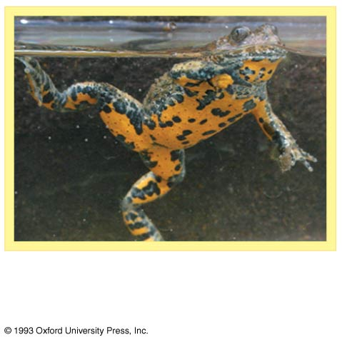
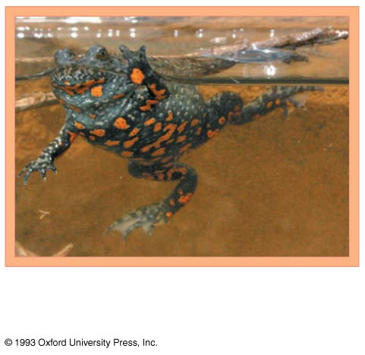
Concept 22.3: Hybrid zones reveal factors that cause reproductive isolation
A hybrid zone is a region in which members of different species mate and produce hybrids.
Hybrids are the result of mating between species with incomplete reproductive barriers.
Yellow-bellied toad,
Bombina variegata
Frog Video
Fire-bellied toad,
Bombina bombina
Notes:
3

Slide 4
Notes:
4
A hybrid zone can occur in a single band where adjacent species meet
For example, two species of toad in the genus Bombina interbreed in a long and narrow hybrid zone
The hybrid zone occurs where the higher-altitude habitat of the yellow-bellied toad meets the lowland habitat of the fire-bellied toad.

Slide 5
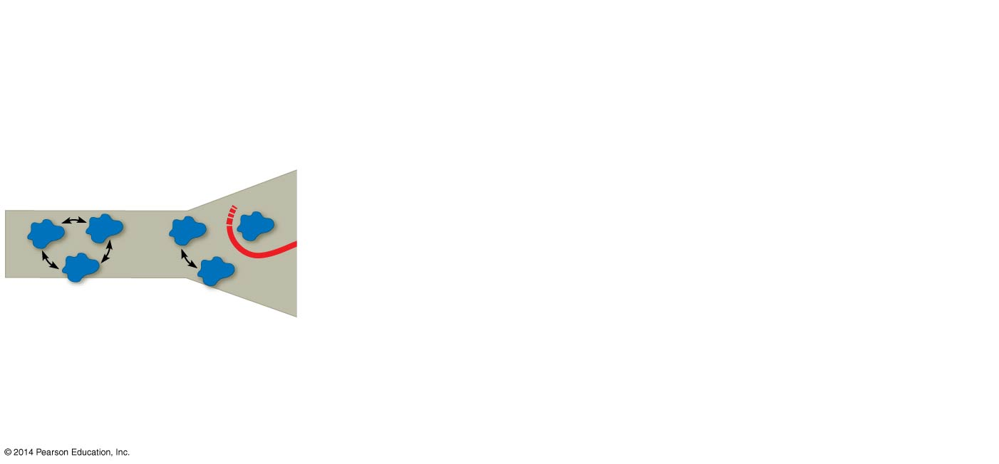
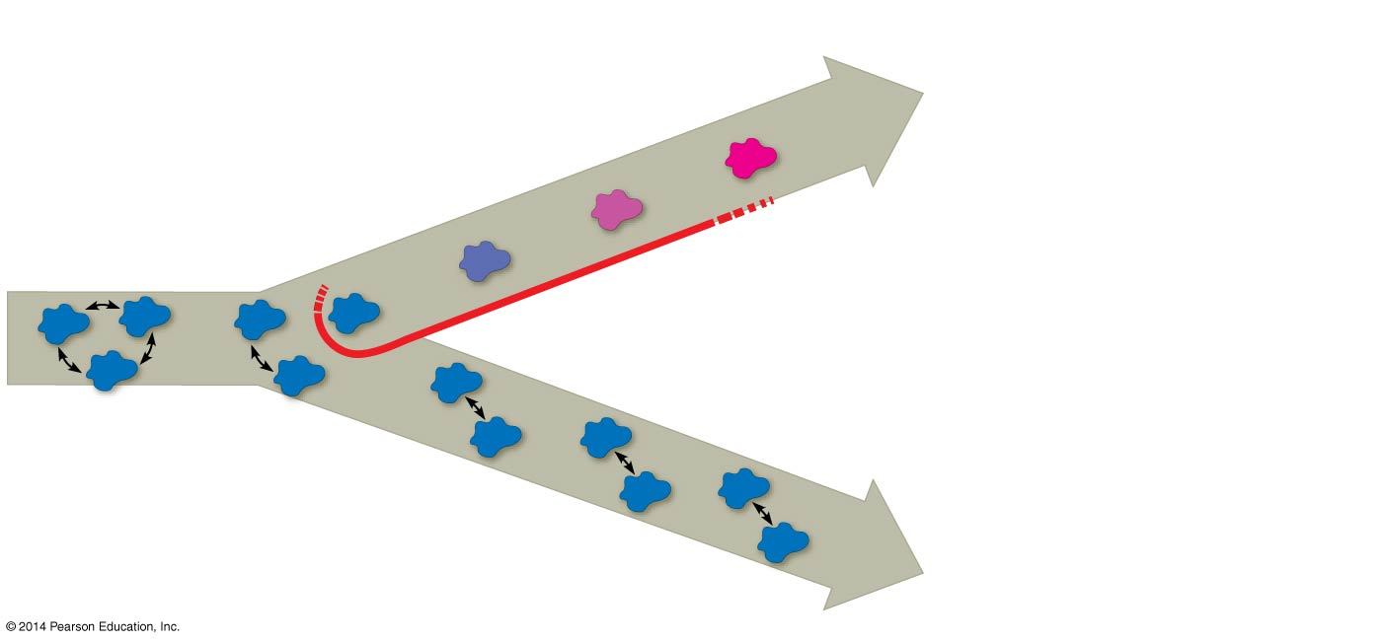
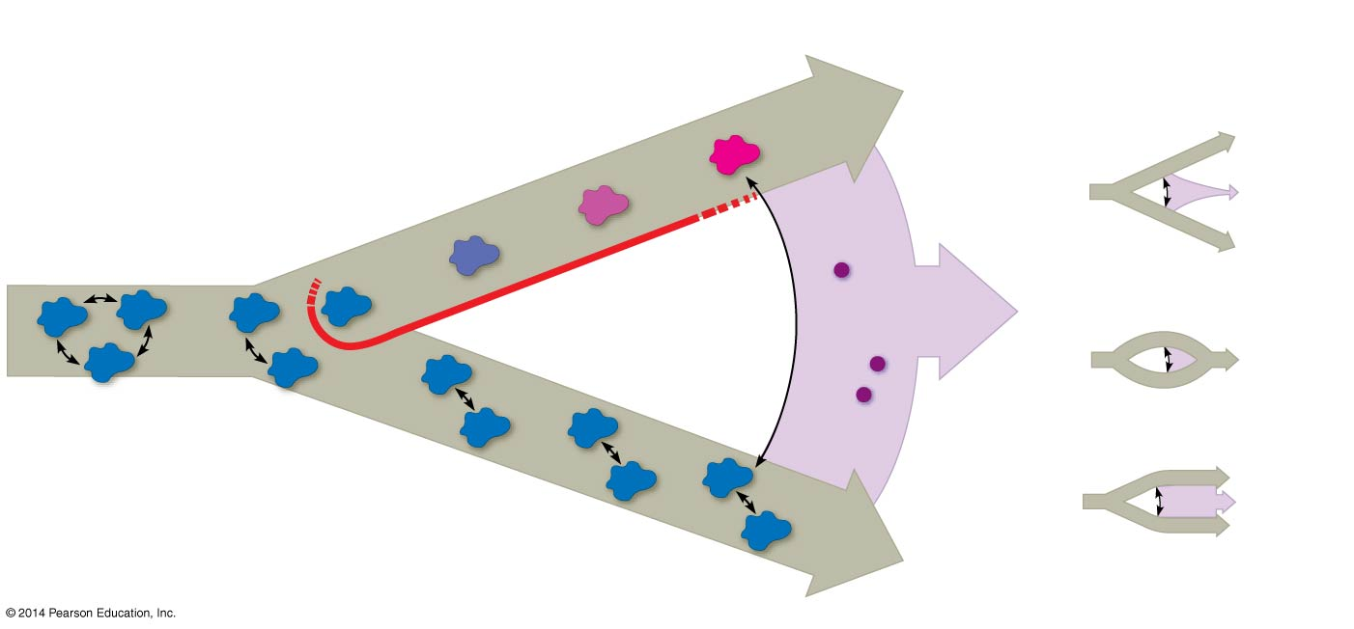
Formation of a hybrid zone and possible outcomes for hybrids over time.
Isolated
population
diverges.
Isolated
population
diverges.
Isolated
population
diverges.
Possible
outcomes:
Hybrid
zone
Hybrid
zone
Reinforcement
Gene flow
Fusion
Gene flow
Gene flow
Gene flow
Population
Population
Population
Population
Hybrid
individual
Barrier to
gene flow
Hybrid
individual
Barrier to
gene flow
Barrier to
gene flow
Barrier to
gene flow
Stability
Notes:
5
Hybrids often have reduced fitness compared with parent species.
The distribution of hybrid zones can be more complex if parent species are found in patches within the same region.
When closely related species meet in a hybrid zone, there are three possible outcomes
Reinforcement
Fusion
Stability
Reinforcement occurs when hybrids are less fit than the parent species.
Natural selection strengthens (reinforces) reproductive barriers, and, over time, the rate of hybridization decreases.
Where reinforcement occurs, reproductive barriers should be stronger for sympatric than for allopatric species.
Fusion of the parent species into a single species may occur if hybrids are as fit as parents, allowing substantial gene flow between species.
For example, researchers think that pollution in Lake Victoria has reduced the ability of female cichlids to distinguish males of different species.
This might be causing the fusion of many species.
Stability of the hybrid zone may be achieved if extensive gene flow from outside the hybrid zone can overwhelm selection for increased reproductive isolation inside the hybrid zone.
In a stable hybrid zone, hybrids continue to be produced over time.

Slide 6
The tempo of speciation

Slide 7
Evolution by creeps
and jerks.
(a) Punctuated model
Time
Time
(b) Gradual model
Notes:
7
Figure 22.14 Two models for the tempo of speciation, based on patterns observed in the fossil record.
The fossil record includes examples of species that appear suddenly, persist essentially unchanged for some time, and then apparently disappear.
These periods of apparent stasis punctuated by sudden change are called punctuated equilibria.
The punctuated equilibrium model contrasts with a model of gradual change in a species’ existence.

Slide 8
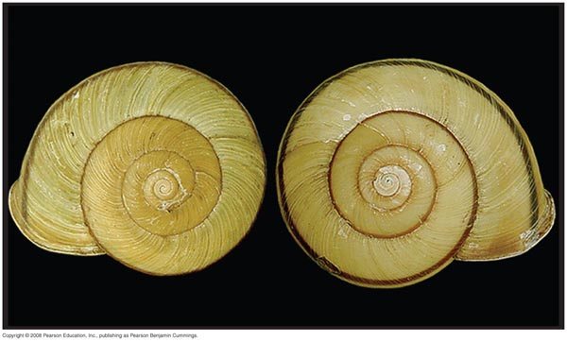
Depending on the species in question, speciation might require the change of only a single allele or many alleles.
Notes:
8
For example, in Japanese Euhadra snails, the direction of shell spiral affects mating and is controlled by a single gene

