Slide 1
0
Chapter 22
Allopatric and Sympatric Speciation

Slide 2
You Must Know
Allopatric and sympatric speciation

Slide 3
Concept 22.2: Speciation can take place with or without geographic separation
Speciation can occur in two ways
Allopatric speciation
Sympatric speciation
Notes:
3

Slide 4
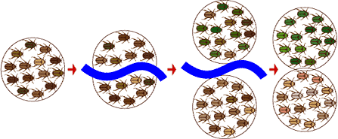
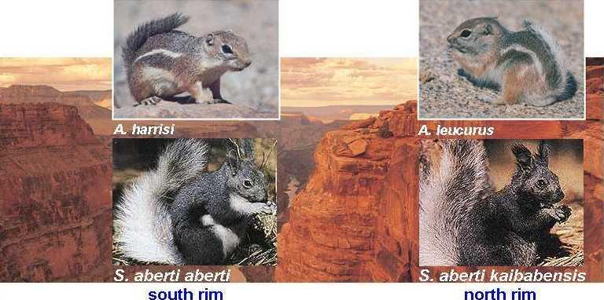
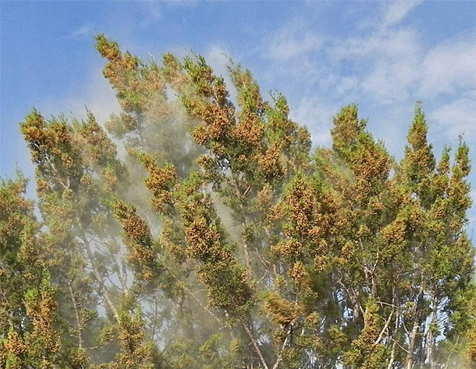
Allopatric (“Other Country”) Speciation
Notes:
4
In allopatric speciation, gene flow is interrupted when a population is divided into geographically isolated subpopulations.
The definition of a geographic barrier depends on the ability of a population to disperse. For example, a canyon may create a barrier for small rodents, but not birds, coyotes, or pollen.

Slide 5
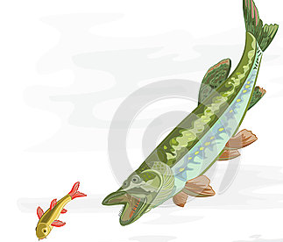
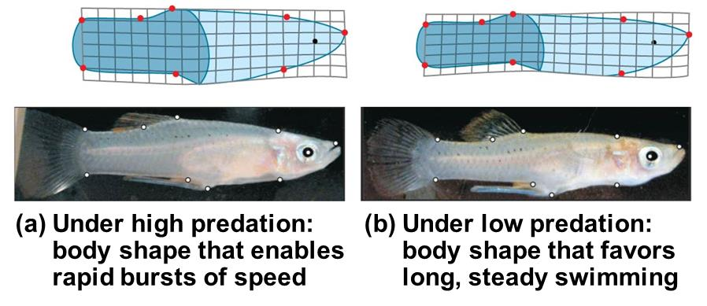
Separate populations may evolve independently through mutation, natural selection, and genetic drift.
mosquitofish
Notes:
5
Reproductive isolation may arise as a result of genetic divergence.
For example, mosquitofish in the Bahamas comprise several isolated populations in different ponds

Slide 6
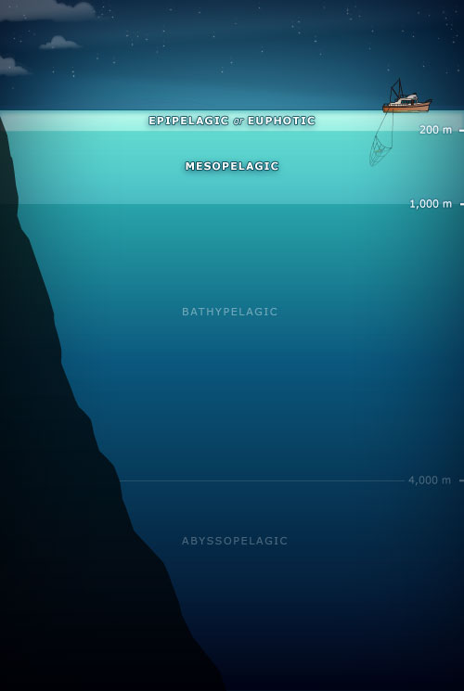
Allopatric speciation in snapping shrimp – Isthmus of Panama
A. formosus
A. nuttingi
ATLANTIC
OCEAN
Isthmus of Panama
Isthmus of Panama
PACIFIC
OCEAN
A. panamensis
A. millsae
Notes:
6
Allopatric speciation in snapping shrimp (Alpheus)
Fifteen pairs of sister species of snapping shrimp (Alpheus) are separated by the Isthmus of Panama.
These species originated from 9 million to 3 million years ago, when the Isthmus of Panama formed and separated the Atlantic and Pacific waters. Sister species that live in the deepest water diverged first.

Slide 7
Can divergence of allopatric populations lead to reproductive isolation?
Experiment
Notes:
7
Barriers to reproduction are intrinsic; separation itself is not a biological barrier.
Intrinsic reproductive barriers can develop in experimentally isolated populations.

Slide 8
Figure 22.8b
Results
Results
Female
Female
Female
Starch
population 1
Starch
population 2
Starch
Starch
Maltose
Maltose
Starch
Starch
population 1
Starch
22
22
9
9
18
15
Male
Male
Male
Maltose
Starch
population 2
Maltose
8
8
20
20
12
15
Number of matings
in experimental group
Number of matings
in experimental group
Number of matings
in control group
Notes:
8
Figure 22.8b Inquiry: Can divergence of allopatric populations lead to reproductive isolation? (part 2: results)

Slide 9
Sympatric (“Same Country”) Speciation
In sympatric speciation, speciation takes place in populations that live in the same geographic area.
Sympatric speciation occurs when gene flow is reduced between groups that remain in contact through factors including.
Polyploidy
Habitat differentiation
Sexual selection
Notes:
9

Slide 10
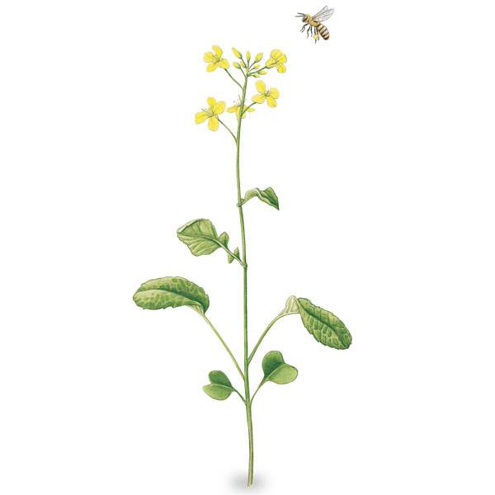
An autopolyploid is an individual with more than two chromosome sets, derived from one species.
Cell
division
error
2n = 6
Tetraploid cell
4n = 12
2n
New species
(4n)
Gametes produced
by tetraploids
Notes:
10
Polyploidy is the presence of extra sets of chromosomes due to accidents during cell division.
Polyploidy is much more common in plants than in animals.
The offspring of matings between autopolyploids and diploids have reduced fertility.

Slide 11
Species A
2n = 6
Species B
2n = 4
Meiotic error; chromosome
number not reduced from 2n to n
Normal
gamete
n = 3
Unreduced gamete
with 4 chromosomes
Hybrid with
7 chromosomes
An allopolyploid is a species with multiple sets of chromosomes derived from different species.
Normal
gamete
n = 3
Unreduced gamete
with 7 chromosomes
New species:
viable fertile hybrid
(allopolyploid)
2n = 10
Notes:
11
An allopolyploid is a species with multiple sets of chromosomes derived from different species.
Allopolyploids cannot interbreed with either parent species.

Slide 12
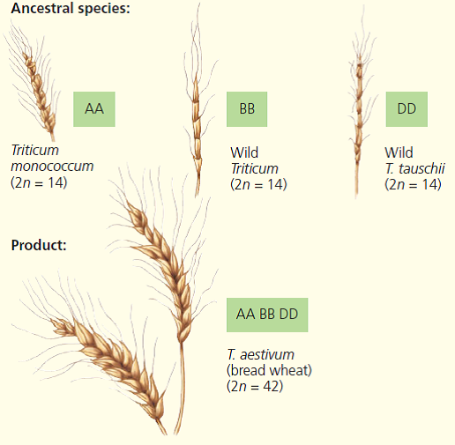
Bread Wheat (Triticum aestivum)
allohexaploid
Notes:
You don’t need to remember this.

Slide 13
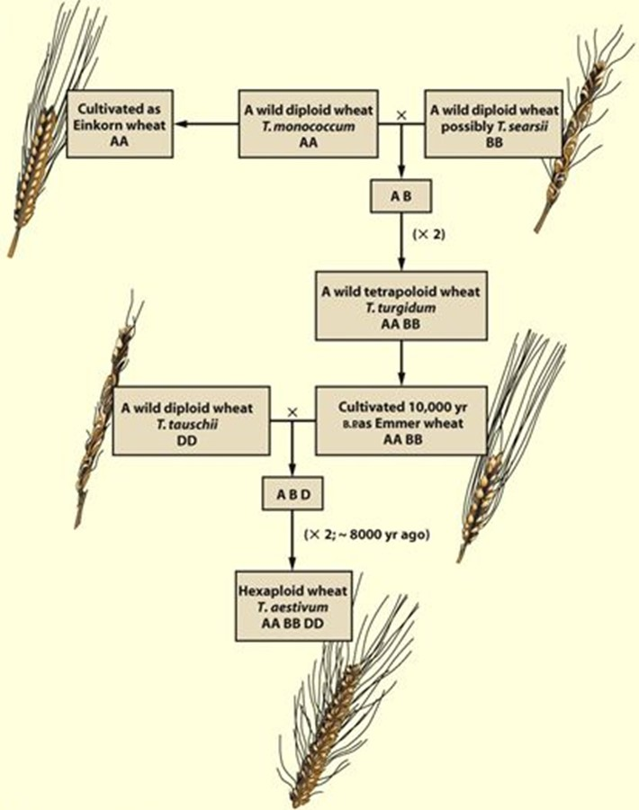
Notes:
You don’t need to remember this.

Slide 14
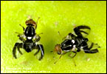
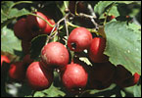
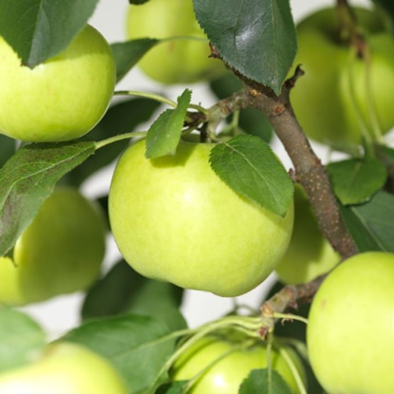
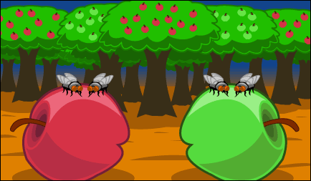
Habitat Differentiation
maggot fly
hawthorn tree
apple tree
Gene flow has been reduced between flies that feed on different food varieties, even though they both live in the same area.
Notes:
14
Sympatric speciation can also result from the appearance of new ecological niches.
For example, the North American maggot fly can live on native hawthorn trees as well as more recently introduced apple trees.

Slide 15
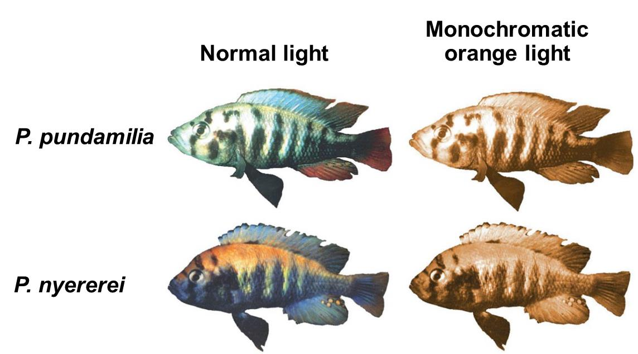
Sexual Selection
Experiment
Notes:
15
Sexual selection can drive sympatric speciation. Sexual selection for mates of different colors has likely contributed to speciation in cichlid fish in Lake Victoria.
Mate choice by females based on male breeding coloration is the main reproductive barrier that normally keeps the gene pools of these two species separate.

Slide 16
Allopatric and Sympatric Speciation: A Review
In allopatric speciation, geographic isolation restricts gene flow between populations.
Reproductive isolation may then arise by natural selection, genetic drift, or sexual selection in the isolated populations.
Even if contact is restored between populations, interbreeding is prevented by reproductive barriers.
Notes:
16

Slide 17
In sympatric speciation, a reproductive barrier isolates a subset of a population without geographic separation from the parent species.
Sympatric speciation can result from polyploidy, natural selection, or sexual selection.
Notes:
17

