Slide 1
The deadline for missing assignments is today at 2:30.

Slide 2
0
Chapter 22
Biological Species Concept

Slide 3
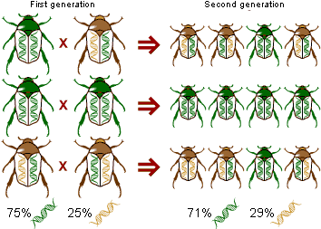
Speciation is the process by which one species splits into two or more species.
Microevolution consists of changes in allele frequency in a population over time.
Macroevolution refers to broad patterns of evolutionary change above the species level.
Notes:
3

Slide 4
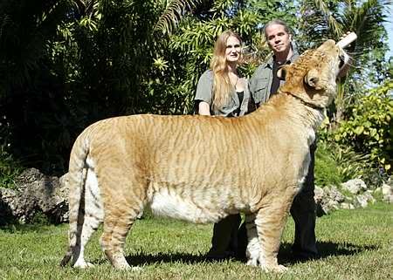
The Biological Species Concept
Interbreed
In nature
Produce offspring that are
Viable
Fertile
Notes:
4
The biological species concept states that a species is a group of populations whose members have the potential to interbreed in nature and produce viable, fertile offspring; they do not breed successfully with other populations. Gene flow between populations holds the populations together genetically.

Slide 5
Reproductive Isolation
Reproductive isolation is the existence of biological barriers that impede two species from producing viable, fertile offspring.
Reproductive isolation can be classified by whether barriers act before or after fertilization.
Notes:
5

Slide 6
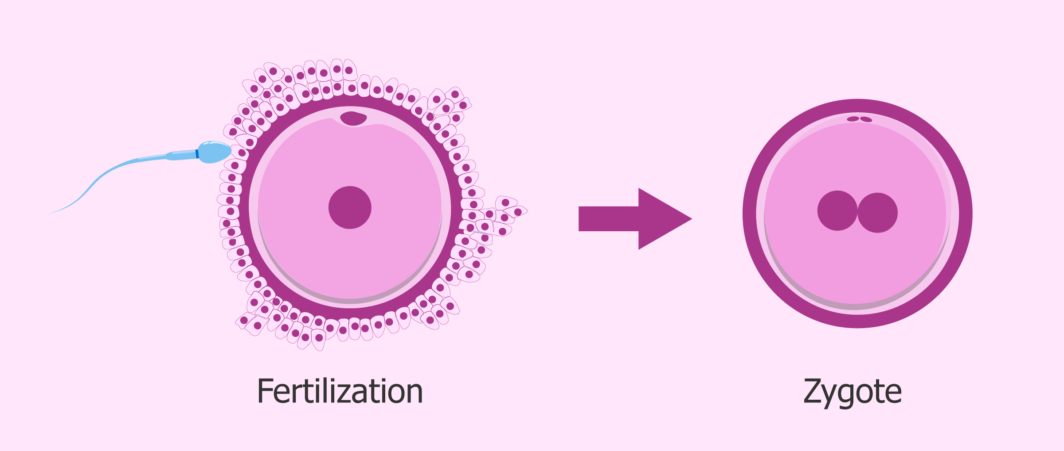
Zygote
fertilized egg
Notes:
Zygote, fertilized egg cell that results from the union of a female gamete (egg, or ovum) with a male gamete (sperm).

Slide 7
(a)
(e)
(d)
(b)
Bird Dance
Notes:
7
Prezygotic barriers block fertilization from occurring by
Impeding different species from attempting to mate
Preventing the successful completion of mating
Hindering fertilization if mating is successful
Habitat isolation: Two species encounter each other rarely, or not at all, because they occupy different habitats, even though not isolated by physical barriers.
Temporal isolation: Species that breed at different times of the day, different seasons, or different years cannot mix their gametes.
Behavioral isolation: Courtship rituals and other behaviors unique to a species are effective barriers.

Slide 8
Figure 22.3b
Notes:
8
Mechanical isolation: Morphological differences prevent successful mating.
Gametic isolation: Sperm of one species may not be able to fertilize eggs of another species.

Slide 9
Notes:
9
Postzygotic barriers prevent the hybrid zygote from developing into a viable, fertile adult by
Reduced hybrid viability
Reduced hybrid fertility
Hybrid breakdown
Reduced hybrid viability: Genes of the different parent species may interact and impair the hybrid’s development or survival.
Reduced hybrid fertility: Even if hybrids are vigorous, they may be sterile
Hybrid breakdown: Some first-generation hybrids are fertile, but when they mate with another species or with either parent species, offspring of the next generation are feeble or sterile.

Slide 10
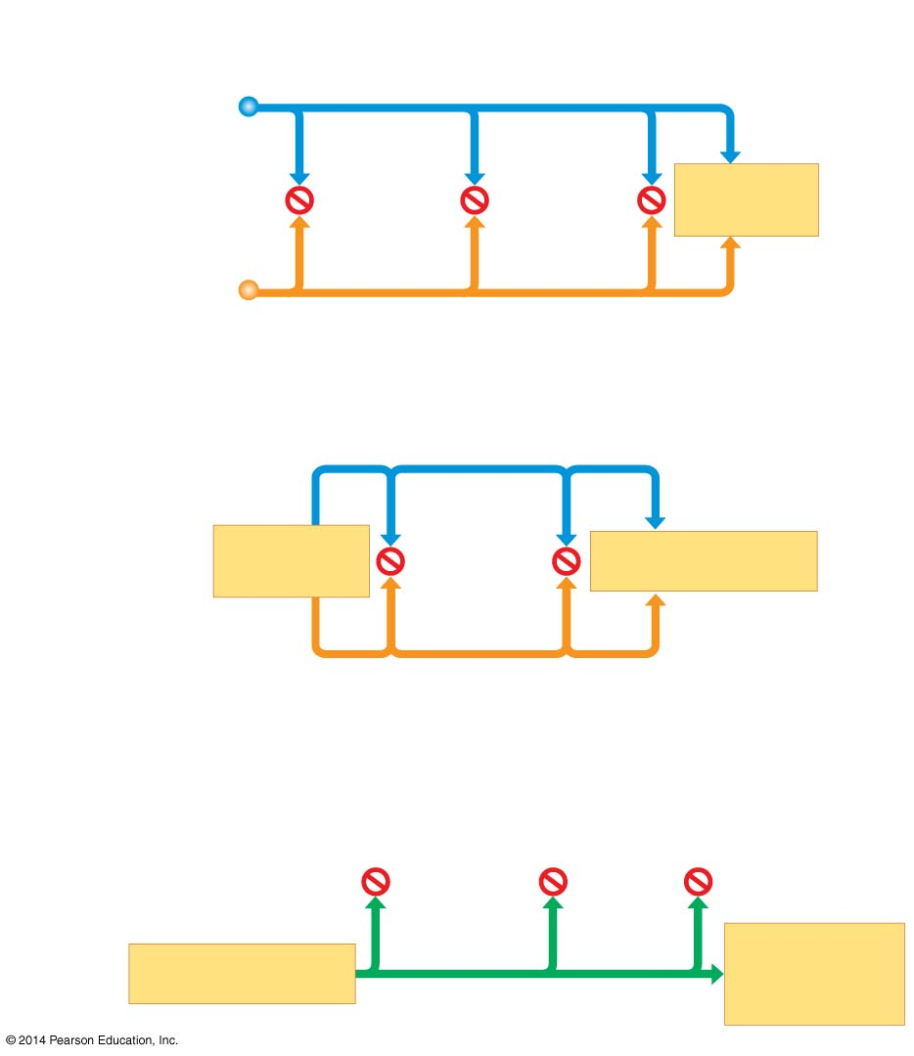
Figure 22.3d
Prezygotic
barriers
Habitat
isolation
Temporal
isolation
Behavioral
isolation
MATING
ATTEMPT
Mechanical
isolation
Gametic
isolation
MATING
ATTEMPT
FERTILIZATION
Postzygotic
barriers
Reduced
hybrid
viability
Reduced
hybrid
fertility
Hybrid
breakdown
VIABLE,
FERTILE
OFFSPRING
FERTILIZATION
Notes:
10

Slide 11
Figure 22.3
Prezygotic barriers
Postzygotic barriers
Habitat
isolation
Temporal
isolation
Behavioral
isolation
Mechanical
isolation
Gametic
isolation
Reduced
hybrid
viability
Reduced
hybrid
fertility
Hybrid
breakdown
VIABLE,
FERTILE
OFF-
SPRING
MATING
ATTEMPT
FERTILI-
ZATION
(a)
(c)
(e)
(f)
(g)
(h)
(i)
(l)
(d)
(j)
(b)
(k)
Notes:
11

