Slide 1
This Friday at 2:30 is the deadline for all missing assignments.

Slide 2
0
Chapter 21
Relative Fitness and Modes of Selection

Slide 3
Concept 21.4: Natural selection is the only mechanism that consistently causes adaptive evolution
Evolution by natural selection involves both chance and “sorting”
New genetic variations arise by chance.
Beneficial alleles are “sorted” and favored by natural selection.
Notes:
3
Only natural selection consistently results in adaptive evolution, an increase in the frequency of alleles that improve fitness. Selection indirectly favors certain genotypes by acting directly on phenotypes. Evolution is a change in allele frequency in a population.

Slide 4
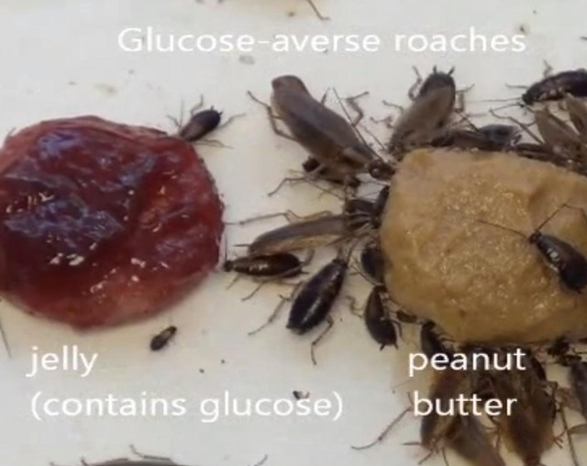
Relative Fitness
Relative fitness is the contribution an individual makes to the gene pool of the next generation, relative to the contributions of other individuals.
Notes:
4
Natural selection brings about adaptive evolution by acting on an organism’s phenotype

Slide 5
Because the environment can change, adaptive evolution is a continuous, dynamic process.
Notes:
5
Natural selection increases the frequencies of alleles that enhance survival and reproduction.
Adaptive evolution occurs as the match between an organism and its environment increases.

Slide 6
There are three modes of natural selection
Original
population
Frequency of
individuals
Original
population
Evolved
population
Phenotypes (fur color)
(a) Directional selection
(b) Disruptive selection
(c) Stabilizing selection
Notes:
6
There are three modes of natural selection
Directional selection favors individuals at one end of the phenotypic range.
Disruptive selection favors individuals at both extremes of the phenotypic range.
Stabilizing selection favors intermediate variants and acts against extreme phenotypes.

Slide 7
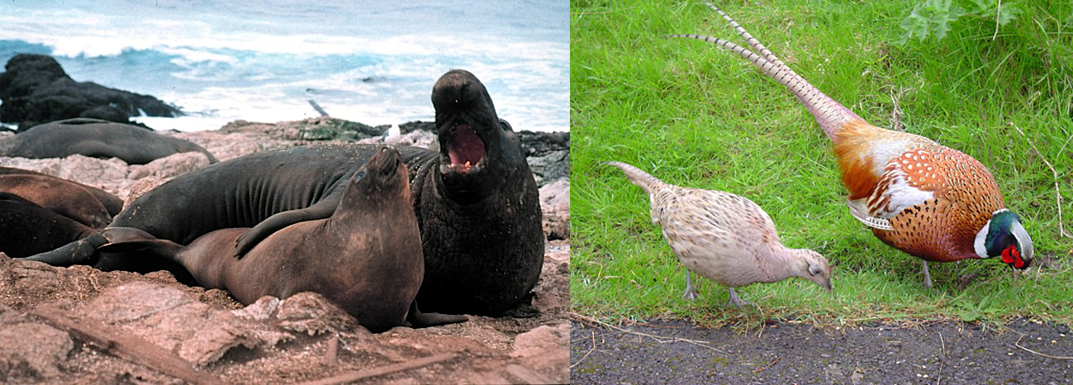
Sexual Selection
Sexual selection is natural selection for mating success.
It can result in sexual dimorphism, marked differences between the sexes.
Notes:
7

Slide 8
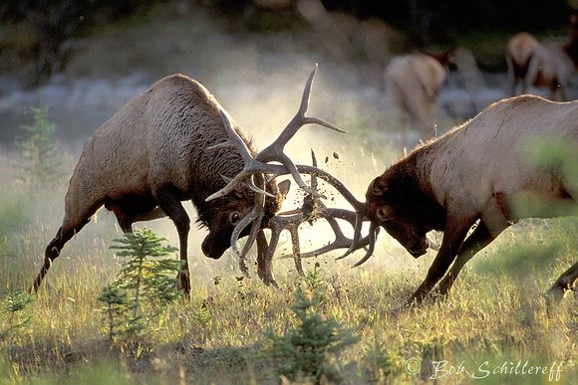
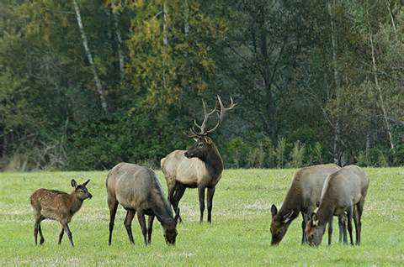
Intrasexual selection
Notes:
8
Intrasexual selection is competition among individuals of one sex (often males) for mates of the opposite sex.

Slide 9
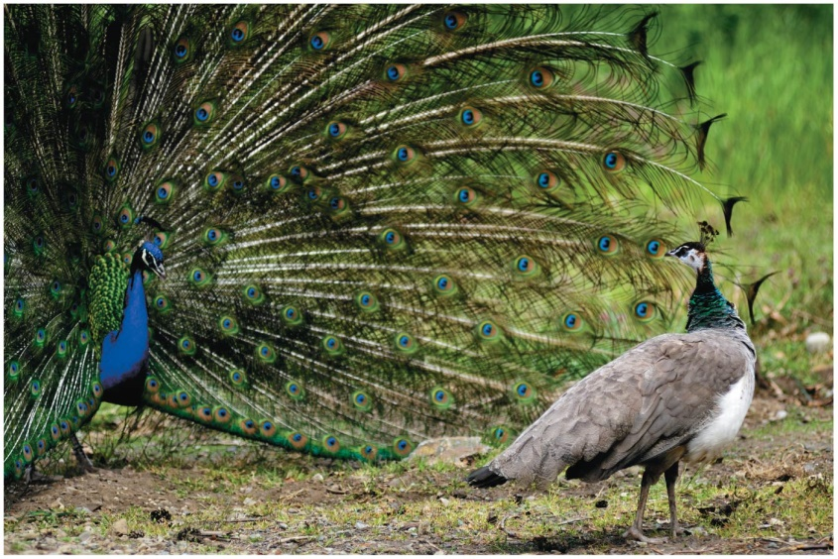
Intersexual selection
mate choice
Notes:
9
Intersexual selection, often called mate choice, occurs when individuals of one sex (usually females) are choosy in selecting their mates.
Male showiness due to mate choice can increase a male’s chances of attracting a female, while decreasing his chances of survival.

Slide 10
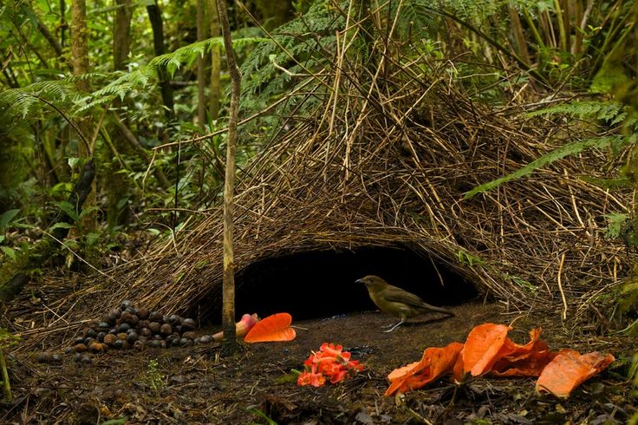
Good gene hypothesis for Intersexual selection
Bower Bird
Video: Bower Bird
Notes:
10
How do female preferences evolve?
The “good genes” hypothesis suggests that if a trait is related to male genetic quality or health, both the male trait and female preference for that trait should increase in frequency.

Slide 11
The Preservation of Genetic Variation
Diploidy maintains genetic variation in the form of hidden recessive alleles.
Heterozygotes can carry recessive alleles that are hidden from the effects of selection.
Notes:
11

Slide 12
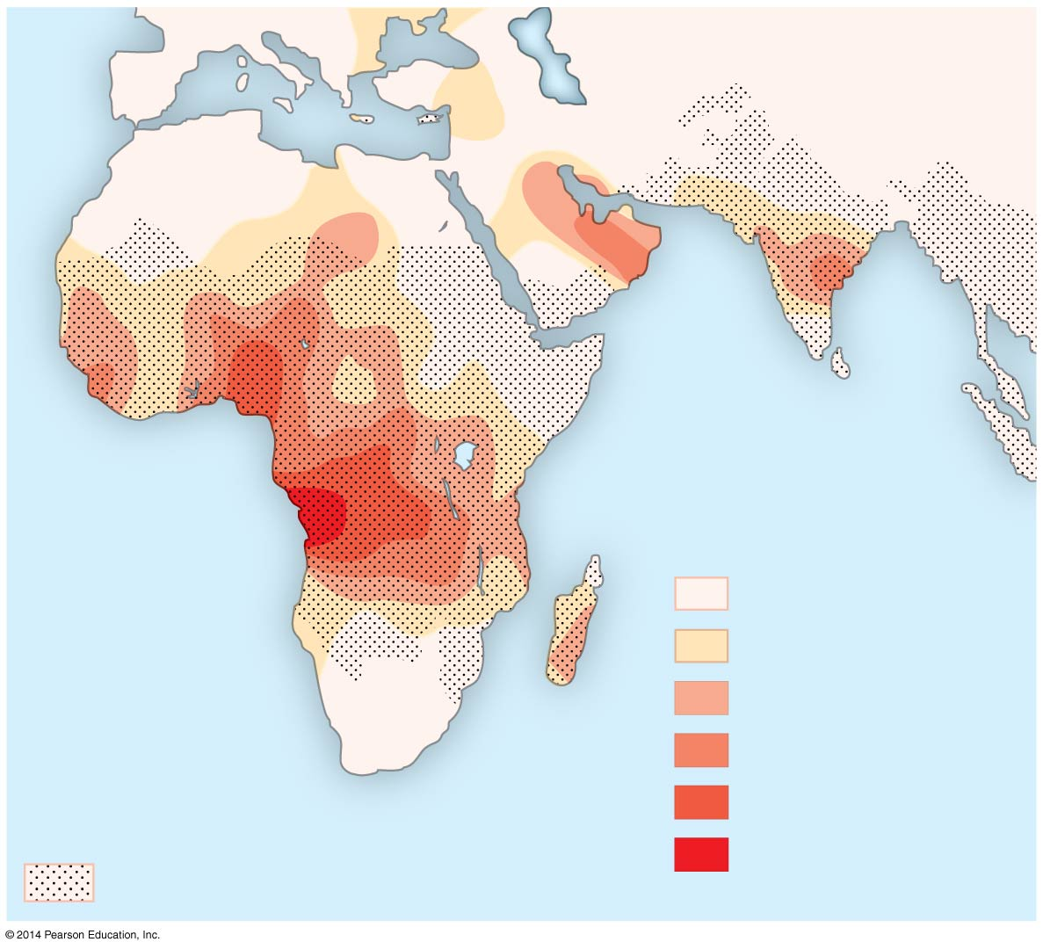
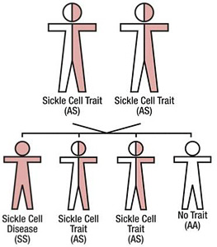
Heterozygote advantage
Key
Frequencies of the
sickle-cell allele
0–2.5%
2.5–5.0%
Distribution of
malaria caused by
Plasmodium falciparum
(a parasitic unicellular eukaryote)
5.0–7.5%
7.5–10.0%
10.0–12.5%
>12.5%
Notes:
12
Balancing selection occurs when natural selection maintains stable frequencies of two or more phenotypic forms in a population.
Balancing selection includes
Heterozygote advantage
Frequency-dependent selection
Heterozygote advantage occurs when heterozygotes have a higher fitness than do both homozygotes.
Natural selection will tend to maintain two or more alleles at that locus.
For example, the sickle-cell allele causes deleterious mutations in hemoglobin but also confers malaria resistance.

Slide 13
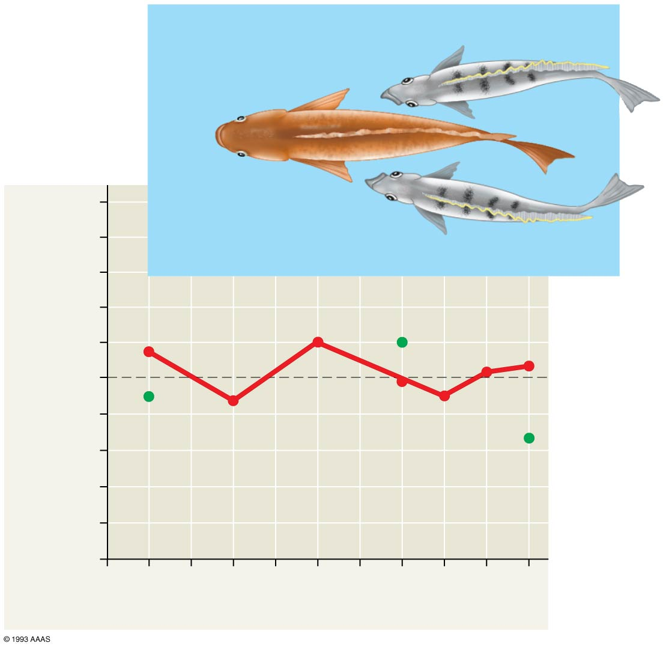
Frequency-dependent selection
“Left-mouthed”
P. microlepis
1.0
“Right-mouthed”
P. microlepis
Prey species guard against attack from whatever phenotype of scale eating fish is most common in the lake.
Frequency of
“left-mouthed” individuals
0.5
0
1981
’83
’85
’87
’89
Sample year
Notes:
13
Frequency-dependent selection occurs when the fitness of a phenotype declines if it becomes too common in the population.
Selection can favor whichever phenotype is less common in a population.
For example, frequency-dependent selection selects for approximately equal numbers of “right-mouthed” and “left-mouthed” scale-eating fish.

Slide 14
Why Natural Selection Cannot Fashion Perfect Organisms
Selection can act only on existing variations.
Evolution is limited by historical constraints.
Adaptations are often compromises.
Chance, natural selection, and the environment interact.
Notes:
14

