Slide 1
The last time to turn in missing assignments is Friday, March 6 at 2:30

Slide 2
There will be a test on Chapter 21 and 22 on Monday, March 16.
The Chapter 21 Homework is due on Thursday, March 5th at 11:59 pm.
The Chapter 22 Homework is due on Sunday, March 15 at 11:59 pm.

Slide 3
0
Chapter 21
Hardy-Weinberg

Slide 4
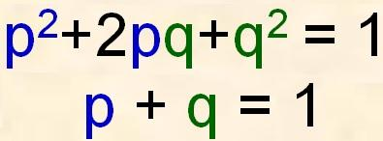
The Hardy-Weinberg equation can be used to test whether a population is evolving
Population: a localized group of individuals capable of interbreeding and producing fertile offspring.
Notes:
4
p and q represent alleles.

Slide 5
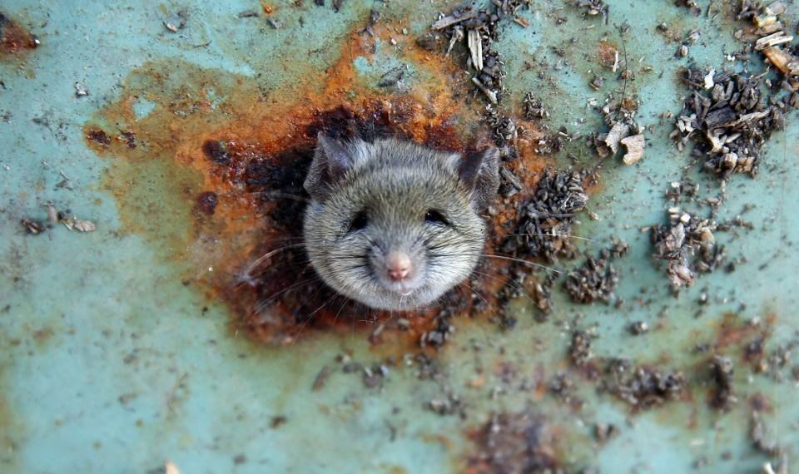
Rats in New York City
(One species, many populations)

Slide 6
Populations of Rats in New York City
Left: a map showing two clusters of rats uptown (black, north of 59th Street) and downtown (white, south of 14 Street). Right: a map showing estimated migration rates of rats. (Combs et al. / Molecular Ecology)
Notes:
Manhattan has two genetically distinguishable groups of rats: the uptown rats and the downtown rats, separated by the geographic barrier that is midtown. It’s not that midtown is rat-free—such a notion is inconceivable—but the commercial district lacks the household trash (aka food) and backyards (aka shelter) that rats like. Since rats tend to move only a few blocks in their lifetimes, the uptown rats and downtown rats don’t mix much. Different neighborhoods have their own distinct rats. “If you gave us a rat, we could tell whether it came from the West Village or the East Village,” says Combs. “They’re actually unique little rat neighborhoods.” And the boundaries of rat neighborhoods can fit surprisingly well with human ones. (From the Atlantic: New York City Has Genetically Distinct ‘Uptown’ and ‘Downtown’ Rats Sarah Zhang Nov 29, 2017.) (You don’t need to remember the details on rat populations.)

Slide 7
A gene pool consists of all the alleles for all loci in a population.
Estimated migration rates of rats. (Combs et al. / Molecular Ecology)
Notes:
An allele for a particular locus is fixed if all individuals in a population are homozygous for the same allele.

Slide 8
Calculate the allele frequency in a population.
For example, consider a population of wildflowers that is incompletely dominant for color
2 red flowers (C^{R}C^{R})
1 pink flower (C^{R}C^{W})
3 white flowers (C^{W}C^{W})
Figure out the number of copies of each allele
C^{R} =
C^{W} =
C^{R}C^{R}
C^{R}C^{R}
C^{R}C^{W}
C^{W}C^{W}
C^{W}C^{W}
C^{W}C^{W}
5
Total # of individuals =
6
7
Total # of alleles =
12
Notes:
8
For diploid organisms, the total number of alleles at a locus is the total number of individuals times 2. The total number of dominant alleles at a locus is 2 alleles for each homozygous dominant individual plus 1 allele for each heterozygous individual; the same logic applies for recessive alleles.
By convention, if there are 2 alleles at a locus, p and q are used to represent their frequencies.
The frequency of all alleles in a population will add up to 1. (For example, p + q = 1)

Slide 9
p + q = 1
To calculate the frequency of each allele
p = freq C^{R} = total # of p alleles/ total # of alleles
p = freq C^{R} =5/12= 0.42 (42%)
q = 1 − p = 0.58 (58%)
The sum of alleles is always 1
0.42 + 0.58 = 1
C^{R}C^{R}
C^{R}C^{R}
C^{R}C^{W}
C^{W}C^{W}
C^{W}C^{W}
C^{W}C^{W}
Notes:
9

Slide 10
Calculate the allele frequency in a population.
For example, consider a population of wildflowers that is incompletely dominant for color
320 red flowers (C^{R}C^{R})
160 pink flowers (C^{R}C^{W})
20 white flowers (C^{W}C^{W})
Calculate the number of copies of each allele
C^{R} =
C^{W} =
Total # of individuals =
500
Total # of alleles =
1000
(320 × 2) + 160 = 800
C^{R}C^{R}
(20 × 2) + 160 = 200
C^{W}C^{W}
C^{R}C^{W}
Notes:
10
For diploid organisms, the total number of alleles at a locus is the total number of individuals times 2. The total number of dominant alleles at a locus is 2 alleles for each homozygous dominant individual plus 1 allele for each heterozygous individual; the same logic applies for recessive alleles.
By convention, if there are 2 alleles at a locus, p and q are used to represent their frequencies.
The frequency of all alleles in a population will add up to 1. (For example, p + q = 1)

Slide 11
To calculate the frequency of each allele
p = freq C^{R} = 800 / 1,000 = 0.8 (80%)
q = 1 − p = 0.2 (20%)
The sum of alleles is always 1
0.8 + 0.2 = 1
p + q = 1
Notes:
11

Slide 12
The Hardy-Weinberg Principle
The Hardy-Weinberg principle describes a population that is not evolving.
Notes:
12

Slide 13
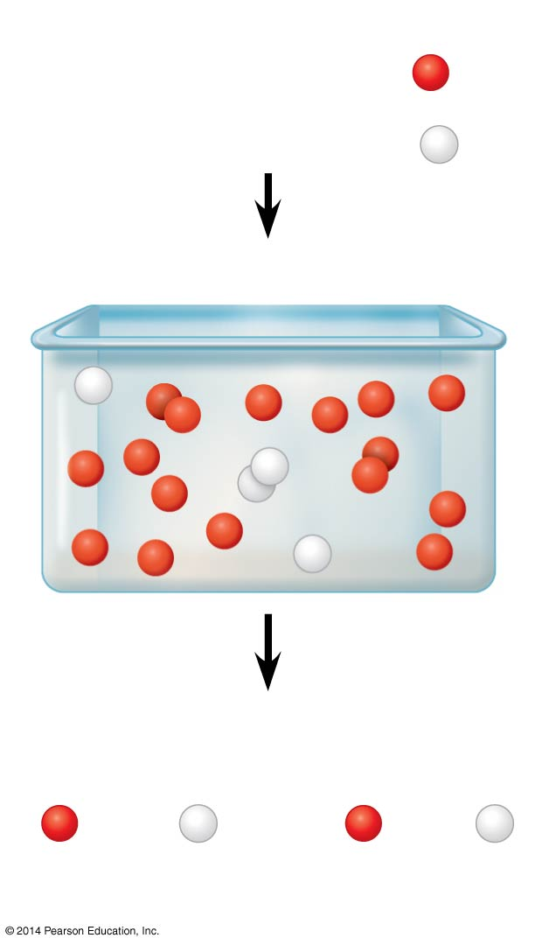
Frequencies of alleles
The Hardy-Weinberg principle states that in a given population where gametes contribute to the next generation randomly, allele frequencies will not change.
Frequencies of alleles
p = frequency of C^{R} allele
p = frequency of C^{R} allele
= 0.8
= 0.8
= 0.2
q = frequency of C^{W} allele
= 0.2
q = frequency of C^{W} allele
Alleles in the population
Alleles in the population
Gametes produced
Each egg:
Each sperm:
80%
chance
20%
chance
80%
chance
20%
chance
Notes:
13
Mendelian inheritance preserves genetic variation in a population.

Slide 14
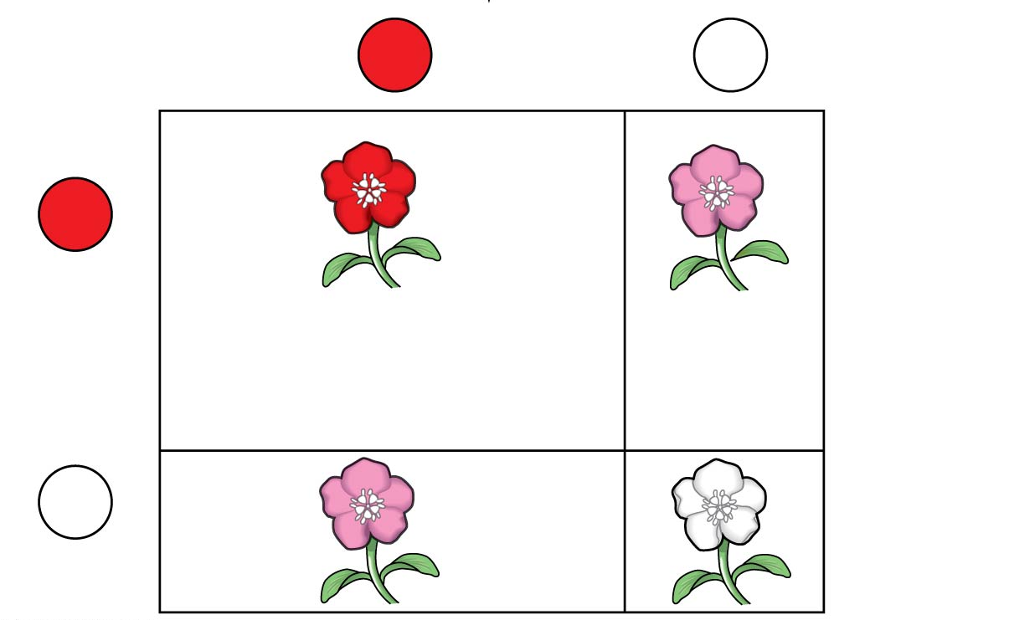
The frequency of genotypes can be calculated
C^{R}C^{R} = p² = (0.8)² = 0.64
C^{R}C^{W} = 2pq = 2(0.8)(0.2) = 0.32
C^{W}C^{W} = q² = (0.2)² = 0.04
Sperm
C^{R}
p = 0.8
C^{W}
q = 0.2
C^{R}
p = 0.8
0.64 (p²)
C^{R}C^{R}
0.16 (pq)
C^{R}C^{W}
Eggs
C^{W}
0.16 (qp)
C^{R}C^{W}
0.04 (q²)
C^{W}C^{W}
q = 0.2
Notes:
14
If p and q represent the relative frequencies of the only two possible alleles in a population at a particular locus, then p² + 2pq + q² = 1 where p² and q² represent the frequencies of the homozygous genotypes and 2pq represents the frequency of the heterozygous genotype

Slide 15
The frequency of genotypes can be calculated
C^{R}C^{R} = p² = (0.8)² = 0.64
C^{R}C^{W} = 2pq = 2(0.8)(0.2) = 0.32
C^{W}C^{W} = q² = (0.2)² = 0.04
Notes:
15

Slide 16
Conditions for Hardy-Weinberg Equilibrium
The Hardy-Weinberg theorem describes a hypothetical population that is not evolving.
In real populations, allele and genotype frequencies do change over time.
Notes:
16

Slide 17
The five conditions for nonevolving populations are rarely met in nature
No mutations
Random mating
No natural selection
Extremely large population size
No gene flow
Notes:
17
If a population does not meet the criteria of the Hardy-Weinberg principle, it can be concluded that the population is evolving.

Slide 18
Natural populations can evolve at some loci while being in Hardy-Weinberg equilibrium at other loci.
Some populations evolve slowly enough that evolution cannot be detected
Notes:
18

