Slide 1
Genetics
Genes are made of DNA and are located on chromosomes. Genes determine an organisms traits.

Slide 2
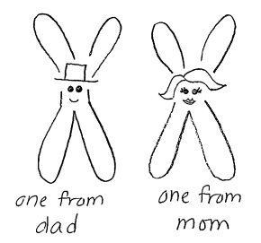
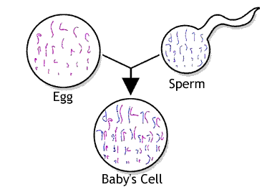
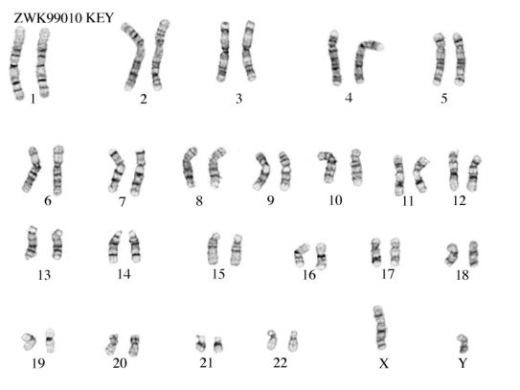
Where did you get your genes?

Slide 3
Are all genes the same?
No!
Different forms of a gene are called alleles.
For example, there is an allele the ability to taste PTC and an allele for not being able to taste PTC.
Allele for not tasting→
← Allele for tasting

Slide 4
Dominant Gene
If you have one or more copies of a dominant allele, you will have that trait.
Ex. The ability to taste PTC is dominant, so if you have an allele for tasting PTC, you will be able to taste it.
Allele for not tasting→
← Allele for tasting
OR
Allele for tasting→
← Allele for tasting

Slide 5
Recessive Gene
You will only have a recessive trait if you don’t have a copy of the dominant allele.
Ex. You won’t be able to taste PTC only if you have two copies of the “not tasting” allele.
Allele not tasting→
← Allele for not tasting

Slide 6
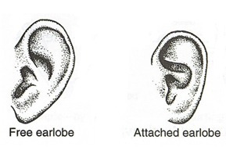
Having free earlobes is a dominant trait. Attached earlobes is a recessive trait.

Slide 7
The capitalized 1st letter of the dominant form of a gene becomes the symbol for the gene.
For example, F= Free earlobe and f = attached earlobe.

Slide 8
Homozygous – two identical alleles for a particular trait.
For example, ff or FF.
Heterozygous – two different alleles for a particular trait.
For example, Ff.

Slide 9
Genotype – the genetic makeup of an organism.
Ff or FF or ff
Phenotype – what an organism looks like.
Free or attached

Slide 10
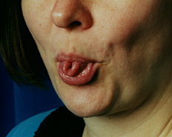
The ability to roll your tongue is dominant. The inability to roll your tongue is recessive.
1. What is the phenotype of the person in the picture?
Tongue roller
2. What is the genotype of a person who can’t roll their tongue?
rr
3. Is a person who can’t roll their tongue homozygous or heterozygous?
Homozygous
4. What are the possible genotypes of a person who can roll their tongue?
Rr or RR
5. Is a person who can roll their tongue homozygous or heterozygous?
They could be either

Slide 11
Karyotype

Slide 12
Where did you get your genes?

Slide 13
