Slide 1
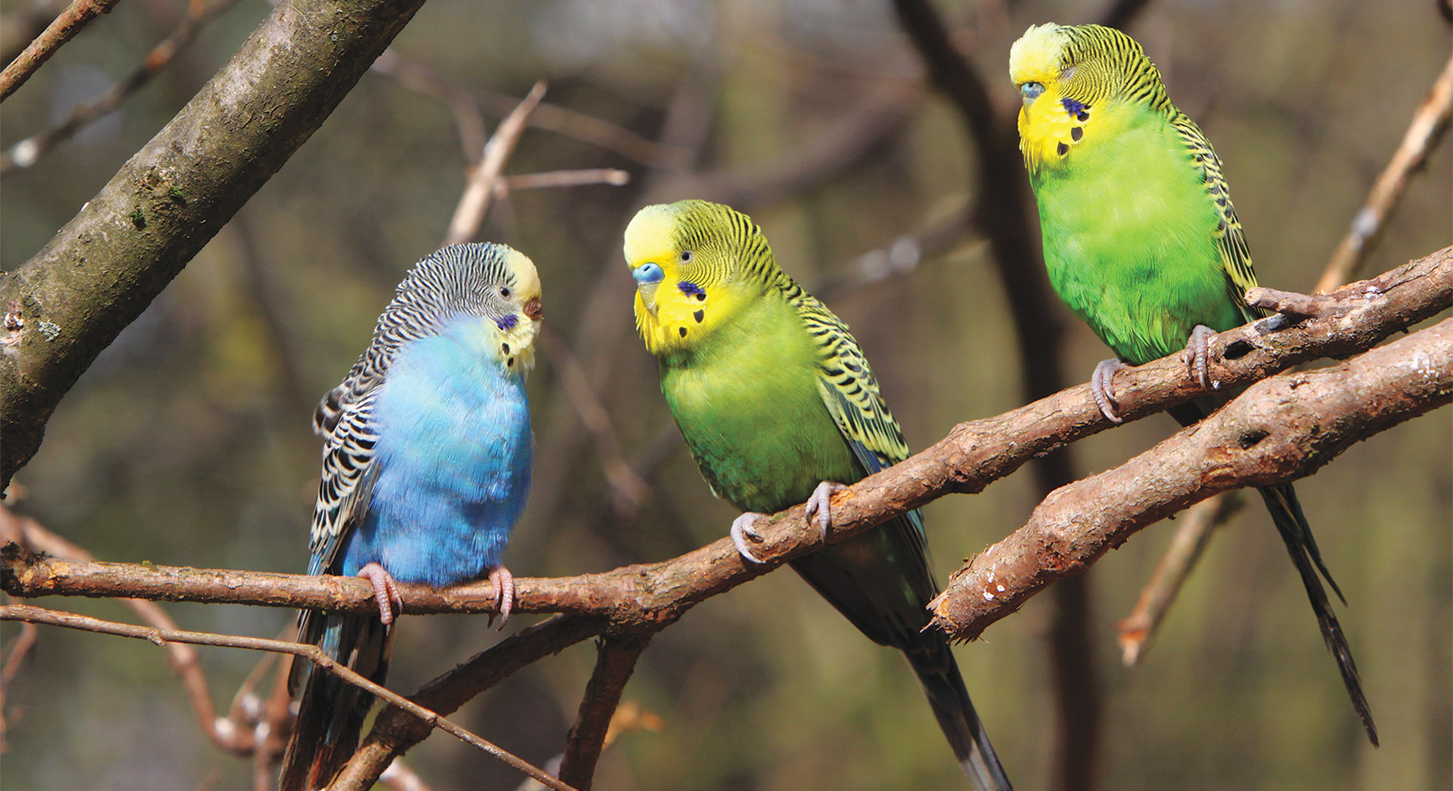
Other Patterns of Inheritance
Notes:
Read the lesson title aloud to students.

Slide 2
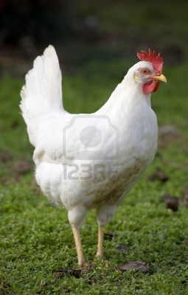
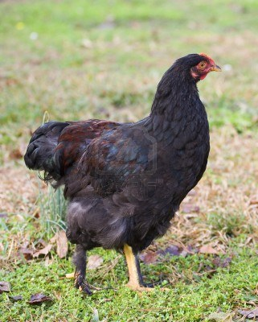
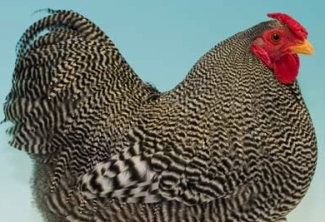
Codominance
Both alleles are expressed.
Ex. Feather color in chickens
Homozygous white x homozygous black.
Heterozygous offspring have black and white feathers

Slide 3
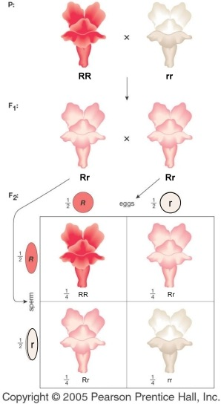
Incomplete Dominance
The heterozygous phenotype is a blend.
Ex. Snap dragons
Homozygous red x Homozygous white
Heterozygous offspring are pink

Slide 4
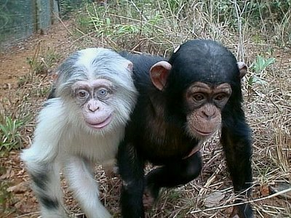
Epistasis
The effects of one gene are modified by one or several other genes.
Example: the gene causing albinism would hide the gene controlling color of an animal’s hair
Example: a gene coding for a widow's peak would be hidden by a gene causing baldness.

Slide 5
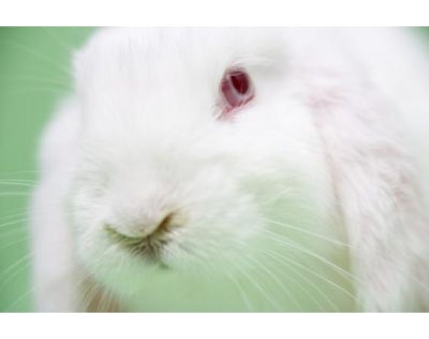
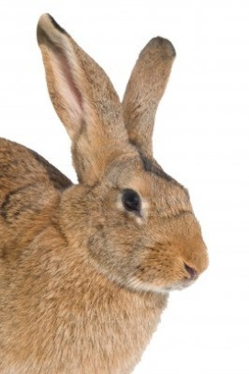
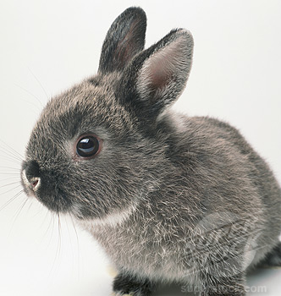
Multiple Alleles
The trait is controlled by one gene, but more than two alleles exist in the population.
Ex. Rabbits have alleles for brown, gray, Himalayan (color only in certain parts of the body), and albino (no color) fur.

Slide 6
Polygenic Traits
More than one gene controls a trait.
Often show a continuous distribution of phenotypes.
Ex. Height
Ex. Skin Color

