Slide 1
This is the last new information that will be on the test.
We are skipping lots of Chapter 15

Slide 2
0
Chapter 15
Eukaryotic Gene Regulation

Slide 3
You Must Know
The control of gene expression in eukaryotes.

Slide 4
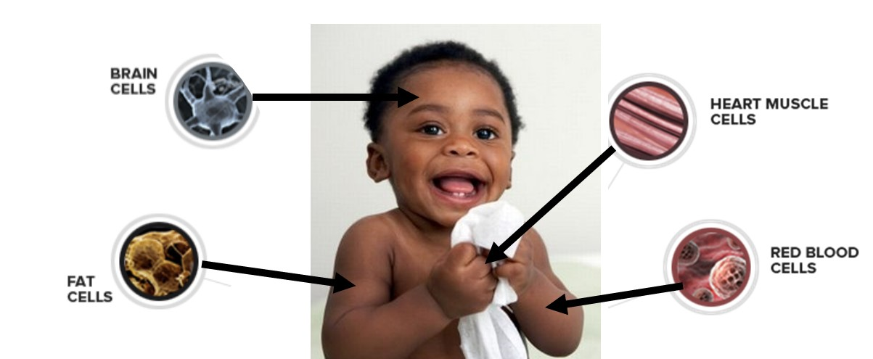
Almost all the cells in an organism are genetically identical.
Differences between cell types result from differential gene expression, the expression of different genes by cells with the same genome.
Notes:
Prokaryotes and eukaryotes alter gene expression in response to their changing environment.
Multicellular eukaryotes also develop and maintain multiple cell types.
Gene expression is often regulated at the transcription stage, but control at other stages is important, too.
All organisms must regulate which genes are expressed at any given time.
In multicellular organisms regulation of gene expression is essential for cell specialization.

Slide 5
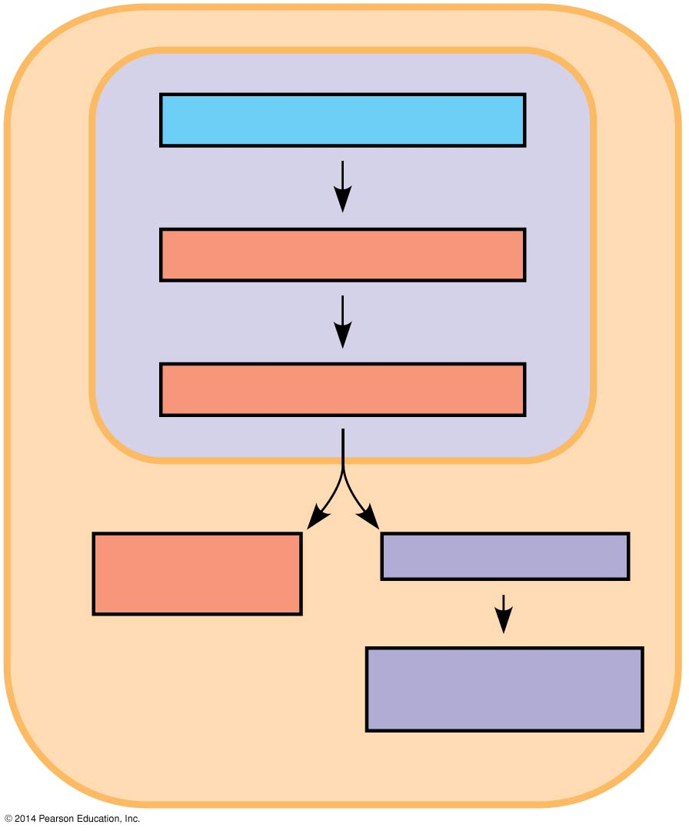
Chromatin Modification
Chromatin modification
Transcription
RNA processing
mRNA degradation
Translation
Protein processing and degradation
Notes:
(

Slide 6
Genes within highly condensed heterochromatin are usually not expressed.
Euchromatin
Methylation
Acetylation
Heterochromatin
Notes:
acetyl –COCH₃)
(methyl –CH₃)
Chemical modifications to histone proteins and DNA can influence chromatin structure and gene expression.

Slide 7
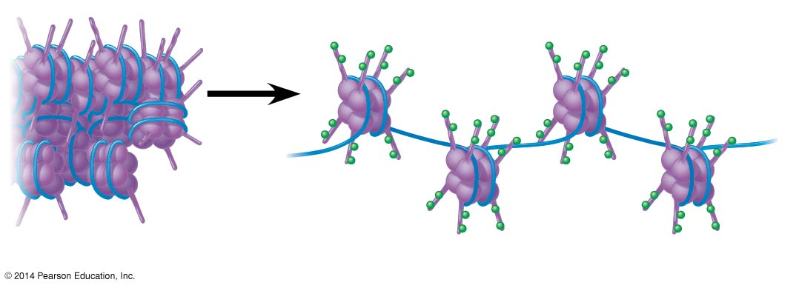
Nucleosome
Histone tails
Unacetylated histones
Acetylated histones
Notes:
7
In histone acetylation, acetyl groups are attached to positively charged lysines in histone tails. This generally loosens chromatin structure, promoting the initiation of transcription. (You don’t need to remember the chemical structure for lysine or acetyl-lysine for the test.)

Slide 8
DNA methylation is the addition of methyl groups to certain bases in DNA, usually cytosine.
Individual genes are usually more heavily methylated in cells where they are not expressed.

Slide 9
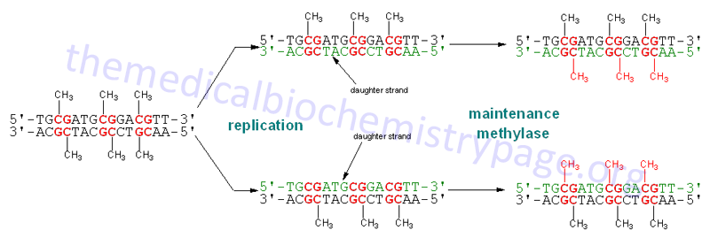
Once methylated, genes usually remain so through successive cell divisions.
Notes:
After replication, enzymes methylate the correct daughter strand so that the methylation pattern is inherited.

Slide 10
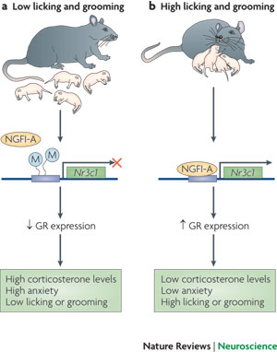
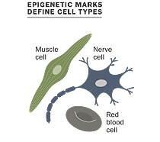
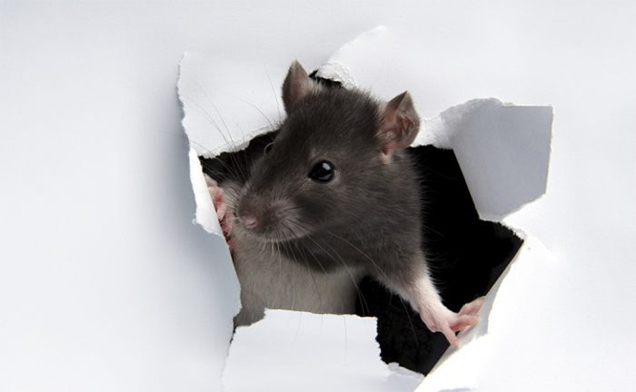
Epigenetic Inheritance
http://learn.genetics.utah.edu/content/epigenetics/
Notes:
10
Though chromatin modifications do not alter DNA sequence, they may be passed to future generations of cells.
The inheritance of traits transmitted by mechanisms not directly involving the nucleotide sequence is called epigenetic inheritance. Epigenetic modifications can be reversed, unlike mutations in DNA sequence.

Slide 11
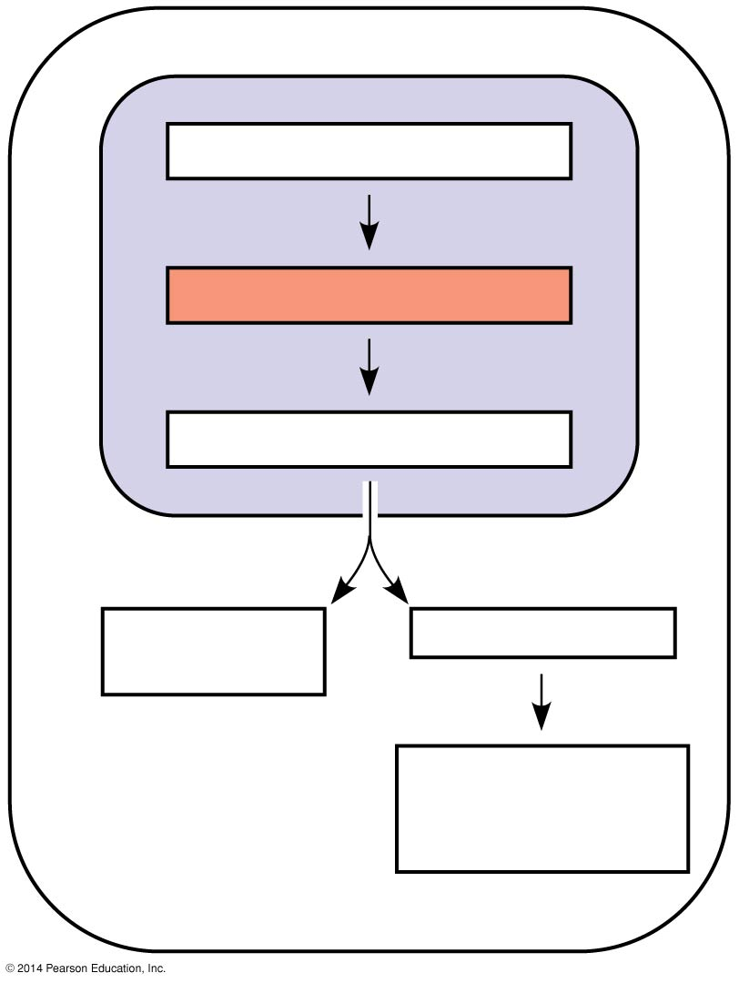
Figure 15.UN01
Chromatin modification
Transcription
RNA processing
mRNA degradation
Translation
Protein processing and degradation
Notes:
11
Figure 15.UN01 In-text figure, regulation at the level of transcription, p. 301

Slide 12
Activators
Enhancer (distal control elements)
Proximal control
elements
Poly-A signal sequence
Transcription termination region
Transcription start site
Exon
Intron
Exon
Intron
Exon
DNA
Upstream
Promoter
Down- stream
An activator is a protein that binds to an enhancer and stimulates transcription of a gene.
Activators have two domains, one that binds DNA and a second that activates transcription.
Notes:
12
Associated with most eukaryotic genes are multiple control elements, segments of noncoding DNA that serve as binding sites for transcription factors that help regulate transcription. Control elements and the transcription factors they bind are critical for the precise regulation of gene expression in different cell types. Proximal control elements are located close to the promoter. Distal control elements, groupings of which are called enhancers, may be far away from a gene or even located in an intron.

Slide 13
Figure 15.10-3
Activators
Promoter
Gene
DNA
Enhancer
Distal control element
TATA box
General transcription factors
DNA-
bending protein
Group of mediator proteins
RNA polymerase II
RNA polymerase II
Transcription initiation complex
RNA synthesis
Notes:
13
Bound activators are brought into contact with a group of mediator proteins through DNA bending.
The mediator proteins in turn interact with proteins at the promoter. These protein-protein interactions help to assemble and position the initiation complex on the promoter.

Slide 14
Combinatorial Control of Gene Activation
A particular combination of control elements can activate transcription only when the appropriate activator proteins are present.
Activators
Enhancer (distal control elements)
Proximal control
elements
Poly-A signal sequence
Transcription termination region
Transcription start site
Exon
Intron
Exon
Intron
Exon
DNA
Upstream
Promoter
Down- stream
Notes:
14

Slide 15
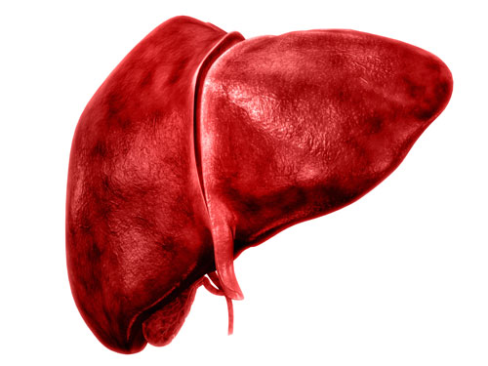
(a) LIVER CELL NUCLEUS
(a) LIVER CELL NUCLEUS
Available activators
Available activators
Albumin gene expressed
Crystallin gene not expressed
Notes:
15

Slide 16
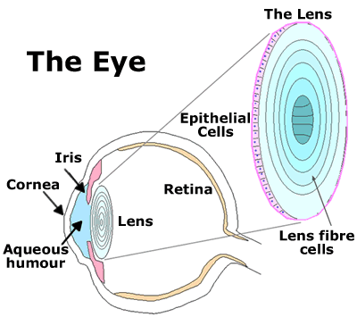
Figure 15.11b
(b) LENS CELL NUCLEUS
(b) LENS CELL NUCLEUS
Available activators
Available activators
Albumin gene not expressed
Crystallin gene expressed
Notes:
16
You aren’t expected to remember any details about the eye.

Slide 17
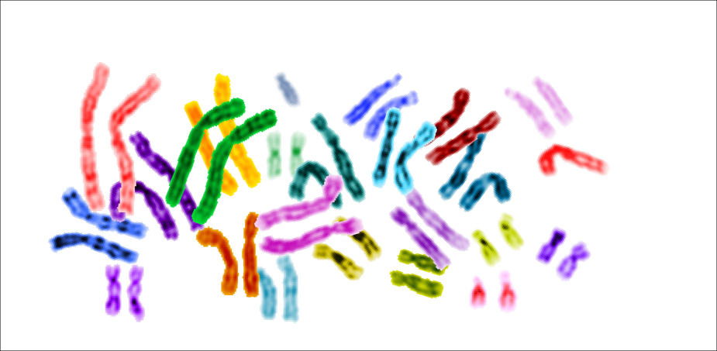
The activators recognize specific control elements and promote simultaneous transcription of the genes, even when the genes are on different chromosomes.
Activators
Notes:
Eukaryotes coordinate gene expression with activators.

Slide 18
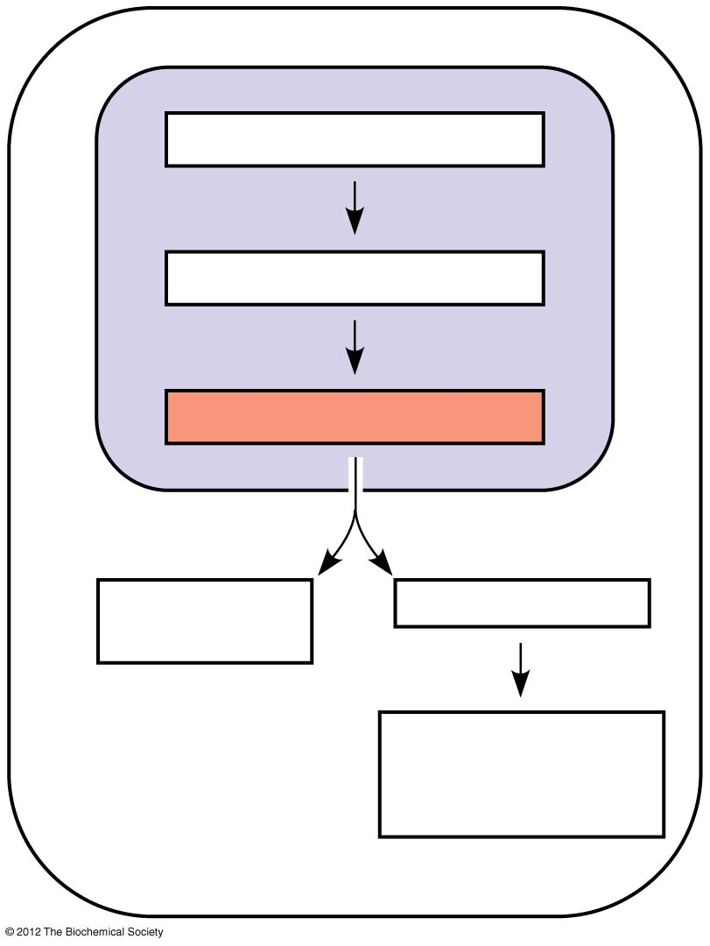
Chromatin modification
Transcription
RNA processing
mRNA degradation
Translation
Protein processing and degradation
Notes:
18
Transcription alone does not account for gene expression. Regulatory mechanisms can operate at various stages after transcription. Such mechanisms allow a cell to fine-tune gene expression rapidly in response to environmental changes.

Slide 19
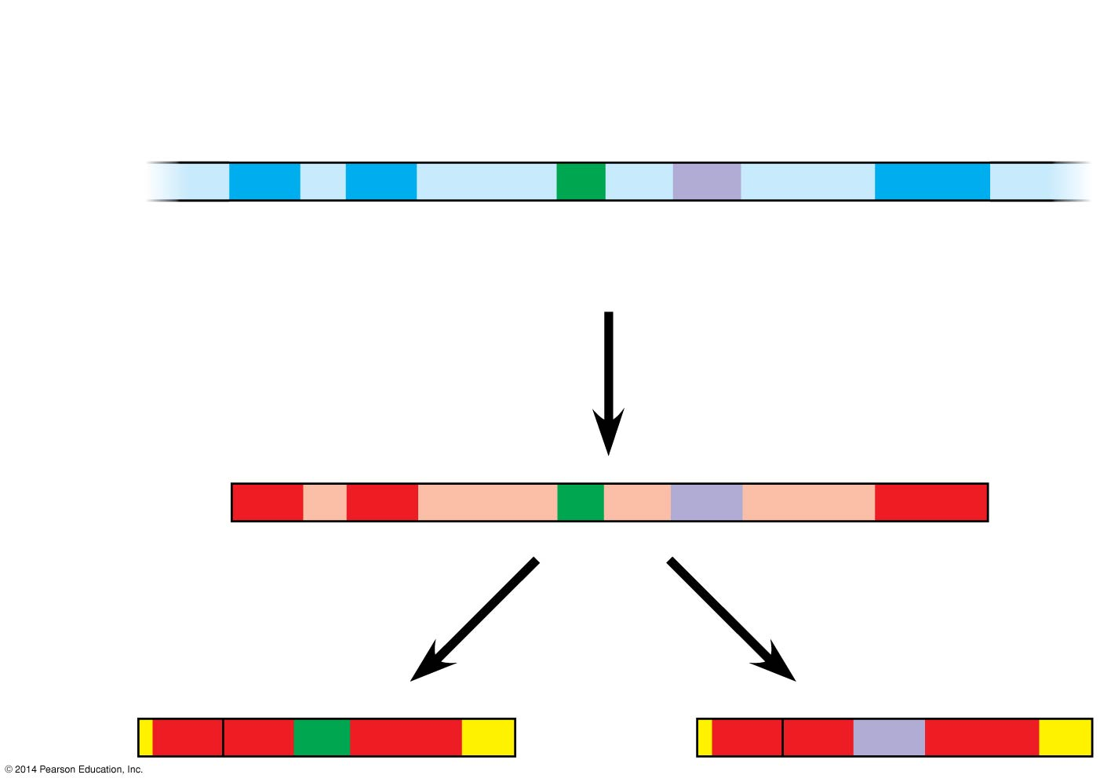
Alternative RNA splicing
Exons
DNA
1
2
3
4
5
Troponin T gene
Primary RNA transcript
1
2
3
4
5
RNA splicing
mRNA
1
2
3
5
or
1
2
4
5
Notes:
19
In alternative RNA splicing, different mRNA molecules are produced from the same primary transcript, depending on which RNA segments are treated as exons and which as introns.

