Slide 1
Punnett Squares
Used to predict the probability of outcomes from different genetic crosses.
back

Slide 3
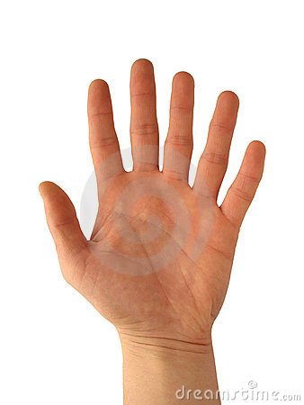
Having six fingers on one hand is a dominant genetic trait.
Gemma Arterton

Slide 4
What is the probability that a mom who is homozygous for six fingers and a dad with five fingers will have a kid with six fingers?
What is the genotype of the mom?
RR
What is the genotype of a the dad?
rr
So the cross would look like this: RR x rr

Slide 5
Mom is homozygous for six fingers and dad has five fingers.
RR x rr
r r
R
R

Slide 6
Mom is homozygous for six fingers and dad has five fingers.
RR x rr
 | r | r
R
R
R R
r
r
r
r
R R

Slide 7
 | r | r
R | Rr | Rr
R | Rr | Rr
What is the phenotype of the kids?
Six fingers
What is the phenotypic ratio? (dominant: recessive)
4:0 or 1:0
What is the genotype of the kids?
Rr
What is the genotypic ratio?
(Homozygous D, Heterozygous, Homozygous R)
0:4:0

Slide 8
Mom and dad are both heterozygous for six fingers

Slide 9
Mom and dad are both heterozygous for six fingers.
What are the possible phenotypes of the kids?
Some have six fingers, some have five.
What is the phenotypic ratio? (dominant: recessive)
3:1
What are the possible genotypes of the kids?
RR, Rr, rr
What is the genotypic ratio?
(Homozygous D, Heterozygous, Homozygous R)
1:2:1
 | R | r
R | RR | Rr
r | R r | rr

Slide 10
Mom is heterozygous for six fingers and dad has five fingers.

Slide 11
Mom is heterozygous for six fingers and dad has five fingers.
What are the possible phenotypes of the kids?
Some will have six fingers, and some will have five fingers.
What is the phenotypic ratio? (dominant: recessive)
1:1 or 2:2
What are the possible genotypes of the kids?
Rr and rr
What is the genotypic ratio?
(Homozygous D, Heterozygous, Homozygous R)
0:2:2 or 0:1:1
 | r | r
R | Rr | Rr
r | rr | rr

Slide 12
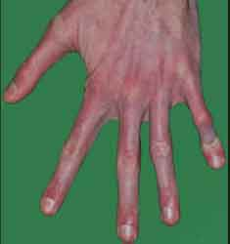
Marfan syndrome is a genetic disorder of the connective tissue. People with Marfan's tend to be unusually tall, with long limbs and long, thin fingers. It is inherited as a dominant trait.
Can two unaffected parents have a child with Marfan syndrome? Defend your answer using a Punnett square.

Slide 13
No
Marfan syndrome is a dominate disease. Since neither parent has the disease, the parents must both be homozygous recessive and therefore they can’t have a child with the disease.
 | m | m
m | mm | mm
m | mm | mm

Slide 14
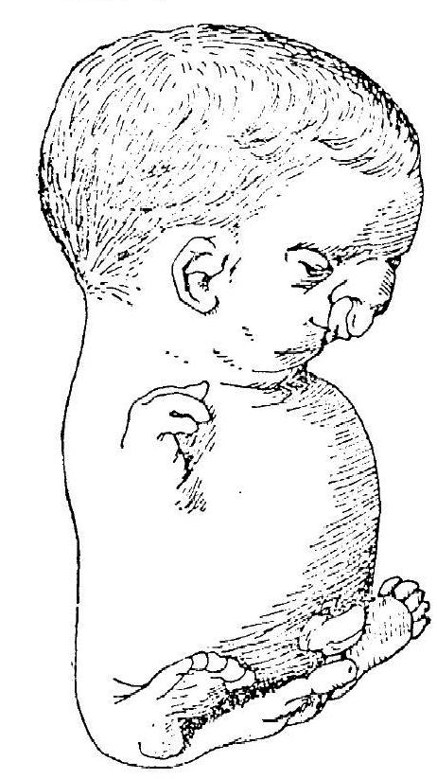
Roberts syndrome, is an extremely rare recessive genetic disorder that is characterized by mild to severe disruption of cell division, leading to malformation of the bones in the skull, face, arms, and legs.
Can two unaffected parents have a child with Robert’s syndrome? Defend your answer using a Punnett square.

Slide 15
Yes
The parents could both be heterozygous carriers of the disease.
 | R | r
R | RR | Rr
r | Rr | rr

Slide 16
Punnett Squares
Used to predict the probability of outcomes from different genetic crosses.
back

