Slide 1
There will be a test on pedigrees and DNA Replication on Thursday, Feb. 27

Slide 2
DNA replication (copying)
The structure of DNA helps explain how it is replicated
DNA is a double stranded helix made up of 4 different kinds of nitrogenous bases. See diagram
1. adenine (A)
2. thymine (T)
3. guanine (G)
4. cytosine (C)

Slide 3
When DNA replicates it follows the “base pairing rules”
- T can only pair with A and G can only pair with C. See diagram
Each single strand of DNA can be used as a template to make a copy of the opposite strand. See diagram

Slide 4
How would the following strand of DNA be replicated?
DNA
A
C
A
T
G

Slide 5
How would the following strand of DNA be replicated?
DNA
A-T
C-G
A-T
T-A
G-C

Slide 6
How would the following strand of DNA be replicated?
DNA
C
G
A
T
T

Slide 7
How would the following strand of DNA be replicated?
DNA
C-G
G-C
A-T
T-A
T-A

Slide 8
How would the following strand of DNA be replicated?
DNA
G
G
C
T
A

Slide 9
How would the following strand of DNA be replicated?
DNA
G-C
G-C
C-G
T-A
A-T

Slide 10
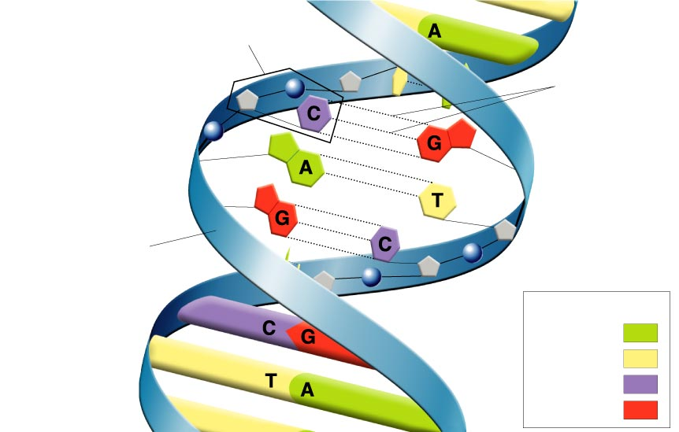
Figure 12–7 Structure of DNA
Section 12-1
Nucleotide
Hydrogen bonds
Sugar-phosphate backbone
Key
Adenine (A)
Thymine (T)
Cytosine (C)
Guanine (G)
return
Go to Section:

Slide 11
Section 12-2
Chromosome
E. coli bacterium
Bases on the chromosome
Back
Go to Section:

Slide 12
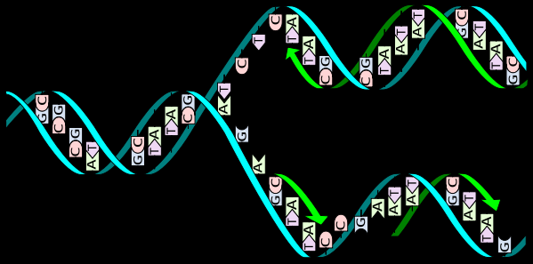
Section 12-2
Go to Section:
Back

