Slide 1
The next test will be on Thursday

Slide 2
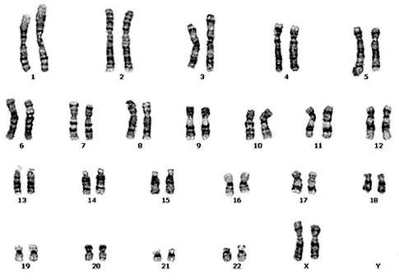
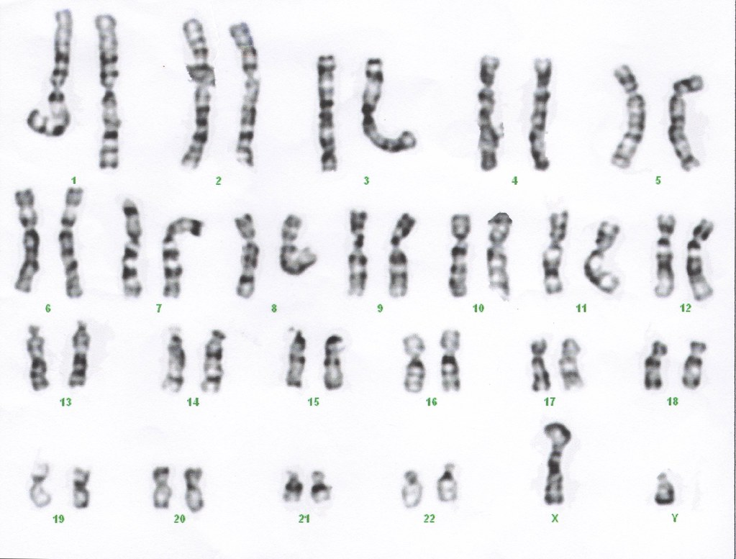
Determining biological Sex
Humans have 46 chromosomes in each cell. 45 of those chromosomes are the same for males and females.

Slide 3
Determining biological Sex
Female XX
Male XY

Slide 4
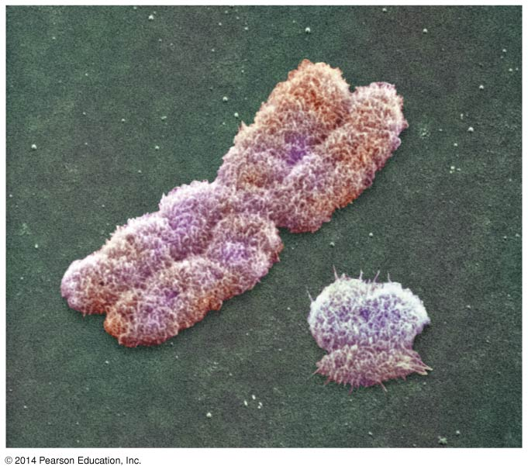
SRY gene on the Y chromosome is required for the developments of testes
X
Y
Notes:
4

Slide 5
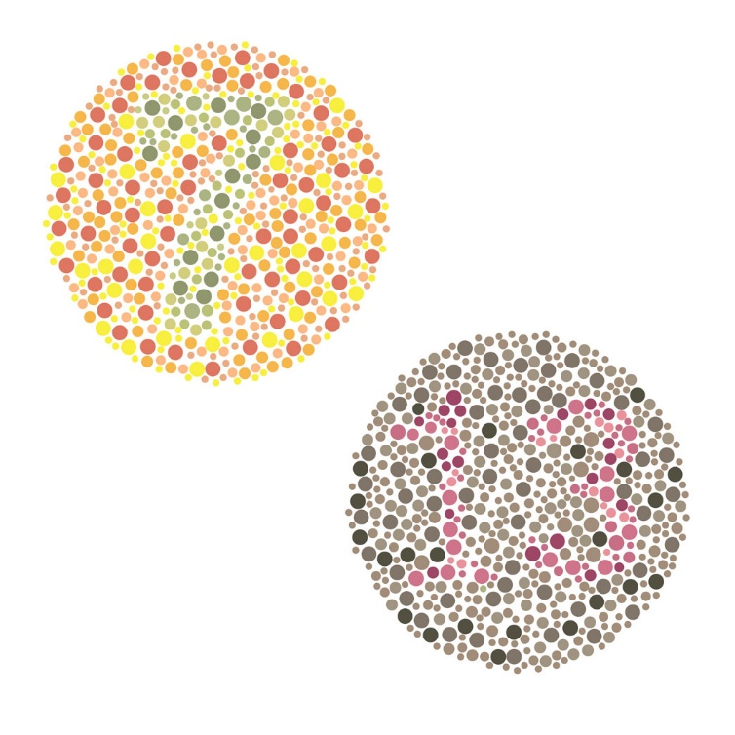
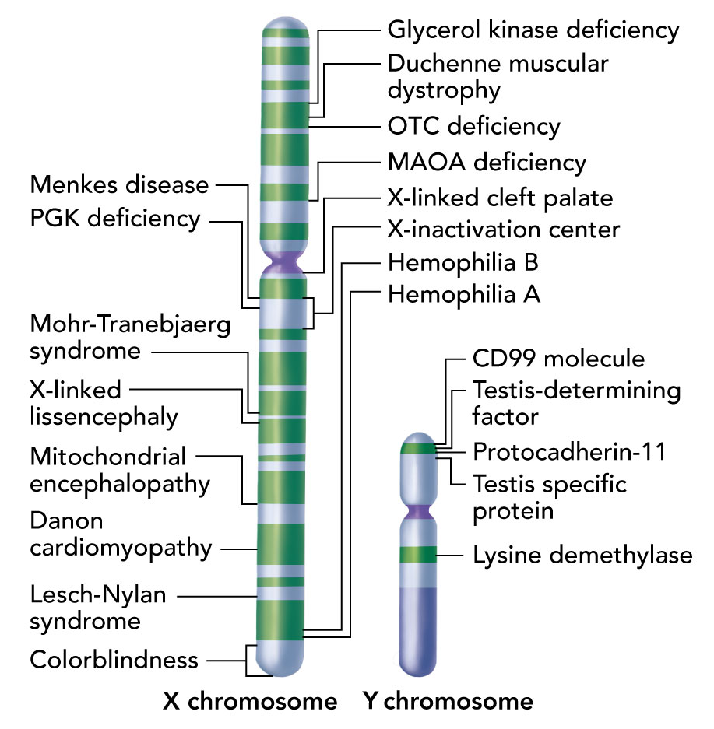
Sex-Linked Genes
Males have only 1 X, so all x-linked alleles are expressed
Colorblindness
Hemophilia

Slide 6
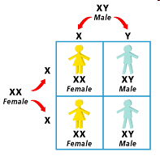
Where do females get their X chromosomes?
One from mom, one from dad.
Where do males get their X chromosome?
From mom
Where do males get their Y chromosome?
From dad
Who determines the sex of the baby, the mom or the dad?
The dad

Slide 7
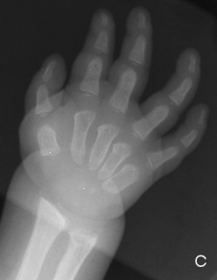
Hunter Syndrome is a recessive genetic disorder that is carried on the X chromosome. Answer the following questions about the family of a baby boy who was born with this disorder.
Does the mother have Hunter Syndrome?
You don’t know, but probably not.
Does the father have Hunter Syndrome?
You don’t know, but probably not. If he is, it’s a coincidence.
Did the boy get the disorder from his mom or his dad?
Mom
Notes:
unter syndrome, or mucopolysaccharidosis Type II, is a lysosomal storage disease caused by a deficient (or absent) enzyme, iduronate-2-sulfatase (I2S).^{[1][2]} The accumulated substrate in Hunter's syndrome is heparan sulfate and dermatan sulfate.^{[3]} The syndrome has X-linked recessive inheritance.^{[3]}

Slide 8
Colorblindness is is a recessive condition carried on the X-chromosome. A girl from a different family is colorblind.
Is her mother colorblind?
Don’t know, probably not
Is her father colorblind?
Yes
Did the girl get the condition from her mom or her dad?
Both

Slide 9
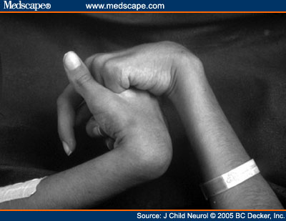
Rett Syndrome is a dominant genetic disease that is carried on the X chromosome. Answer the following questions about the family of a baby boy who was born with this disease
Does the mother have Rett Syndrome?
Yes
Does the father have Rett Syndrome?
Don’t know, probably not. If he does, it’s a coincidence.
Did the boy get the disease from his mom or his dad?
Mom
Notes:
Rett syndrome, originally termed as cerebroatrophic hyperammonemia,^{[1]} is a neurodevelopmental disorder of the grey matter of the brain^{[2]} that almost exclusively affects females but has also been found in male patients. The clinical features include small hands and feet and a deceleration of the rate of head growth (including microcephaly in some). Repetitive stereotyped hand movements, such as wringing and/or repeatedly putting hands into the mouth, are also noted.^{[3]} People with Rett syndrome are prone to gastrointestinal disorders and up to 80% have seizures.^{[4]} They typically have no verbal skills, and about 50% of individuals affected do not walk. Scoliosis, growth failure, and constipation are very common and can be problematic.

