Slide 1
0
Chapter 19
Overview of Homologous and Analogous Structures, Convergent Evolution, Biogeography and the Fossil Record

Slide 2
Need to Know
Homology
Analogy
Convergent evolution
Biogeography
The fossil record

Slide 3
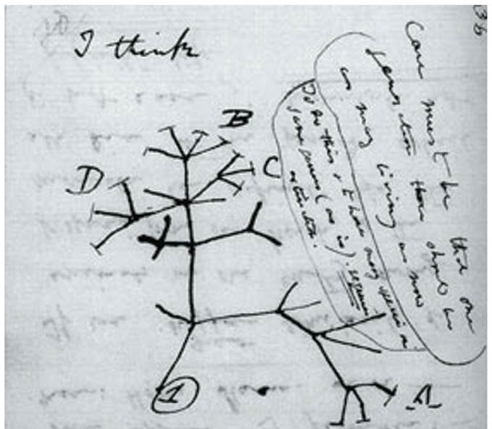
Evolution is a process of descent with modification.
Homology is similarity resulting from common ancestry.
Banana video clip
Notes:
3
Examples of homologies at the molecular level are genes shared among organisms inherited from a common ancestor. Homologous genes can be found in organisms as dissimilar as humans and bacteria.

Slide 4
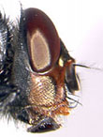
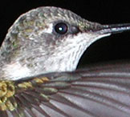
Example of homology
Pac-6 gene
Notes:
All of these species carry a version of the gene Pac-6 that is used in eye formation. The human version of the gene can be inserted into a fly and still trigger the building of an insect eye.

Slide 5
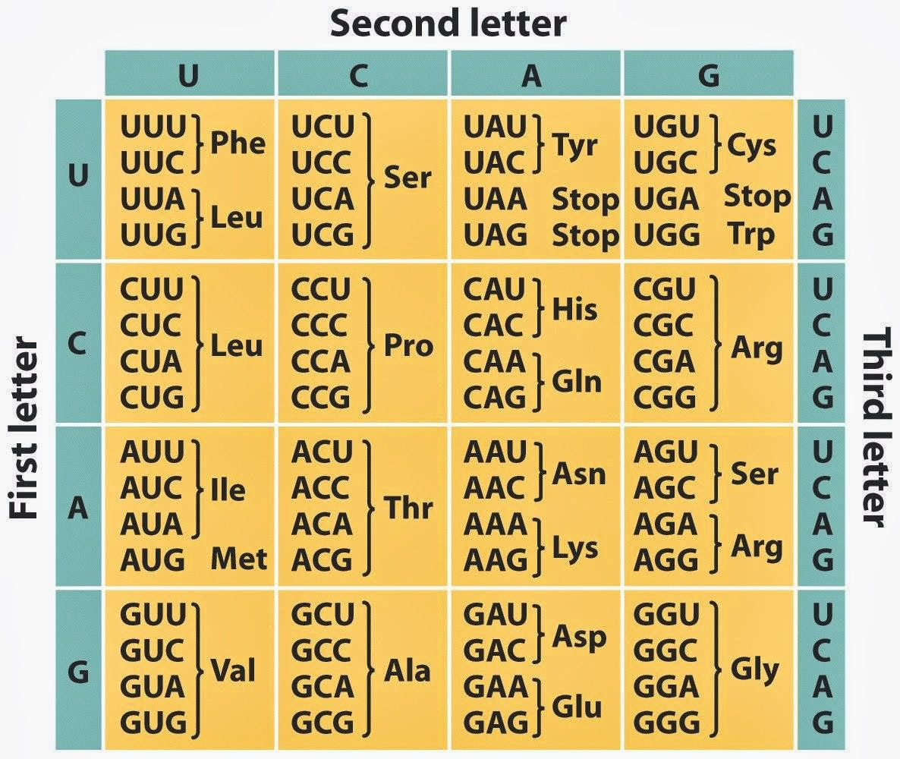
Example of homology

Slide 6
Homologous structures are anatomical resemblances that represent variations on a structural theme present in a common ancestor.
Notes:
6

Slide 7
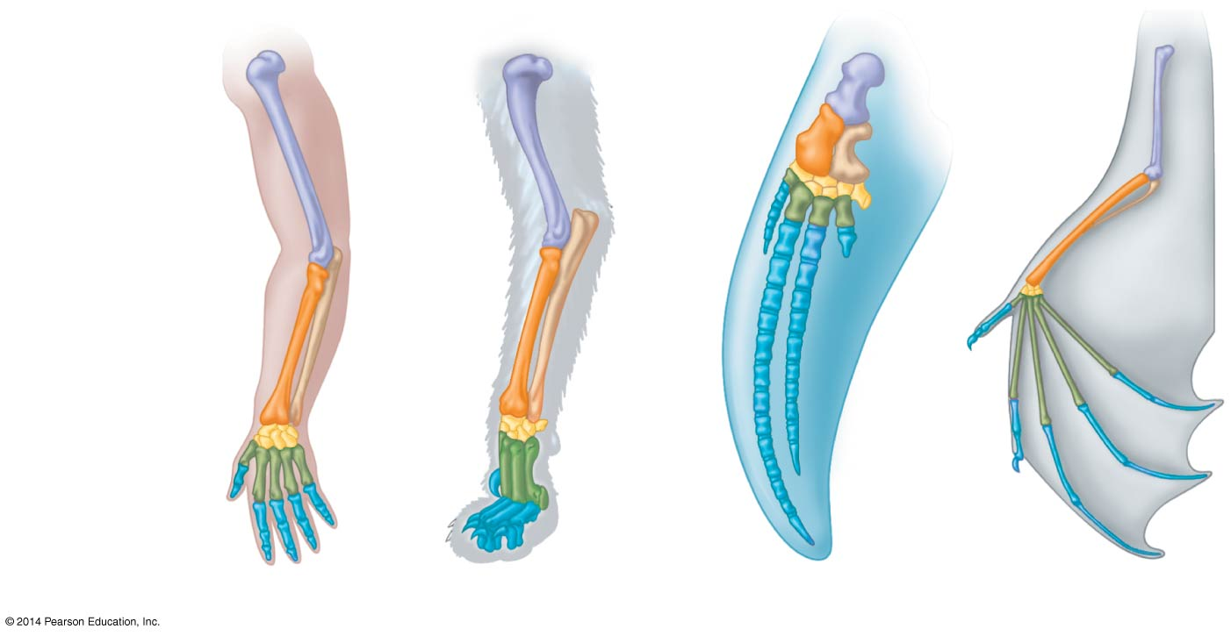
Example of homologous structures
Related species can have characteristics with underlying similarity that function differently.
Humerus
Radius
Ulna
Carpals
Metacarpals
Phalanges
Human
Cat
Whale
Bat
Notes:
7

Slide 8
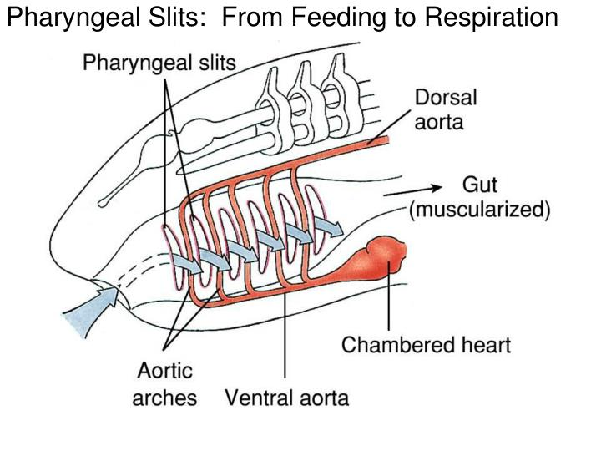
Example of homologous structures
Notes:
8
Comparative embryology reveals anatomical homologies not visible in adult organisms.
Pharyngeal arches ultimately develop into structures with vary different functions, such as gills in fishes and parts of the ears and throat in humans and other mammals.

Slide 9
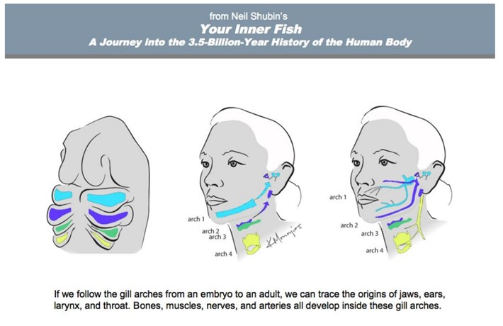

Slide 10
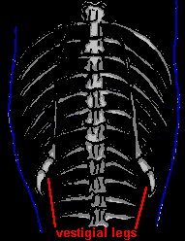
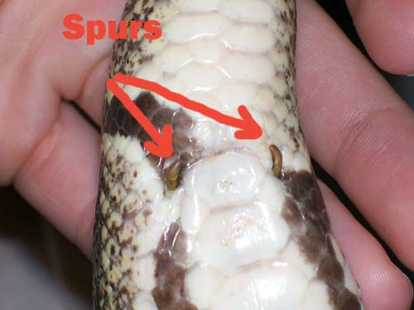
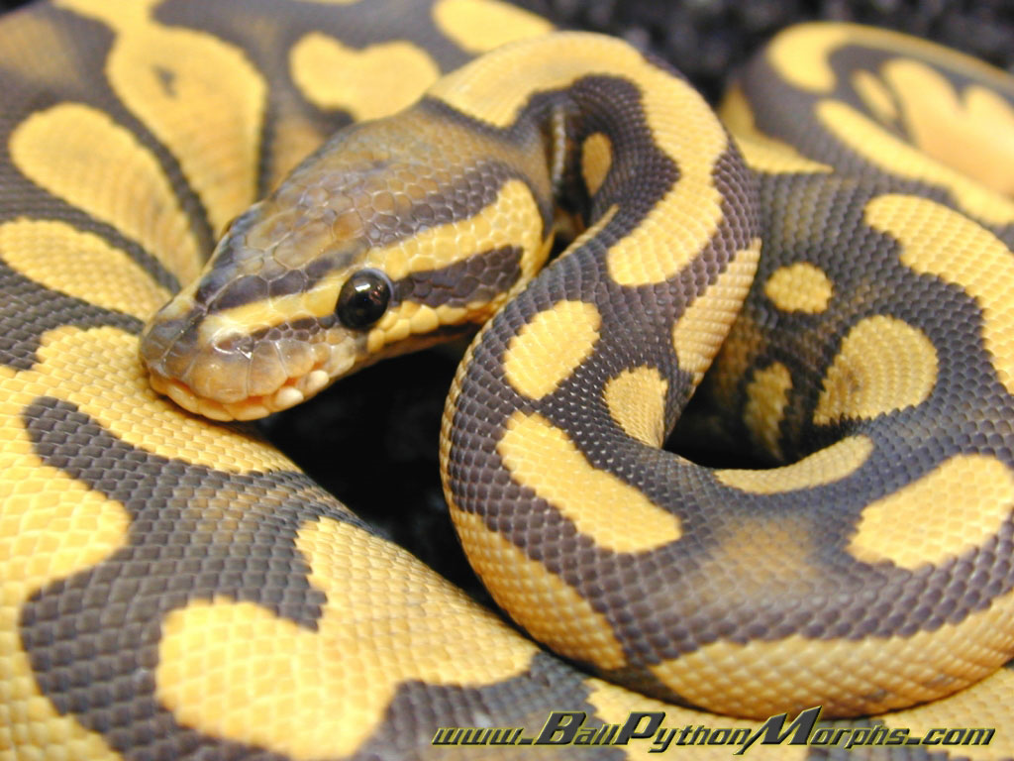
Vestigial structures are remnants of features that served important functions in the organism’s ancestors.
Notes:
10

Slide 11
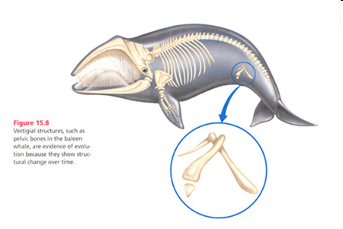
Vestigial Structure example

Slide 12
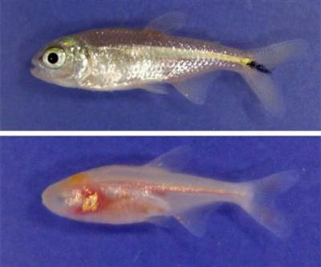
Vestigial Structure example

Slide 13
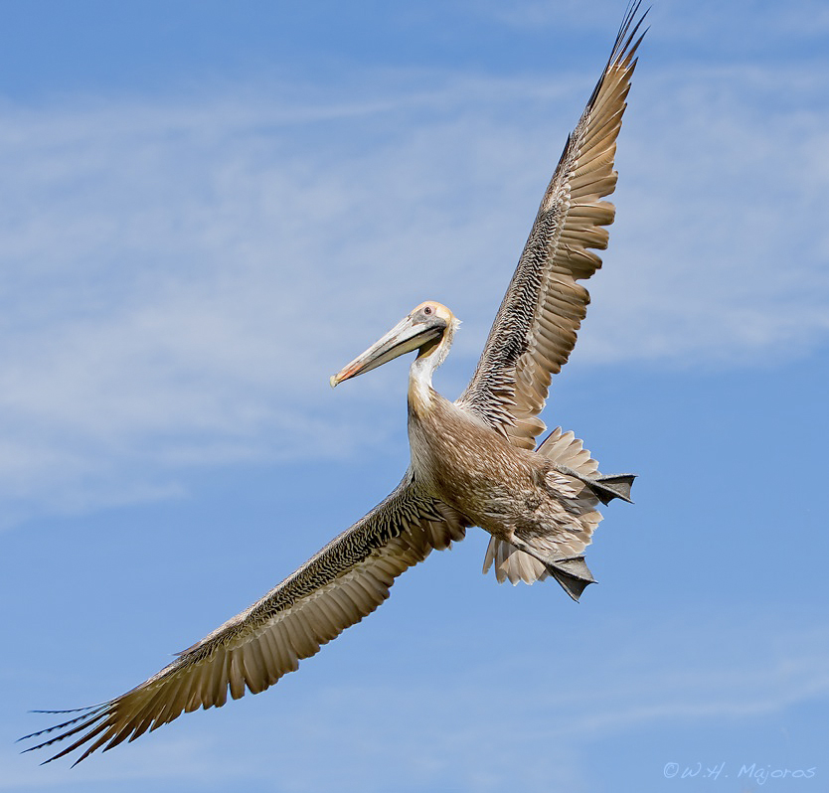
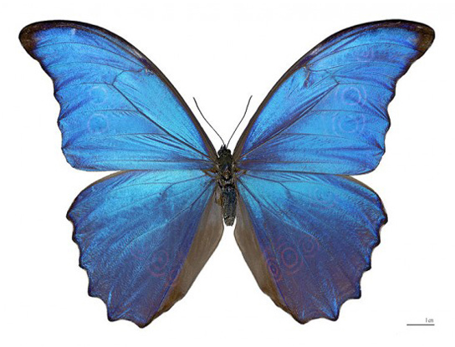
Convergent Evolution
The wings are analogous.
Notes:
13
Convergent evolution is the evolution of similar, or analogous, features in distantly related groups.
Analogous traits arise when groups independently adapt to similar environments in similar ways.
Convergent evolution does not provide information about ancestry.

Slide 14
Convergent evolution is the evolution of similar, or analogous, features in distantly related groups.
Analogous traits arise when groups independently adapt to similar environments in similar ways.
Convergent evolution does not provide information about ancestry.

Slide 15
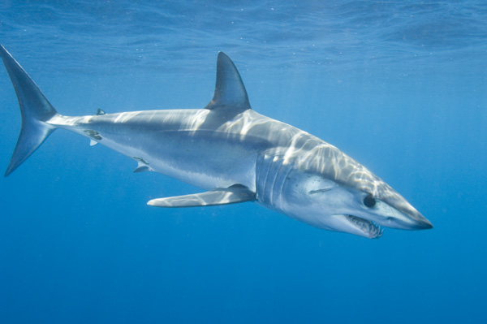
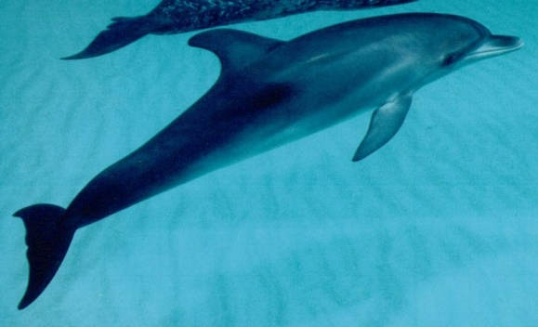
Example of Convergent Evolution
Shark (Chondrichthyes) Dolphin (mammal)
The fins and streamlined shape are analogous.

Slide 16
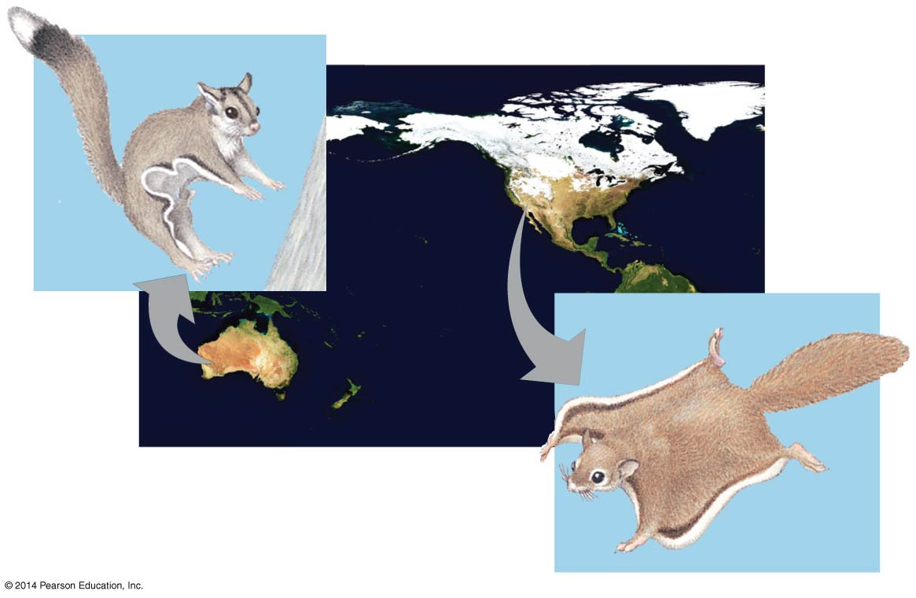
Example of Convergent Evolution
NORTH AMERICA
Sugar
glider
AUSTRALIA
Flying
squirrel
The side flaps of skin are analogous.
Notes:
16

Slide 17
The Fossil Record
The fossil record provides evidence of
The extinction of species
The origin of new groups
Changes within groups over time
Notes:
17

Slide 18
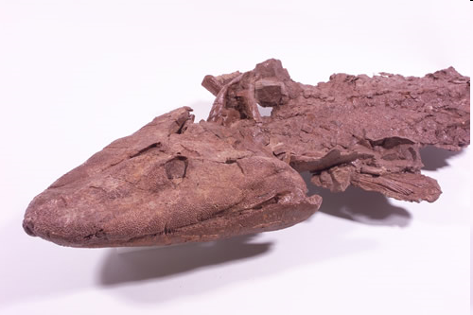
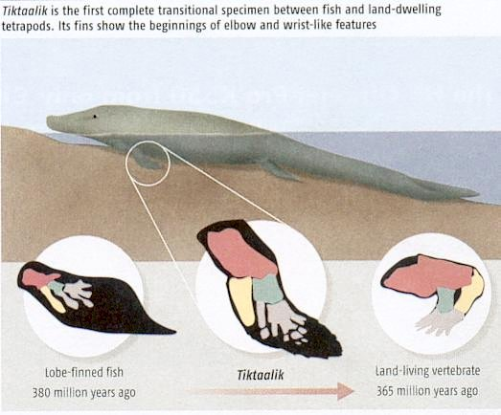
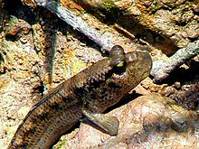
Tiktaalik
Scientists believe Tiktaalik's ventured onto land just as present day mudskippers do, propping up on their fins.
Video – Fish Fossil
Video – mud skipper

Slide 19
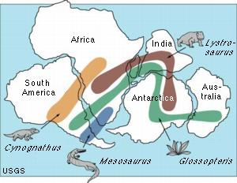
Biogeography
Biogeography, the geographic distribution of species, provides evidence of evolution.
(You don’t need to remember the details of this figure.)
Notes:
19
Earth’s continents were formerly united in a single large continent called Pangaea but have since separated by continental drift.
An understanding of continent movement and modern distribution of species allows us to predict when and where different groups evolved.

Slide 20
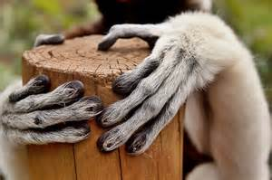
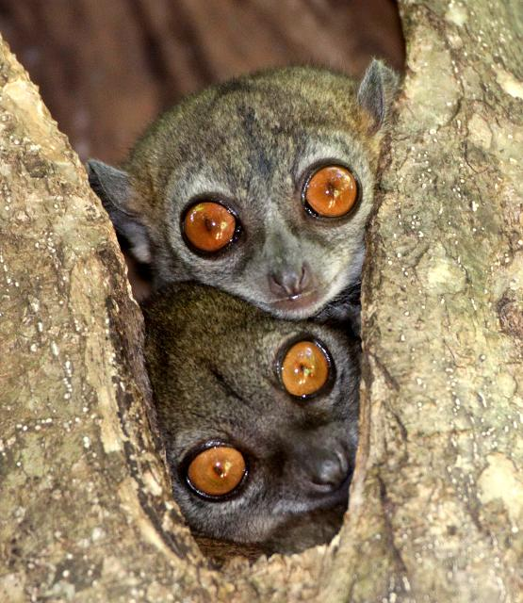
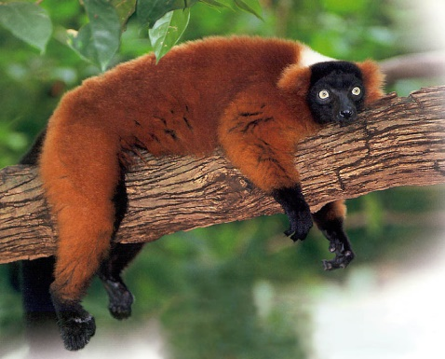
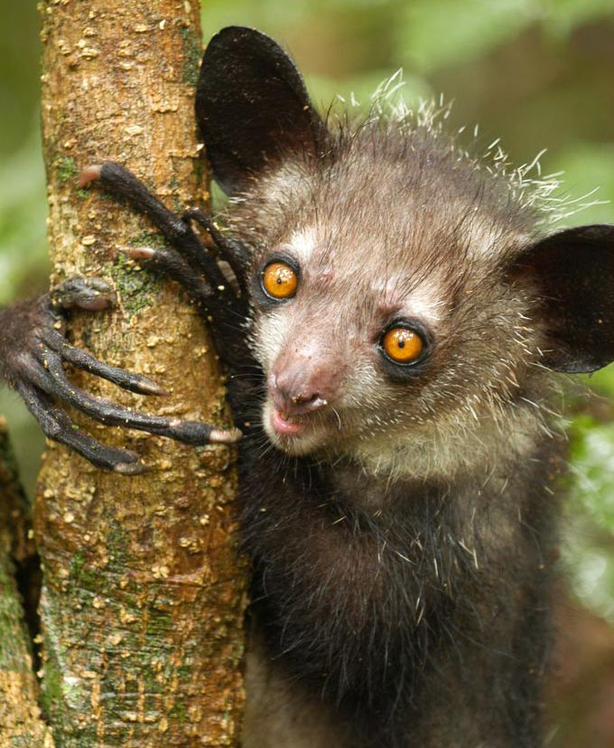
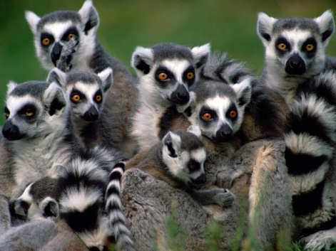
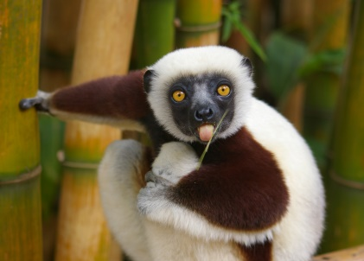
Endemic species are species that are not found anywhere else in the world.
Darwin explained that species on islands gave rise to new species as they adapted to new environments.
Notes:
Islands have many endemic species that are often closely related to species on the nearest mainland or island. Darwin explained that species on islands gave rise to new species as they adapted to new environments.
Lemurs are endemic to Madagascar. There are five families of lemurs with 99 species and subspecies. The smallest lemur would easily fit in your hand, while the largest can top 25 pounds.

