Slide 1
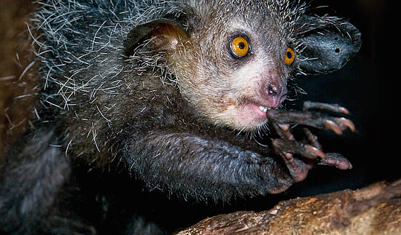
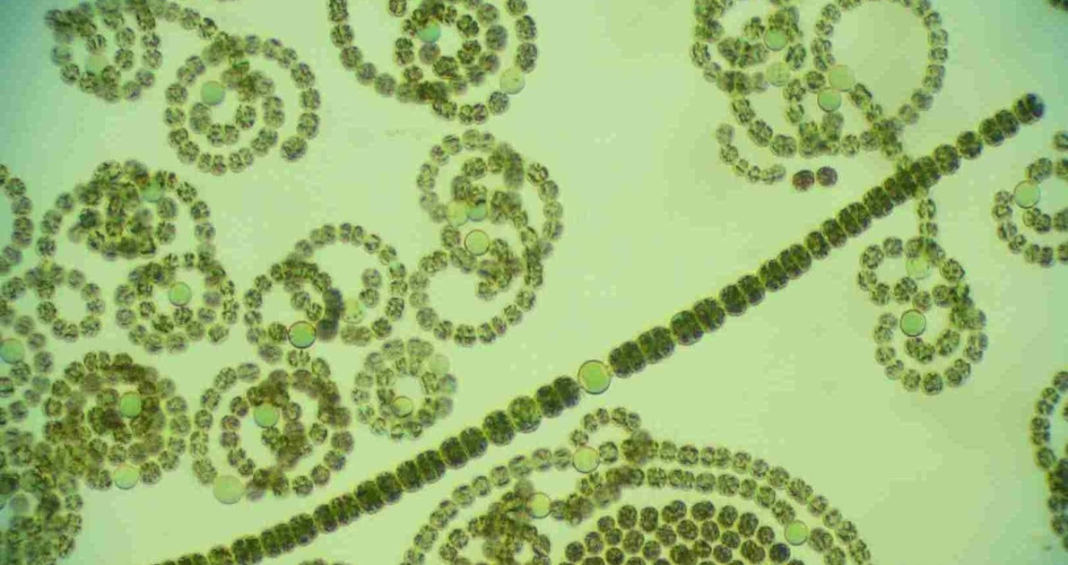
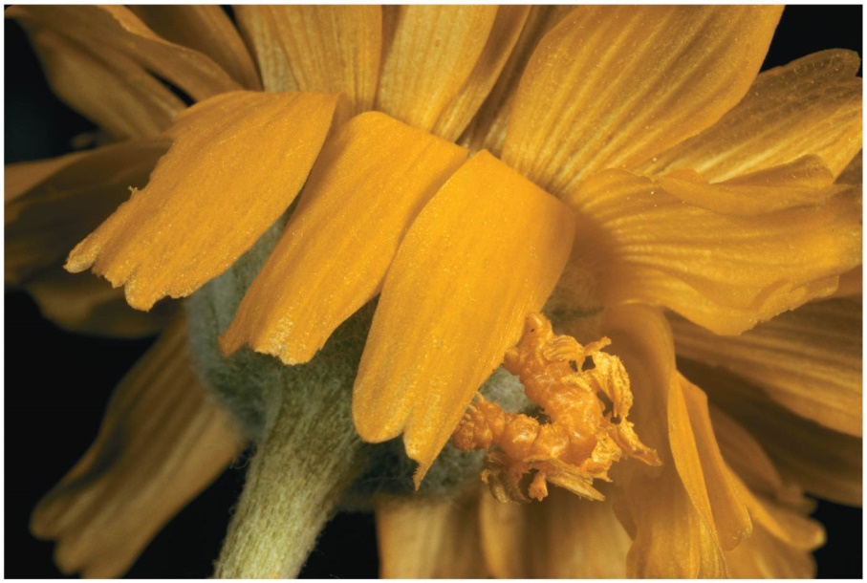
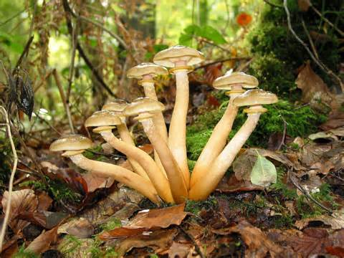
“There is grandeur in this view of life…. [in which] endless forms most beautiful and most wonderful have been, and are being, evolved.”
Charles Darwin - The Origin of Species

Slide 2
The Chapter 19 and 20 Test will be on Thursday, February 27
The Chapter 19 and 20 Homework is due on Wednesday, February 26

Slide 3
0
Chapter 19
Introduction to Evolution

Slide 4
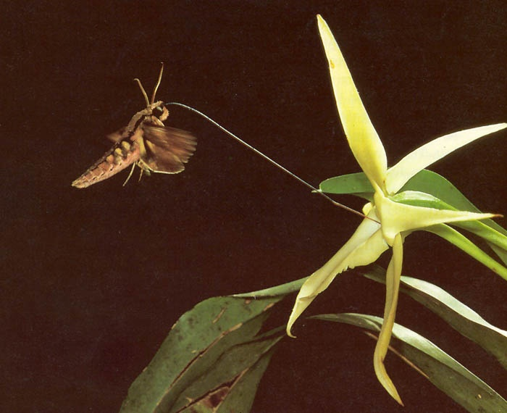
Darwin explained three broad observations about life
The fit between organisms and their environment
The shared characteristics (unity) of life
The diversity of life
Notes:
4

Slide 5
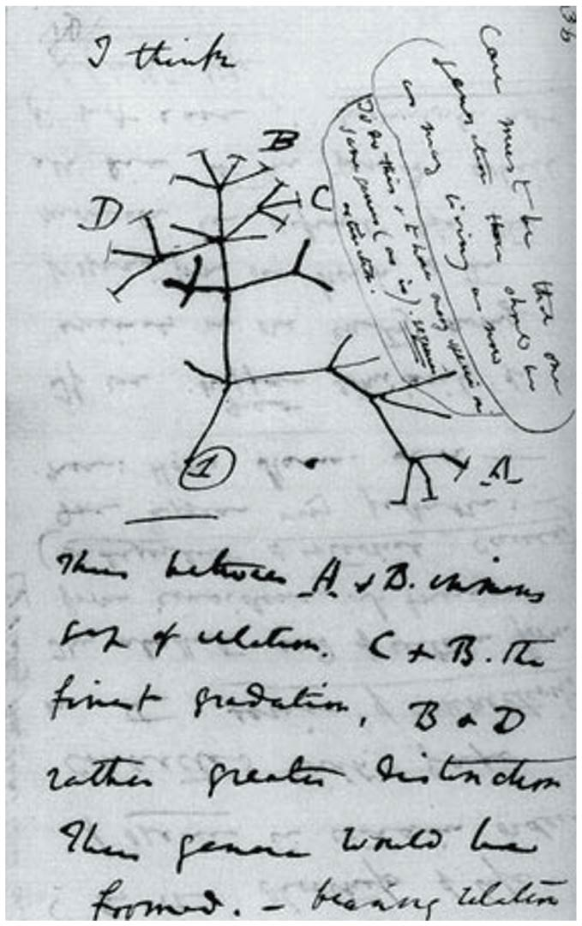
Descent with Modification
All organisms are related through descent from an ancestor that lived in the remote past.
Notes:
5
The phrase descent with modification summarized Darwin’s perception of the unity of life. The phrase refers to the view that all organisms are related through descent from an ancestor that lived in the remote past. In the Darwinian view, the history of life is like a tree with branches representing life’s diversity. Fossils of extinct species help to “fill in” the morphological gaps between present-day groups

Slide 6
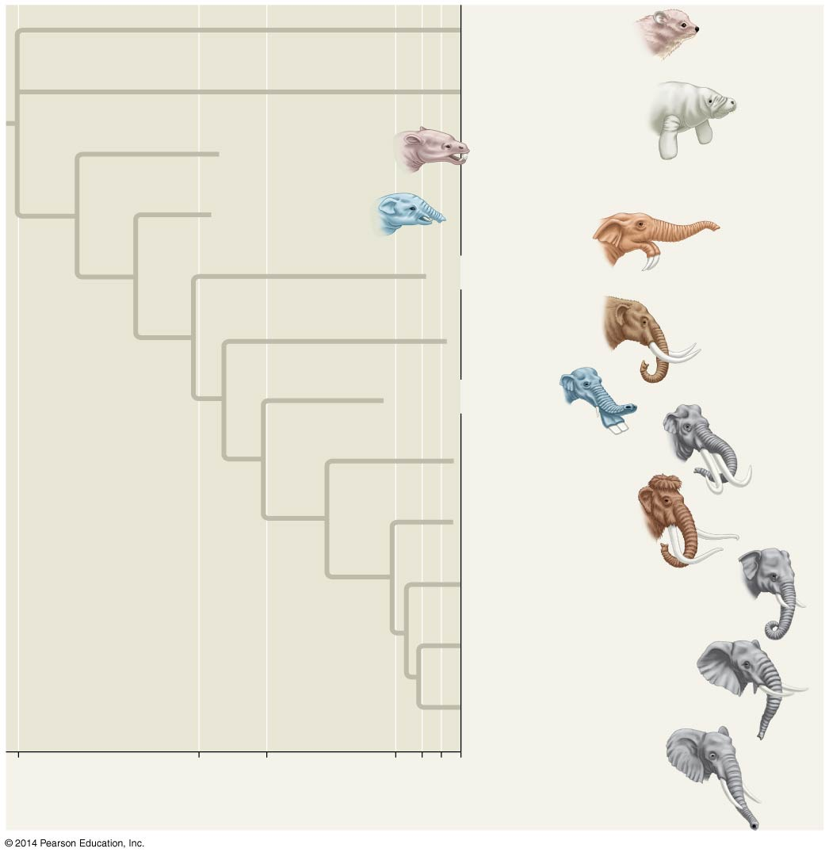
Figure 19.9
Hyracoidea
(Hyraxes)
Sirenia
(Manatees
and relatives)
†
Moeritherium
†
Barytherium
†
Deinotherium
†
Mammut
†
Platybelodon
†
Stegodon
†
Mammuthus
Elephas maximus
(Asia)
Loxodonta africana
(Africa)
Loxodonta cyclotis
(Africa)
60
34
24
5.5
2
10⁴
0
Millions of years ago
Years ago
Notes:
6
Figure 19.9 Descent with modification

Slide 7
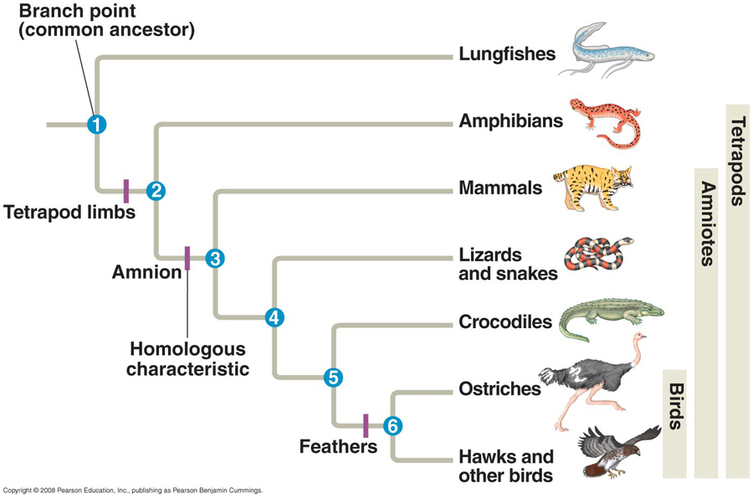

Slide 8
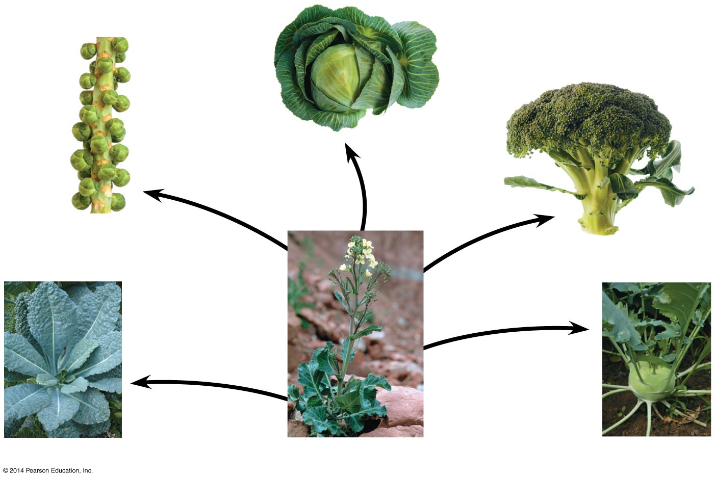
Artificial Selection
Cabbage
Selection for
apical (tip) bud
Brussels
sprouts
Selection for
axillary (side)
buds
Selection
for flowers
and stems
Broccoli
Selection
for stems
Selection
for leaves
Kale
Wild mustard
Kohlrabi
Darwin argued that a similar process occurs in nature.
Notes:
8
Darwin noted that humans have modified other species by selecting and breeding individuals with desired traits, a process called artificial selection. Darwin argued that a similar process occurs in nature.

Slide 9
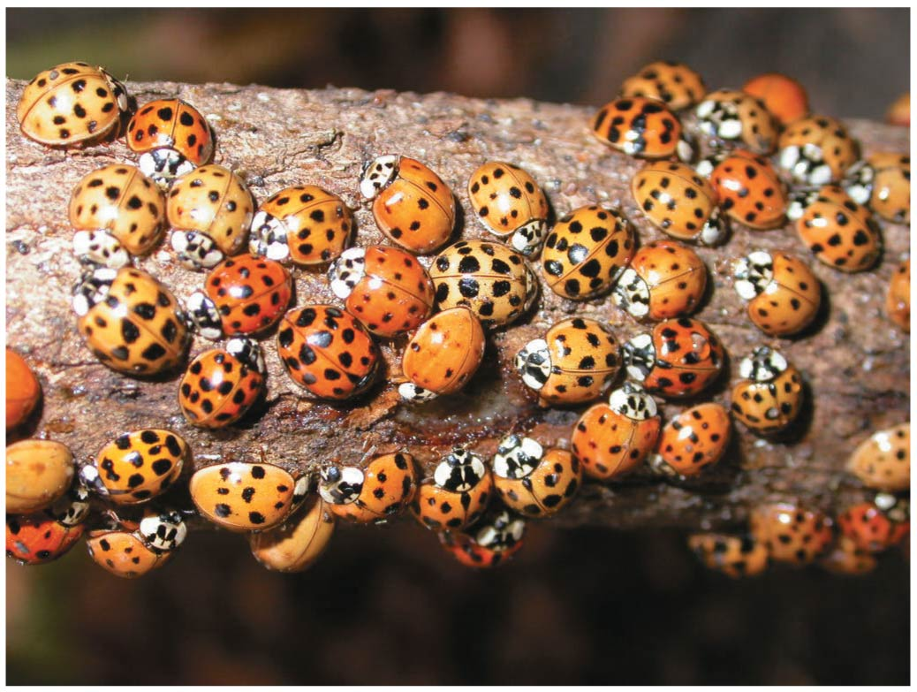
Darwin drew two inferences from two observations.
Observation #1: Members of a population often vary in their inherited traits
Notes:
9

Slide 10
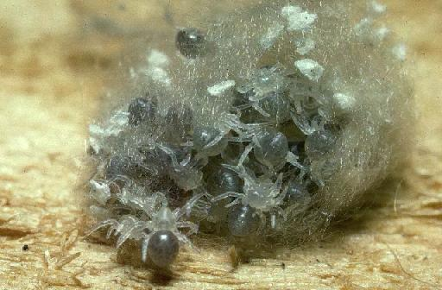
Observation #2: All species can produce more offspring than the environment can support, and many of these offspring fail to survive and reproduce.
https://www.youtube.com/watch?v=B3OjfK0t1XM
Notes:
10
Darwin was influenced by Thomas Malthus, who noted the potential for human population to increase faster than food supplies and other resources.

Slide 11
Inference #1: Individuals whose inherited traits give them a higher probability of surviving and reproducing in a given environment tend to leave more offspring than other individuals.
Inference #2: This unequal ability of individuals to survive and reproduce will lead to the accumulation of favorable traits in the population over generations.
Bird video
Notes:
11

Slide 12
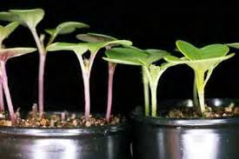
Wisconsin Fast Plants

Slide 13
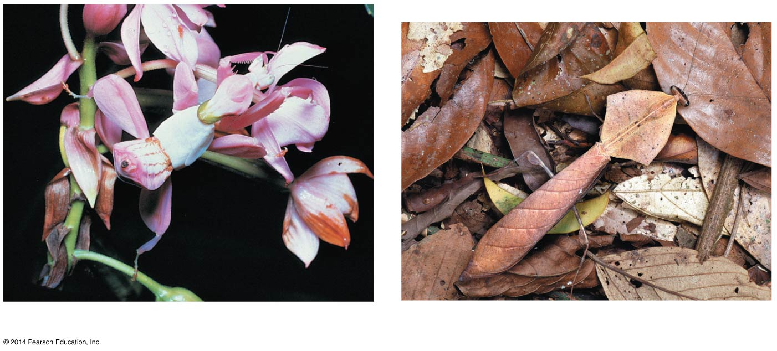
Note that individuals do not evolve; populations evolve over time.
Natural selection can only increase or decrease heritable traits that vary in a population.
Adaptations vary with different environments.
(a) A flower mantid in Malaysia
(b) A leaf mantid in Borneo
Notes:
13
If some heritable traits are advantageous, these will accumulate in a population over time, and this will increase the frequency of individuals with these traits. This process explains the match between organisms and their environment.

Slide 14
Natural Selection: A Summary
Individuals with certain heritable traits survive and reproduce at a higher rate than other individuals.
Over time, natural selection increases the match between organisms and their environment .
If an environment changes over time, natural selection may result in adaptation to these new conditions and may give rise to new species.
Notes:
14

Slide 15
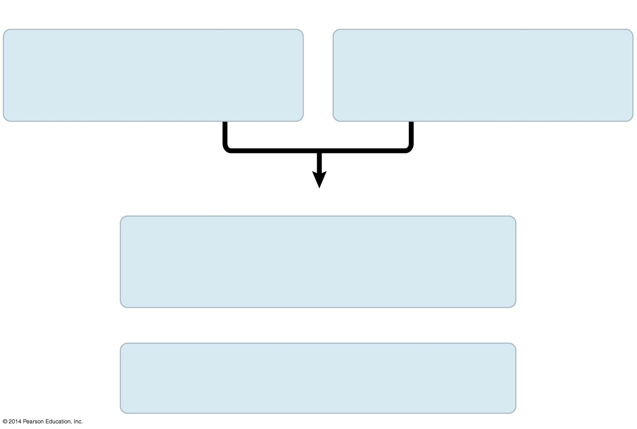
Figure 19.UN03
Evolution by Natural Selection
Individuals in a population
vary in their heritable
characteristics.
Organisms produce more
offspring than the
environment can support.
Inferences
Individuals that are well suited
to their environment tend to leave more
offspring than other individuals.
and
Over time, favorable traits
accumulate in the population.
Notes:
15
Figure 19.UN03 Summary of key concepts: natural selection.

