Slide 1
0
Chapter 19
Historical roots of Darwin’s Ideas

Slide 2
A new era of biology began in 1859 when Charles Darwin published The Origin of Species
The Origin of Species focused biologists’ attention on the great diversity of organisms
Notes:
2

Slide 3
Darwin noted that current species are descendants of ancestral species
Evolution can be defined by Darwin’s phrase descent with modification
Evolution can be viewed as both a pattern and a process
Notes:
3

Slide 4
Concept 19.1: The Darwinian revolution challenged traditional views of a young Earth inhabited by unchanging species
Darwin’s revolutionary ideas had deep historical roots
Notes:
4

Slide 5
Scala Naturae and Classification of Species
The Greek philosopher Aristotle viewed species as fixed and arranged them on a scala naturae
The Old Testament holds that species were individually designed by God and therefore perfect
Notes:
5

Slide 6
Carolus Linnaeus interpreted organismal adaptations as evidence that the Creator had designed each species for a particular purpose
Linnaeus was the founder of taxonomy, the branch of biology concerned with classifying organisms
He developed the binomial format for naming species (for example, Homo sapiens)
Notes:
6

Slide 7
Ideas About Change over Time
The study of fossils helped to lay the groundwork for Darwin’s ideas
Fossils are remains or traces of organisms from the past, usually found in sedimentary rock, which appears in layers or strata
Notes:
7

Slide 8
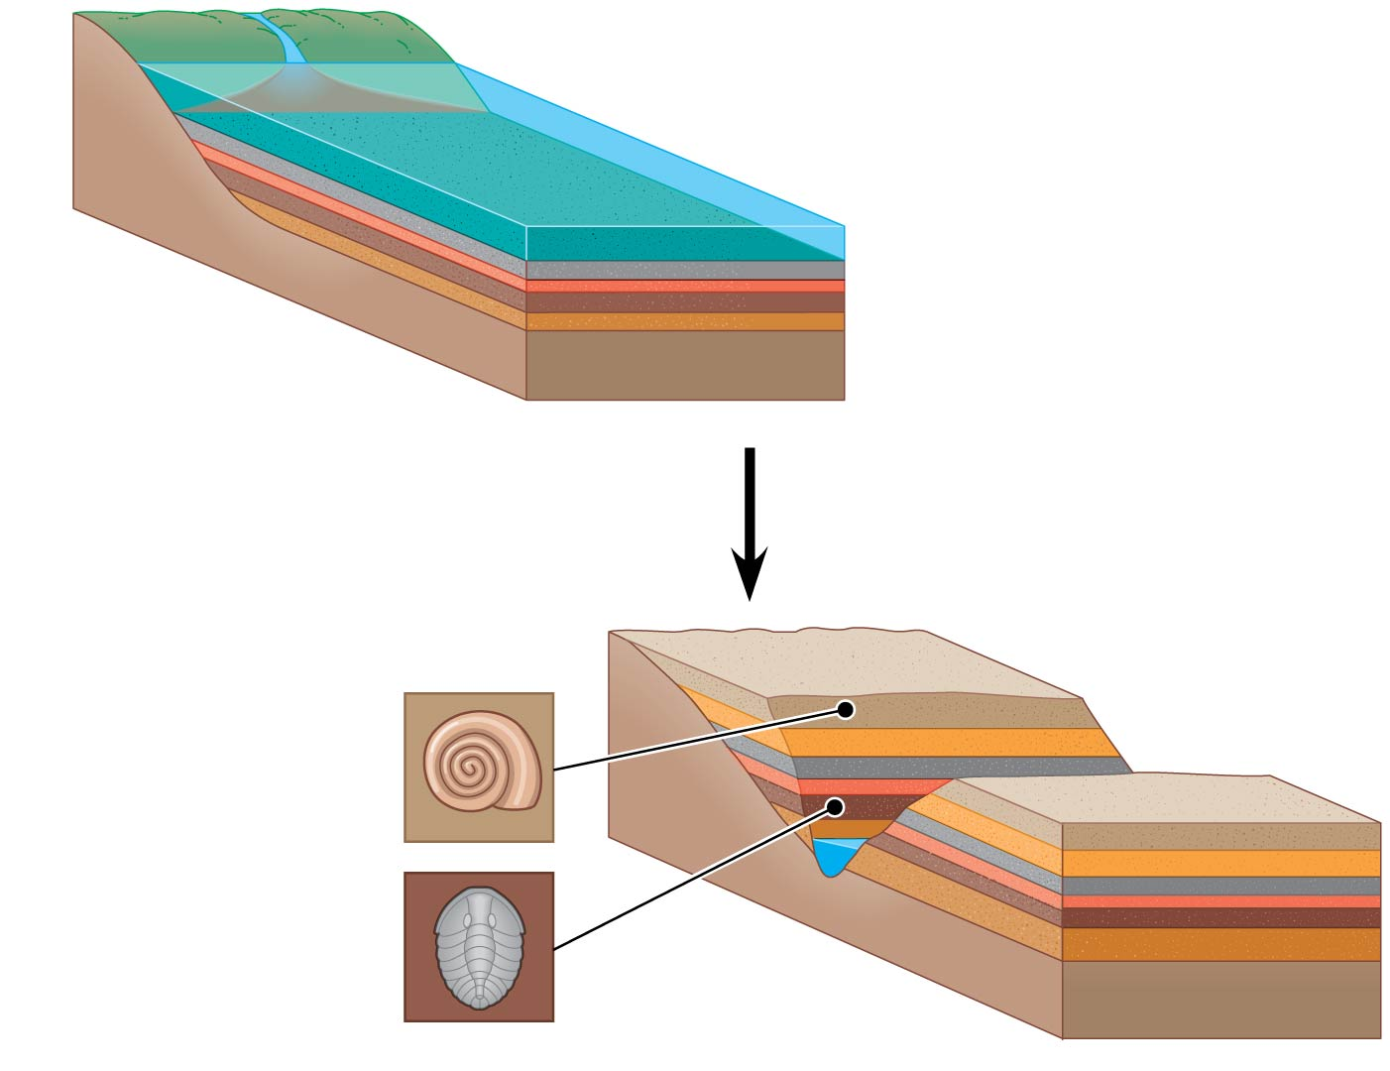
Figure 19.3
Younger stratum
with more recent
fossils
Older stratum
with older fossils
Notes:
8
Figure 19.3 Formation of sedimentary strata with fossils

Slide 9
Paleontology, the study of fossils, was largely developed by French scientist Georges Cuvier
Cuvier speculated that each boundary between strata represents a catastrophe that destroyed many species
Notes:
9

Slide 10
Geologists James Hutton and Charles Lyell perceived that changes in Earth’s surface can result from slow, continuous actions still operating today
Lyell further proposed that the mechanisms of change are constant over time
This view strongly influenced Darwin’s thinking
Notes:
10

Slide 11
Lamarck’s Hypothesis of Evolution
Lamarck hypothesized that species evolve through use and disuse of body parts and the inheritance of acquired characteristics
The mechanisms he proposed are unsupported by evidence
Notes:
11

Slide 12
Concept 19.2: Descent with modification by natural selection explains the adaptations of organisms and the unity and diversity of life
Some doubt about the permanence of species preceded Darwin’s ideas
Notes:
12

Slide 13
Darwin’s Research
As a boy and into adulthood, Charles Darwin had a consuming interest in nature
Darwin first studied medicine (unsuccessfully) and then theology at Cambridge University
After graduating, he took an unpaid position as naturalist and companion to Captain Robert FitzRoy for a five-year around-the-world voyage on the Beagle
Notes:
13

Slide 14
The Voyage of the Beagle
During his travels on the Beagle, Darwin collected specimens of South American plants and animals
He observed that fossils resembled living species from the same region, and living species resembled other species from nearby regions
He experienced an earthquake in Chile and observed the uplift of rocks
Notes:
14

Slide 15
Darwin was influenced by Lyell’s Principles of Geology and thought that Earth was more than 6,000 years old
His interest in geographic distribution of species was kindled by a stop at the Galápagos Islands west of South America
He hypothesized that species from South America had colonized the Galápagos and speciated on the islands
Notes:
15

Slide 16
Darwin’s Focus on Adaptation
In reassessing his observations, Darwin perceived adaptation to the environment and the origin of new species as closely related processes
From studies made years after Darwin’s voyage, biologists have concluded that this is what happened to the Galápagos finches
Notes:
16

Slide 17
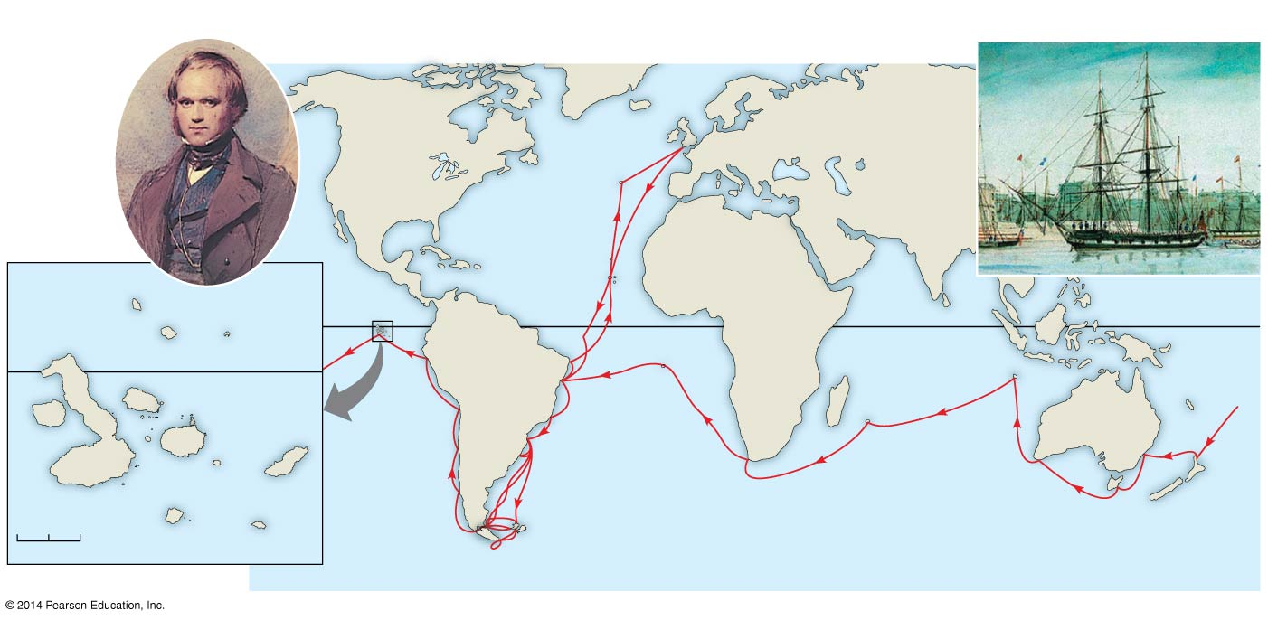
Figure 19.5
Darwin in
1840, after
his return
from the
voyage
HMS Beagle at sea
Great
Britain
EUROPE
NORTH
AMERICA
ATLANTIC
OCEAN
The
Galápagos
Islands
PACIFIC
OCEAN
AFRICA
Pinta
Marchena
Genovesa
SOUTH
AMERICA
Equator
Malay Archipelago
Equator
PACIFIC
OCEAN
Santiago
Daphne
Islands
Chile
Brazil
AUSTRALIA
Fernandina
Pinzón
Andes Mtns.
Isabela
PACIFIC
OCEAN
Santa
Cruz
Santa
Fe
San
Cristobal
Argentina
Cape of
Good Hope
Tasmania
0
20
40
Florenza
Española
Cape Horn
New
Zealand
Kilometers
Notes:
17
Figure 19.5 The voyage of HMS Beagle

Slide 18
In 1844, Darwin wrote an essay on natural selection as the mechanism of descent with modification but did not introduce his theory publicly
Natural selection is a process in which individuals with favorable inherited traits are more likely to survive and reproduce
In June 1858, Darwin received a manuscript from Alfred Russell Wallace, who had developed a theory of natural selection similar to Darwin’s
Darwin quickly finished The Origin of Species and published it the next year
Notes:
18

