Slide 2
0
Chapter 19
Direct Observations of Evolution by Natural Selection

Slide 3
You Must Know
Examples of direct observation of evolution by natural selection.

Slide 4
Concept 19.3: Evolution is supported by an overwhelming amount of scientific evidence
There are four types of data that document the pattern of evolution.
Direct observations
natural selection in response to introduced plant species
evolution of drug-resistant bacteria
Homology
The fossil record
Biogeography
Notes:
4

Slide 5
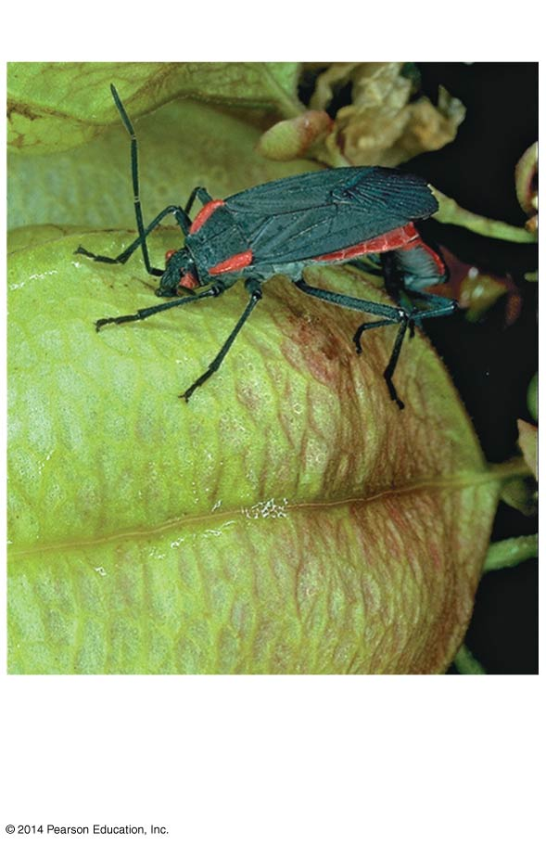
The length of the soapberry bug beaks fit their environment.
Soapberry bug
Soapberry bug
goldenrain tree
balloon vine
Introduced species
Native species
Southern Florida
soapberry bugs have longer beaks
Central Florida soapberry bugs have shorter beaks
Notes:
5
Soapberry bugs use their “beak” to feed on seeds within fruits. Soapberry bugs feed most effectively when their beak length closely matches the depth at which the seeds are found within the fruit. Scott Carroll and his colleagues measured beak lengths in soapberry bug populations feeding on the native balloon vine. They also measured beak lengths in populations feeding on the introduced goldenrain tree. (The goldenrain tree was recently introduced from Asia) The researchers then compared the measurements with those of museum specimens collected in the two areas before the goldenrain tree was introduced. In southern Florida soapberry bugs feed on balloon vine with larger fruit; they have longer beaks. In central Florida they feed on goldenrain tree with smaller fruit; they have shorter beaks. Correlation between fruit size and beak size has also been observed in Louisiana, Oklahoma, and Australia.

Slide 6
Figure 19.14b
Results
Beak Length
10
On native species,
balloon vine
(southern Florida)
8
6
4
2
0
Number of individuals
Museum-specimen average
10
On introduced
species,
goldenrain tree
(central Florida)
8
6
4
2
0
6
7
8
9
10
11
Beak length (mm)
Notes:
6
Results: Beak lengths were shorter in populations feeding on the introduced species than in populations feeding on the native species, in which the seeds are buried more deeply. The average beak length in museum specimens from each population (indicated by red arrows) was similar to beak lengths in populations feeding on native species.
Conclusion: Museum specimens and contemporary data suggest that a change in the size of the soapberry bug’s food source can result in evolution by natural selection for matching beak size.
In all cases, beak size has evolved in populations that feed on introduced plants with fruits that are smaller or larger than the native fruits. These cases are examples of evolution by natural selection. In Florida this evolution in beak size occurred in less than 35 years.

Slide 7
The bacterium Staphylococcus aureus is commonly found on people’s skin or in their nasal passages.
Methicillin works by inhibiting a protein used by bacteria in their cell walls.
Evolution of
drug-resistant bacteria
Notes:
The bacterium Staphylococcus aureus is commonly found on people’s skin or in their nasal passages. Methicillin-resistant S. aureus (MRSA) strains are dangerous pathogens. S. aureus became resistant to penicillin in 1945, two years after it was first widely used. S. aureus became resistant to methicillin in 1961, two years after it was first widely used. Methicillin works by inhibiting a protein used by bacteria in their cell walls. MRSA bacteria use a different protein in their cell walls. When exposed to methicillin, MRSA strains are more likely to survive and reproduce than nonresistant S. aureus strains. MRSA strains are now resistant to many antibiotics.

Slide 8
Natural selection does not create new traits, but it selects for traits already present in the population.
The local environment determines which traits will be selected for or selected against in any specific population.
https://vimeo.com/180908160
Notes:
8

