Slide 1
The Chapter 15 Homework is due on Wednesday, February 12 at 11:59 pm.
The Chapter 15 Test will be on Thursday, February 13
There will be a POGIL Quiz tomorrow

Slide 2
0
Chapter 15
Operons

Slide 3
You Must Know
How the components of an operon function to regulate gene expression in both repressible and inducible operons.

Slide 4
Repressible Operons
A repressible operon is one that is usually on; binding of a repressor to the operator shuts off transcription.
The trp operon is a repressible operon.
Anabolic
trp operon
Promoter
Promoter
Genes of operon
DNA
trpR
trpE
trpD
trpC
trpB
trpA
Regulatory
gene
RNA
polymerase
Operator
Start codon
Stop codon
3′
mRNA
mRNA 5′
5′
E
D
C
B
A
Protein
Inactive
repressor
Polypeptide subunits that make up
enzymes for tryptophan synthesis
(a) Tryptophan absent, repressor inactive, operon on
Notes:
4
Repressible enzymes usually function in anabolic pathways; their synthesis is repressed by high levels of the end product.

Slide 5
Inducible Operon
An inducible operon is one that is usually off; a molecule called an inducer inactivates the repressor and turns on transcription.
The lac operon is an inducible operon
catabolic
Notes:
5
Inducible enzymes usually function in catabolic pathways; their synthesis is induced by a chemical signal.

Slide 6
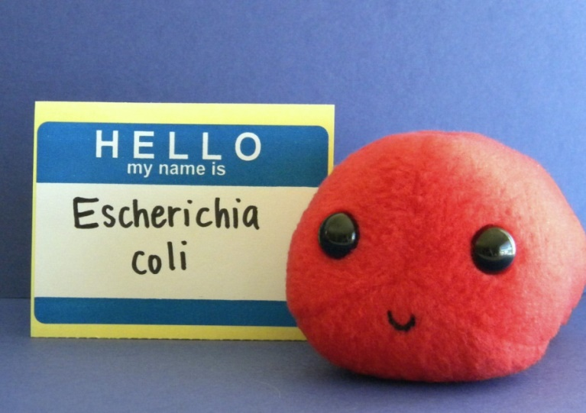
lac operon
E. Coli’s preferred energy source is glucose.
E. Coli can use lactose as an energy source, but it has to make a series of proteins in order to do so.
E. Coli will only make large amounts of the proteins necessary for lactose metabolism if the following two conditions are met.
Glucose levels are low
Lactose is available

Slide 7
The lac operon produces the proteins needed for lactose metabolism.
RNA polymerase
lac operon
DNA
IacZ
IacY
IacA
mRNA 5′
Protein
β-Galactosidase
Permease
Transacetylase
Notes:
The lacZ gene codes for β-galactosidase which hydrolyzes lactose into glucose and galactose . The lacY gene codes for the membrane protein permease which transports lactose into the cell. The lacA gene = ?

Slide 8
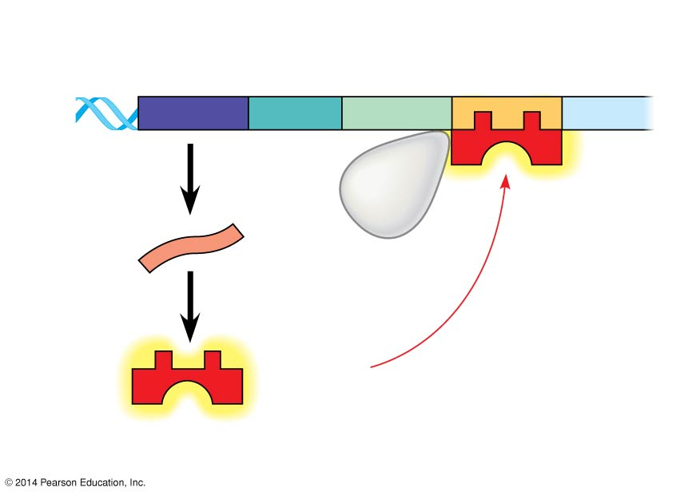
Figure 15.4a
Regulatory
gene
Operator
Regulatory
gene
Promoter
DNA
DNA
IacZ
lacI
lacI
No RNA made
mRNA
RNA
polymerase
mRNA
By itself, the lac repressor is active and switches the lac operon off.
Protein
Protein
Active
repressor
Active
repressor
(a) Lactose absent, repressor active, operon off
Notes:
8

Slide 9
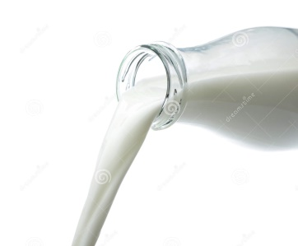
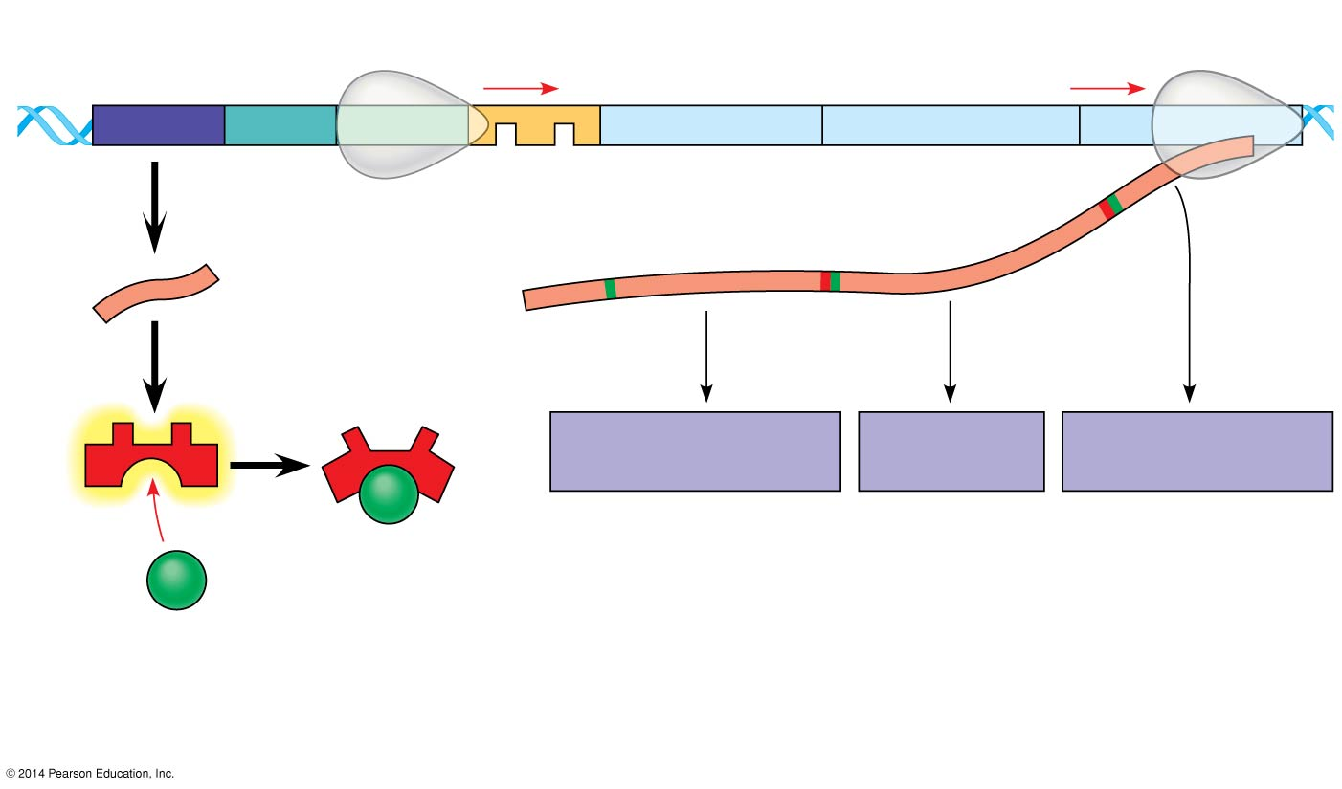
(b) Lactose present, repressor inactive, operon on
DNA
lac operon
IacI
IacI
IacZ
IacY
IacA
RNA polymerase
mRNA
3′
mRNA 5′
5′
Protein
β-Galactosidase
Permease
Transacetylase
Inactive
repressor
Allolactose (inducer)
Allolactose (inducer)
A molecule called an inducer inactivates the repressor to turn the lac operon on.
Notes:
9
“For the lac operon, the inducer is allolactose, an isomer of lactose formed in small amounts from lactose that enters the cell. In the absence of lactose (and hence allolactose), the lac operon are silenced. If lactose is added to the cell’s surroundings, allolactose binds to the lac repressor and alters its conformation, nullifying the repressor's ability to attach to the operator. Without bound repressor, the lac operon is transcribed into mRNA for the lactose-utilizing enzyme.” p.296
Enzymes of the lactose pathway are called inducible enzymes.

Slide 10
E. Coli’s favorite food is glucose.
E. Coli will only bother to “eat” significant amounts of lactose if glucose is scarce.
E. Coli will only ramp up the production of the proteins needed for lactose metabolism when glucose is scarce.
Notes:
10

Slide 11
How E. Coli “knows” when glucose is scarce
When glucose concentrations are low, cyclic AMP (cAMP), an allosteric regulatory molecule, accumulates in the cell.

Slide 12
The cAMP binds with a regulatory protein called CAP.
When cAMP binds with CAP, the CAP becomes activated.
Active
CAP
cAMP
Inactive
CAP

Slide 13
Figure 15.5a
Promoter
DNA
lacI
IacZ
CAP-binding site
RNA polymerase binds and transcribes
Operator
Active
CAP
cAMP
Inactive lac repressor
Inactive
CAP
Allolactose
abundant lac mRNA synthesized
(a) Lactose present, glucose scarce (cAMP level high):
Notes:
13
Activated CAP attaches to the promoter of the lac operon and increases the affinity of RNA polymerase, thus greatly accelerating transcription.

Slide 14
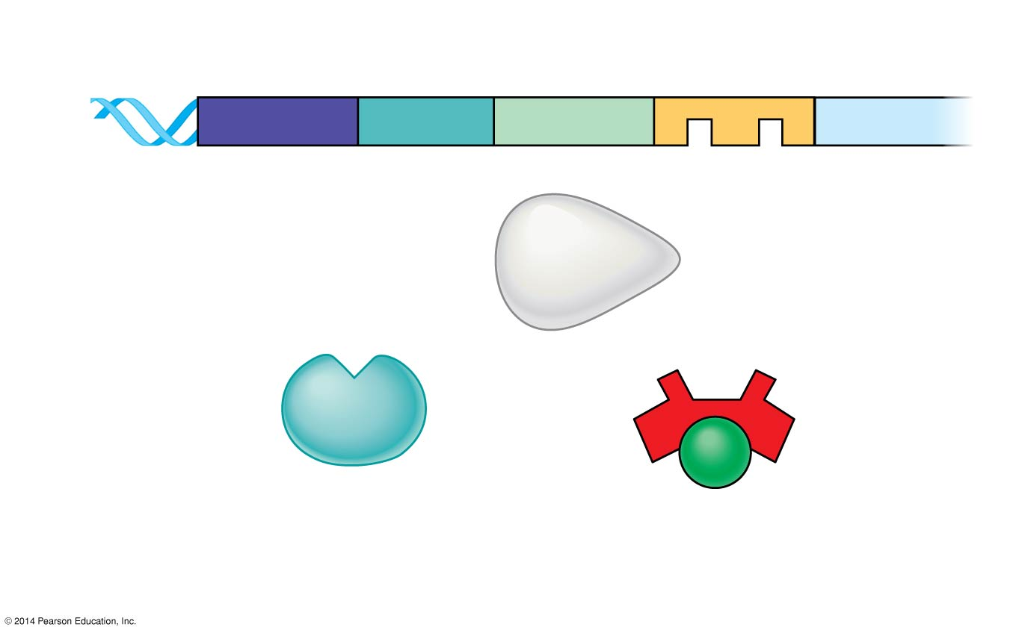
When glucose levels increase, CAP detaches from the lac operon, and transcription proceeds at a very low rate, even if lactose is present.
Promoter
DNA
lacI
IacZ
CAP-binding site
Operator
RNA
polymerase less likely to bind
Inactive
CAP
Inactive lac repressor
(b) Lactose present, glucose present (cAMP level low):
little lac mRNA synthesized
Notes:
14

