Slide 1
0
Chapter 21
Genetic Variation and Evolution

Slide 2
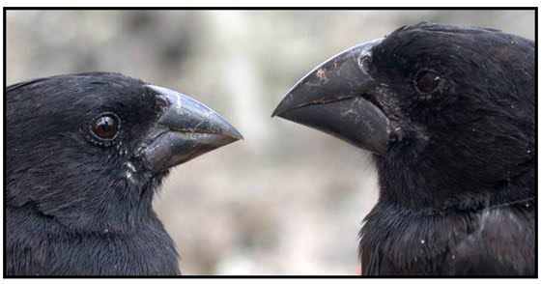
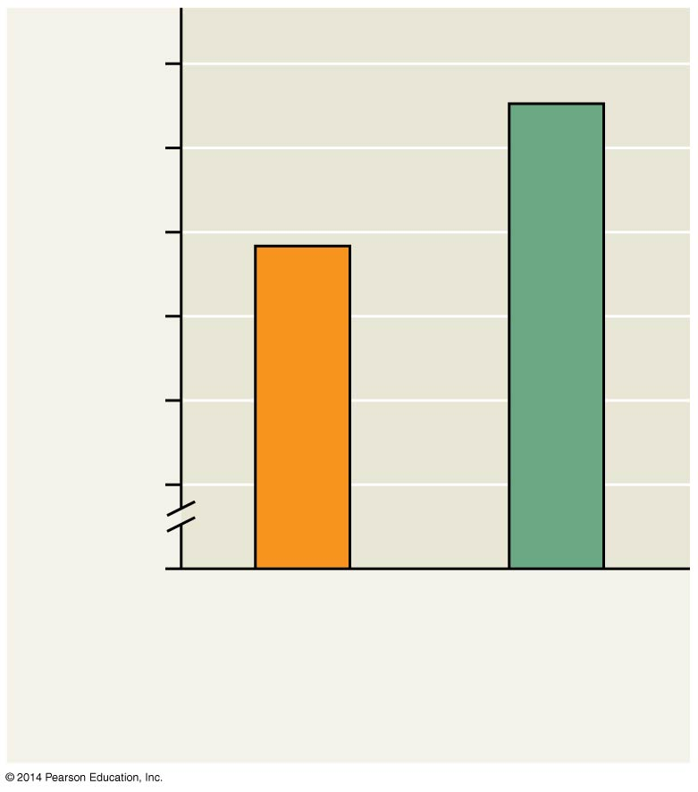
Beak length of Ground Finches on Daphne Major Island
10
9
Average beak depth (mm)
Natural selection acts on individuals, but only populations evolve.
8
0
1976
(similar to the
prior 3 years)
1978
(after
drought)
Notes:
2
One common misconception is that organisms evolve during their lifetimes. Natural selection acts on individuals, but only populations evolve. Consider, for example, a population of medium ground finches on Daphne Major Island. During a drought, large-beaked birds were more likely to crack large seeds and survive. The finch population evolved by natural selection.

Slide 3
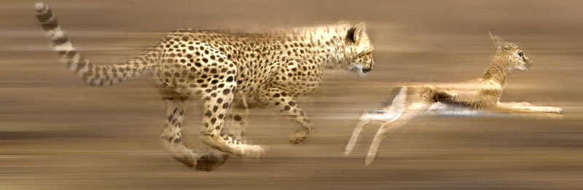
Microevolution is a change in allele frequencies in a population over generations.
Three mechanisms cause allele frequency change
Natural selection
Genetic drift
Gene flow
Only natural selection consistently causes adaptive evolution
Notes:
3

Slide 4
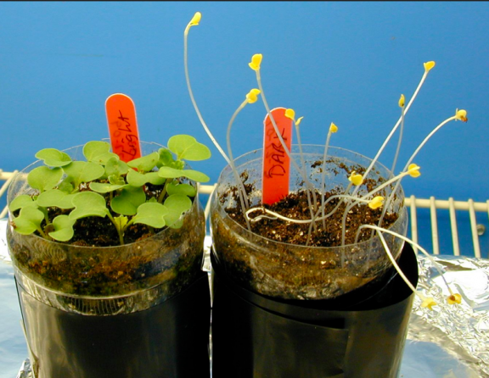
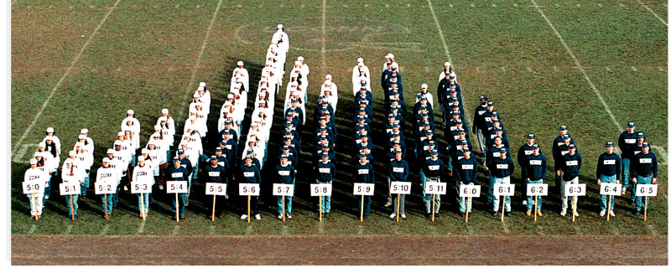
Genetic variation makes evolution possible
Variation in heritable traits is a prerequisite for evolution.
single gene trait
Polygenic trait
Notes:
4
Mendel’s work on pea plants provided evidence of discrete heritable units (genes).
Phenotypic variation often reflects genetic variation. Genetic variation among individuals is caused by differences in genes or other DNA sequences. Some phenotypic differences are due to differences in a single gene and can be classified on an “either-or” basis. Other phenotypic differences are due to the influence of many genes and vary in gradations along a continuum.

Slide 5
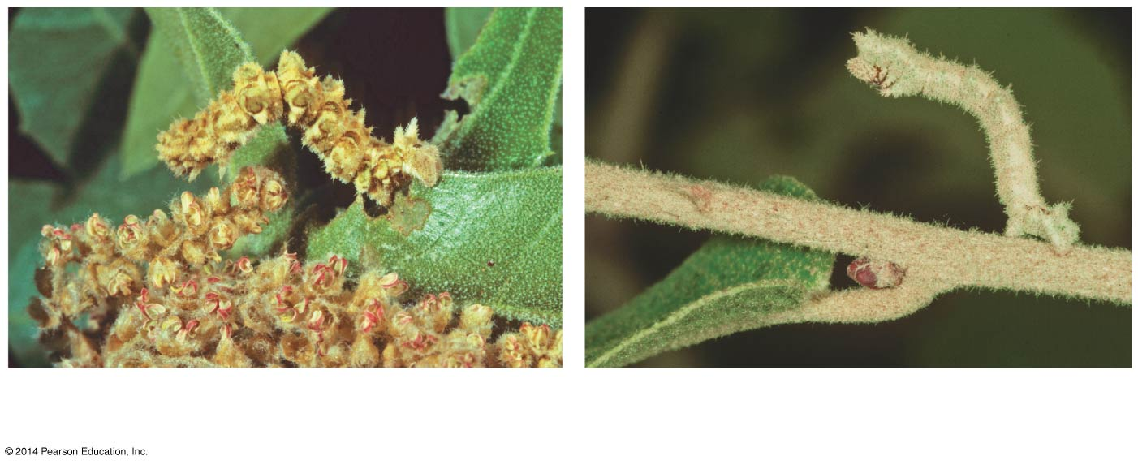
Phenotype is the product of inherited genotype and environmental influences.
Natural selection can only act on phenotypic variation that has a genetic component.
(a) Caterpillars raised on a diet of
oak flowers
(b) Caterpillars raised on a diet of
oak leaves
Notes:
5

Slide 6
Genetic variation among individuals of the same species can be measured at the whole gene level as gene variability.
Gene variability can be quantified as the average percent of loci that are heterozygous.
Notes:
6

Slide 7
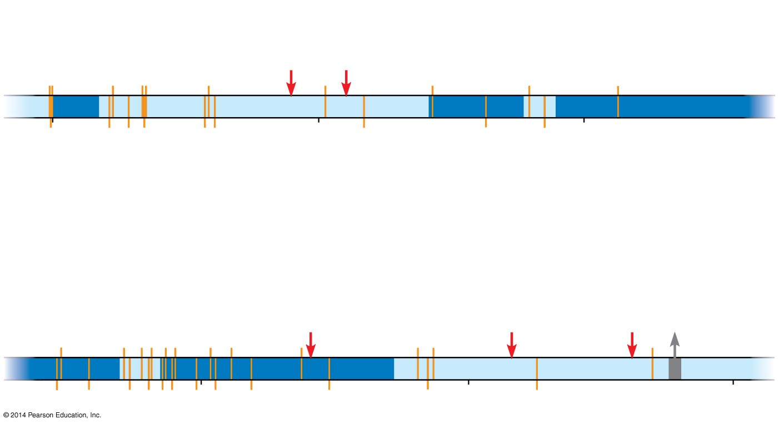
This diagram summarizes data from a study comparing the DNA sequence of the alcohol dehydrogenase gene in several fruit flies. (The exons are dark blue and the introns are light blue.)
Base-pair
substitutions
Insertion sites
1
500
1,000
Exon
Intron
Explain how a base-pair substitution that alters a coding region could have no effect on the amino acid sequence.
Substitution resulting
in translation of
different amino acid
Deletion
1,500
2,000
2,500
Notes:
7
Genetic variation can be measured at the molecular level of DNA as nucleotide variability. Nucleotide variation rarely results in phenotypic variation. Most differences occur in noncoding regions (introns). Variations that occur in coding regions (exons) rarely change the amino acid sequence of the encoded protein.

Slide 8
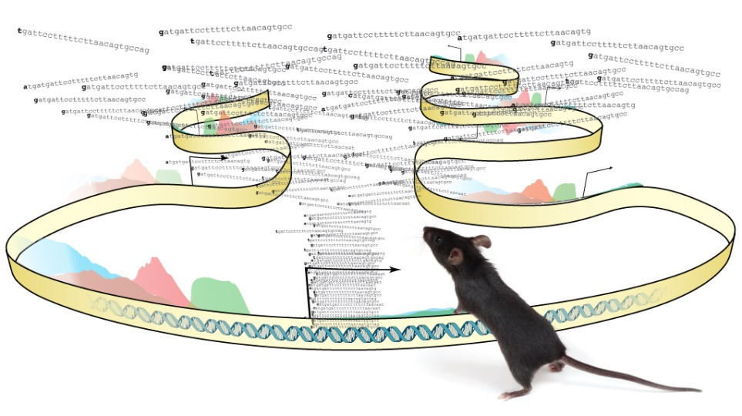
Sources of Genetic Variation
New genes and alleles can arise by mutation or gene duplication.
Duplicated genes can take on new functions by further mutation.
An ancestral odor-detecting gene has been duplicated many times: Humans have 350 functional copies of the gene; mice have 1,000
Notes:
8
Review (You have had this in before in previous chapters.)
A mutation is a change in the nucleotide sequence of DNA. Only mutations in cells that produce gametes can be passed to offspring. A “point mutation” is a change in one base in a gene. The effects of point mutations can vary. Mutations in noncoding regions of DNA are often harmless. Mutations to genes can be neutral because of redundancy in the genetic code. The effects of point mutations can vary. Mutations that alter the phenotype are often harmful. Mutations that result in a change in protein production can sometimes be beneficial. Chromosomal mutations that delete, disrupt, or rearrange many loci are typically harmful. Duplication of small pieces of DNA increases genome size and is usually less harmful.

Slide 9
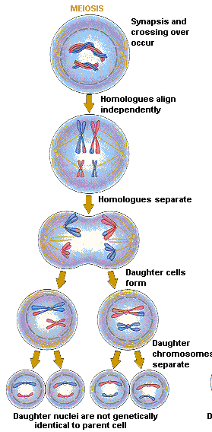
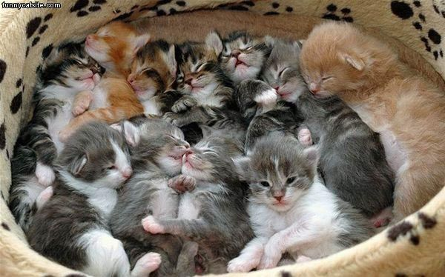
In organisms that reproduce sexually, most genetic variation results from recombination of alleles.
Notes:
9
Sexual reproduction can shuffle existing alleles into new combinations through three mechanisms: crossing over, independent assortment, and fertilization. (Review meiosis.)

