Slide 1
0
Chapter 20
Three Domains of Life

Slide 2
You Must Know
The three domains of life
Horizontal gene transfer

Slide 3
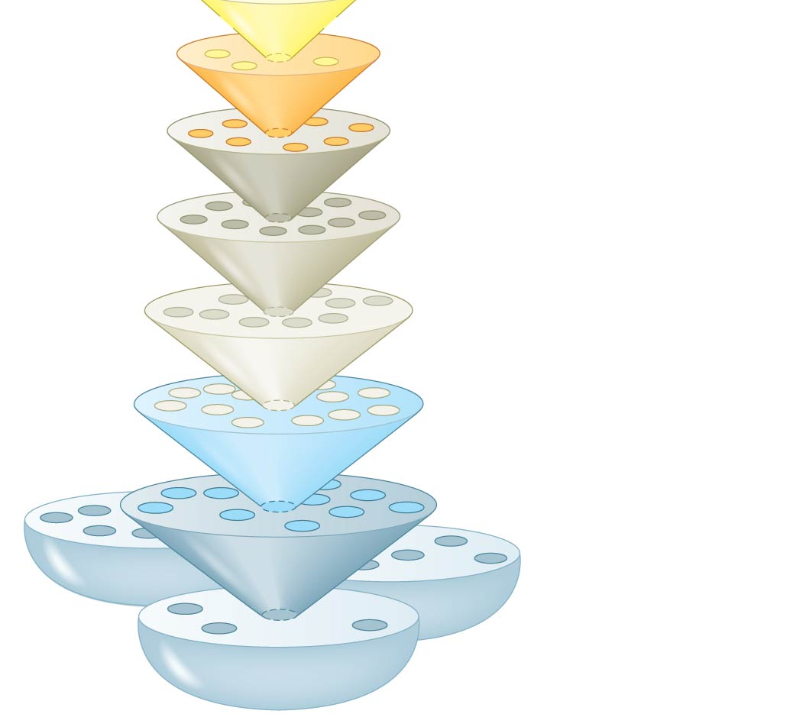
Species:
Genus:
Family:
Order:
Class:
Phylum:
Domain:
Bacteria
Kingdom:
Animalia
Domain:
Archaea
Domain:
Eukarya
Notes:
3
Figure 20.3 Linnaean classification

Slide 4
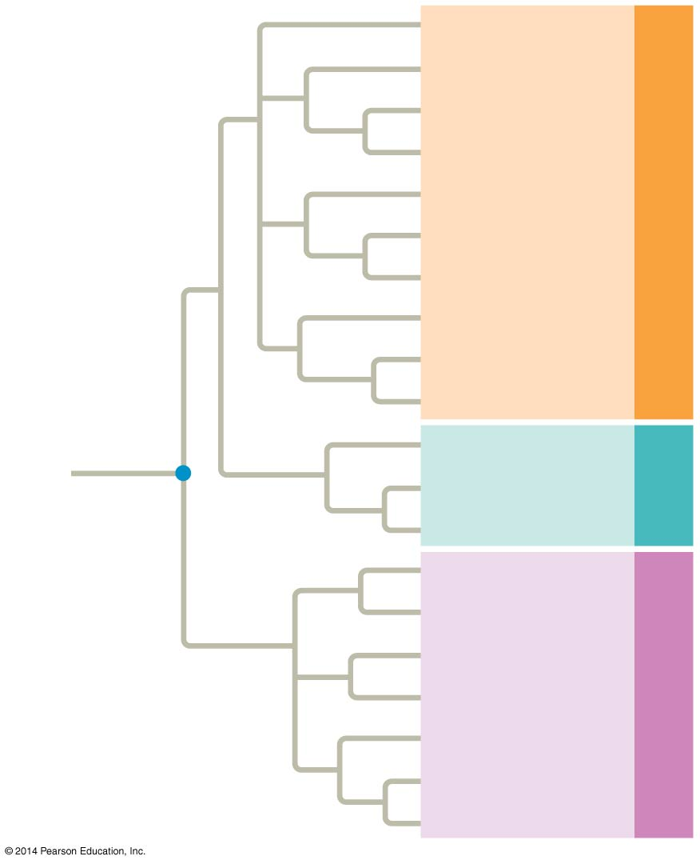
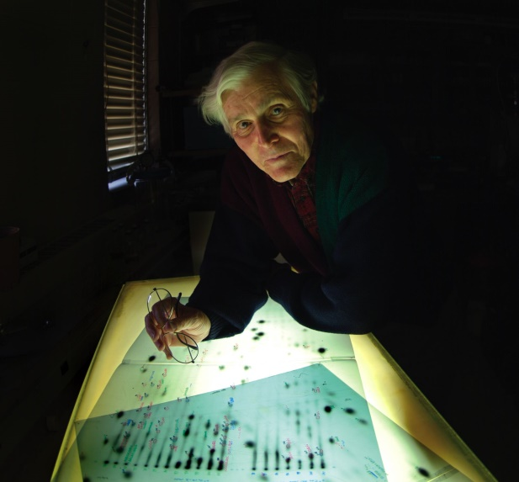
Three Domains
(This is NOT based on molecular clocks)
Euglenozoans
Forams
Diatoms
Ciliates
Red algae
Green algae
Domain Eukarya
Land plants
Amoebas
Fungi
Animals
Nanoarchaeotes
Methanogens
Domain
Archaea
Thermophiles
COMMON
ANCESTOR
OF ALL LIFE
Proteobacteria
(Mitochondria)*
Chlamydias
Spirochetes
Domain Bacteria
Gram-positive
bacteria
Cyanobacteria
Carl Woese
(Chloroplasts)*
Notes:
4
Recently, systematists have gained insight into the very deepest branches of the tree of life through analysis of DNA sequence data. The three-domain system is supported by data from many sequenced genomes. The three-domain system highlights the importance of single-celled organisms in the history of life. Domains Bacteria and Archaea are single-celled prokaryotes. Only three lineages in the domain Eukarya are dominated by multicellular organisms, kingdoms Plantae, Fungi, and Animalia. The tree of life is based largely on rRNA genes, which have evolved slowly, allowing detection of homologies between distantly related organisms. The tree of life suggests that eukaryotes and archaea are more closely related to each other than to bacteria.

Slide 5
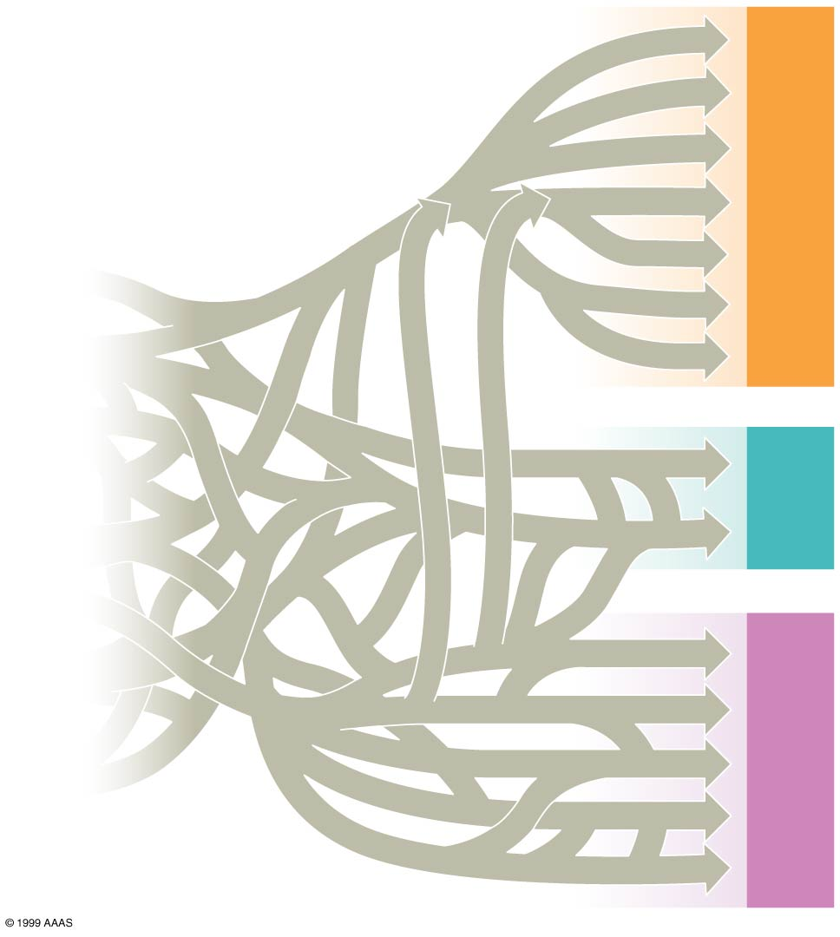
Horizontal gene transfer is the movement of genes from one genome to another.
Caused by:
Plasmids
Viral infection
Fusion of organisms
Fungi
Plantae
Domain Eukarya
Chloroplasts
Methanogens
Domain
Archaea
Ancestral cell
populations
Mitochondria
Thermophiles
Cyanobacteria
Proteobacteria
Domain Bacteria
Notes:
5
There have been substantial interchanges of genes between organisms in different domains.
Horizontal gene transfer is the movement of genes from one genome to another.
Horizontal gene transfer occurs by exchange of plasmids, viral infection, and fusion of organisms. Horizontal gene transfer complicates efforts to build a tree of life. Horizontal gene transfer may have been common enough that the early history of life is better depicted by a tangled web than a branching tree.

