Slide 1
0
Chapter 20
Phylogenetic Trees

Slide 2
Concept 20.3: Shared characters are used to construct phylogenetic trees
Once homologous characters have been identified, they can be used to infer a phylogeny
Notes:
2

Slide 3
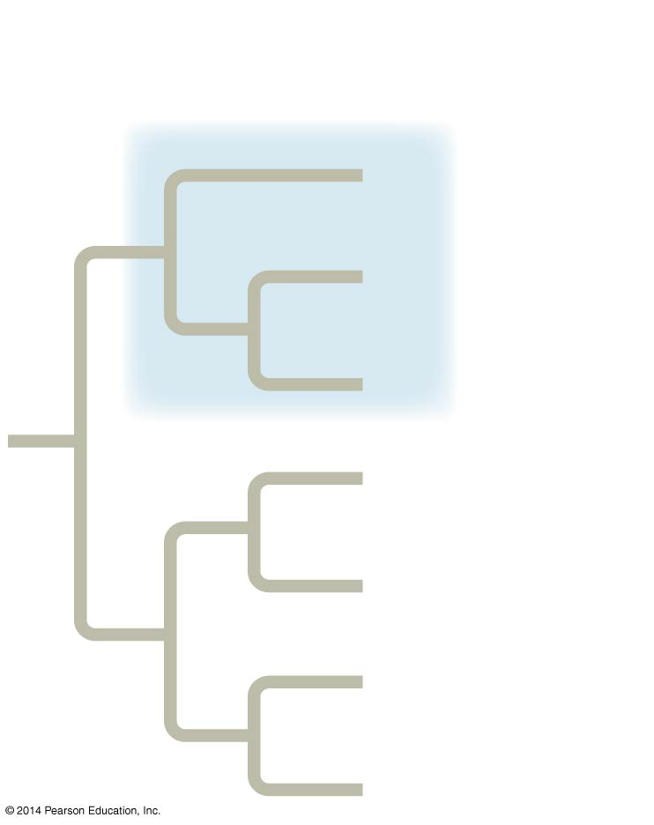
A clade is a group of species that includes an ancestral species and all its descendants.
(a) Monophyletic group
(clade)
A
1
B
Group I
C
D
E
F
G
Notes:
3
Cladistics classifies organisms by common descent. A clade is a group of species that includes an ancestral species and all its descendants. Clades can be nested in larger clades, but not all groupings of organisms qualify as clades.

Slide 4
(a) Monophyletic group
(clade)
(b) Paraphyletic group
(c) Polyphyletic group
A
A
A
1
B
Group I
B
1
B
Group III
C
C
C
D
D
D
E
E
Group II
E
2
2
F
F
F
G
G
G
Notes:
4
A paraphyletic grouping consists of an ancestral species and some, but not all, of the descendants. In a paraphyletic group, the most recent common ancestor of all members of the group is part of the group, but some of the descendants are left out. A polyphyletic grouping consists of various taxa with different ancestors. In a polyphyletic group, the most recent common ancestor of all members of a group is not part of the group.

Slide 5
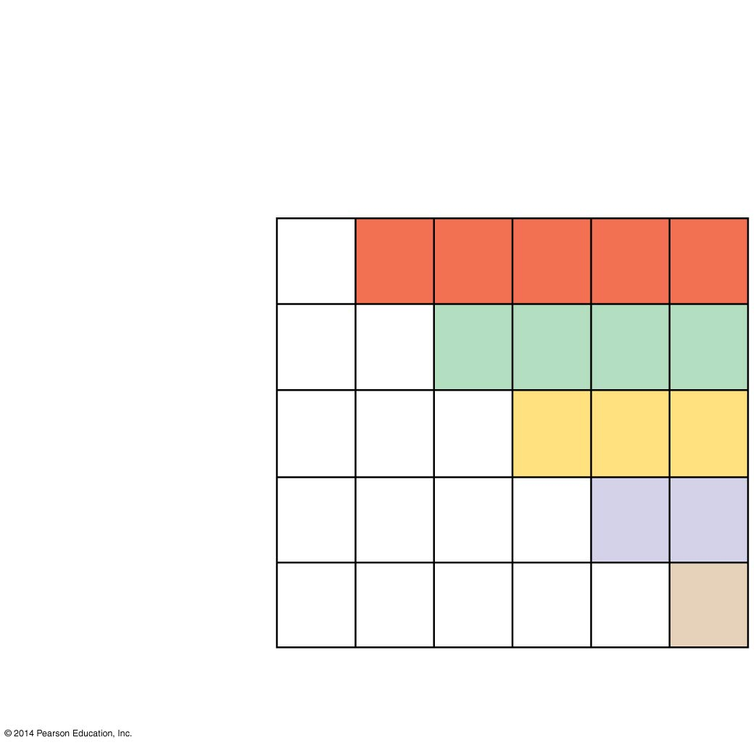
Figure 20.11a
TAXA
Lancelet
(outgroup)
Lamprey
Leopard
Bass
Frog
Turtle
Vertebral
column
(backbone)
0
1
1
1
1
1
Hinged jaws
0
0
1
1
1
1
Four
walking legs
CHARACTERS
0
0
0
1
1
1
Use the information in the table to construct a cladogram.
Amnion
0
0
0
0
1
1
Hair
0
0
0
0
0
1
(a) Character table
Notes:
5

Slide 6
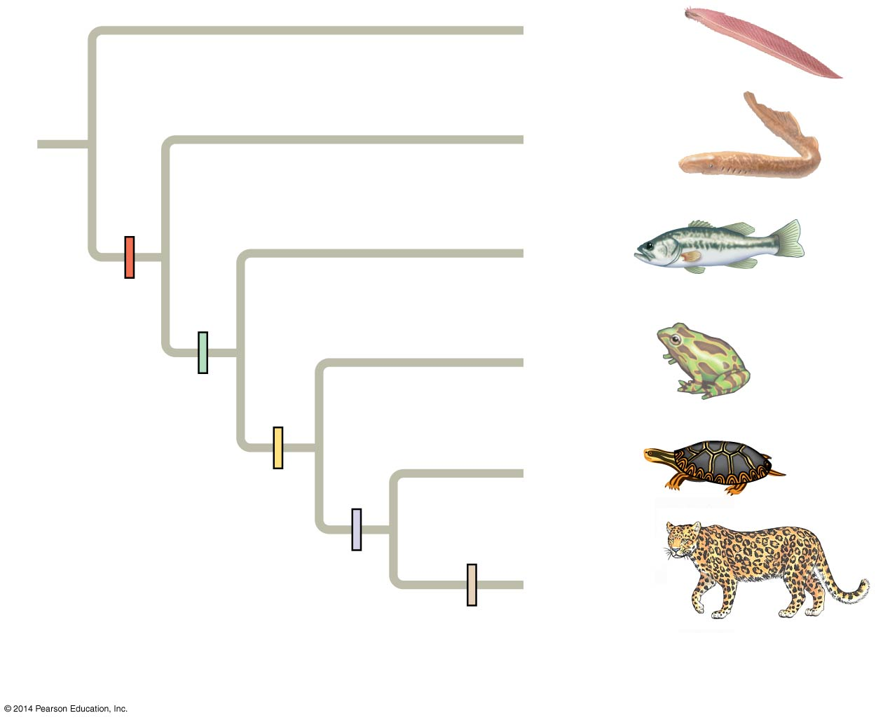
Figure 20.11b
Lancelet
(outgroup)
Lamprey
Bass
Vertebral
column
Frog
Hinged jaws
Four walking legs
Turtle
Amnion
Leopard
Hair
(b) Phylogenetic tree
Notes:
6

Slide 7
An outgroup is a species or group of species that is closely related to the ingroup, the various species being studied.
The outgroup is a group that has diverged before the ingroup.
Lancelet
(outgroup)
Lamprey
Bass
Vertebral
column
Frog
Hinged jaws
Four walking legs
Turtle
Amnion
Leopard
Hair
Notes:
7

Slide 8
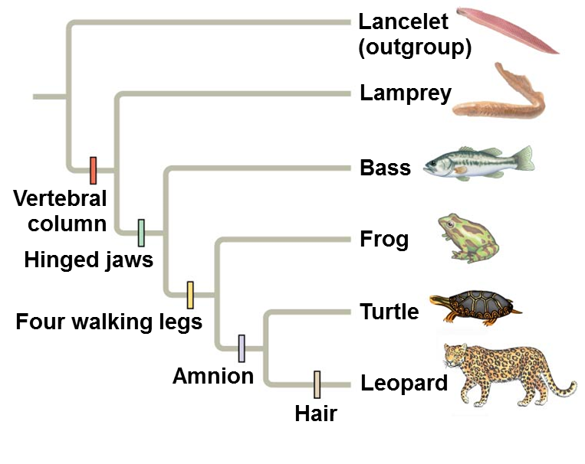
Characters shared by the outgroup and ingroup are ancestral characters that predate the divergence of both groups from a common ancestor.
Examples of ancestral characters
DNA Polymerase
Mitochondria
Etc.!
Notes:
8

Slide 9
Systematists compare each ingroup species with the outgroup to differentiate between shared derived and shared ancestral characteristics.
Example of a shared derived character
Vertebral column
Examples of shared ancestral character
DNA Polymerase
Mitochondria
Etc.!
Lancelet
(outgroup)
Lamprey
Bass
Vertebral
column
Frog
Hinged jaws
Four walking legs
Turtle
Amnion
Leopard
Hair
Notes:
9
When inferring evolutionary relationships, it is useful to know in which clade a shared derived character first appeared.
A shared ancestral character is a character that originated in an ancestor of the taxon.
A shared derived character is an evolutionary novelty unique to a particular clade.
A character can be both ancestral and derived, depending on the context.

Slide 10
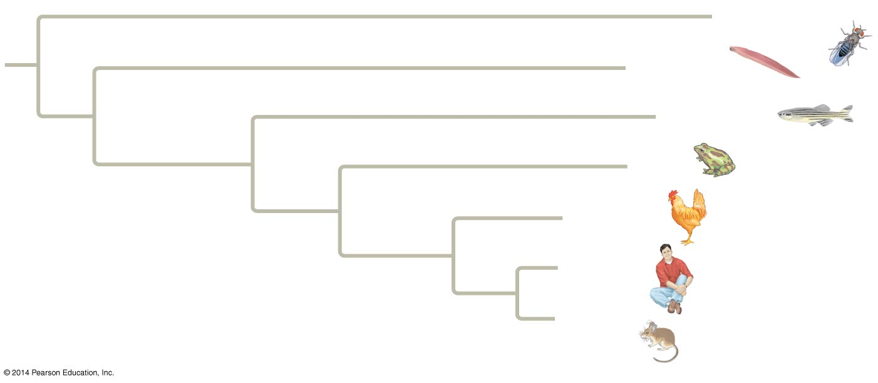
In some trees, the length of a branch can reflect the number of genetic changes that have taken place in a particular DNA sequence in that lineage.
In which vertebrate lineage shown has the studied gene evolved the most rapidly?
Zebrafish
Drosophila
Lancelet
Zebrafish
Frog
Vertebral
column
Chicken
Human
Mouse
Notes:
10
Varying branch lengths indicate that the gene has evolved at different rates in different lineages.

Slide 11
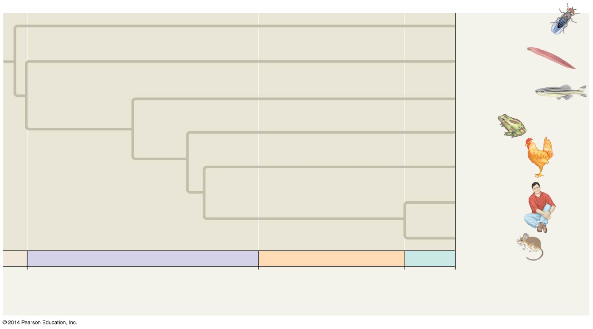
Branch lengths can indicate time
When did the common ancestor of the mouse and human live?
~65.5 mya
Drosophila
Lancelet
Zebrafish
Frog
Chicken
Human
Mouse
PALEOZOIC
MESOZOIC
CENOZOIC
542
251
65.5 Present
Millions of years ago
Notes:
11
In other trees, branch length can represent chronological time, and branching points can be determined from the fossil record.

Slide 12
Maximum parsimony
assumes that the tree that requires the fewest evolutionary events (appearances of shared derived characters) is the most likely.
Notes:
12
Systematists can never be sure of finding the best tree in a large data set. They narrow possibilities by applying the principle of maximum parsimony. Computer programs are used to search for trees that are parsimonious.

Slide 13
Figure 20.14
Technique
I
1/C
I
III
1/C
II
III
II
1/C
III
II
I
1/C
1/C
Species I
Species II
Species III
Three phylogenetic hypotheses:
3/A
I
2/T
I
3/A
III
2/T
3/A
4/C
I
I
III
II
III
II
II
III
II
4/C
4/C
2/T
III
II
I
III
II
I
3/A 4/C
2/T 4/C
2/T 3/A
Site
1
2
3
4
Results
Species I
C
T
A
T
I
I
III
Species II
C
T
T
C
II
III
II
Species III
A
G
A
C
Ancestral sequence
III
II
I
A
G
T
T
6 events
7 events
7 events
Notes:
13
Figure 20.14 Research method: applying parsimony to a problem in molecular systematics

