Slide 1
0
Chapter 20
Phylogenetic Trees

Slide 2
You Must Know
How to make and interpret phylogenetic trees.

Slide 3
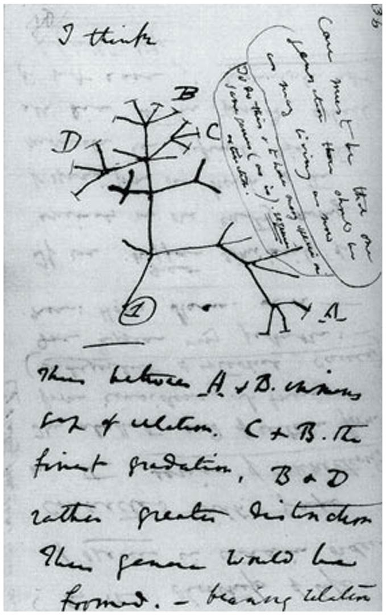
A phylogenetic tree represents a hypothesis about evolutionary relationships.

Slide 4
Concept 20.2: Phylogenies are inferred from morphological and molecular data
The similarities used to infer phylogenies must result from shared ancestry.
Bat and bird wings are homologous as forelimbs, but analogous as functional wings.
Trick Question: Homologous or Analogous?
Notes:
4
Homology can be distinguished from analogy by comparing fossil evidence and the degree of complexity.
The more complex two similar structures are, the more likely it is that they are homologous.

Slide 5
Molecular Homologies
1
C C A T
C A G A
G T C C
2
C C A T
C A G A
G T C C
Deletion
1
C C A T
C A G A
G T C C
2
C C A T
C A G A
G T C C
G T A
Insertion
BLAST
1
C C A T
C A
A G T C C
2
C C A T
G T A
C A
G
A G T C C
1
C C A T
C A
A G T C C
2
C C A T
G T A
C A
G
A G T C C
Notes:
5
Molecular homologies are determined based on the degree of similarity in nucleotide sequence between taxa. Systematists use computer programs when analyzing comparable DNA segments from different organisms.

Slide 6
About how much DNA would you expect two species to share based on chance alone?
Analogous structures or molecular sequences are also called homoplasies.
A C G
G A T
A G T
C C A
C T A
G G C
A C T A
T C A
C C G
A C A
G G T
C T T
T G A
C T A G
Notes:
6
Analogous structures or molecular sequences are also called homoplasies. Shared bases in nucleotide sequences that are otherwise very dissimilar are called molecular homoplasies.

Slide 7
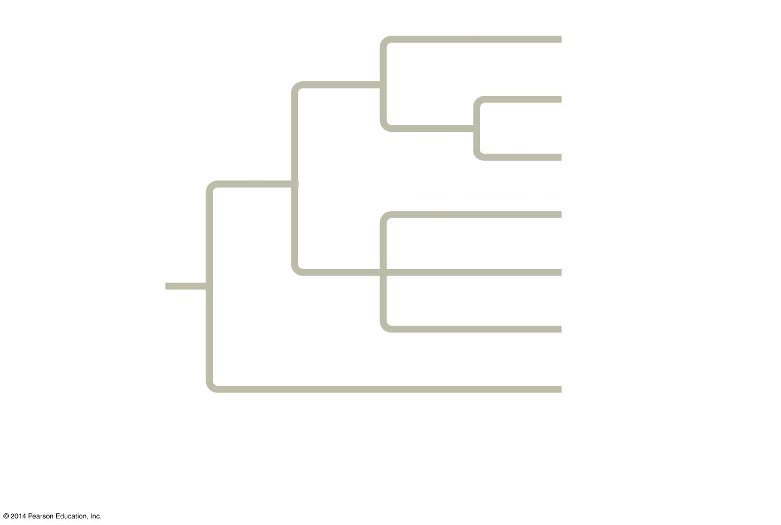
Figure 20.5
Branch point:
where lineages diverge
Taxon A
3
Taxon B
Sister
taxa
4
Taxon C
rooted
2
Taxon D
5
Taxon E
ANCESTRAL
LINEAGE
1
Taxon F
Basal
taxon
Taxon G
This branch point
represents the common
ancestor of taxa A−G.
This branch point forms a
polytomy: an unresolved
pattern of divergence.
Notes:
7
A phylogenetic tree represents a hypothesis about evolutionary relationships. Each branch point represents the divergence of two taxa from a common ancestor.
Sister taxa are groups that share an immediate common ancestor. A rooted tree includes a branch to represent the most recent common ancestor of all taxa in the tree. A basal taxon diverges early in the history of a group and originates near the common ancestor of the group. A polytomy is a branch from which more than two groups emerge. Phylogenetic trees show patterns of descent, not phenotypic similarity. Phylogenetic trees do not generally indicate when a species evolved or how much change occurred in a lineage. It should not be assumed that a taxon evolved from the taxon next to it.

Slide 8
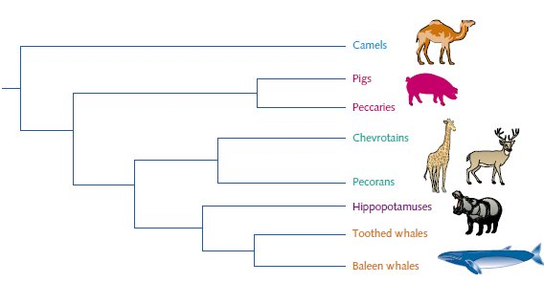
Which animal represents the basal taxon?
Camels

Slide 9
Which animal is least like the others?
Camels

Slide 10
Are pigs and peccaries sister taxa?
Yes, they share an immediate common ancestor.

Slide 11
Did baleen whales evolve from toothed whales?
No! Do not assume that a taxon evolved from the taxon next to it.

Slide 12
Which are more closely related, hippos and toothed whales or hippos and pecorans?
Hippos and toothed whales

Slide 13
Which are more closely related, hippos and toothed whales or hippos and baleen whales?
You can’t tell from the information given

