Slide 1
0
Chapter 20
Introduction to Classification

Slide 2
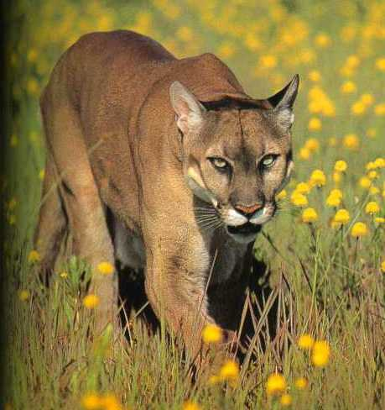
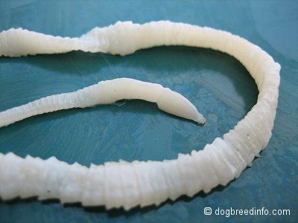
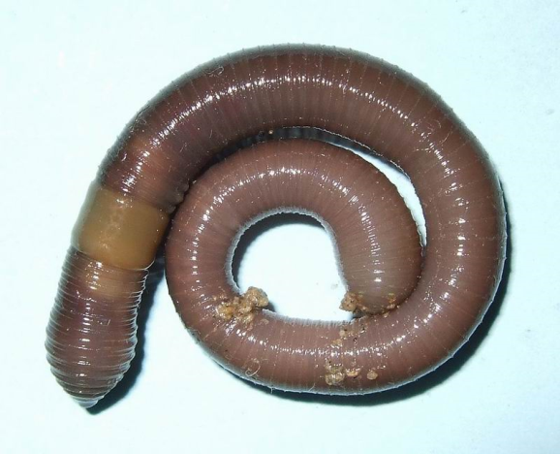
Classification
Worm
mountain lion, cougar, puma
Go to Section:

Slide 3
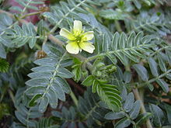
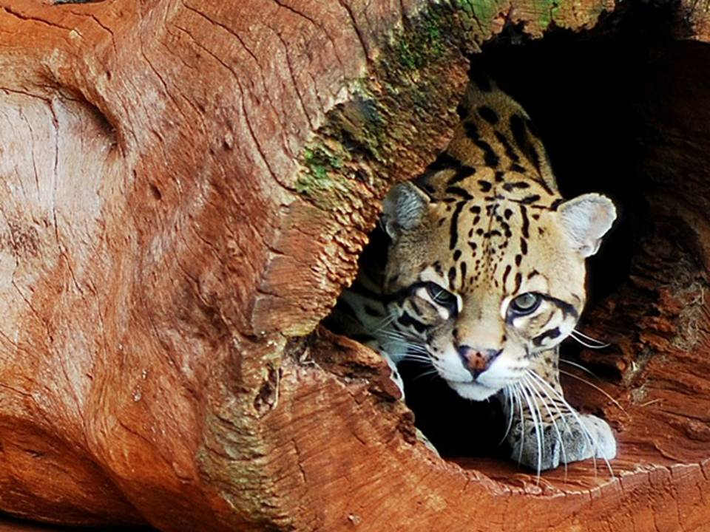
Binomial Nomenclature
Puma concolor
Taenia solium Lumbricus terrestris
Puma yagouaroundi
Go to Section:
Tribulus terrestris
Notes:
The two-part scientific name of a species is called a binomial. The first part of the name is the genus. The second part, called the specific epithet, is unique for each species within the genus. The first letter of the genus is capitalized, and the entire species name is italicized. Both parts together name the species (not the specific epithet alone).

Slide 4
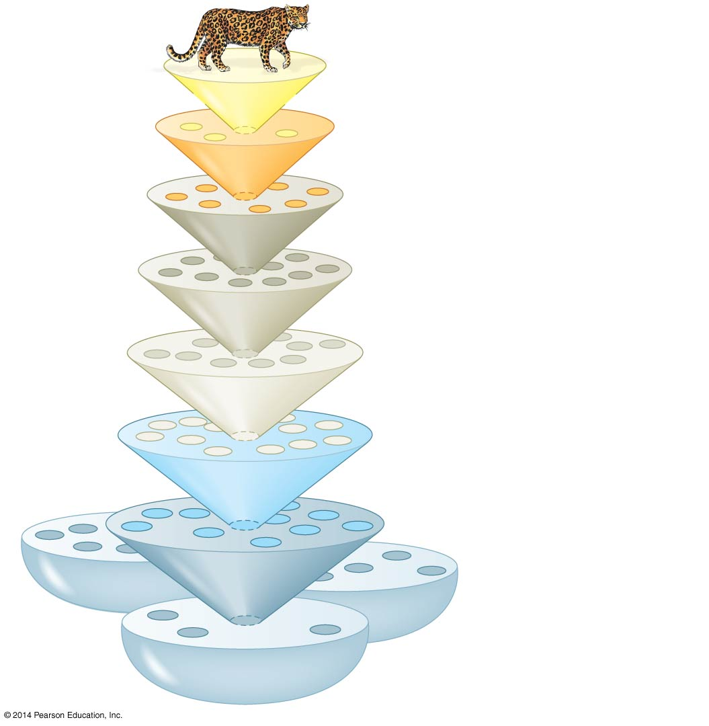
Leopard (common name)
Species: Panthera pardus
Genus: Panthera
Family: Felidae
Order: Carnivora
Class: Mammalia
Phylum: Chordata
Kingdom:
Animalia
Domain:
Eukarya
Hierarchical Classification
Notes:
4
Hierarchical classification a system for grouping species in increasingly broad categories. The taxonomic groups from narrow to broad are species, genus, family, order, class, phylum, kingdom, and domain

Slide 5
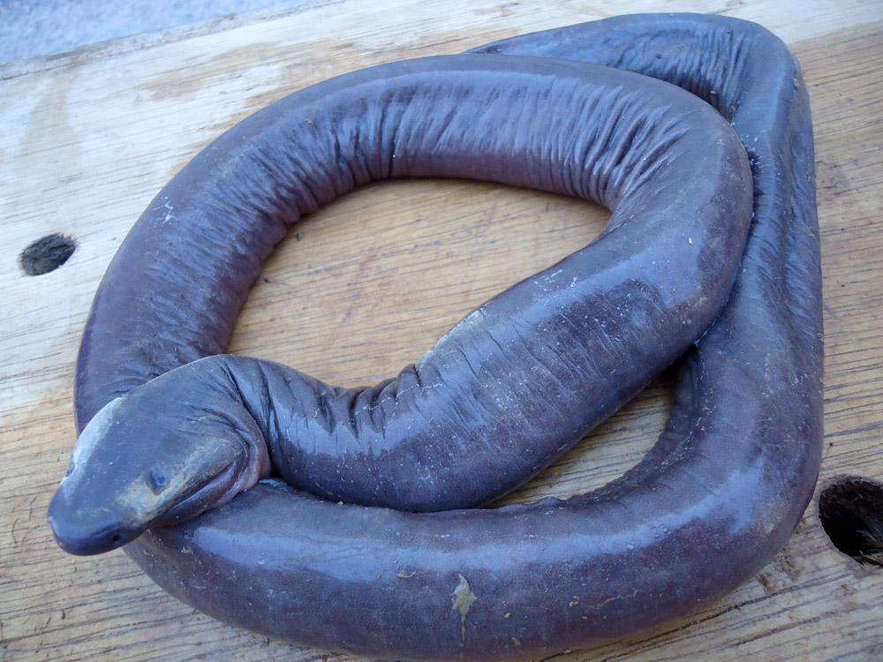
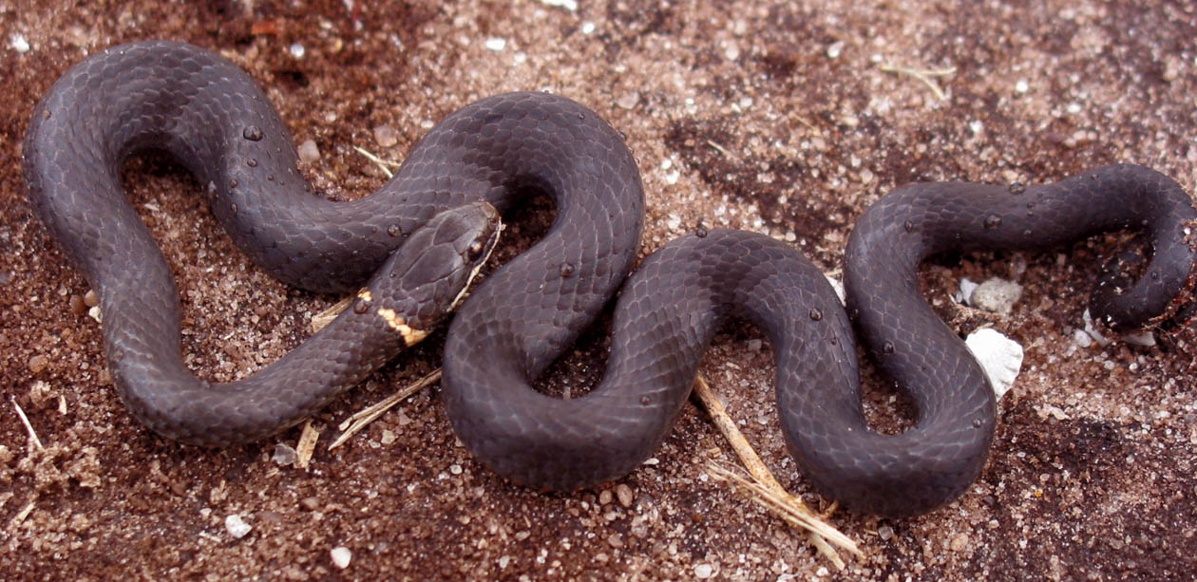
Why aren’t caecilians classified as snakes?
Caecilians video clip

Slide 6
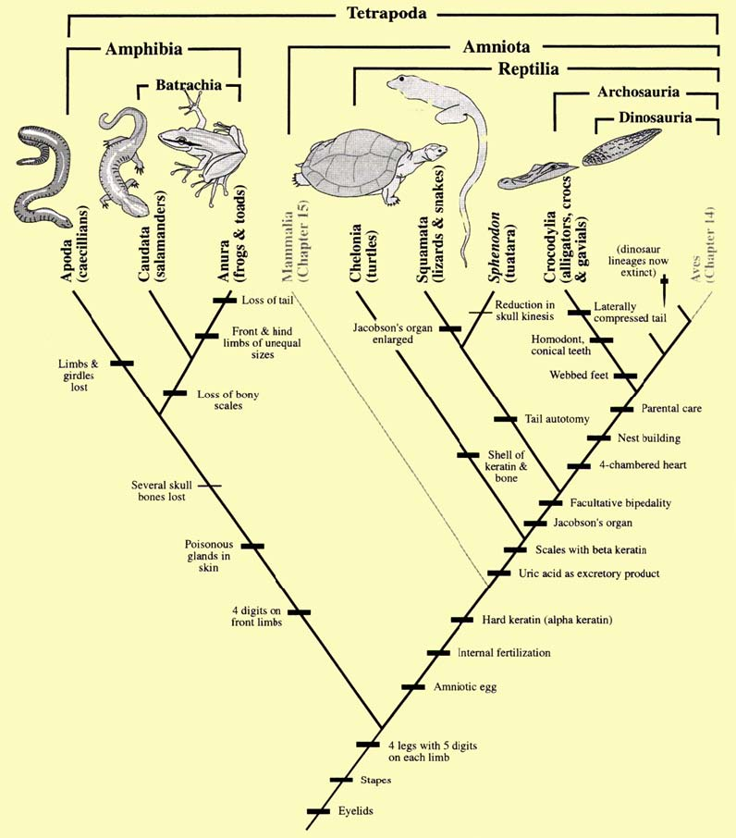
You don’t need to know details about caecilians.

Slide 7
Is the leglessness of caecilians and snakes homologous or analogous?
Analogous
The leglessness of caecilians and snakes is the result of ____________ evolution
convergent
Are the backbones of snakes and caecilians homologous or analogous?
homologous
Notes:
Convergent evolution occurs when similar environmental pressures and natural selection produce similar (analogous) adaptations in organisms from different evolutionary lineages

Slide 8
Caecilians and snakes have a backbone because they ________________ it from a common ancestor that had a backbone.
inherited

Slide 9
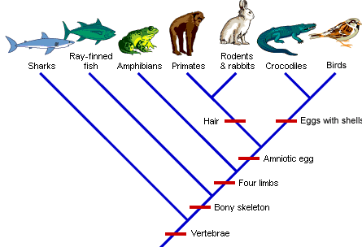
Do birds have four limbs?
Yes

Slide 10
How can you tell from the cladogram that birds don’t have hair?

Slide 11
What two groups do have hair?

Slide 12
What levels of classification do humans share with leopards?
Leopard (common name)
Species: Panthera pardus
Genus: Panthera
Family: Felidae
Order: Carnivora
Domain
Kingdom
Phylum
Class
Class: Mammalia
Phylum: Chordata
Domain:
Bacteria
Kingdom:
Animalia
Domain:
Archaea
Domain:
Eukarya
Notes:
12
Figure 20.3 Linnaean classification

Slide 13
What genus is the leopard in?
Leopard (common name)
Species: Panthera pardus
Panthera
Notes:
13
Figure 20.3 Linnaean classification

Slide 14
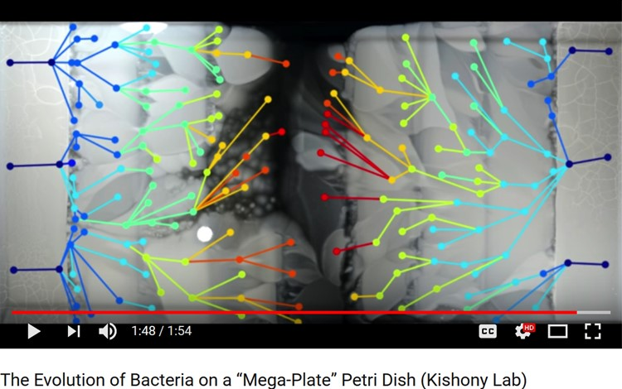
A
B
Is the antibiotic resistance in strains A and B homologous or analogous?

Slide 15
D
C
Is the antibiotic resistance in strains C and D homologous or analogous?

Slide 16
A
B
Is the antibiotic resistance in strains A and B is a result of _______________ evolution.
convergent

Slide 17
D
C
The antibiotic resistance in strains C and D is an example of a ___________.
homology

