Slide 1
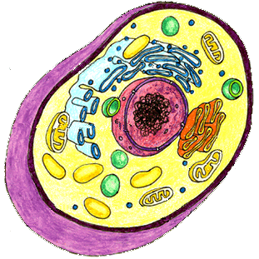
Fun Fact:
If ATP could not be regenerated from ADP, humans would use up nearly their body weight in ATP each day.

Slide 2
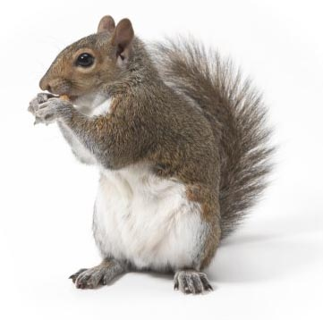
Respiration
Cells use the energy in glucose to make ATP
Two types of respiration
1. Aerobic Respiration (with oxygen)
glucose + oxygen → carbon dioxide + water + energy (ATP)
C₆H₁₂O₆ + O₂ → CO₂ + H₂O
(Notice that this is the reverse of photosynthesis)
36 molecules of ATP are produced for every molecule of glucose “burned”

Slide 3
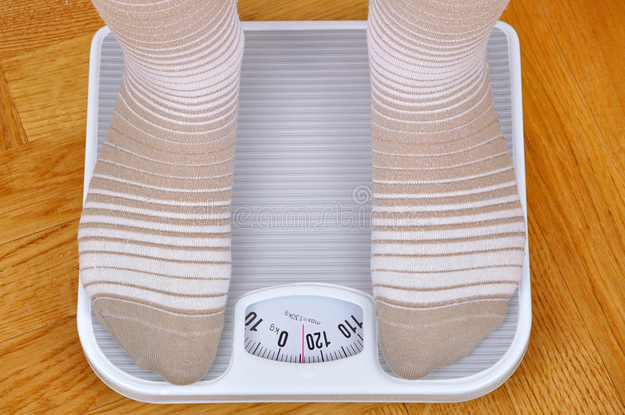
Where does weight go?

Slide 4
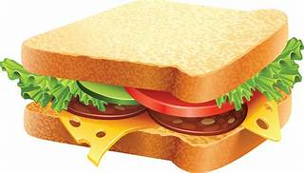
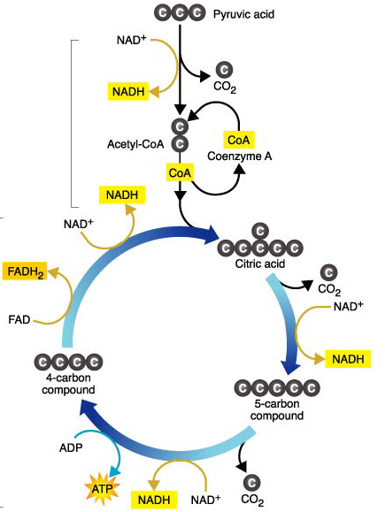
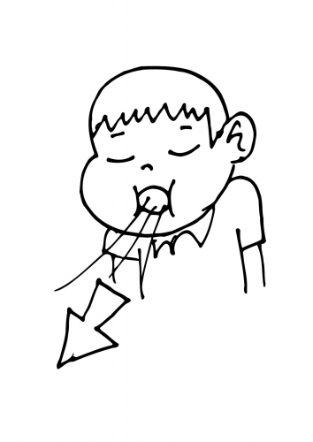
C₆H₁₂O₆
CO₂
H₂O

Slide 5
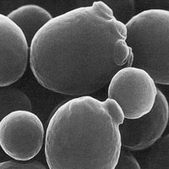
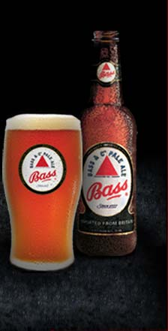
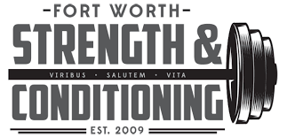
2. Anaerobic Respiration (without oxygen) (Fermentation)
The partial “burning” of glucose in the absence of oxygen
Produces 2 molecules of ATP, carbon dioxide and ethyl alcohol
OR
Produces 2 molecules of ATP, carbon dioxide and lactic acid

