Slide 1
Review:
Where do you get your DNA?
Mother and Father
What is the probability that you would have the exact same DNA as your brother or sister?
Way less that 1 in 70 trillion!
70,000,000,000,000
Wild guess :

Slide 2
Three things contribute to genetic variation in siblings
Independent assortment of chromosomes during meiosis
Notes:
2
Review: In crossing over, homologous portions of two nonsister chromatids trade places.
Crossing over contributes to genetic variation by combining DNA, producing chromosomes with new combinations of maternal and paternal alleles.

Slide 3
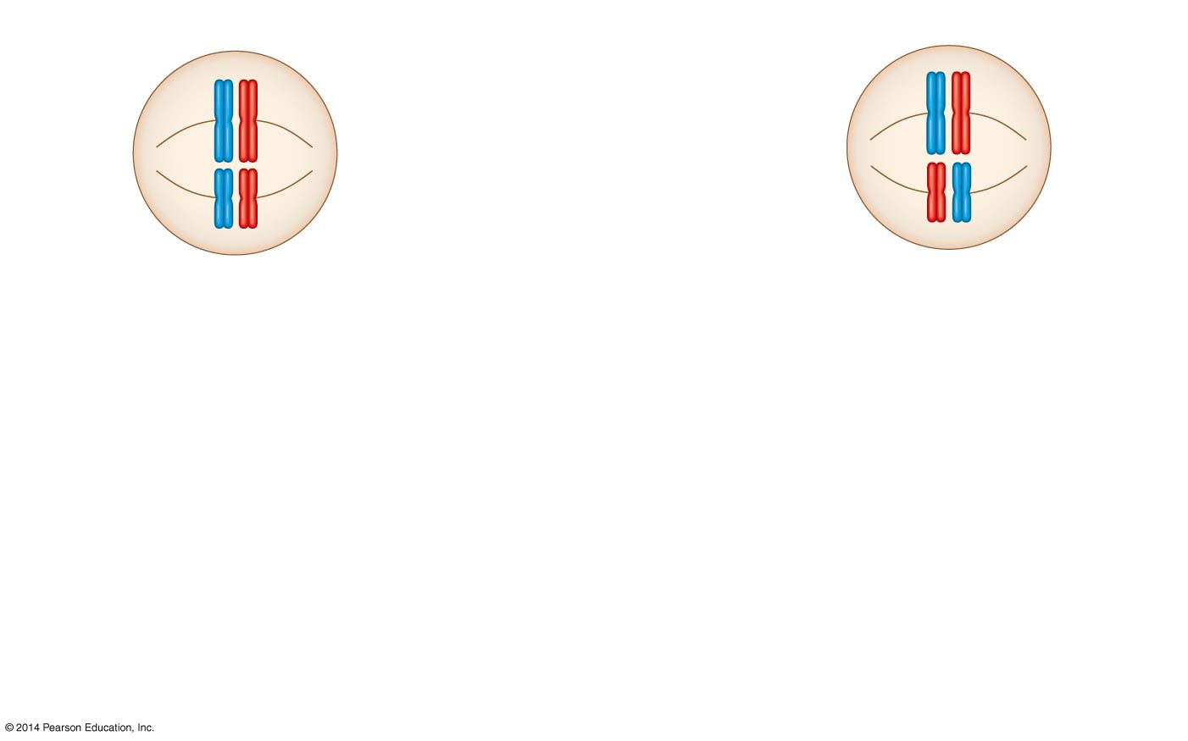
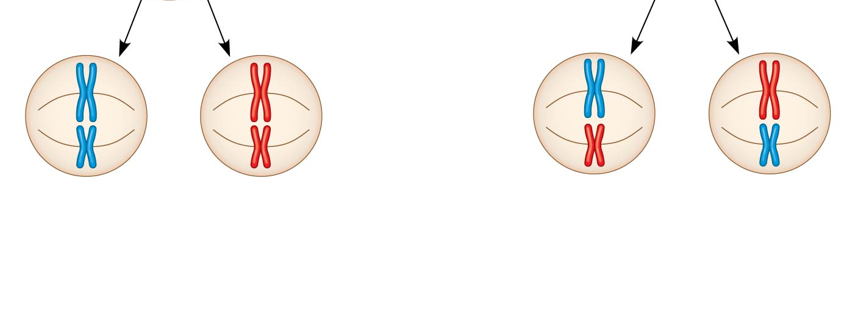
Independent Assortment of Chromosomes
Possibility 1
Possibility 2
Daughter
cells
Combination 1
Combination 2
Combination 3
Combination 4
What is the haploid number for humans?
23
2²³ = 8,388,608 possible chromosome combinations
Notes:
3
Homologous pairs of chromosomes orient randomly at metaphase I of meiosis.
In independent assortment, each pair of chromosomes sorts maternal and paternal homologs into daughter cells independently of the other pairs.
For humans (n = 23), there are more than 8 million (2²³) possible combinations of chromosomes.

Slide 4
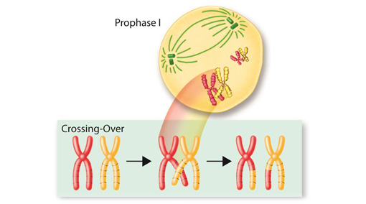
Crossing over during meiosis
DNA can be exchanged between chromatids of homologous chromosomes to produce new combinations of DNA.
Notes:
4
Review: In crossing over, homologous portions of two nonsister chromatids trade places.
Crossing over contributes to genetic variation by combining DNA, producing chromosomes with new combinations of maternal and paternal alleles.

Slide 5
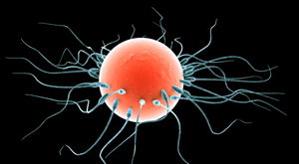
Random fertilization – any sperm can fuse with any egg
Notes:
5
Review: In crossing over, homologous portions of two nonsister chromatids trade places.
Crossing over contributes to genetic variation by combining DNA, producing chromosomes with new combinations of maternal and paternal alleles.

