Slide 2
0
Chapter 14
Translation

Slide 3
You Must Know
How genetic material is translated into polypeptides.

Slide 4
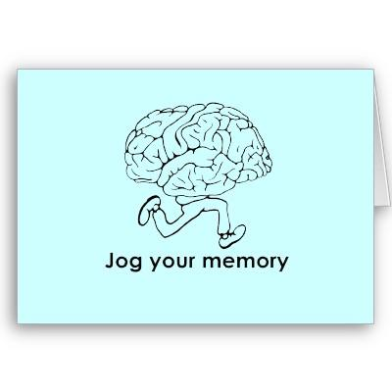
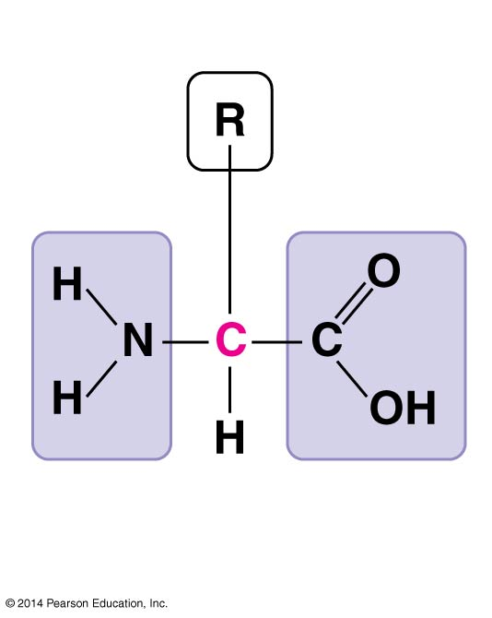
What are the monomers of proteins?
Amino Acids
α carbon
There are 20 different amino acids.
Notes:
4
Amino acids are organic molecules with carboxyl and amino groups.
Amino acids differ in their properties due to differing side chains, called R groups.

Slide 5
Which part of the molecule is unique to each amino acid?
R Group
α carbon
There are 20 different amino acids.
Notes:
5
Amino acids are organic molecules with carboxyl and amino groups.
Amino acids differ in their properties due to differing side chains, called R groups.

Slide 6
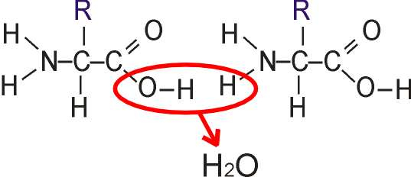
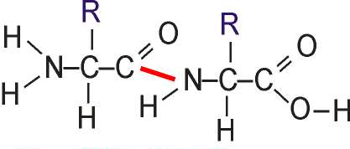
What is the name of the bond that links amino acids?
peptide bond
Notes:
Amino acids are linked by peptide bonds
A polypeptide is a polymer of amino acids
Polypeptides range in length from a few to more than a thousand monomers
Each polypeptide has a unique linear sequence of amino acids, with a carboxyl end (C-terminus) and an amino end (N-terminus)

Slide 7
What are the four levels of protein structure?

Slide 8
What are the four levels of protein structure?

Slide 9
What are the four levels of protein structure?

Slide 10
What are the four levels of protein structure?

Slide 11
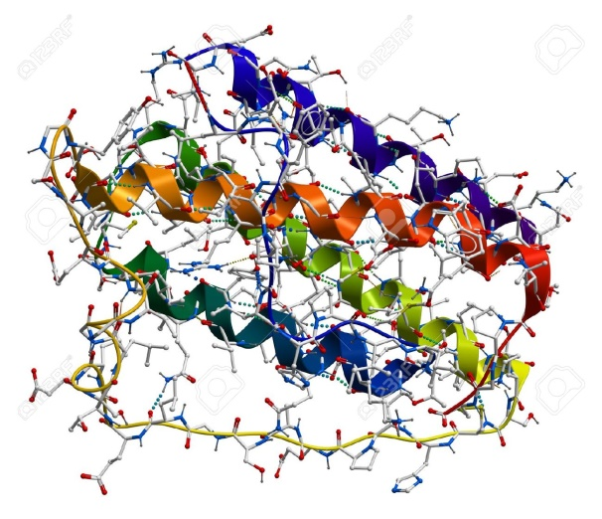
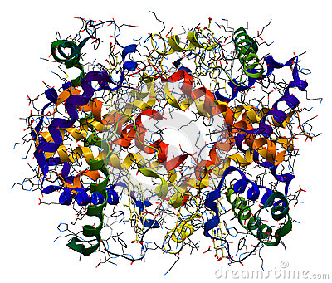
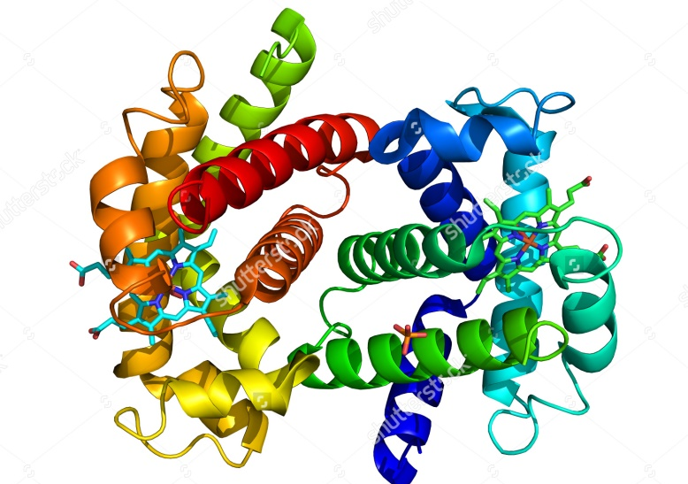
A protein’s structure determines its function!
© 2014 Pearson Education, Inc.
Notes:
11
Polypeptides are unbranched polymers built from the same set of 20 amino acids. A protein is a biologically functional molecule that consists of one or more polypeptides.

Slide 12
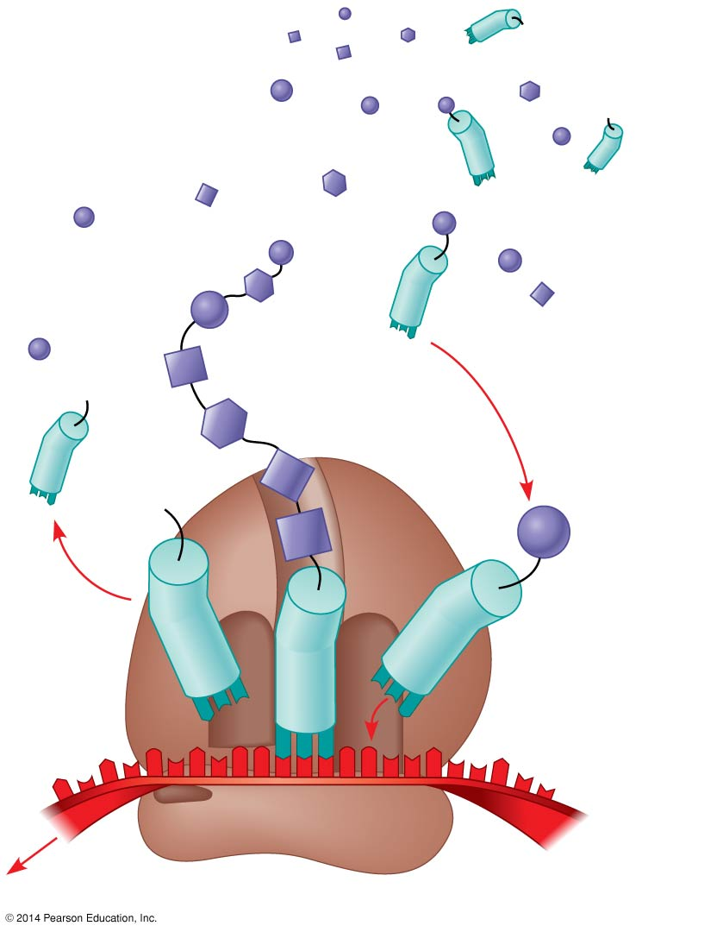
Translation - overview
Amino acids
Polypeptide
tRNA with
amino acid
attached
Ribosome
Trp
Phe
Gly
tRNA
C
C
C
Anticodon
A
C
G
A
A
A
U
G
G
U
U
U
G
G
C
5′
Codons
3′
mRNA
Notes:
12
A cell translates an mRNA message into protein with the help of transfer RNA (tRNA).
tRNAs transfer amino acids to the growing polypeptide in a ribosome.
Each tRNA can translate a particular mRNA codon into a given amino acid.
The tRNA contains an amino acid at one end and at the other end has a nucleotide triplet that can base-pair with the complementary codon on mRNA.

Slide 13
tRNA
3′
Amino acid
attachment
site
A
C
C
5′
A
Amino acid
attachment site
C
G
G
C
C
G
U
G
U
A
A
U
*
U
C
A
U
G
C
A
C
A
G
U
A
C
A
*
G
*
C
U
*
C
G
U
G
U
*
C
G
A
G
G
*
*
U
C
A
G
G
*
*
G
A
G
C
Hydrogen
bonds
G
C
U
A
*
G
A
*
A
C
A
A
G
*
U
3′
5′
A
A
G
Anticodon
Anticodon
wobble
Notes:
13
A tRNA molecule consists of a single RNA strand that is only about 80 nucleotides long.
tRNA molecules can base-pair with themselves
Flattened into one plane, a tRNA molecule looks like a cloverleaf.
In three dimensions, tRNA is roughly L-shaped, where one end of the L contains the anticodon that base-pairs with an mRNA codon.
RNA)
Accurate translation requires two steps
First: a correct match between a tRNA and an amino acid.
Second: a correct match between the tRNA anticodon and an mRNA codon.
Flexible pairing at the third base of a codon is called wobble and allows some tRNAs to bind to more than one codon.

Slide 14
Ribosome
P site
(Peptidyl-tRNA
binding site)
Exit tunnel
A site (Aminoacyl-
tRNA binding site)
E site
(Exit site)
E
P
A
Large
subunit
mRNA
binding site
Small
subunit
Notes:
14
Ribosomes facilitate specific coupling of tRNA anticodons with mRNA codons during protein synthesis.
The large and small ribosomal are made of proteins and ribosomal RNAs (rRNAs).
In bacterial and eukaryotic ribosomes the large and small subunits join to form a ribosome only when attached to an mRNA molecule.

Slide 15
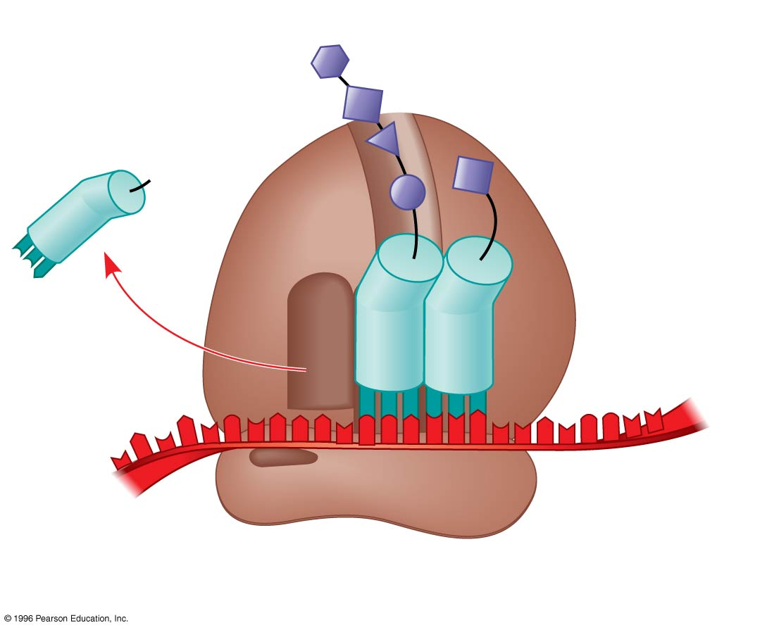
Ribosome
Growing polypeptide
Amino end
Next amino acid
to be added to
polypeptide
chain
E
tRNA
mRNA
3′
5′
Codons
Notes:
15
A ribosome has three binding sites for tRNA
The P site holds the tRNA that carries the growing polypeptide chain
The A site holds the tRNA that carries the next amino acid to be added to the chain
The E site is the exit site, where discharged tRNAs leave the ribosome

Slide 16
Building a Polypeptide
The three stages of translation
Initiation
Elongation
Termination
Notes:
16
16
All three stages require protein “factors” that aid in the translation process

Slide 17
Initiation of translation
Large
ribosomal
subunit
3′
U
A
C
5′
P site
Met
5′
A
U
G
3′
Met
P
P
i
Initiator
tRNA
+
i
+
GDP
GTP
GDP
E
A
mRNA
5′
3′
5′
3′
Start codon
Small
ribosomal
subunit
mRNA binding site
Translation initiation complex
1
Small ribosomal subunit binds
to mRNA.
2
Large ribosomal subunit
completes the initiation complex.
Notes:
17
The initiation stage of translation brings together mRNA, a tRNA with the first amino acid, and the two ribosomal subunits.
A small ribosomal subunit binds with mRNA and a special initiator tRNA.
Then the small subunit moves along the mRNA until it reaches the start codon (AUG).
The start codon is important because it establishes the reading frame for the mRNA.
The addition of the large ribosomal subunit is last and completes the formation of the translation initiation complex.
Proteins called initiation factors bring all these components together.

Slide 18
Elongation
Amino end
of polypeptide
1
Codon recognition
E
3′
mRNA
Ribosome ready for
next aminoacyl tRNA
mRNA
P
site
A
site
5′
GTP
5′
GDP
+
P
i
E
E
P
P
A
A
P
P
A
A
GDP
2
Peptide bond
formation
GDP
+
+
P
P
i
i
3
Translocation
GTP
GTP
E
P
P
A
A
Notes:
18
During elongation, amino acids are added one by one to the previous amino acid at the C-terminus of the growing chain.
Each addition involves proteins called elongation factors and occurs in three steps: codon recognition, peptide bond formation, and translocation.
Translation proceeds along the mRNA in a 5′ to 3′ direction.

Slide 19
Termination of translation
Release
factor
Free
polypeptide
5′
3′
3′
5′
5′
3′
2
GTP
Stop codon
(UAG, UAA, or UGA)
GDP
+
P
i
1
Ribosome reaches a
stop codon on mRNA.
2
Release factor
promotes
hydrolysis.
3
Ribosomal
subunits and other
components
dissociate.
Notes:
19
Termination occurs when a stop codon in the mRNA reaches the A site of the ribosome.
The A site accepts a protein called a release factor.
The release factor causes the addition of a water molecule instead of an amino acid.
This reaction releases the polypeptide, and the translation assembly then comes apart.

Slide 20
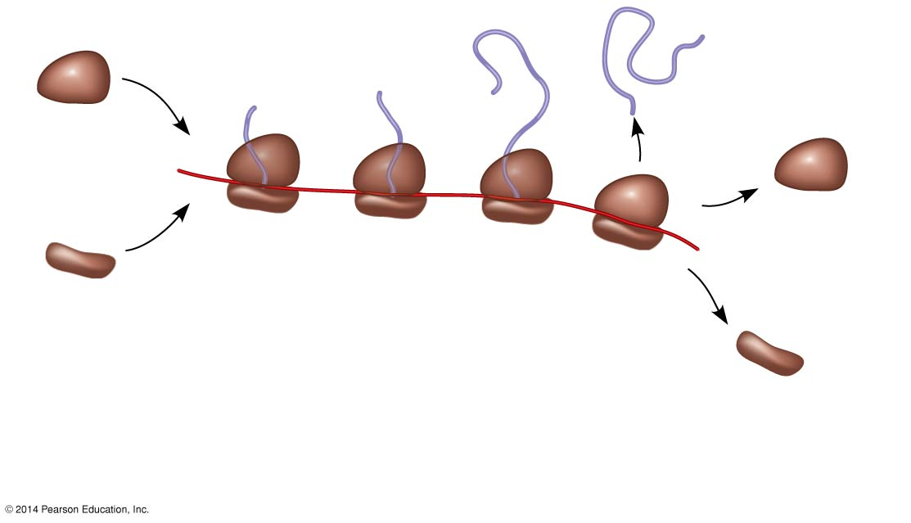
Figure 14.22a
Growing
polypeptides
Completed
polypeptide
Incoming
ribosomal
subunits
Polyribosome
Start of
mRNA
(5′ end)
End of mRNA
(3′ end)
(a) Several ribosomes simultaneously translating one
mRNA molecule
Notes:
20
In bacteria and eukaryotes multiple ribosomes translate an mRNA at the same time.
Once a ribosome is far enough past the start codon, another ribosome can attach to the mRNA.
Strings of ribosomes called polyribosomes (or polysomes) can be seen with an electron microscope.

Slide 21
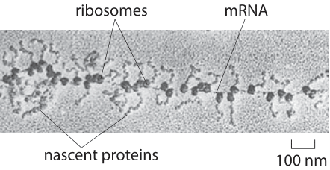
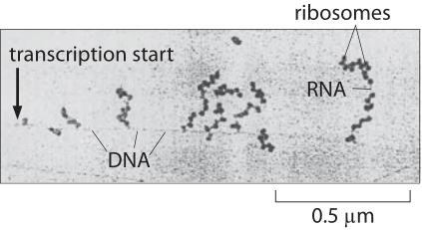
Eukaryote
A
Prokaryote
B
Notes:
Which electron micrograph came from a prokaryote and which came from a eukaryote. How can you tell?

