Slide 1
Remember that the test is on Tuesday
The triple POGIL POGIL Quiz will be on Tuesday or Wednesday

Slide 2
0
Chapter 14
Mutations

Slide 3
You Must Know
How mutations can change the amino acid sequence of a protein and the affect that will have on how the protein functions.

Slide 4
Mutation
A change in the genetic material of a cell or virus.
Notes:
4
4
Concept 14.5: Mutations of one or a few nucleotides can affect protein structure and function

Slide 5
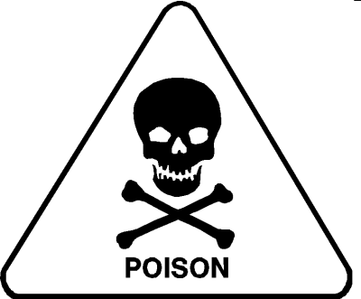
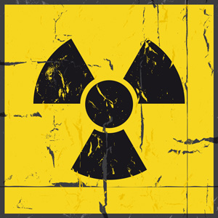
Mutagens
Notes:
Spontaneous mutations can occur during DNA replication, recombination, or repair.
Mutagens are physical or chemical agents that can cause mutations.
Most cancer-causing chemicals (carcinogens) are mutagenic, and the converse is also true.

Slide 6
Point mutations are chemical changes in just one or a few nucleotide pairs of a gene.
The change of a single nucleotide in a DNA template strand can lead to the production of an abnormal protein.
Notes:
6
6

Slide 7
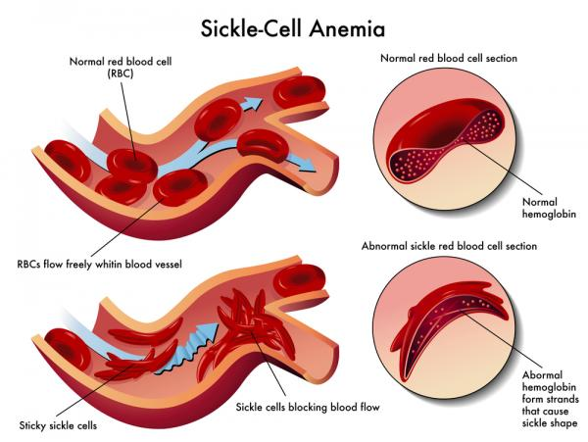

Slide 8
The molecular basis of sickle-cell disease
Wild-type hemoglobin
Sickle-cell hemoglobin
Wild-type hemoglobin DNA
Mutant hemoglobin DNA
C
C
A
C
C
C
T
C
5′
3′
T
5′
3′
A
G
T
G
G
A
3′
G
G
5′
G
3′
5′
mRNA
mRNA
G
G
G
A
G
5′
A
3′
5′
G
U
G
3′
Normal hemoglobin
Sickle-cell hemoglobin
Glu
Glu
Val
Notes:
8

Slide 9
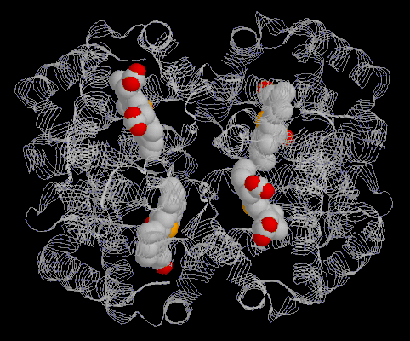
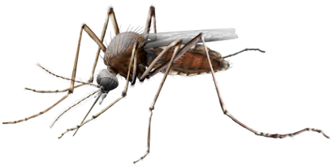
Normal hemoglobin
Sickle-cell hemoglobin
Glu
Val
Hemoglobin is made up of four polypeptides.
Hemoglobin alleles are codominant.
What would the hemoglobin of someone who was heterozygous for sickle cell anemia be like?
People who are heterozygous for sickle cell anemia don’t have the disease and they are resistant to malaria!
Normal polypeptide
Sickle-cell polypeptide
Glu
Val
Normal polypeptide
Sickle-cell polypeptide
Glu
Val

Slide 10
Types of Small-Scale Mutations
Point mutations within a gene can be divided into two general categories.
Nucleotide-pair substitutions.
One or more nucleotide-pair insertions or deletions.
Notes:
10
10

Slide 11
Substitutions
Nucleotide-pair substitution
replaces one nucleotide with another nucleotide.
Silent mutations
have no effect on the amino acid produced by a codon because of redundancy in the genetic code.
Notes:
11
11

Slide 12
Figure 14.26a
Wild type
DNA template strand
3′
T
A
C
T
T
C
A
A
A
C
C
G
A
T
T
5′
5′
A
T
G
A
A
G
T
T
T
G
G
C
T
A
A
3′
mRNA
5′
A
U
G
A
A
G
U
U
U
G
G
C
U
A
A
3′
Protein
Met
Lys
Phe
Gly
Stop
Amino end
Carboxyl end
What would the amino acid sequence be in a silent mutation?
Nucleotide-pair substitution: silent
A instead of G
3′
T
A
C
T
T
C
A
A
A
C
C
A
A
T
T
5′
5′
A
T
G
A
A
G
T
T
T
G
G
T
T
A
A
3′
U instead of C
5′
A
U
G
A
A
G
U
U
U
G
G
U
U
A
A
3′
Met
Lys
Phe
Gly
Stop
Notes:
12

Slide 13
Missense mutations still code for an amino acid, but not the correct amino acid.
Is sickle cell anemia a missense mutation?
Yes.
Substitution mutations are usually missense mutations.
Nonsense mutations change an amino acid codon into a stop codon, nearly always leading to a nonfunctional protein.
Notes:
13
13

Slide 14
Wild type
DNA template strand
3′
T
A
C
T
T
C
A
A
A
C
C
G
A
T
T
5′
5′
A
T
G
A
A
G
T
T
T
G
G
C
T
A
A
3′
mRNA
5′
A
U
G
A
A
G
U
U
U
G
G
C
U
A
A
3′
Protein
Met
Lys
Phe
Gly
Stop
Amino end
Carboxyl end
What would the amino acid sequence be if there were a nonsense mutation at the arrow?
Nucleotide-pair substitution: nonsense
A instead of T
3′
T
A
C
A
T
C
A
A
A
C
C
G
A
T
T
5′
5′
A
T
G
T
A
G
T
T
T
G
G
C
T
A
A
3′
U instead of A
5′
A
U
G
U
A
G
U
U
U
G
G
C
U
A
A
3′
Met
Stop
Notes:
14
Figure 14.26c Types of small-scale mutations that affect mRNA sequence (part 3: nonsense)

Slide 15
Frameshift mutations
Notes:
Insertions and deletions are additions or losses of nucleotide pairs in a gene. These mutations have a disastrous effect on the resulting protein more often than substitutions do. Insertion or deletion of nucleotides may alter the reading frame of the genetic message, producing a frameshift mutation.

Slide 16
Figure 14.26f
3 nucleotide-pair deletion
There is no frameshift, but one amino acid is missing
Notes:
16

