Slide 1
0
Chapter 14
Transcription

Slide 2
You Must Know
The differences between replication (from chapter 13), transcription and translation and the role of DNA and RNA in each process. (There will be more on this later.)
How eukaryotic cells modify RNA after transcription.

Slide 3
Three stages of Transcription
Promoter
Transcription unit
5′
3′
3′
5′
Start point
RNA polymerase
1
Initiation
5′
3′
3′
5′
Unwound
DNA
RNA
transcript
Template strand of DNA
2
Elongation
Rewound
DNA
5′
3′
3′
3′
5′
5′
RNA
transcript
Direction of
transcription
(“downstream”)
3
Termination
5′
3′
3′
5′
5′
3′
Completed RNA transcript
Notes:
3
RNA synthesis is catalyzed by RNA polymerase, which pries the DNA strands apart and joins together the RNA nucleotides.
RNA polymerases assemble polynucleotides in the 5′ to 3′ direction.
However, RNA polymerases can start a chain without a primer.
The DNA sequence where RNA polymerase attaches is called the promoter; in bacteria, the sequence signaling the end of transcription is called the terminator.
The stretch of DNA that is transcribed is called a transcription unit.

Slide 4
Initiation
Promoter
Nontemplate strand
DNA
5′
T
A
T
A
A
A
A
3′
3′
A
T
A
T
T
T
T
5′
1
A eukaryotic
promoter
TATA box
Start point
Template
strand
Transcription
factors
5′
3′
2
Several transcription
factors bind to DNA.
3′
5′
RNA polymerase II
Transcription
factors
3
Transcription
initiation
complex forms.
5′
3′
3′
3′
5′
5′
RNA transcript
Transcription initiation complex
Notes:
4
Promoters signal the transcriptional start point and usually extend several dozen nucleotide pairs upstream of the start point.
Transcription factors mediate the binding of RNA polymerase and the initiation of transcription.
The completed assembly of transcription factors and RNA polymerase II bound to a promoter is called a transcription initiation complex.
A promoter called a TATA box is crucial in forming the initiation complex in eukaryotes.

Slide 5
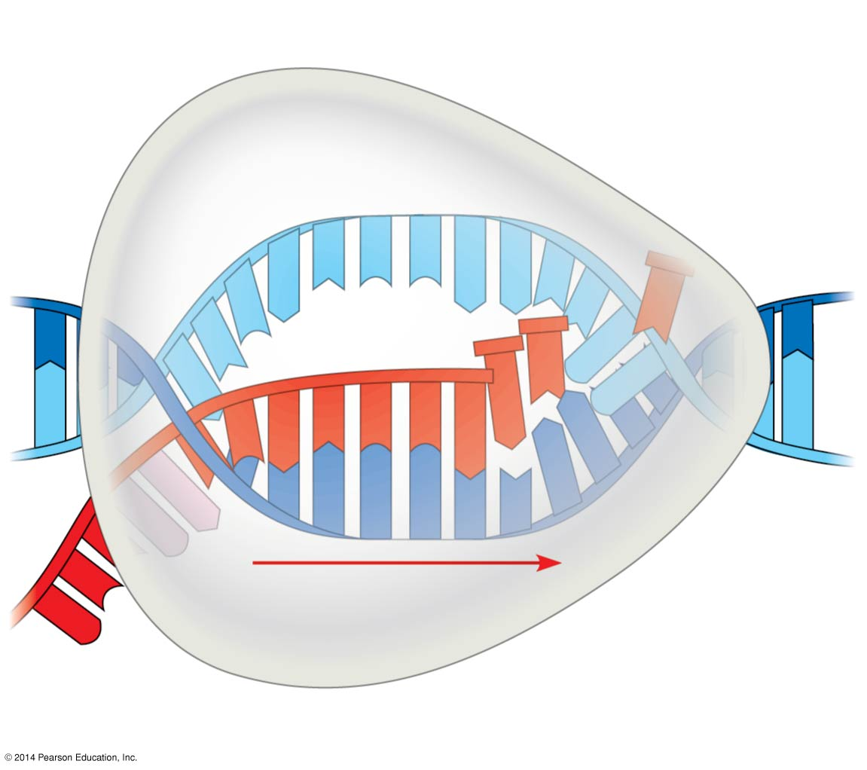
Elongation
Nontemplate
strand of DNA
RNA nucleotides
RNA
polymerase
A
T
C
C
A
A
3′
T
5′
C
T
U
3′ end
G
T
U
A
G
A
C
C
A
U
C
C
A
C
A
5′
A
3′
T
A
G
G
T
T
5′
Direction of transcription
Template
strand of DNA
Newly made
RNA
Notes:
5
As RNA polymerase moves along the DNA, it untwists the double helix, 10 to 20 bases at a time.
Transcription progresses at a rate of 40 nucleotides per second in eukaryotes.
A gene can be transcribed simultaneously by several RNA polymerases.

Slide 6
Termination
RNA polymerase II transcribes a polyadenylation signal sequence; the RNA transcript is released 10–35 nucleotides past this polyadenylation sequence.
Polyadenylation
signal
5′
3′
AAUAAA
Notes:
6
6

Slide 7
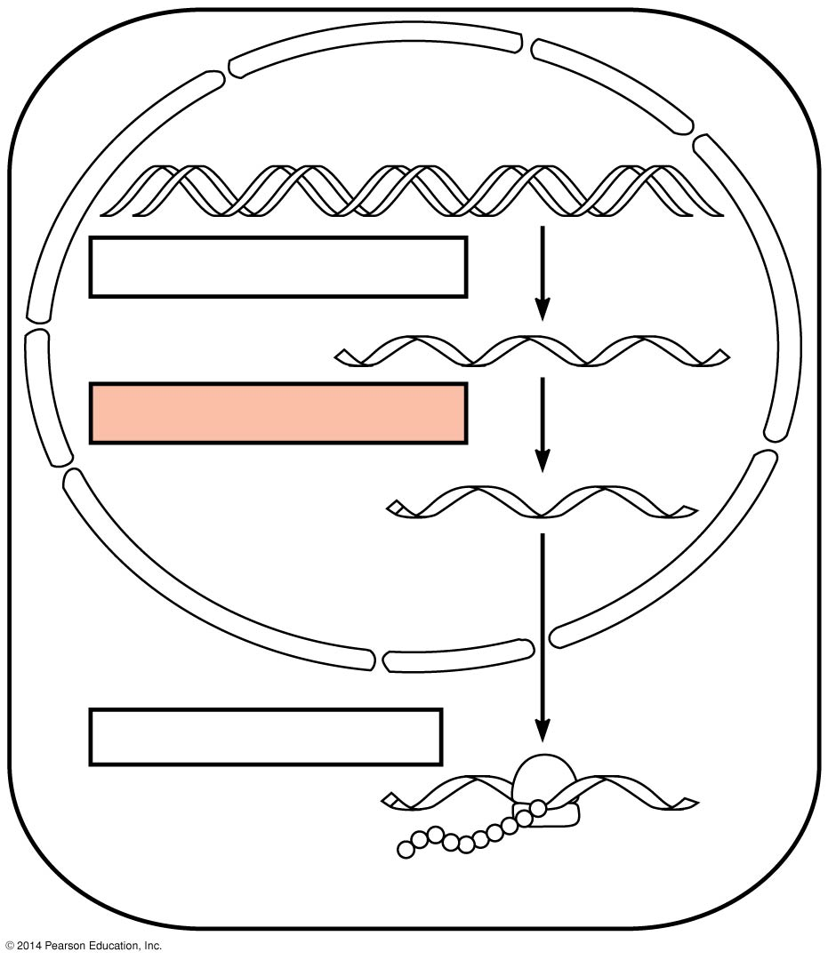
Figure 14.UN03
TRANSCRIPTION
DNA
RNA PROCESSING
Pre-mRNA
mRNA
TRANSLATION
Ribosome
Polypeptide
Notes:
7
Enzymes in the eukaryotic nucleus modify pre-mRNA (RNA processing) before the genetic messages are dispatched to the cytoplasm.
During RNA processing, both ends of the primary transcript are altered.
Also, usually some interior parts of the molecule are cut out and the other parts spliced together.

Slide 8
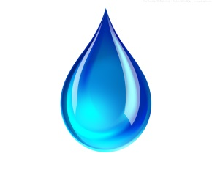
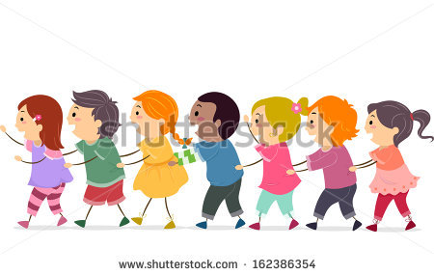
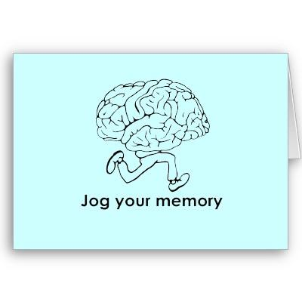
What is hydrolysis?
© 2014 Pearson Education, Inc.
Notes:
8
Polymers are disassembled to monomers by hydrolysis, a reaction that is essentially the reverse of the dehydration reaction
These processes are facilitated by enzymes, which speed up chemical reactions.

Slide 9
RNA Processing in Eukaryotes
A modified guanine
nucleotide added to
the 5′ end
50–250 adenine
nucleotides added
to the 3′ end
Polyadenylation
signal
Protein-coding segment
5′
3′
G
P
P
P
AAUAAA
AAA
…
AAA
5′ Cap
5′ UTR
Start
codon
Stop
codon
3′ UTR
Poly-A tail
Notes:
9
Each end of a pre-mRNA molecule is modified in a particular way
The 5′ end receives a modified G nucleotide 5′ cap
The 3′ end gets a poly-A tail

Slide 10
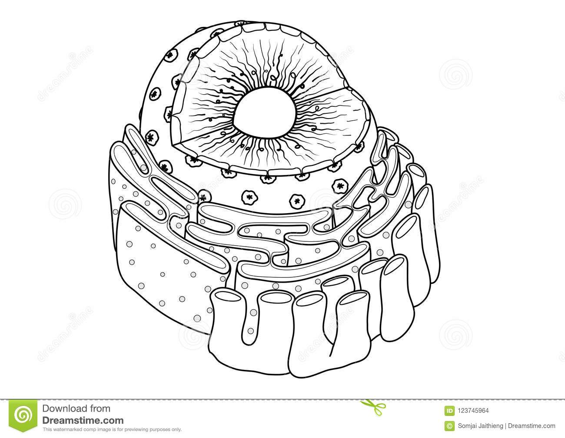
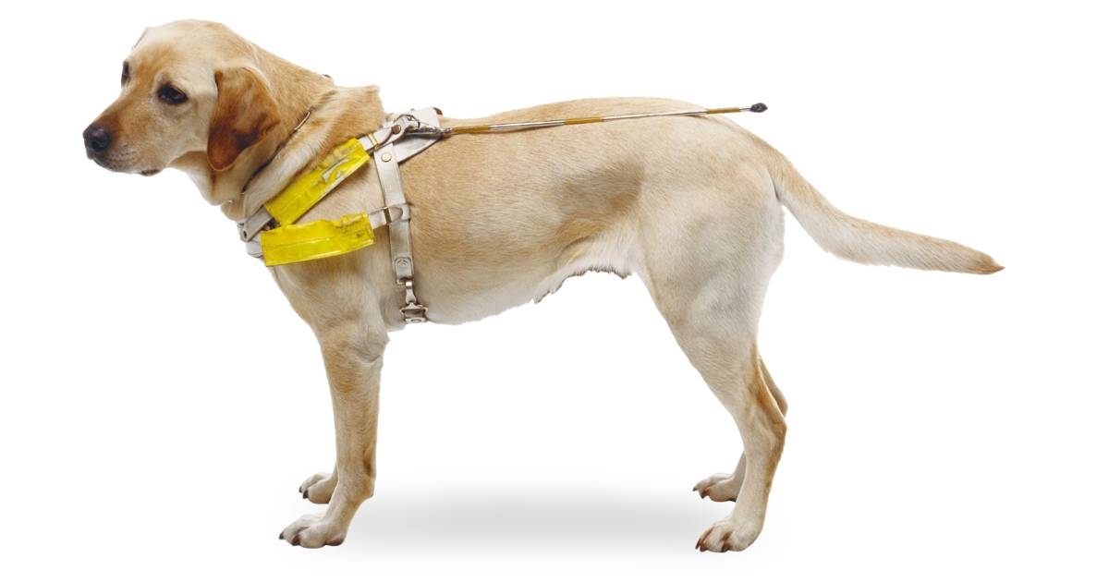
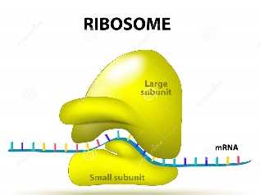
These modifications share several functions
Facilitating the export of mRNA to the cytoplasm
Helping ribosomes attach to the 5′ end
Notes:
10
Each end of a pre-mRNA molecule is modified in a particular way
The 5′ end receives a modified G nucleotide 5′ cap
The 3′ end gets a poly-A tail

Slide 11
These modifications share several functions
3. Protecting mRNA from hydrolytic enzymes
A
A
A
A
A
A
A
Notes:
11
Each end of a pre-mRNA molecule is modified in a particular way
The 5′ end receives a modified G nucleotide 5′ cap
The 3′ end gets a poly-A tail

Slide 12
Figure 14.12
Exons
Pre-mRNA
Intron
Intron
5′ Cap
Poly-A tail
Introns cut out and
exons spliced together
mRNA
5′ Cap
Poly-A tail
5′ UTR
3′ UTR
Coding
segment
AAUAAA
Notes:
12
Most eukaryotic mRNAs have long noncoding stretches of nucleotides that lie between coding regions.
The noncoding regions are called intervening sequences, or introns.
The other regions are called exons and are usually translated into amino acid sequences.
RNA splicing removes introns and joins exons, creating an mRNA molecule with a continuous coding sequence.

Slide 13
Alternative RNA Splicing
Notes:
Many genes can give rise to two or more different polypeptides, depending on which segments are used as exons.
This process is called alternative RNA splicing.

Slide 14
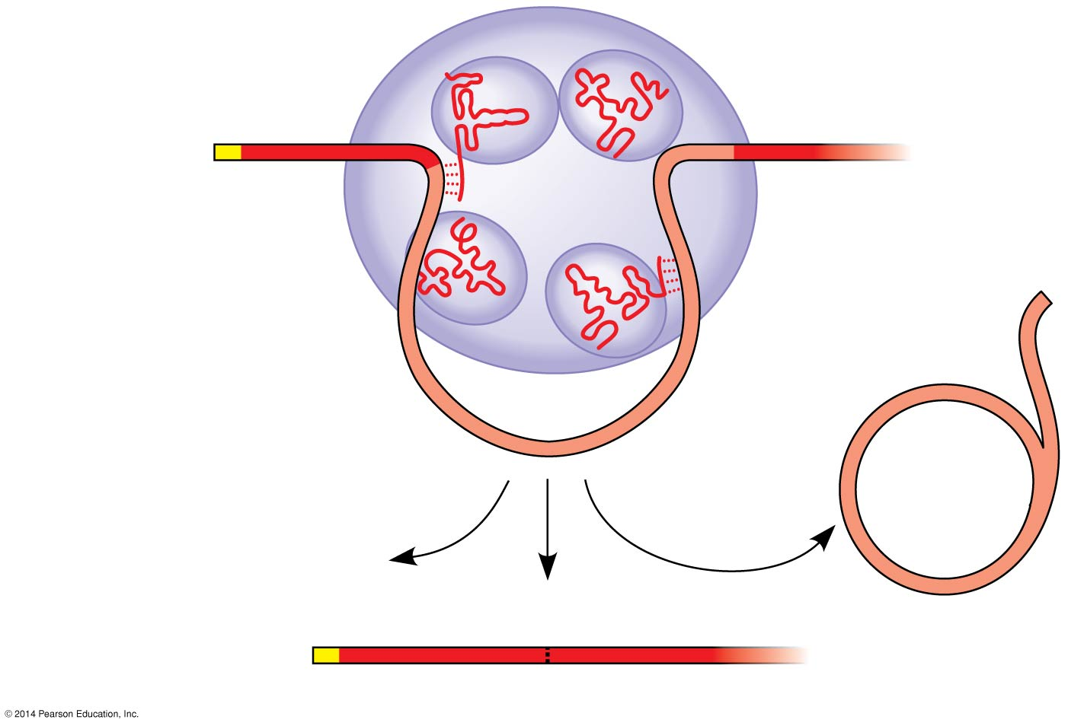
RNA splicing is carried out by spliceosomes
Small RNAs
Spliceosome
Small RNAs
Spliceosome
5′
5′
Pre-mRNA
Pre-mRNA
Exon 2
Exon 1
Exon 2
Exon 1
Intron
Intron
Spliceosome
components
mRNA
5′
Cut-out
intron
Exon 1
Exon 2
Notes:
14
Spliceosomes consist of proteins and small RNAs.

