Slide 1
There will be a test over chapters 13 and 14 on Monday, February 3rd
The Chapter 13 and 14 Homework is due on Sunday, February 2nd

Slide 2
0
Chapter 13
Genetic Experiments

Slide 3
Background Information

Slide 4
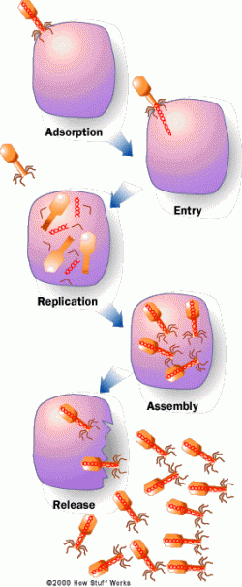
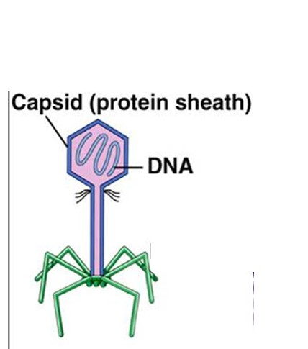
Virus
An infective agent that typically consists of a nucleic acid molecule in a protein coat.
It is able to multiply only within the living cells of a host.

Slide 5
Horizontal Gene Transfer
The transfer of genetic information that is NOT from parent to offspring. (NOT vertical gene transfer.)

Slide 6
Three ways bacteria acquire new DNA
Transduction: the process by which foreign DNA is introduced into a bacterial cell by a virus.

Slide 7
Three ways bacteria acquire new DNA
Conjugation: the transfer of genetic material between bacterial cells by direct cell-to-cell contact.

Slide 8
Three ways bacteria acquire new DNA
3. Transformation: a change in genotype due to assimilation of foreign DNA.

Slide 9
Techniques used in experiments

Slide 10
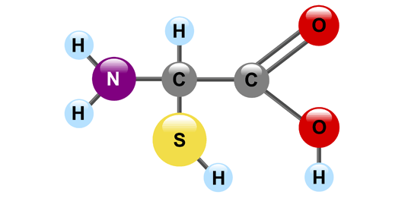
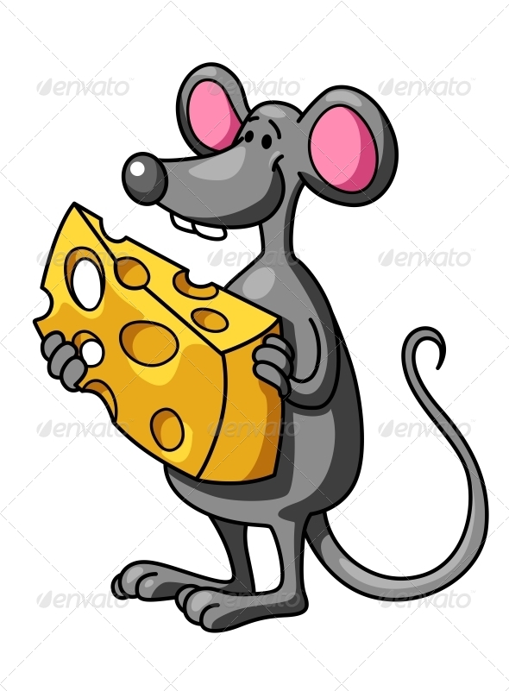
Radioactive Labeling Technique

Slide 11
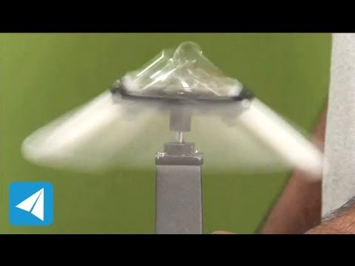
Centrifuge Density Separation

Slide 12
Hershey and Chase Experiment

Slide 13
Transformation
Notes:
13
Transformation: a change in genotype due to assimilation of foreign DNA.

