Slide 1
0
Chapter 13
Genetic Engineering
Day

Slide 2
You Must Know
The key ideas that make PCR possible and applications for this technology.
How gel electrophoresis can be used to separate DNA fragments.

Slide 3
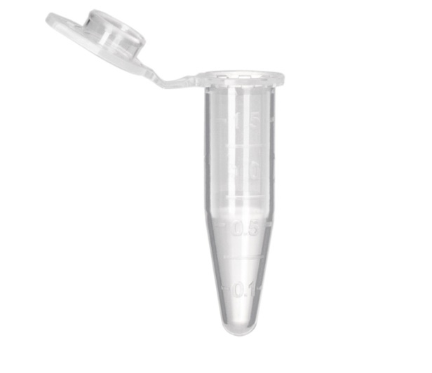
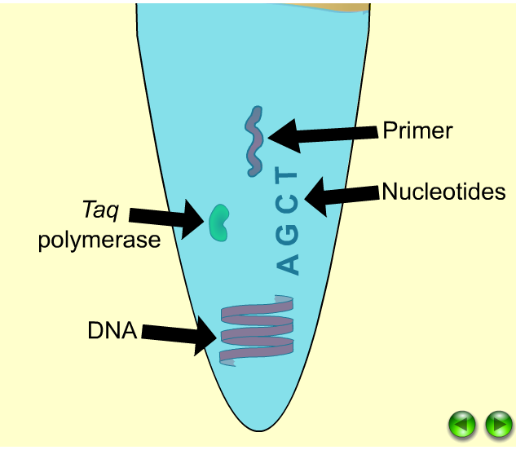
PCR
Used to make many copies of a piece of DNA.

Slide 4
PCR
Taq polymerase
Notes:
The polymerase chain reaction, PCR, can produce many copies of a specific target segment of DNA.
A three-step cycle brings about a chain reaction that produces an exponentially growing population of identical DNA molecules.
The key to PCR is an unusual, heat-stable DNA polymerase called Taq polymerase.
PCR amplification alone cannot substitute for gene cloning in cells.
Instead, PCR is used to provide the specific DNA fragment to be cloned.
PCR primers are synthesized to include a restriction site that matches the site in the cloning vector.
The fragment and vector are cut and ligated together.

Slide 5
PCR

Slide 6
Gel Electrophoresis
Notes:
To see the fragments produced by cutting DNA molecules with restriction enzymes, researchers use gel electrophoresis.
This technique separates a mixture of nucleic acid fragments based on length.

Slide 7
Negatively charged DNA molecules will move toward the positive electrode.

