Slide 1
0
Chapter 13
Evidence that DNA is the Genetic Material

Slide 2
You Must Know
The knowledge about DNA gained from the work of Griffith; Hershey and Chase; Wilkins and Franklin; and Watson and Crick.

Slide 3
Overview: Life’s Operating Instructions
In 1953, James Watson and Francis Crick introduced an elegant double-helical model for the structure of deoxyribonucleic acid, or DNA
DNA, the substance of inheritance, is the most celebrated molecule of our time
Hereditary information is encoded in DNA and reproduced in all cells of the body (DNA replication)
Notes:
3

Slide 4
Concept 13.1: DNA is the genetic material
Early in the 20th century, the identification of the molecules of inheritance loomed as a major challenge to biologists
Notes:
4

Slide 5
The Search for the Genetic Material: Scientific Inquiry
When T. H. Morgan’s group showed that genes are located on chromosomes, the two components of chromosomes—DNA and protein—became candidates for the genetic material
The key factor in determining the genetic material was choosing appropriate experimental organisms
The role of DNA in heredity was first discovered by studying bacteria and the viruses that infect them
Notes:
5

Slide 6
Evidence That DNA Can Transform Bacteria
The discovery of the genetic role of DNA began with research by Frederick Griffith in 1928
Griffith worked with two strains of a bacterium, one pathogenic and one harmless
Notes:
6

Slide 7
When he mixed heat-killed remains of the pathogenic strain with living cells of the harmless strain, some living cells became pathogenic
He called this phenomenon transformation, now defined as a change in genotype and phenotype due to assimilation of foreign DNA
Notes:
7

Slide 8
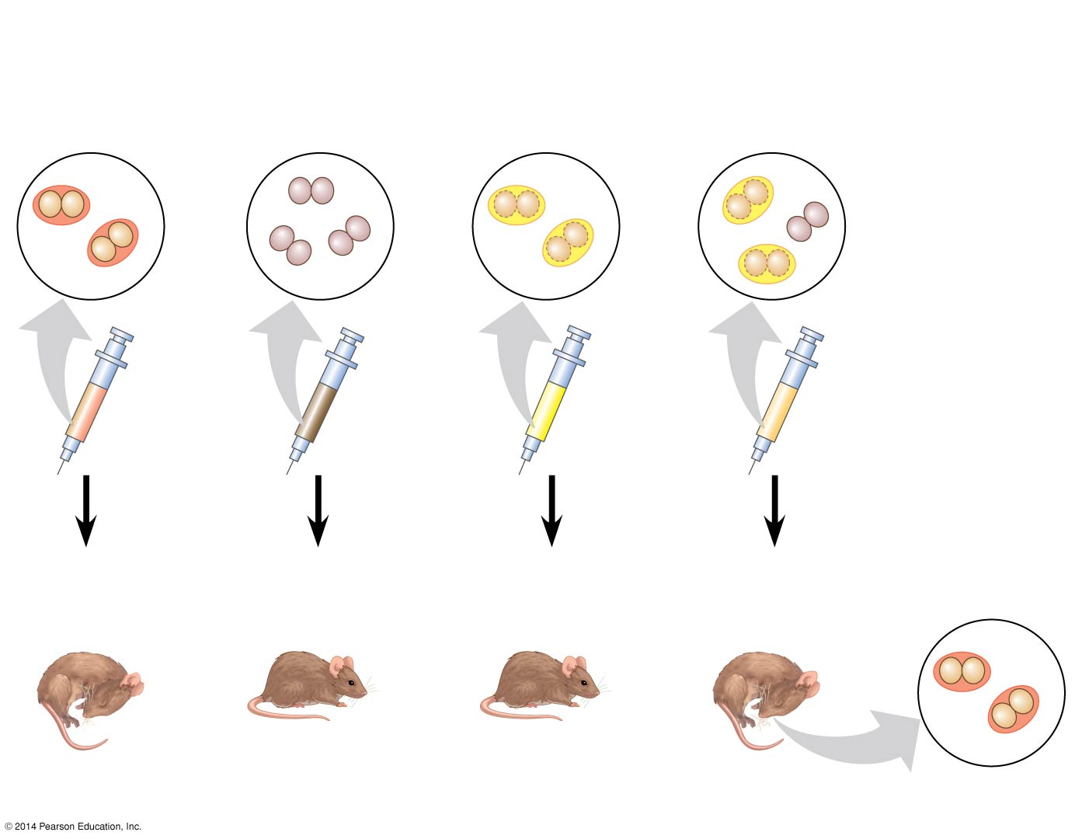
Figure 13.2
Experiment
Mixture of
heat-killed
S cells and
living R cells
Living
S cells
(control)
Living
R cells
(control)
Heat-killed
S cells
(control)
Results
Mouse dies
Mouse healthy
Mouse healthy
Mouse dies
Living S cells
Notes:
8
Figure 13.2 Inquiry: Can a genetic trait be transferred between different bacterial strains?

Slide 9
Later work identified the transforming substance as DNA.
Many biologists remained skeptical, mainly because little was known about DNA and they thought proteins were better candidates for the genetic material.
Notes:
9

Slide 10
Evidence That Viral DNA Can Program Cells
More evidence for DNA as the genetic material came from studies of viruses that infect bacteria
Such viruses, called bacteriophages (or phages), are widely used in molecular genetics research
A virus is DNA (or RNA) enclosed by a protective protein coat
Viruses must infect cells and take over the cells’ metabolic machinery in order to reproduce
Notes:
10

Slide 11
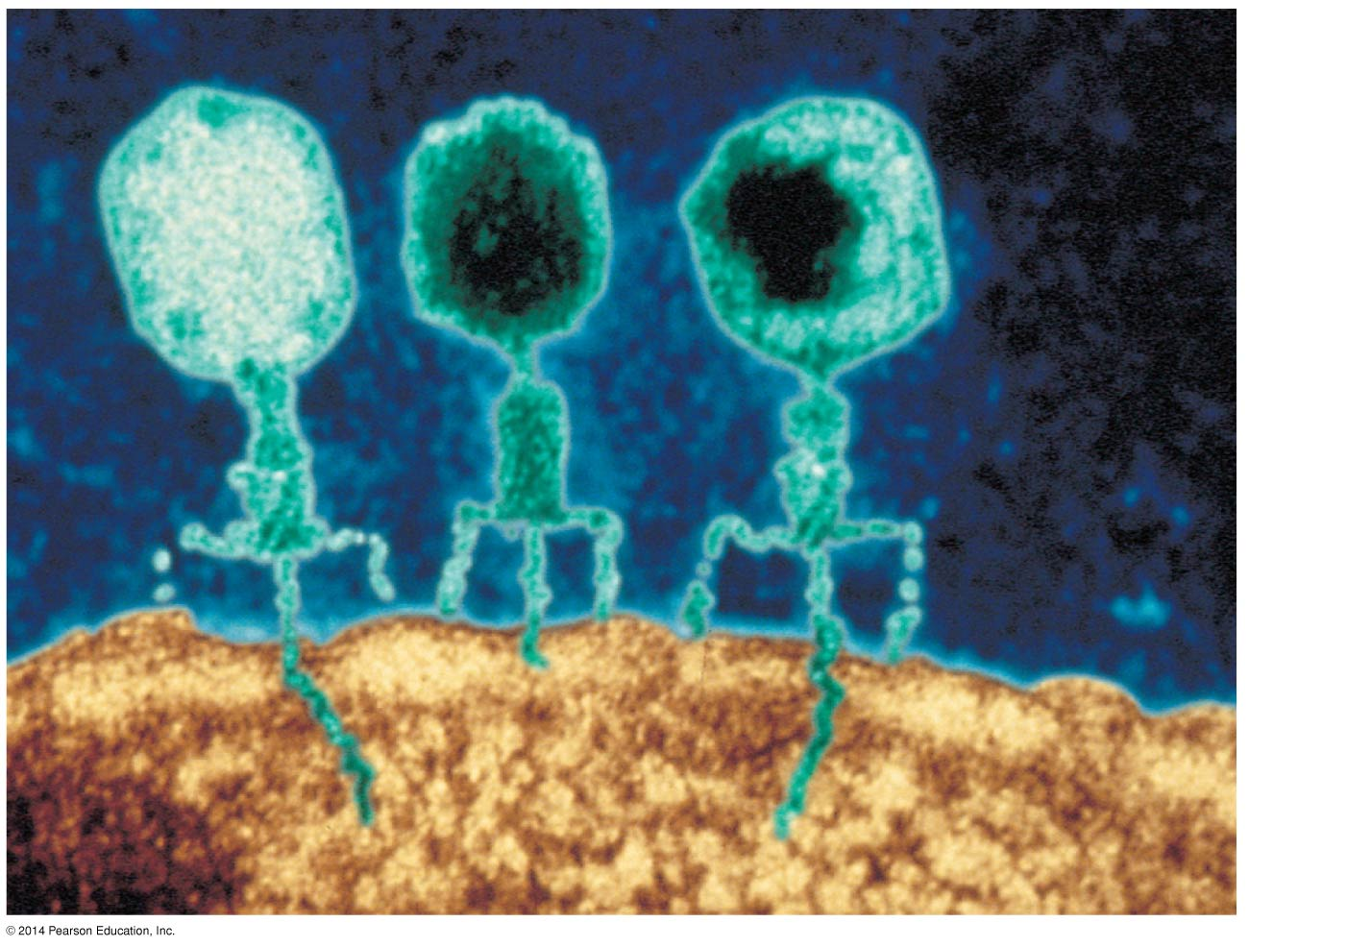
Figure 13.3
Phage
head
Tail
sheath
Tail fiber
DNA
100 nm
Bacterial
cell
Notes:
11
Figure 13.3 Viruses infecting a bacterial cell

Slide 12
In 1952, Alfred Hershey and Martha Chase showed that DNA is the genetic material of a phage known as T2
To determine this, they designed an experiment showing that only the DNA of the T2 phage, and not the protein, enters an E. coli cell during infection
They concluded that the injected DNA of the phage provides the genetic information
Notes:
12

Slide 13
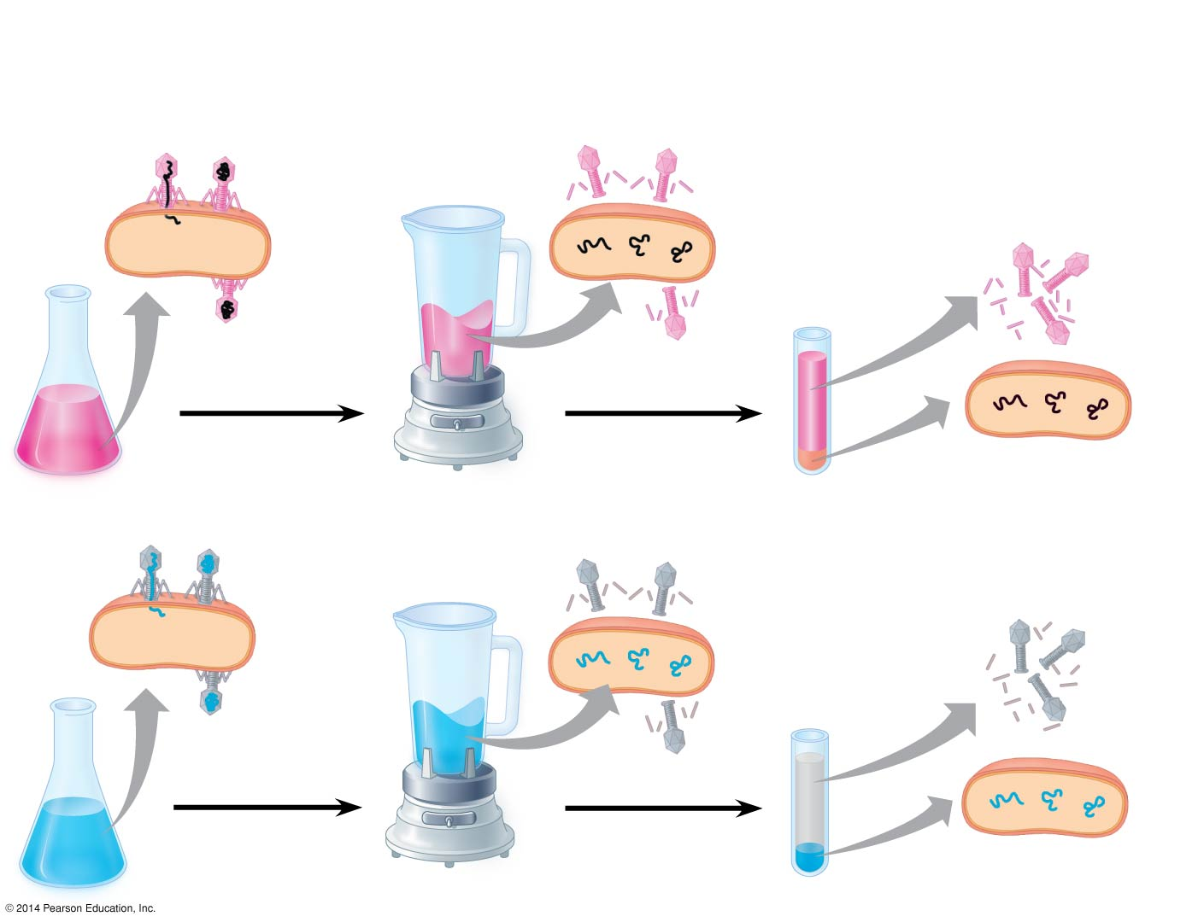
Figure 13.4
Experiment
Batch 1: Radioactive sulfur (³⁵S) in phage protein
1
Labeled phages
infect cells.
2
Agitation frees outside
phage parts from cells.
3
Centrifuged cells
form a pellet.
Radioactive
protein
4
Radioactivity
(phage protein)
found in liquid
Centrifuge
Batch 2: Radioactive phosphorus (³²P) in phage DNA
Pellet
Radioactive
DNA
Centrifuge
4
Radioactivity (phage
DNA) found in pellet
Pellet
Notes:
13
Figure 13.4 Inquiry: Is protein or DNA the genetic material of phage T2?

Slide 14
Additional Evidence That DNA Is the Genetic Material
It was known that DNA is a polymer of nucleotides, each consisting of a nitrogenous base, a sugar, and a phosphate group
In 1950, Erwin Chargaff reported that DNA composition varies from one species to the next
This evidence of diversity made DNA a more credible candidate for the genetic material
Notes:
14

Slide 15
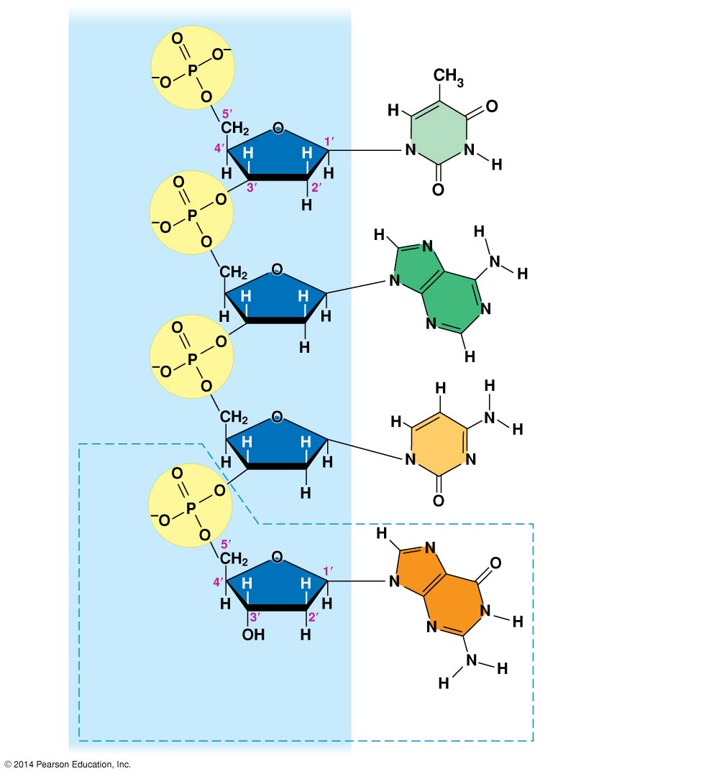
Figure 13.5
Sugar–
phosphate
backbone
Nitrogenous bases
5′ end
Thymine (T)
Adenine (A)
Cytosine (C)
3′ end
Guanine (G)
DNA
nucleotide
Notes:
15
Figure 13.5 The structure of a DNA strand

Slide 16
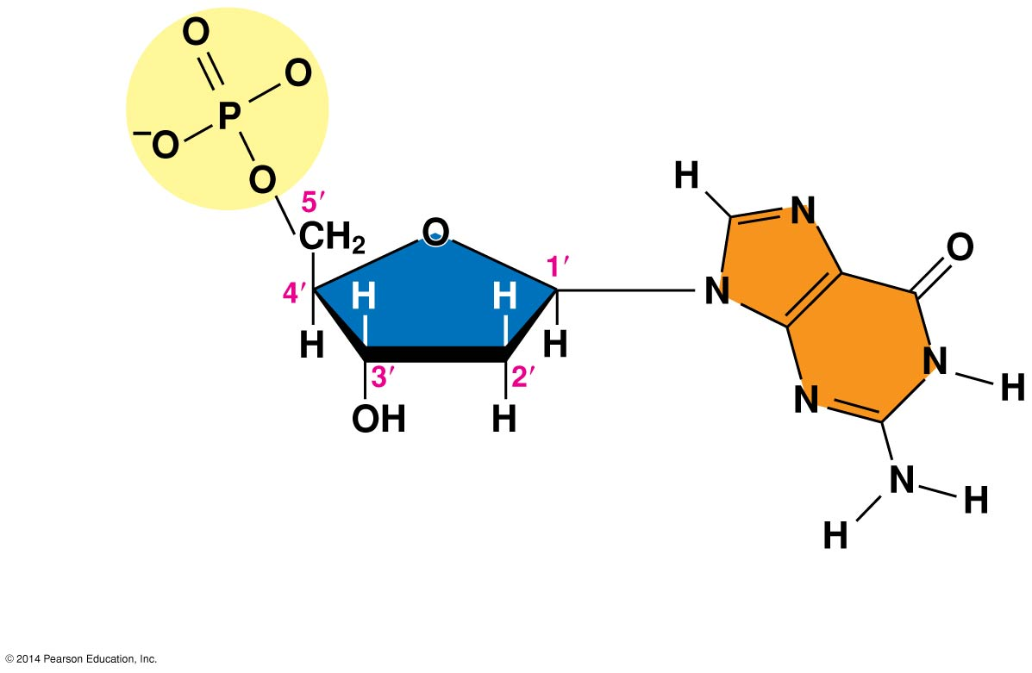
Figure 13.5a
Phosphate
3′ end
Sugar
(deoxyribose)
DNA
nucleotide
Nitrogenous
base
Notes:
16
Figure 13.5a The structure of a DNA strand (part 1: nucleotide)

Slide 17
Two findings became known as Chargaff’s rules
The base composition of DNA varies between species
In any species the number of A and T bases is equal and the number of G and C bases is equal
The basis for these rules was not understood until the discovery of the double helix
Notes:
17

Slide 18
Building a Structural Model of DNA: Scientific Inquiry
James Watson and Francis Crick were first to determine the structure of DNA
Maurice Wilkins and Rosalind Franklin were using a technique called X-ray crystallography to study molecular structure
Franklin produced a picture of the DNA molecule using this technique
Notes:
18

Slide 19
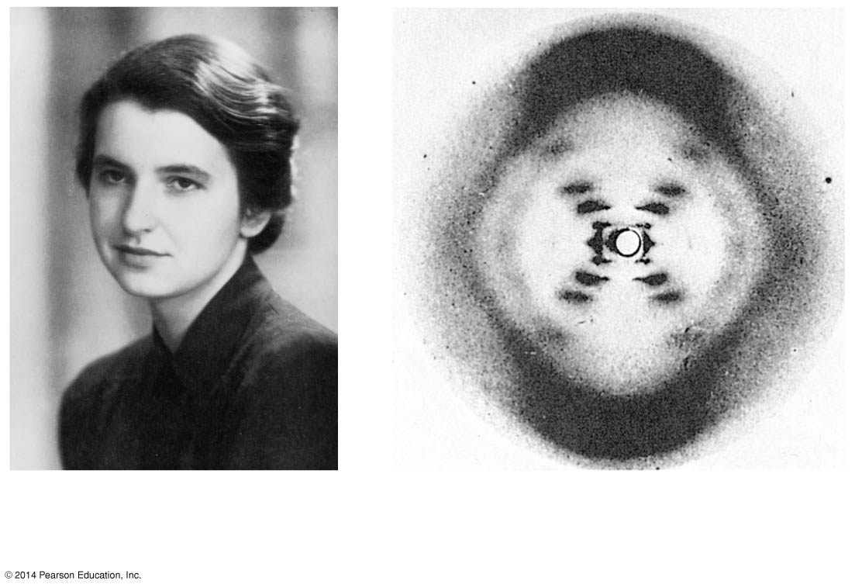
Figure 13.6
(a) Rosalind Franklin
(b) Franklin’s X-ray diffraction
photograph of DNA
Notes:
19
Figure 13.6 Rosalind Franklin and her X-ray diffraction photo of DNA

Slide 20
Franklin’s X-ray crystallographic images of DNA enabled Watson to deduce that DNA was helical
The X-ray images also enabled Watson to deduce the width of the helix and the spacing of the nitrogenous bases
The pattern in the photo suggested that the DNA molecule was made up of two strands, forming a double helix
Notes:
20

Slide 21
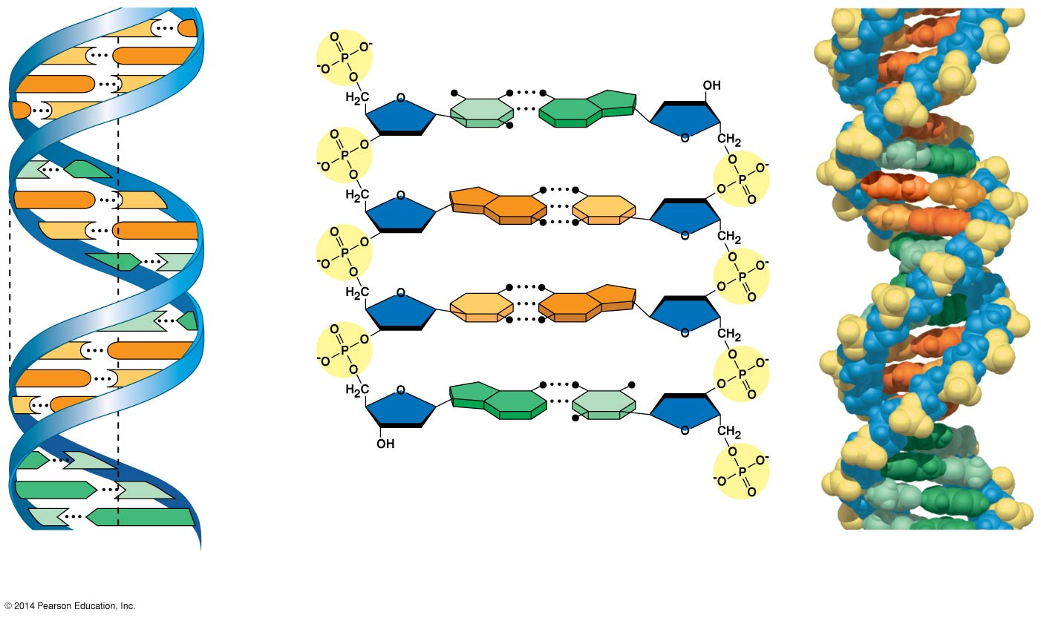
Figure 13.7
C
G
5′ end
C
G
Hydrogen bond
3′ end
G
C
G
C
T
A
3.4 nm
T
A
G
C
G
C
C
G
A
T
1 nm
C
G
T
A
C
G
G
C
C
G
A
T
A
T
3′ end
A
T
0.34 nm
T
A
5′ end
(a) Key features of
DNA structure
(b) Partial chemical structure
(c) Space-filling
model
Notes:
21
Figure 13.7 The double helix

Slide 22
Watson and Crick built models of a double helix to conform to the X-ray measurements and the chemistry of DNA
Franklin had concluded that there were two outer sugar-phosphate backbones, with the nitrogenous bases paired in the molecule’s interior
Watson built a model in which the backbones were antiparallel (their subunits run in opposite directions)
Notes:
22

Slide 23
At first, Watson and Crick thought the bases paired like with like (A with A, and so on), but such pairings did not result in a uniform width
Instead, pairing a purine with a pyrimidine resulted in a uniform width consistent with the X-ray data
Notes:
23

Slide 24
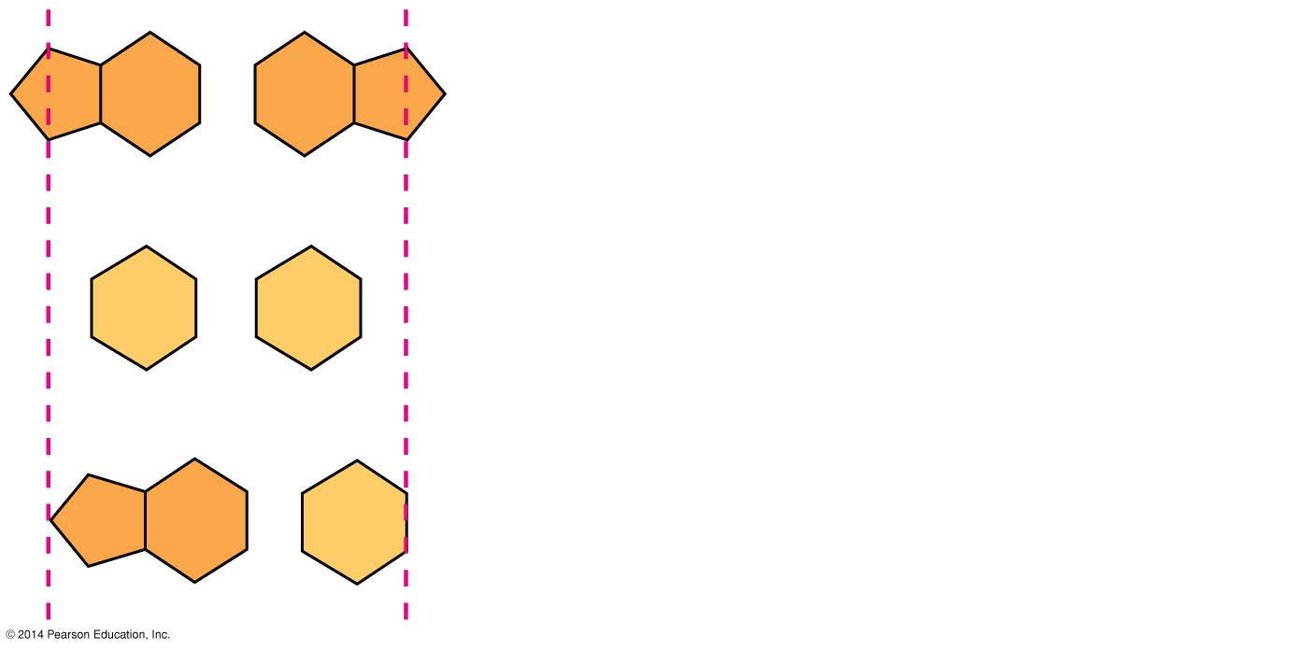
Figure 13.UN02
Purine + purine: too wide
Pyrimidine + pyrimidine: too narrow
Purine + pyrimidine: width
consistent with X-ray data
Notes:
24
Figure 13.UN02 In-text figure, purines and pyrimidines, p. 250

Slide 25
Watson and Crick reasoned that the pairing was more specific, dictated by the base structures
They determined that adenine (A) paired only with thymine (T), and guanine (G) paired only with cytosine (C)
The Watson-Crick model explains Chargaff’s rules: in any organism the amount of A = T, and the amount of G = C
Notes:
25

Slide 26
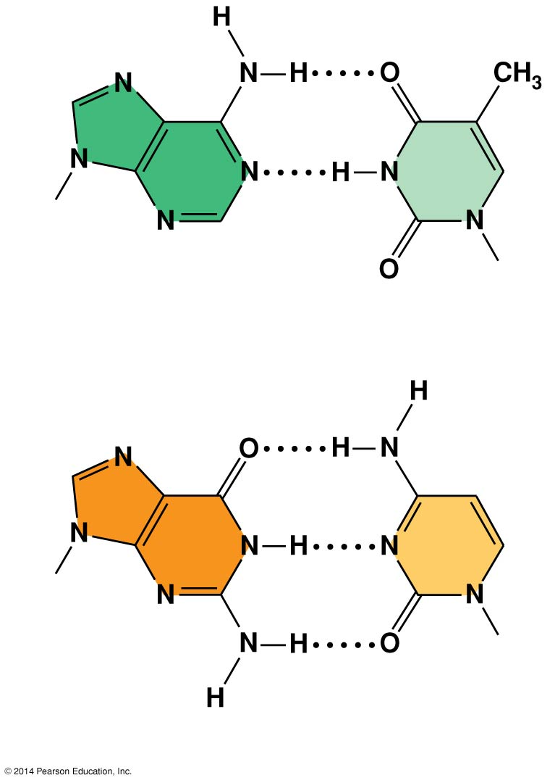
Figure 13.8
Sugar
Sugar
Adenine (A)
Thymine (T)
Sugar
Sugar
Guanine (G)
Cytosine (C)
Notes:
26
Figure 13.8 Base pairing in DNA

