Slide 1
Remember that there is a test over chapters 11 and 12 on Thursday

Slide 2
0
Chapter 12
Linkage Maps

Slide 3
You Must Know
The pattern of inheritance for linked and unlinked genes.

Slide 4
Independent Assortment
Notes:
Review

Slide 5
Unlinked genes are located on different chromosomes.
Unlinked genes follow independent assortment.
Genes A and C are not linked.

Slide 6
Independent Assortment
Notes:
Review

Slide 7
Mendel
Gametes from yellow-round
dihybrid parent (YyRr)
YR
yr
Yr
yR
Gametes from green-
wrinkled homozygous
recessive parent (yyrr)
yr
YyRr
yyrr
Yyrr
yyRr
YyRr
yyrr
Yyrr
yyRr
Parental-
type
offspring
Recombinant
offspring
A 50% frequency of recombination is observed for any two genes on different chromosomes.
Notes:
7
Mendel observed that combinations of traits in some offspring differ from either parent.
Offspring with a phenotype matching one of the parental phenotypes are called parental types.
Offspring with nonparental phenotypes (new combinations of traits) are called recombinant types, or recombinants.

Slide 8
Linked genes are located on the same chromosome and therefore will be inherited together
The further apart the genes are, the more likely they will be separated by crossing over.
unless
crossing over occurs.
Genes A and B are linked

Slide 9
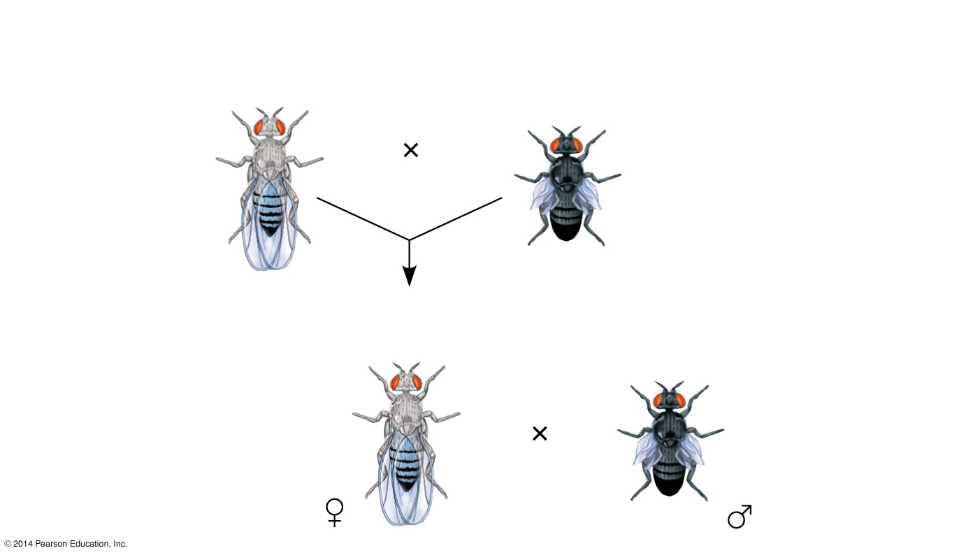
Morgan did experiments with fruit flies that show how linkage affects inheritance of two characters.
Experiment
P Generation
(homozygous)
Wild type
(gray body,
normal wings)
Double mutant
(black body,
vestigial wings)
b⁺ b⁺ vg⁺ vg⁺
b b vg vg
List the genotype and phenotype of the F₁
Notes:
9
Figure 12.9a Inquiry: How does linkage between two genes affect inheritance of characters? (part 1: experiment)

Slide 10
Morgan did experiments with fruit flies that show how linkage affects inheritance of two characters.
Experiment
P Generation
(homozygous)
Wild type
(gray body,
normal wings)
Double mutant
(black body,
vestigial wings)
b⁺ b⁺ vg⁺ vg⁺
b b vg vg
F₁ dihybrid testcross
Wild-type F₁ dihybrid
(gray body, normal wings)
Homozygous
recessive (black
body, vestigial
wings)
b⁺ b vg⁺ vg
b b vg vg
List all the gametes these flies could produce.
Notes:
10
Figure 12.9a Inquiry: How does linkage between two genes affect inheritance of characters? (part 1: experiment)

Slide 11
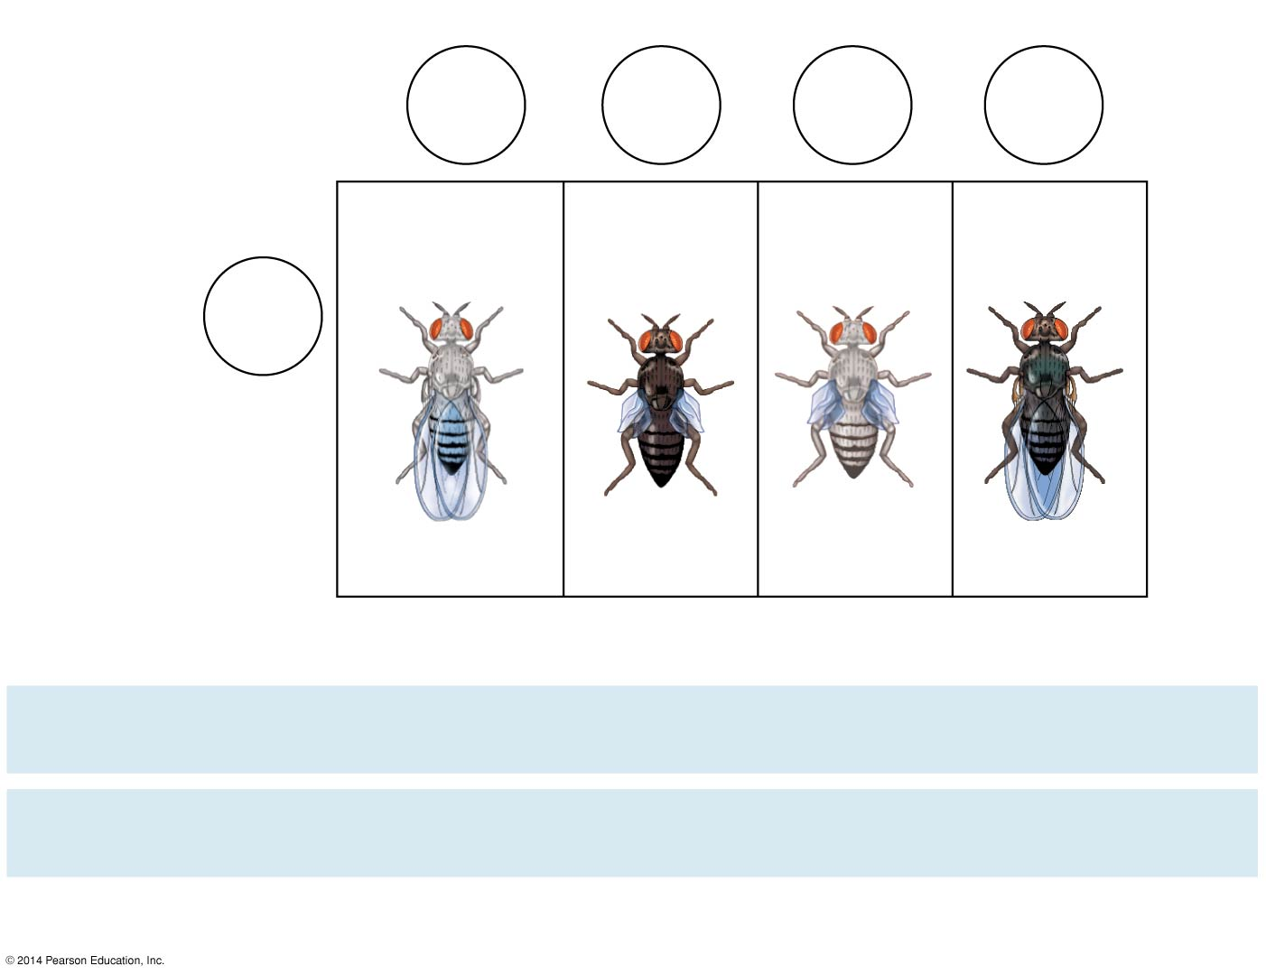
Testcross
offspring
Eggs
b⁺ vg⁺
b vg
b⁺ vg
b vg⁺
Wild-type
(gray-normal)
Black-
vestigial
Gray-
vestigial
Black-
normal
b vg
Sperm
b⁺ b vg⁺ vg
b b vg vg
b⁺ b vg vg
b b vg⁺ vg
Notes:
11
Morgan found that body color and wing size are usually inherited together in specific combinations (parental phenotypes).
He reasoned that since these genes did not assort independently, they were on the same chromosome.
However, nonparental phenotypes were also produced.
Understanding this result involves exploring genetic recombination, the production of offspring with combinations of traits differing from either parent.

Slide 12
Testcross
offspring
Eggs
b⁺ vg⁺
b vg
b⁺ vg
b vg⁺
Wild-type
(gray-normal)
Black-
vestigial
Gray-
vestigial
Black-
normal
b vg
Sperm
b⁺ b vg⁺ vg
b b vg vg
b⁺ b vg vg
b b vg⁺ vg
PREDICTED RATIOS
Genes on different
chromosomes:
1
:
1
:
1
:
1
Genes on same
chromosome:
1
:
1
:
0
:
0
Results
965
:
944
:
206
:
185
Notes:
12
Morgan found that body color and wing size are usually inherited together in specific combinations (parental phenotypes).
He reasoned that since these genes did not assort independently, they were on the same chromosome.
However, nonparental phenotypes were also produced.
Understanding this result involves exploring genetic recombination, the production of offspring with combinations of traits differing from either parent.

Slide 13
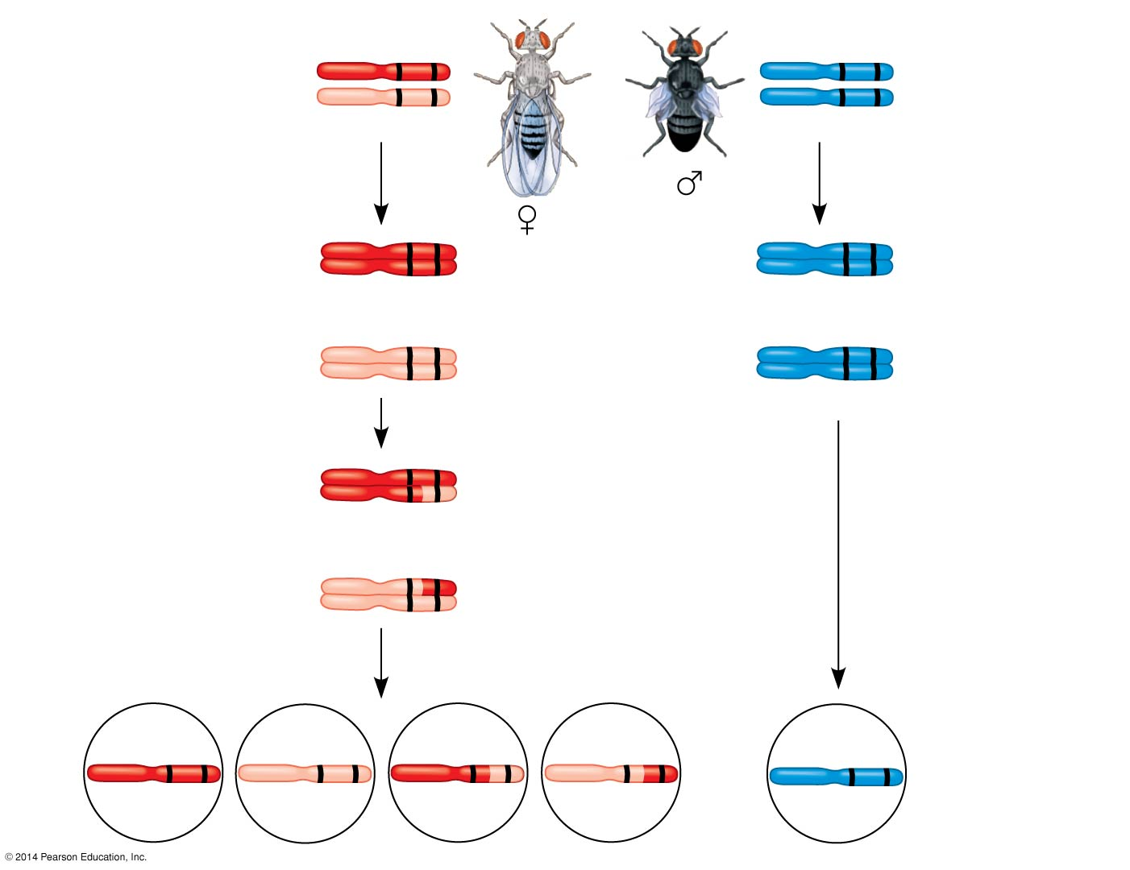
F₁ dihybrid testcross
b⁺ vg⁺
b vg
Wild-type F₁
dihybrid
(gray body,
normal wings)
Homozygous
recessive
(black body,
vestigial wings)
b vg
b vg
b⁺ vg⁺
b vg
b⁺ vg⁺
b vg
b vg
b vg
Meiosis I
b vg
b vg
crossing over
b⁺ vg⁺
Meiosis I and II
b⁺ vg
b vg⁺
b vg
Recombinant
chromosomes
Meiosis II
b⁺ vg⁺
b vg
b⁺ vg
b vg⁺
b vg
Eggs
Sperm
Notes:
13
Morgan discovered that even when two genes were on the same chromosome, some recombinant phenotypes were observed.
He proposed that some process must occasionally break the physical connection between genes on the same chromosome.
That mechanism was the crossing over between homologous chromosomes.

Slide 14
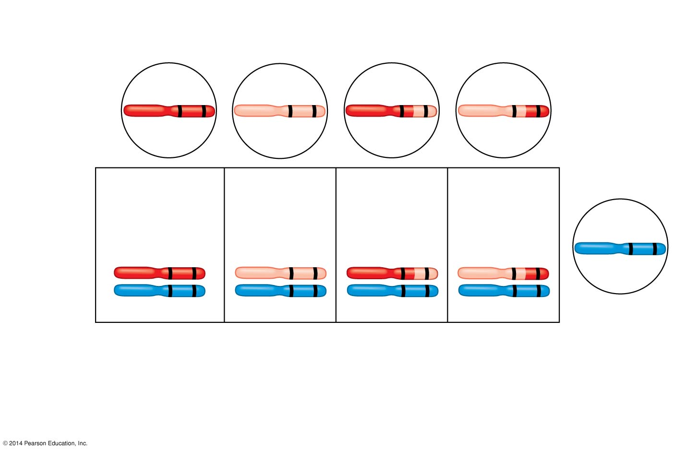
Figure 12.10c
Recombinant
chromosomes
b⁺ vg⁺
b vg
b⁺ vg
b vg⁺
Eggs
Testcross
offspring
965
Wild type
(gray-normal)
944
Black-
vestigial
206
Gray-
vestigial
185
Black-
normal
b vg
b⁺ vg⁺
b vg
b⁺ vg
b vg⁺
b vg
b vg
b vg
b vg
Sperm
Parental-type offspring
Recombinant offspring
Recombination
frequency
391 recombinants
× 100 = 17%
=
2,300 total offspring
Notes:
14

Slide 15
Video
Video: Genetic Recombination and Gene Mapping Bozeman Science https://www.youtube.com/watch?v=TU44tR0hJ8A

Slide 16
Alfred Sturtevant, one of Morgan’s students, constructed a genetic map, an ordered list of the genetic loci along a particular chromosome.
Sturtevant predicted that the farther apart two genes are, the higher the probability that a crossover will occur between them and therefore the higher the recombination frequency.

Slide 17
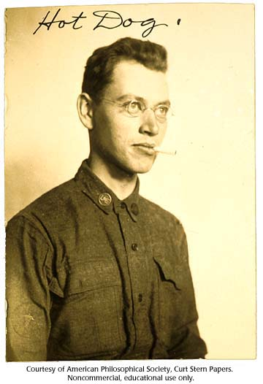
Given the following recombination frequencies, what is the correct order of the genes on the chromosome?
A-B: 22
A-C: 7
A-D: 27
C-D: 34
C A B D
(DBAC works also)

Slide 18
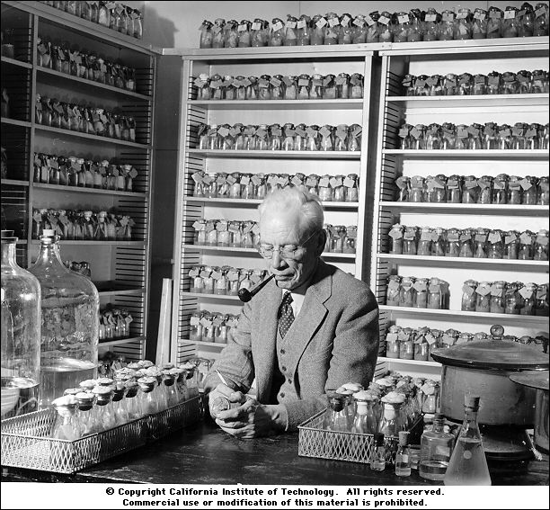
Given the following recombination frequencies, what is the correct order of the genes on the chromosome?
A-B: 30
A-C: 21
A-D: 42
B-C: 9
A C B D
(DBCA works also)

Slide 19
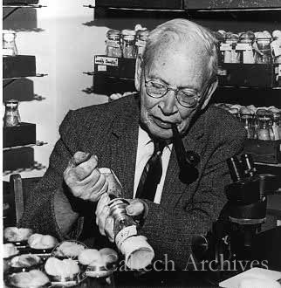
Given the following recombination frequencies, what is the correct order of the genes on the chromosome?
A-B: 4
A-C: 8
C-D: 15
B-D: 27
B A C D
(DCAB works also)

Slide 20
A linkage map is a genetic map of a chromosome based on recombination frequencies.
Distances between genes can be expressed as map units; one map unit represents a 1% recombination frequency.
Notes:
20

Slide 21
Genes that are far apart on the same chromosome can have a recombination frequency near 50%.
Such genes are physically linked, but genetically unlinked, and behave as if found on different chromosomes.
Notes:
21

Slide 22
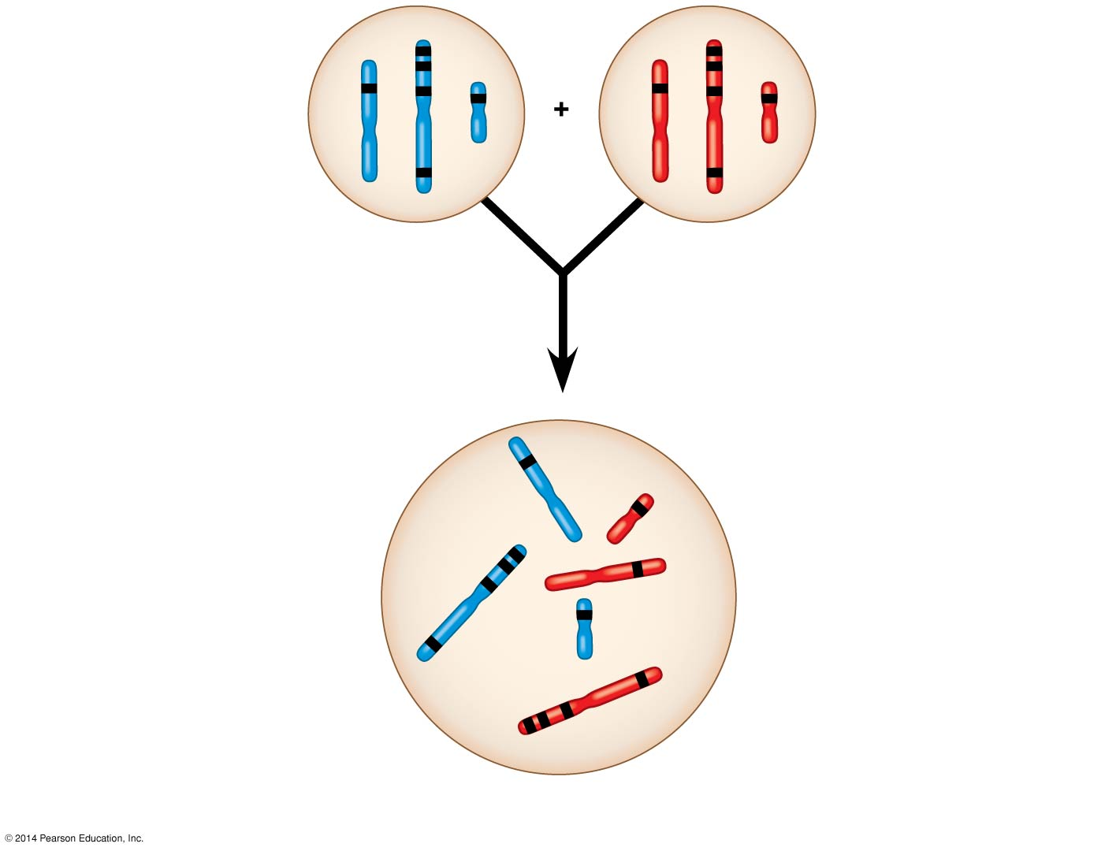
Figure 12.UN04
Sperm
Egg
C
c
B
b
P generation
gametes
D
A
E
d
a
e
F
f
This F₁ cell has 2n = 6 chromo-
somes and is heterozygous
for all six genes shown
(AaBbCcDdEeFf).
The alleles of unlinked
genes are either on
separate chromosomes
(such as d and e)
or so far apart on the
same chromosome
(c and f) that they
assort independently.
Red = maternal; blue = paternal.
D
e
C
d
B
A
Genes on the same
chromosome whose
alleles are so close to-
gether that they do not
assort independently
(such as a, b, and c) are
said to be genetically
linked.
F
E
Each chromosome has
hundreds or thousands
of genes. Four (A, B, C,
F) are shown on this one.
c
b
a
Notes:
22
Figure 12.UN04 Summary of key concepts: linkage

