Slide 1
0
Chapter 13
DNA Replication

Slide 2
You Must Know
How DNA is replicated
The roles of DNA polymerase, ligase, helicase, topoisomerase, and telomerase in replication.
Enzyme

Slide 3
semiconservative model of replication
A
T
A
T
A
T
A
T
C
G
C
G
C
G
C
G
T
A
T
A
T
A
T
A
A
T
A
T
A
T
A
T
G
C
G
C
G
C
G
C
(a) Parental
molecule
(b) Separation of parental
strands into templates
(c) Formation of new
strands complementary
to template strands
Notes:
3
The relationship between structure and function is manifest in the double helix
Watson and Crick noted that the specific base pairing suggested a possible copying mechanism for genetic material
Since the two strands of DNA are complementary, each strand acts as a template for building a new strand in replication.
In DNA replication, the parent molecule unwinds, and two new daughter strands are built based on base-pairing rules.
Watson and Crick’s semiconservative model of replication predicts that when a double helix replicates, each daughter molecule will have one old strand (derived or “conserved” from the parent molecule) and one newly made strand.

Slide 4
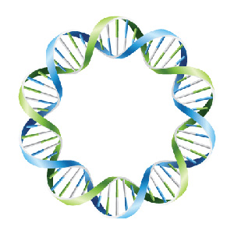
An E. coli cell that contains a single circular chromosome is allowed to replicated in ¹⁵N medium until all of the DNA is labeled with ¹⁵N. One cell is removed and placed in ¹⁴N medium. The E coli is allowed to replicate until eight E-coli are formed.
Which of the following is true?
Some of the ¹⁵N DNA will be found in all eight cells.
Some of the ¹⁵N DNA will be found in only four of the cells.
Some of the ¹⁵N DNA will be found in only two of the cells.
Some of the ¹⁵N DNA will be found in only one of the cells.
To explain your answer, draw the sequence of events that occurred.

Slide 5
3. Some of the ¹⁵N DNA will be found in only two of the cells.
Notes:
5

Slide 6
Replication
bubble
DNA replication in a prokaryotic cell
Daughter
(new) strand
Parental
(template) strand
Origin of replication
Replication
fork
Double-stranded
DNA molecule
Two
daughter DNA
molecules
Notes:
6

Slide 7
Origins of replication in a eukaryotic cell
Origin of
replication
Double-stranded
DNA molecule
Parental (template)
strand
Daughter (new)
strand
Bubble
Replication fork
Two daughter DNA molecules
Notes:
7
Multiple replication bubbles form and eventually fuse, speeding up the copying of DNA.

Slide 8
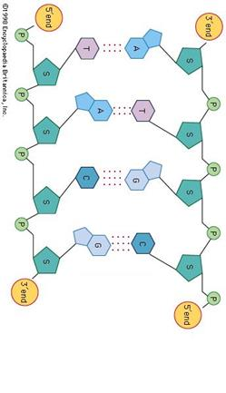
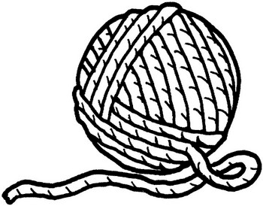
Things to keep in mind….
A
T
A
T
A
T
A
T
C
G
C
G
C
G
C
G
DNA polymerases can only add nucleotides to an already existing chain
T
A
T
A
T
A
T
A
A
T
A
T
A
T
A
G
C
G
C
G
C
G
C
Nucleotide
Notes:
8

Slide 9
Video
DNA Replication Process [3D Animation]
https://www.youtube.com/watch?v=TNKWgcFPHqw

Slide 10
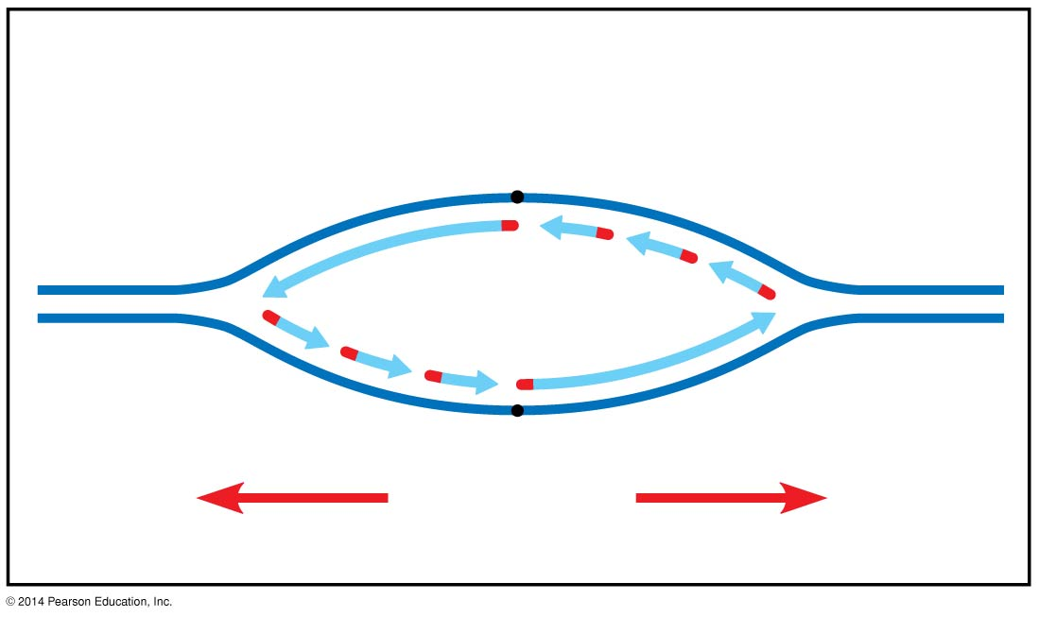
Figure 13.15a
Overview
Leading
strand
Origin of replication
Lagging
strand
Primer
Leading
strand
Lagging strand
Overall
directions
of replication
Notes:
10
Figure 13.15a Synthesis of the leading strand during DNA replication (part 1)

Slide 11
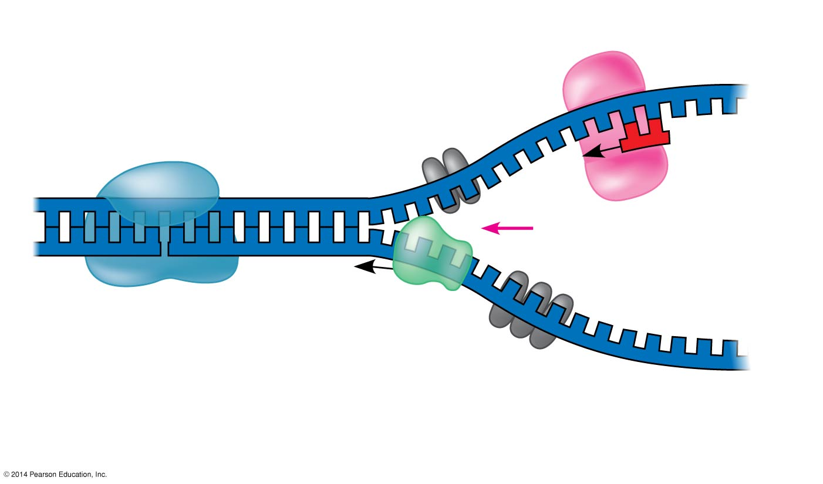
DNA preparing to add new nucleotides
Primase
Topoisomerase
3′
5′
RNA
primer
3′
5′
Replication
fork
3′
Helicase
5′
Single-strand binding
proteins
Notes:
11
Helicases are enzymes that unzip the double helix at the replication forks.
Single-strand binding proteins bind to and stabilize single-stranded DNA.
Topoisomerase relieves the strain caused by tight twisting ahead of the replication fork by breaking, swiveling, and rejoining DNA strands.
DNA polymerases cannot initiate synthesis of a polynucleotide; they can only add nucleotides to an already existing chain base-paired with the template.
The initial nucleotide strand is a short RNA primer.
The enzyme, primase, starts an RNA chain from a single RNA nucleotide and adds RNA nucleotides one at a time using the parental DNA as a template.
The primer is short (5–10 nucleotides long).
The new DNA strand will start from the 3′ end of the RNA primer.

Slide 12
DNA adding new nucleotides
Origin of replication
3′
5′
5′
RNA primer
3′
3′
Parental DNA
DNA pol III
5′
3′
5′
5′
Continuous elongation
Of the leading strand
3′
3′
5′
Notes:
12
Enzymes called DNA polymerases catalyze the elongation of new DNA at a replication fork.
Most DNA polymerases require a primer and a DNA template strand.

Slide 13
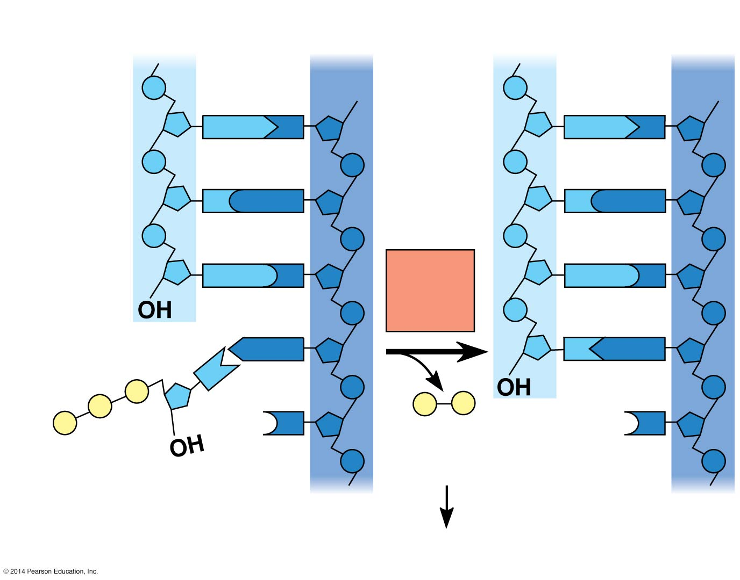
Figure 13.14
New strand
Template strand
5′
3′
5′
3′
Sugar
A
T
A
T
Phosphate
Base
C
G
C
G
G
C
DNA
poly-
merase
G
C
3′
A
T
A
T
P
P
P
P
i
P
C
3′
C
Pyro-
phosphate
Nucleotide
dATP
5′
5′
2
P
i
Notes:
13
Each nucleotide that is added to a growing DNA consists of a sugar attached to a base and three phosphate groups.
dATP is used to make DNA and is similar to the ATP of energy metabolism.
The difference is in the sugars: dATP has deoxyribose, while ATP has ribose.
As each monomer nucleotide joins the DNA strand, it loses two phosphate groups as a molecule of pyrophosphate.
The antiparallel structure of the double helix affects replication.
DNA polymerases add nucleotides only to the free 3′ end of a growing strand; therefore, a new DNA strand can elongate only in the 5′ to 3′ direction.

Slide 14
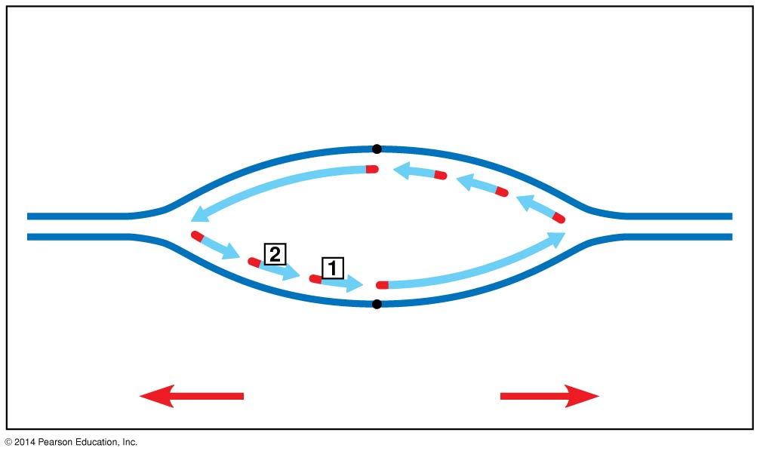
Figure 13.16a
Overview
Lagging
strand
Lagging
strand
Overall directions
of replication
Okazaki fragments
Notes:
14
To elongate the other new strand, called the lagging strand, DNA polymerase must work in the direction away from the replication fork.
The lagging strand is synthesized as a series of segments called Okazaki fragments

Slide 15
Synthesis of the lagging strand
3′
1
Primase makes
RNA primer.
3′
5′
3′
Template
strand
Template
strand
5′
5′
RNA primer
for fragment 1
2
DNA pol III
makes Okazaki
fragment 1.
3′
5′
3′
5′
3
DNA pol III
detaches.
3′
Okazaki
fragment 1
5′
3′
5′
Notes:
15

Slide 16
Synthesis of the lagging strand
RNA primer for fragment 2
5′
Okazaki
fragment 2
3′
4
DNA pol III
makes Okazaki
fragment 2.
3′
5′
5′
3′
5
DNA pol I
replaces RNA
with DNA.
3′
5′
5′
6
DNA ligase forms
bonds between
DNA fragments.
5′
3′
3′
5′
Notes:
16
After formation of Okazaki fragments, DNA polymerase I removes the RNA primers and replaces the nucleotides with DNA.
The remaining gaps are joined together by DNA ligase.

Slide 17
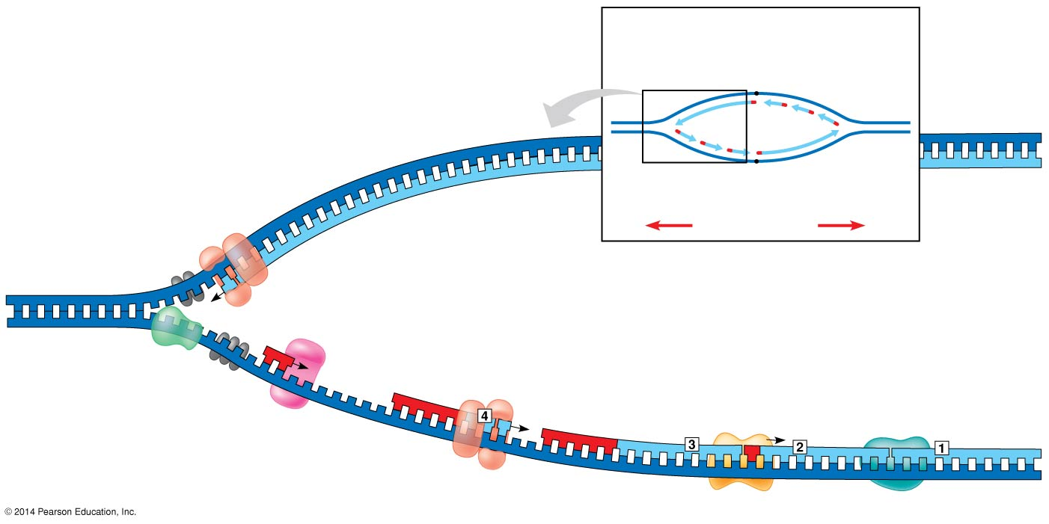
A summary of DNA replication
Overview
Origin of replication
Leading strand
template
Leading strand
Lagging
strand
Single-strand
binding proteins
Lagging strand
Leading strand
Leading strand
Overall directions
of replication
Helicase
5′
DNA pol III
3′
Primer
3′
5′
Primase
3′
Lagging strand
Parental DNA
DNA pol III
5′
DNA pol I
DNA ligase
Lagging strand
template
3′
5′
3′
5′
Notes:
17

Slide 18
Replicating the Ends of DNA Molecules
RNA Primer
Notes:
Limitations of DNA polymerase create problems for the linear DNA of eukaryotic chromosomes. The usual replication machinery cannot complete the 5′ ends of daughter strands. Repeated rounds of replication produce shorter DNA molecules with uneven ends.

Slide 19
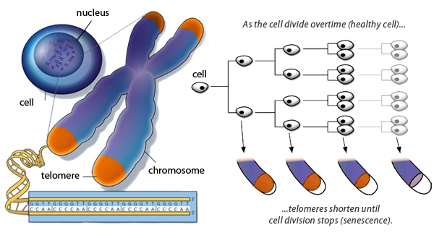
Telomeres
Notes:
Eukaryotic chromosomal DNA molecules have special nucleotide sequences at their ends called telomeres. Telomeres do not prevent the shortening of DNA molecules, but they do postpone it. It has been proposed that the shortening of telomeres is connected to aging.

Slide 20
An enzyme called telomerase catalyzes the lengthening of telomeres in germ cells.
You don’t need to know details from the video that aren’t in the notes.
https://www.youtube.com/watch?v=i6nE6gUp2cw
Notes:
20
If chromosomes of germ cells became shorter in every cell cycle, essential genes would eventually be missing from the gametes they produce.

