Slide 1
0
Chapter 13
DNA Repair and Chromosome Structure

Slide 2
You Must Know
DNA proofreading and packaging
How restriction enzymes work
How plasmids are used in bacterial transformation to clone genes.

Slide 3
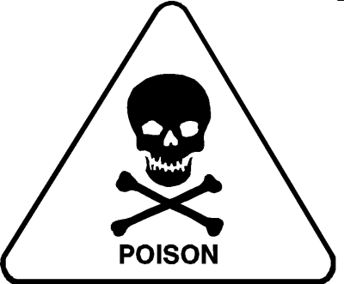
Things that can damage DNA
Notes:
DNA can be damaged by exposure to harmful chemical or physical agents such as cigarette smoke and X-rays; it can also undergo spontaneous changes.

Slide 4
DNA Mismatch Repair
Notes:
DNA polymerases proofread newly made DNA, replacing any incorrect nucleotides.
In mismatch repair of DNA, other enzymes correct errors in base pairing. (You don’t need to remember all of the enzymes involved in this.)

Slide 5
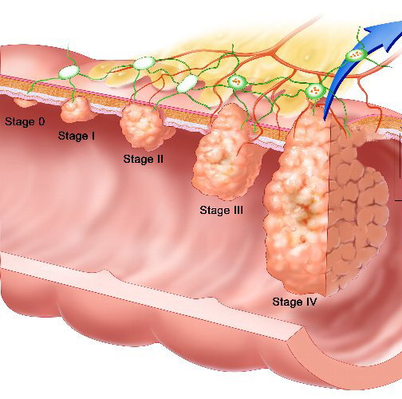
DNA Mismatch Repair
Notes:
DNA polymerases proofread newly made DNA, replacing any incorrect nucleotides.
In mismatch repair of DNA, other enzymes correct errors in base pairing.
A hereditary defect in one such enzyme is associated with a form of colon cancer.
This defect allows cancer-causing errors to accumulate in DNA faster than normal

Slide 6
Nucleotide excision repair
5′
3′
3′
5′
Nuclease
5′
3′
3′
5′
DNA
polymerase
5′
3′
3′
5′
DNA ligase
5′
3′
3′
5′
Notes:
6
In nucleotide excision repair, a nuclease cuts out and replaces damaged stretches of DNA.

Slide 7
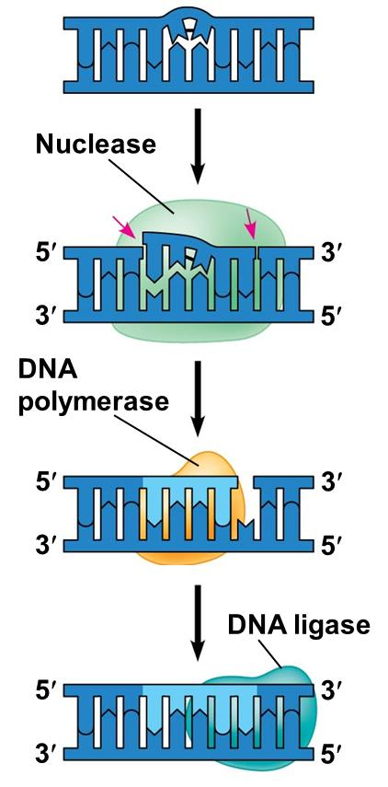
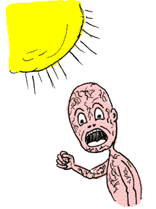
Nucleotide excision repair malfunction
Xeroderma pigmentosum
Notes:
7
In nucleotide excision repair, a nuclease cuts out and replaces damaged stretches of DNA.

Slide 8
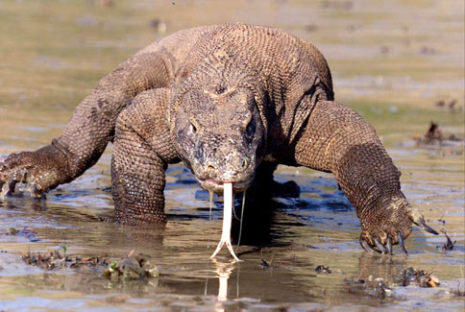
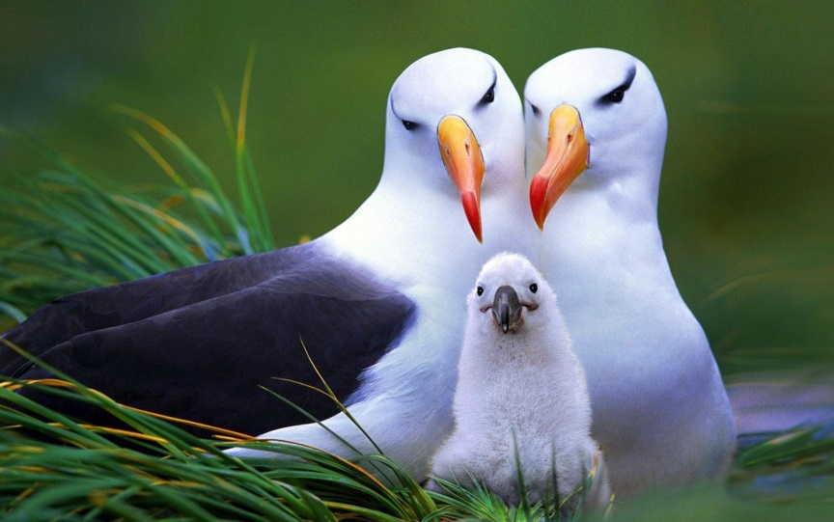
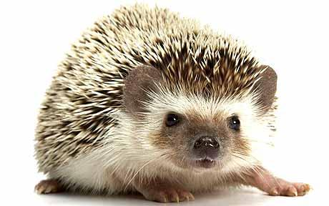
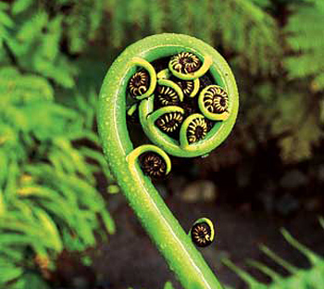
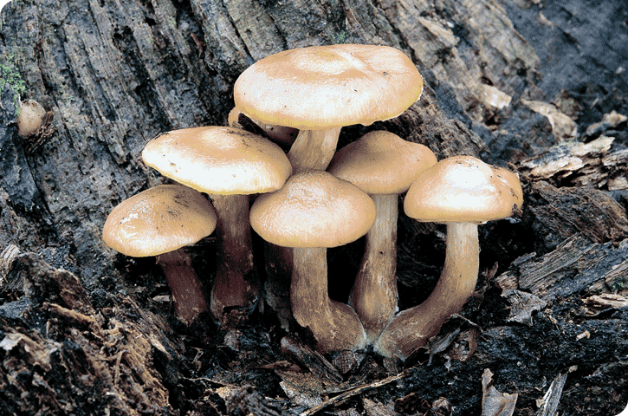
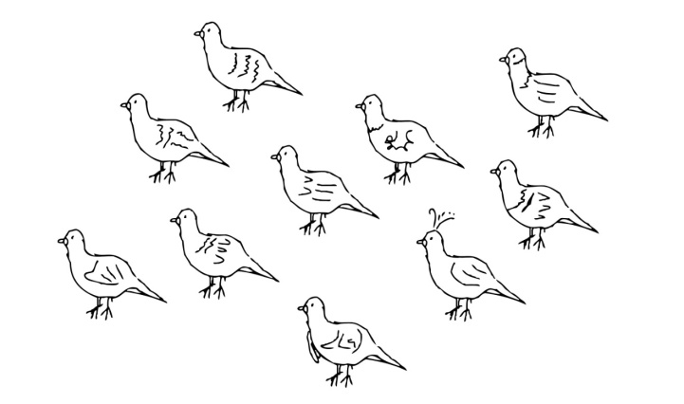
Evolutionary Significance of Altered DNA Nucleotides
Notes:
8
Error rate after proofreading repair is low but not zero.
Sequence changes may become permanent and can be passed on to the next generation.
These changes (mutations) are the source of the genetic variation upon which natural selection operates.

Slide 10
DNA Packaging
Chromatin, a complex of DNA and protein, is found in the nucleus of eukaryotic cells.
Notes:
10
Chromosomes fit into the nucleus through an elaborate, multilevel system of packing
Chromatin undergoes striking changes in the degree of packing during the course of the cell cycle

Slide 11
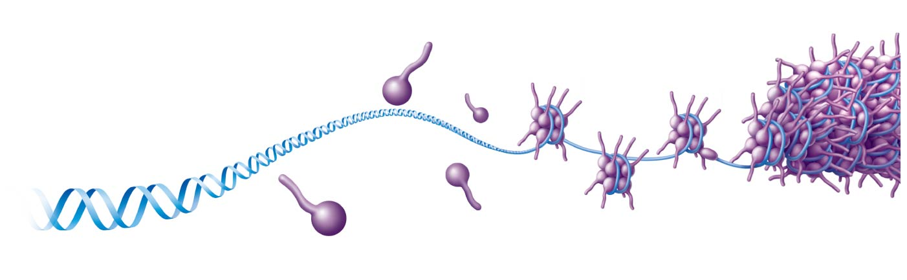
Exploring chromatin packing in a eukaryotic chromosome
Nucleosome
Histones
Notes:
11

Slide 12
Euchromatin
Heterochromatin
Notes:
At interphase, most of the chromatin is compacted into a 30-nm fiber, which is folded further in some areas by looping
Even during interphase, centromeres and some other parts of chromosomes are highly condensed, similar to metaphase chromosomes
This condensed chromatin is called heterochromatin; the more dispersed, less compacted chromatin is called euchromatin. Dense packing of the heterochromatin makes it largely inaccessible to the machinery responsible for transcribing genetic information.
Chromosomes are dynamic in structure; a condensed region may be loosened or modified as needed for various cell processes.
For example, histones can undergo chemical modifications that result in changes in chromatin organization.

Slide 14
Restriction Enzymes
Restriction enzymes cut DNA at specific places along the DNA molecule called restriction sites.
Restriction sites are locations on a DNA molecule containing specific (4-8 base pairs in length) sequences of nucleotides, which are recognized by restriction enzymes.
Different enzymes recognize different restriction sites.

Slide 15
Example

Slide 16
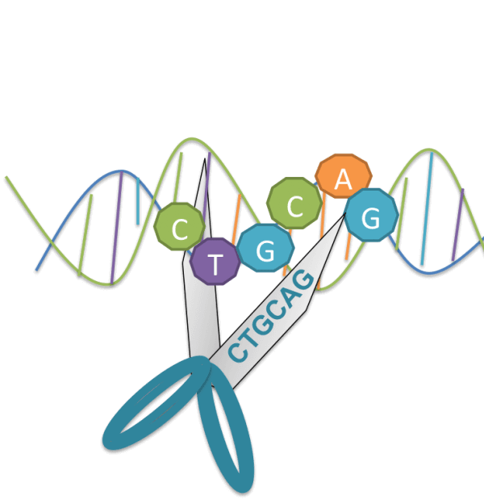
Example
ApaLI (restriction enzyme)

Slide 17
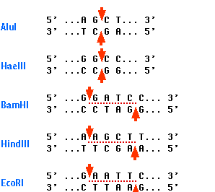
Examples of different restriction enzymes. (You don’t need to remember these.)

Slide 18
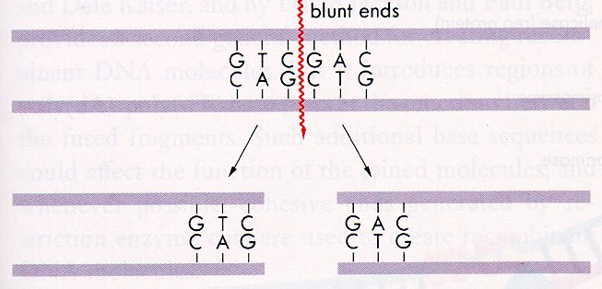
Blunt Ends
If the restriction enzyme cut sites are directly across from each other it will produce DNA fragments with “blunt ends.”

Slide 19
Sticky Ends
If the restriction enzyme cut sites are not directly across from each other it will produce DNA fragments with “sticky ends.”

Slide 20
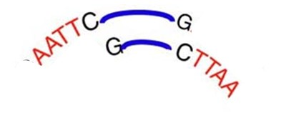
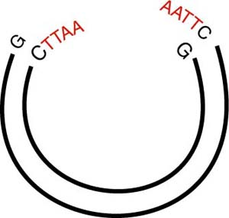
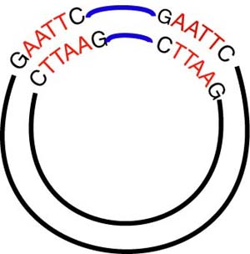
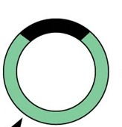
Nucleic Acid Hybridization
Notes:
Complementary base pairing of DNA is the basis for nucleic acid hybridization, the base pairing of one strand of a nucleic acid to another, complementary sequence. Nucleic acid hybridization forms the foundation of virtually every technique used in genetic engineering, the direct manipulation of genes for practical purposes.

Slide 21
Using a restriction enzyme and DNA ligase to make recombinant DNA
Restriction site
5′
3′
DNA
G
A
A
T
T
C
C
T
T
A
A
G
3′
5′
1
Restriction enzyme cuts
the sugar-phosphate
backbones.
3′
5′
3′
5′
G
A
A
T
T
C
C
T
T
A
A
G
5′
3′
3′
Sticky end
5′
5′
5′
3′
A
3′
DNA fragment added
from another molecule
cut by same enzyme.
Base pairing occurs.
A
A
A
T
T
T
2
T
C
C
G
G
3′
3′
5′
5′
5′
3′
5′
3′
5′
3′
G
A
A
T
T
C
G
A
A
T
T
C
C
T
T
A
A
G
C
T
T
A
A
G
3′
5′
3′
5′
3′
5′
3
DNA ligase
seals the strands.
One possible combination
5′
3′
3′
Recombinant DNA molecule
5′
Notes:
21
Bacterial restriction enzymes cut DNA molecules at specific DNA sequences called restriction sites.
A restriction enzyme usually makes many cuts, yielding restriction fragments.
The most useful restriction enzymes cleave the DNA in a staggered manner to produce sticky ends.
Sticky ends can bond with complementary sticky ends of other fragments.
DNA ligase can close the sugar-phosphate backbones of DNA strands.

Slide 22
Gene cloning
Bacterium
Cell containing
gene of interest
1
Gene inserted
into plasmid
Bacterial
chromosome
Plasmid
DNA of
chromosome
(“foreign” DNA)
Gene of interest
Gene of interest
2
Plasmid put into
bacterial cell
Recombinant
bacterium
3
Host cell grown in culture to
form a clone of cells containing
the “cloned” gene of interest
Gene of
interest
Protein expressed
from gene of interest
Notes:
22
To work directly with specific genes, scientists prepare well-defined segments of DNA in identical copies, a process called DNA cloning.
Many bacteria contain plasmids, small circular DNA molecules that replicate separately from the bacterial chromosome.
To clone pieces of DNA, researchers first obtain a plasmid and insert DNA from another source (“foreign DNA”) into it.
The resulting plasmid is called recombinant DNA.
In gene cloning, the original plasmid is called a cloning vector.
A cloning vector is a DNA molecule that can carry foreign DNA into a host cell and replicate there.
This technique is used to produce useful proteins such as insulin, human growth hormone and a protein that dissolves blood clots in heart attack therapy. It is also used to create GMO plants that are resistant to insects and pesticides.

