Slide 2
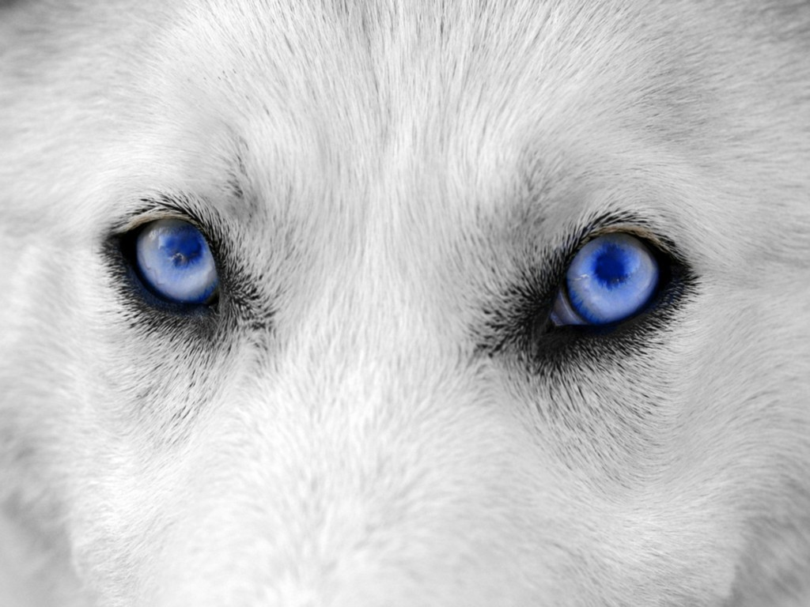
Identify the following as either characters or traits
Eye color
Character
Brown or blue eyes
Trait
A trait is a distinct variant of a phenotypic character of an organism

Slide 3
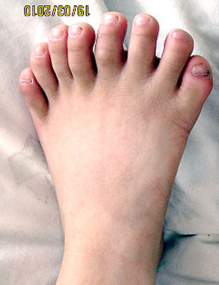
Identify the following as either characters or traits
Eight toes on one foot
Trait
Number of toes
Character
A trait is a distinct variant of a phenotypic character of an organism

Slide 4
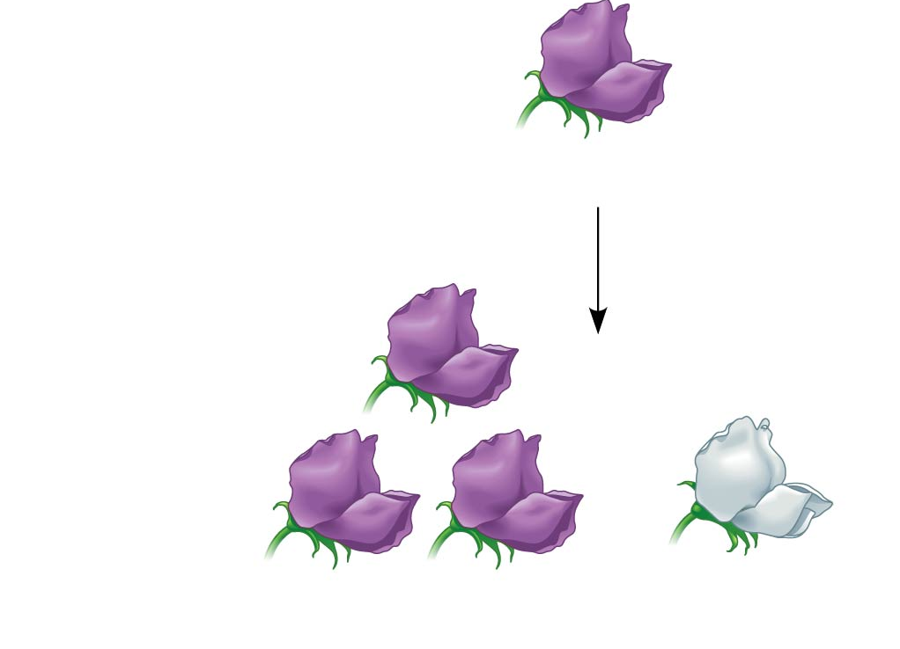
Is this plant true-breeding?
All plants had purple flowers
Self-pollination
No, because the plant was self-pollinated and not all the offspring match the parent.
705 purple-flowered
plants
224 white-flowered
plants
Notes:
4
Figure 11.3-3 Inquiry: When F₁ hybrid pea plants self- or cross-pollinate, which traits appear in the F₂ generation? (step 3)

Slide 5
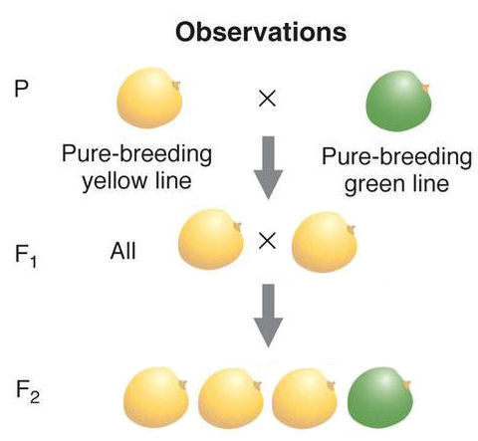
True of False: The red arrow is pointing to the P generation.
False, the red arrow is pointing to the F₁

Slide 6
Is green or yellow dominant?
yellow

Slide 7
What is the genotype of the circled seed?
AA
(I’m only using “A” because it is easy to tell the uppercase from the lowercase.)

Slide 8
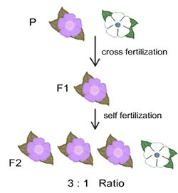
Is purple or white dominant?
purple

Slide 9
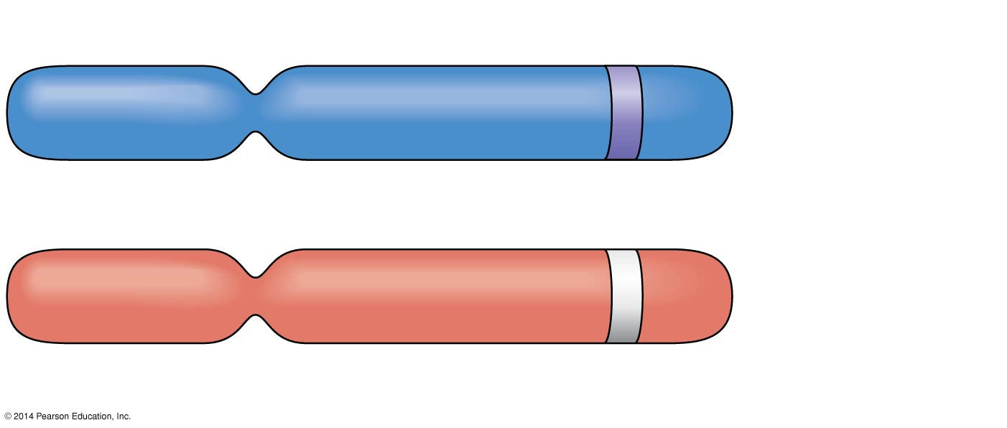
Is the flower that these chromosomes came from homozygous or heterozygous for flower color?
Heterozygous
Allele for purple flowers
Pair of
homologous
chromosomes
Locus for flower-color gene
Allele for white flowers
Notes:
9
Figure 11.4 Alleles, alternative versions of a gene

Slide 10
What is the genotype of the circled flower?
aa

Slide 11
Is the circled flower homozygous or heterozygous?
homozygous

Slide 12
What is the phenotype of the circled flower?
white

Slide 13
Is the circled flower homozygous or heterozygous?
heterozygous

Slide 14
What is the genotype of the circled plant?
Aa

Slide 15
Is the circled flower homozygous or heterozygous?
There is not enough information to answer the question
 | A | a
A | AA | Aa
a | Aa | aa
Aa

Slide 16
Work with the people at your table to devise an experiment you could do to figure out the genotype of the circled plant. You don’t need to go into detail.

Slide 17
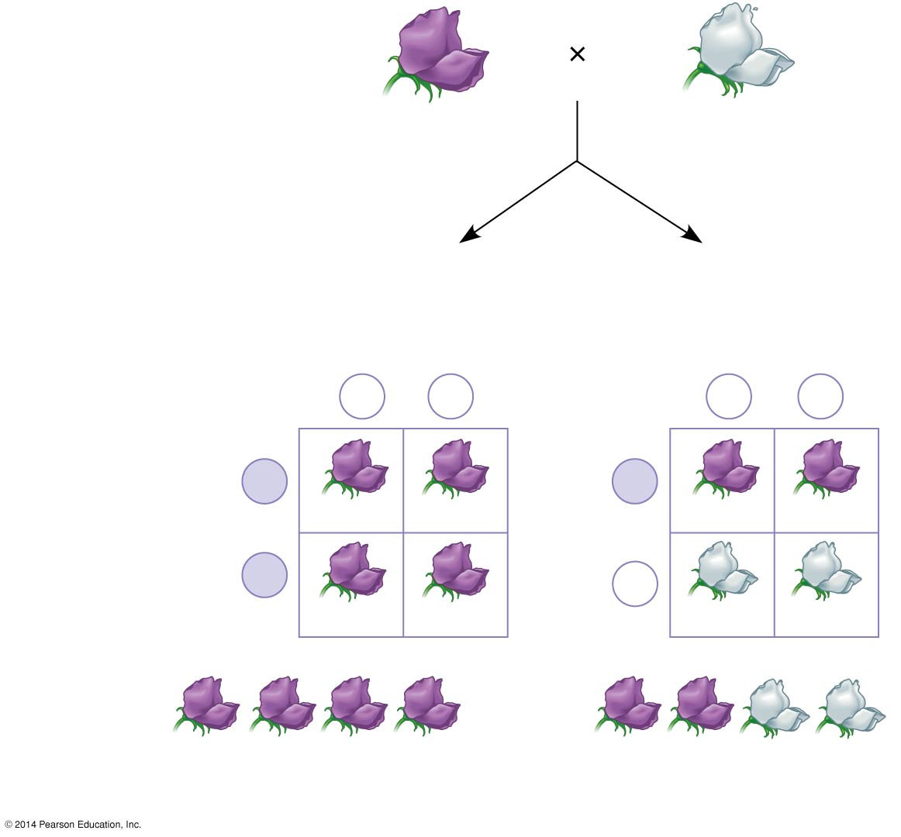
Technique: the testcross
Dominant phenotype,
unknown genotype:
PP or Pp?
Recessive phenotype,
known genotype:
pp
Predictions
If purple-flowered
parent is PP
or
If purple-flowered
parent is Pp
Sperm
Sperm
p
p
p
p
P
P
Eggs
Pp
Pp
Eggs
Pp
Pp
P
p
Pp
Pp
pp
pp
Results
or
All offspring purple
½ offspring purple and
½ offspring white
Notes:
17

Slide 18
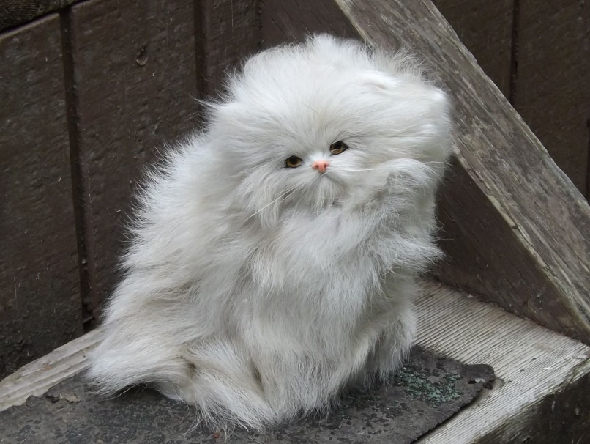
Identify the following as either characters or traits
Long fur
Trait
Fur length
Character
A trait is a distinct variant of a phenotypic character of an organism

Slide 19
What is the phenotype of this flower?
Self-pollination
purple
705 purple-flowered
plants
224 white-flowered
plants
Notes:
19
Figure 11.3-3 Inquiry: When F₁ hybrid pea plants self- or cross-pollinate, which traits appear in the F₂ generation? (step 3)

Slide 20
What is the genotype of this flower?
Self-pollination
Aa
705 purple-flowered
plants
224 white-flowered
plants
Notes:
20
Figure 11.3-3 Inquiry: When F₁ hybrid pea plants self- or cross-pollinate, which traits appear in the F₂ generation? (step 3)

Slide 21
Having six fingers on one hand is a dominant genetic trait.
Mom is heterozygous for six fingers and dad has five fingers. Make a Punnett square of this cross.
 | s | s
S | Ss | Ss
s | ss | ss
What is the predicted phenotypic ratio of the offspring? (dominant: recessive)
1:1 or 2:2
What is the genotypic ratio?
(Homozygous D, Heterozygous, Homozygous R)
0:2:2 or 0:1:1

Slide 22
Having six fingers on one hand is a dominant genetic trait.
Mom and dad are both heterozygous for six fingers. Make a Punnett square of this cross.
 | S | s
S | SS | Ss
s | S s | ss
What is the predicted phenotypic ratio of the offspring? (dominant: recessive)
3:1
What is the genotypic ratio?
(Homozygous D, Heterozygous, Homozygous R)
1:2:1

