Slide 1
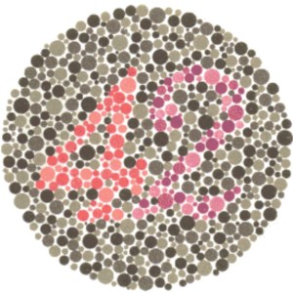
Color blindness is a recessive genetic disorder that is carried on the X chromosome. Answer the following questions about the family of a baby boy who was born with this disorder.
Is the mother color blind?
You don’t know, but probably not.
Is the father color blind?
You don’t know, but probably not. If he is, it’s a coincidence.
Did the boy get the disorder from his mom or his dad?
Mom

Slide 2
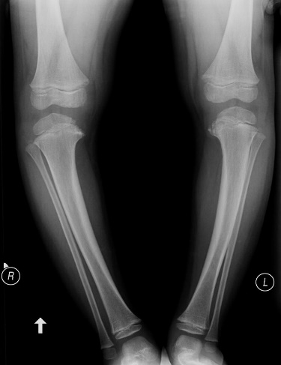
Vitamin D-resistant rickets is a dominant genetic disease that is carried on the X chromosome. Answer the following questions about the family of a baby boy who was born with this disease
Does the mother have D- resistant rickets?
Yes
Does the father have D-resistant rickets?
It’s very unlikely. If he does, it’s a coincidence.
Did the boy get the disease from his mom or his dad?
Mom

Slide 3
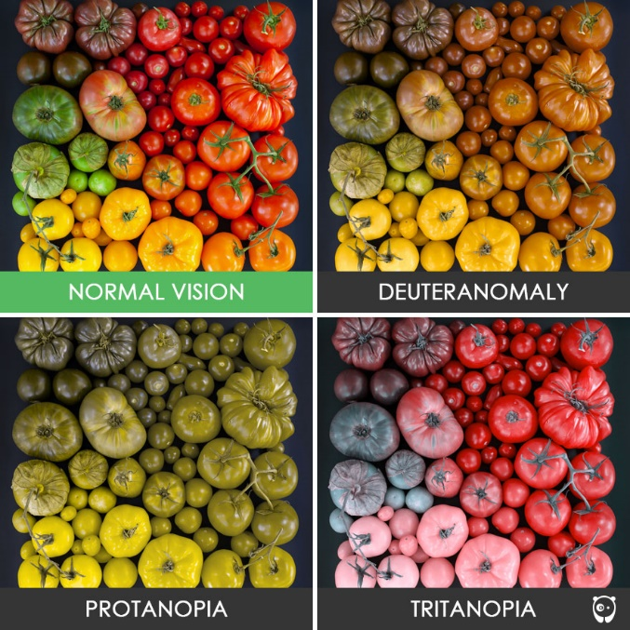
A woman is heterozygous for colorblindness and her husband is colorblind. What is the probability that their first child will be a colorblind girl?
X^{B}X ^{b} x X^{b}Y
1/4
 | X^{b} | Y
X^{b} | X^{b} X^{b} | X^{b} Y
X^{B} | X^{B} X^{b} | X^{B} Y

Slide 4
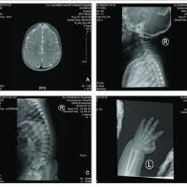
CLS is caused by a X-linked dominant allele. A normal woman and a man with CLS have a daughter. What are the chances that the girl has CLS?
100%
Notes:
. You won’t need to remember this for a test..

Slide 5
ALD is caused by a X-linked recessive allele. A normal woman (whose father had ALD) marries a man with ALD. What fraction of their children are expected to be girls with ALD?
25%
 | Xª | Y
Xª | Xª Xª | Xª Y
X^{A} | X^{A} Xª | X^{A} Y

Slide 6
Colorblindness is an X-linked condition.
A man with a widow’s peak (an autosomal dominant allele) and normal color vision marries a color-blind woman with a straight hairline. The man’s father had a straight hairline, as did both of the woman’s parents.
What are the genotypes of the couple?
Woman: X^{b}X^{b}ww
Man: X^{B}YWw

Slide 7
Colorblindness is X-linked recessive. Widow’s peak is autosomal dominant.
Wife: X^{b}X^{b}ww Husband: X^{B}YWw
If the couple has a child, what are the chances that it will be a son with a widow’s peak?
Chance of son: ½
Chance of widow’s peak: ½
Chance the kid with both be a son and have a widow’s peak: (1/2)(1/2) = 1/4

Slide 8
Colorblindness is X-linked recessive. Widow’s peak is autosomal dominant.
Wife: X^{b}X^{b}ww Husband: X^{B}YWw
What is that chance that any son the couple has will be colorblind with a straight hairline?
Chance that the son will be colorblind: 1
Chance of straight hairline: 1/2
Chance the son will be colorblind and have a straight hairline: (1)(1/2) = 1/2

Slide 9
Colorblindness is X-linked recessive. Widow’s peak is autosomal dominant.
Wife: X^{b}X^{b}ww Husband: X^{B}YWw
What is that chance that any daughter the couple has will be colorblind with a widow’s peak?
Chance of colorblind daughter: 0
Chance of widow’s peak: ½
Chance of colorblind and widow's peak: (0)(1/2) = 0

Slide 10
Colorblindness is X-linked recessive. Widow’s peak is autosomal dominant.
Wife: X^{b}X^{b}ww Husband: X^{B}YWw
Suppose the couple had a daughter with normal color vision and a widow’s peak. What is the chance that she is heterozygous for both conditions?
Chance of daughter being heterozygous for colorblindness: 1
Chance of being heterozygous for widow’s peak: 1
Chance of being heterozygous for colorblindness and widow's peak: (1)(1) = 1

