Slide 2
What are all the genotypes that code for type A blood?
I^{A}I^{A} (homozygous)
I^{A}i (heterozygous)

Slide 3
What are all the genotypes that code for type AB blood?
I^{A}I^{B}

Slide 4
What are all the genotypes that code for type O blood?
ii
O

Slide 5
What are all the genotypes that code for type B blood?
I^{B}I^{B} (homozygous)
I^{B}i (heterozygous)

Slide 6
Example
Mom has type O blood and dad is type AB. What are the chances the kid will have type A blood?
ii x I^{A}I^{B}
50%
 | i | i
I^{A}
I^{B}
i
i
i
i
I^{A} I^{A}
I^{B} I^{B}

Slide 7
Example
Dad is heterozygous for type A blood and mom is type AB. What are the chances the kid will have type B blood?
I^{A}i x I^{A}I^{B}
25%
 | I^{A} | i
I^{A}
I^{B}
I^{A}
I^{A}
i
i
I^{A} I^{A}
I^{B} I^{B}

Slide 8
Mother has type O blood and the father is homozygous for type B blood. Mom is pregnant. What is the probability that her baby will have type B blood?
100% chance the baby will have type B blood.
 | i | i
I^{B} | I^{B}i | I^{B}i
I^{B} | I^{B}i | I^{B}i

Slide 9
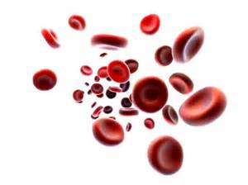
A child with type-B blood has a mother with type-O blood. What are the possible genotypes of the child’s father and mother?
Mother: ii
Father: I^{B}I^{B}, I^{B}i, I^{B}I^{A}

Slide 10
×
Rr
×
The multiplication rule states that the probability that two or more independent events will occur together is the product of their individual probabilities.
Ex. (1/2)(1/2)=1/4
What is the probability you will get a RR offspring?
Rr
Rr
Rr
Rr
×
Rr
Segregation of
alleles into eggs
Segregation of
alleles into eggs
Segregation of
alleles into sperm
Segregation of
alleles into sperm
Segregation of
alleles into eggs
Segregation of
alleles into sperm
Sperm
Sperm
½
R
½
r
½
R
½
r
R
R
R
R
½
R
R
r
½
R
R
r
¼
¼
Eggs
¼
¼
Eggs
r
r
r
r
½
r
R
r
½
r
R
r
¼
¼
¼
¼
Notes:
10
Figure 11.9 Segregation of alleles and fertilization as chance events.
Mendel’s laws of segregation and independent assortment reflect the rules of probability.
When tossing a coin, the outcome of one toss has no impact on the outcome of the next toss.
The multiplication rule states that the probability that two or more independent events will occur together is the product of their individual probabilities.
This can be applied to an F₁ monohybrid cross.
Segregation in a heterozygous plant is like flipping a coin: Each gamete has a 1/2 chance of carrying the dominant allele and a 1/2 chance of carrying the recessive allele.

Slide 11
The addition rule states that the probability that any one of two or more mutually exclusive events will occur is calculated by adding together their individual probabilities.
Ex. ¼ + ¼ = ½
What is the probability you will get either a RR or a rr offspring?
Rr
×
Rr
Segregation of
alleles into eggs
Segregation of
alleles into sperm
Sperm
½
R
½
r
R
R
½
R
R
r
¼
¼
Eggs
r
r
½
r
R
r
¼
¼
Notes:
11
The addition rule states that the probability that any one of two or more mutually exclusive events will occur is calculated by adding together their individual probabilities.
It can be used to figure out the probability that an F₂ plant from a monohybrid cross will be heterozygous rather than homozygous.

Slide 12
Use probability, not Punnett Squares! Show your work!
What is probability that a homozygous recessive mom and a heterozygous dad will have a homozygous child?
aa x Aa
(1) (1/2) = 1/2
Probability of getting “a” from mom
Probability of getting “a” from dad
You multiply because the kid would have to get an “a” from mom AND dad in order to be “aa”

Slide 13
Use probability, not Punnett Squares! Show your work!
What is probability that a homozygous recessive mom and a homozygous dominant dad will have a homozygous recessive child?
aa x AA
(1) (0) = 0
Probability of getting “a” from mom
Probability of getting “a” from dad
You multiply because the kid would have to get an “a” from mom AND dad in order to be “aa”

Slide 14
Addition rule for mutually exclusive events:
Add to figure out the probability that this OR that will happen.
What is the probability that when you flip a coin it will be heads or tails?
Probability of heads = ½
Probability of tails = ½
½ + ½ = 1
Notes:
14

Slide 15
No Punnett Squares! Show your work!
What is probability that a heterozygous mom and a heterozygous dad will have a child that is aa or AA?
Aa x Aa
(1/2) (1/2) = ¼
OR
(1/2) (1/2) = ¼
¼ + ¼ = ½
Probability of getting “a” from dad
Probability of getting “a” from mom
Probability of being “aa”
Probability of being “AA”
Probability of being “aa” or “AA”

Slide 16
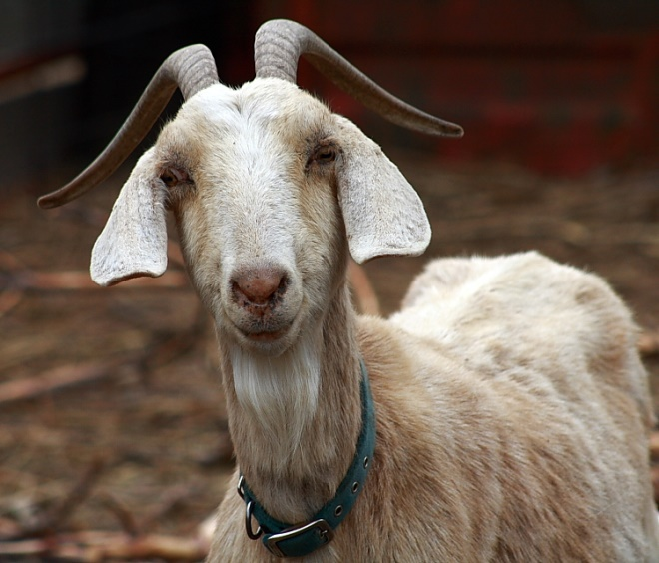
A goat has the following genotype: AaRr. List all of the possible gametes this goat could produce. (The A and R alleles are on different chromosomes.)
AR
Ar
aR
ar

Slide 17
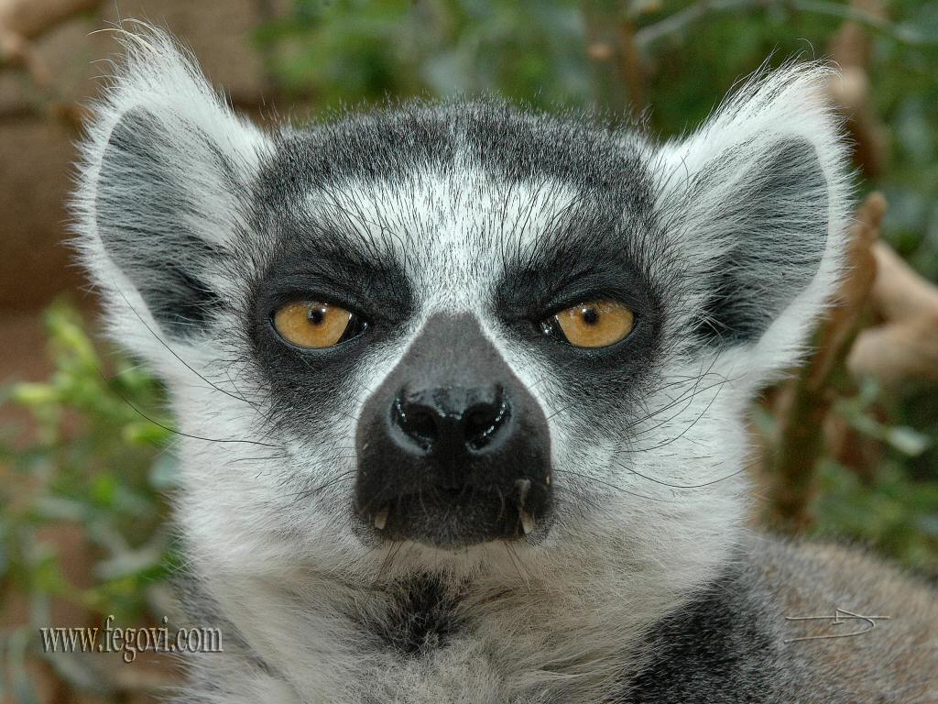
A lemur has the following genotype: aaRr. List all of the possible gametes this lemur could produce. (The A and R alleles are on different chromosomes.)
aR
ar

Slide 18
Solving Complex Genetics Problems with the Rules of Probability
We can apply the rules of probability to predict the outcome of crosses involving multiple characters.
A dihybrid or other multicharacter cross is equivalent to two or more independent monohybrid crosses occurring simultaneously.
In calculating the chances for various genotypes, each character is considered separately, and then the individual probabilities are multiplied.
Notes:
18

Slide 19
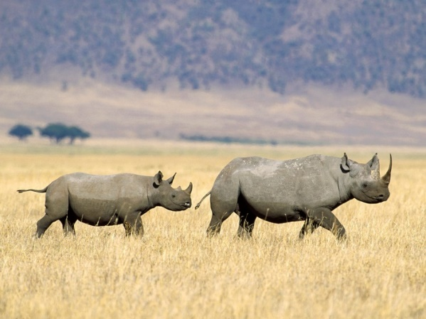
Rhinoceroses with the following genotypes are crossed AARr x Aarr
What fraction of their progeny are expected to be heterozygous for both alleles?
Probability of Aa: (1)(1/2) = ½
Probability of Rr: (1/2)(1) = ½
Probability of Aa and Rr: (1/2)(1/2) = ¼

Slide 20
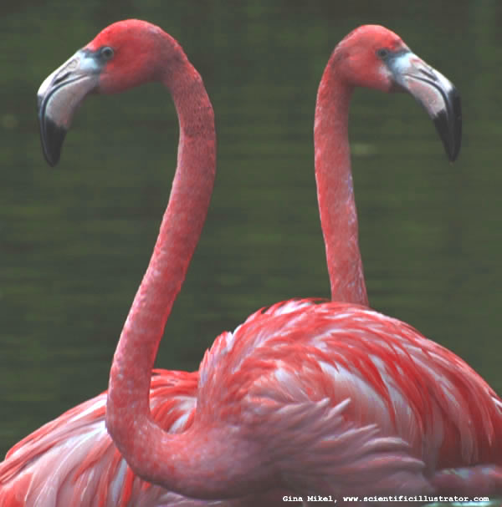
Flamingos with the following genotypes are crossed AARr x Aarr
What fraction of their progeny are expected to be Aarr?
Probability of Aa: (1)(1/2) = ½
Probability of rr: (1/2)(1) = ½
Probability of Aa and rr: (1/2)(1/2) = ¼

Slide 22
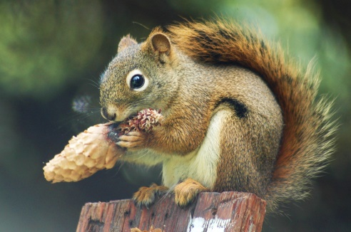
Squirrels with the following genotypes are crossed: AaRr x AArr
What fraction of their progeny are expected show the dominant phenotype for both traits?
Probability of at least one “A”
Probability of Aa: (1/2)(0) = 0
or
Probability of aA: (1/2)(1) = ½
or
Probability of AA: (1/2)(1) = ½
0 + ½ + ½ = 1
Probability of at least one “R”
Probability of Rr: (1/2)(1) = 1/2
or
Probability of rR: (1/2)(0) = 0
or
Probability of RR (1/2)(0) = 0
½ + 0 + 0 = 1/2
Probability of at least one “A” and at least one “R”: ( 1 )(1/2) = 1/2

Slide 23
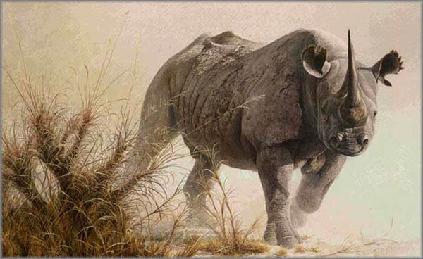
Rhinoceroses with the following genotypes are crossed AARr x Aarr
What fraction of their progeny are expected to be homozygous dominant for both alleles?
Zero!

Slide 24
In corn purple is dominant to yellow and round is dominant to wrinkled. (Use the letters P and R)
List all of the possible genotypes for a kernel that is yellow and wrinkled.
pprr
The yellow/wrinkled kernel is planted and grows into an adult plant. List all of the possible genotypes of the sperm produced by this plant.
pr
A yellow/wrinkled plant is mated with a homozygous purple and homozygous round. List all of the possible genotypes of their offspring.
PpRr

