Slide 2
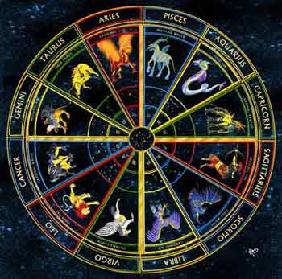
Does your zodiac sign determine how successful you will be? Fortune magazine collected the zodiac signs of 256 heads of the largest 400 companies. Is there sufficient evidence to claim that successful people are more likely to be born under some signs than others?

Slide 3
Aries 23
Taurus 20
Gemini 18
Cancer 23
Aquarius 24
Scorpio 21
Sagittarius 19
Capricorn 22
Leo 20
Virgo 19
Libra 18
Pisces 29
Total 256
Can you use a χ² test to evaluate these data? Why or why not.

Slide 4
You can use a χ² test because the data fits the following three assumptions:
We have counts of categorical data & each category happens at least once.
The sample size is large enough, there are at least 5 in each category.
The observations are mutually exclusive and independent.

Slide 5
What is your null hypothesis?
H₀: There is not a significant difference in the number of CEOs born under each sign.

Slide 6
What is your alternative hypothesis?
H_{a}: There is a significant difference in the number of CEOs born under each sign.

Slide 7
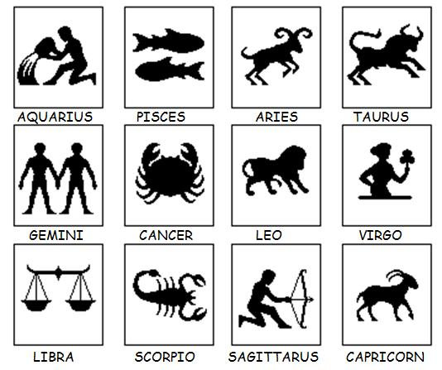
What is your expected value? (Remember that there were 256 people in the study and there are 12 months in a year.)
256/12 = 21.33

Slide 8
How many degrees of freedom do you have?
12-1=11

Slide 9
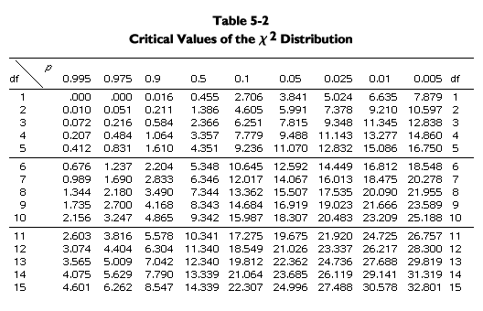
95% probability that the difference is NOT due to chance alone.
The difference may be due to chance alone.
You can’t say that the difference is not due to chance alone.
Fail to reject the null hypothesis.
Reject the null hypothesis.

Slide 10
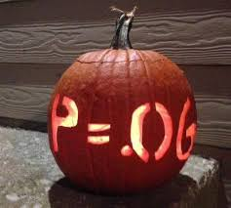
Nightmare!

Slide 11
What is your critical value?
19.675
χ² = 5.094
Do you reject your null hypothesis?
No
95% probability that the difference is NOT due to chance alone.
The difference may be due to chance alone.
You can’t say that the difference is not due to chance alone.
Fail to reject the null hypothesis.
Reject the null hypothesis.

Slide 12
Is there sufficient evidence to claim that people who are successful in business are more likely to be born under some signs than others?
No!

