Slide 2
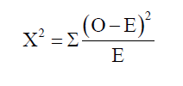
How do you know if the variation in data is the result of random chance or environmental factors?
O is the observed value
E is the expected value

Slide 3
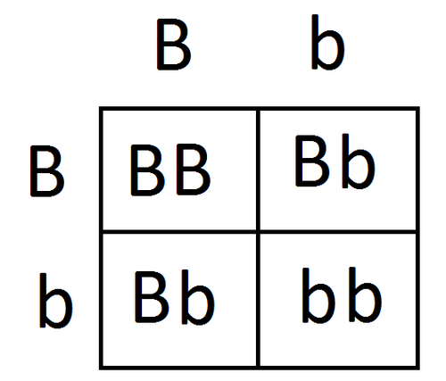
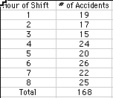
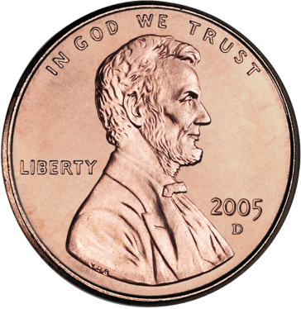
What are the expected values?
50% Heads
50% Tails
200 Flips
100 Heads
100 Tails
25% BB
50% Bb
25% bb
Equal # of accidents
168 Accidents
21 pre shift
200 Offspring
50 BB
100 Bb
50 bb

Slide 4
Equation
The χ² test provides a measure of the difference between the observed and expected values (χ² value) and the probability that the differences are due to chance alone (the P value)

Slide 5
Why is the chi-square test an appropriate statistic to use in each of these examples?

Slide 6
Chi-square is used to compare observed data with data we would expect to obtain according to a specific hypothesis.

Slide 7
χ² assumptions
Have counts of categorical data and we expect each category to happen at least once.
Sample size – to insure that the sample size is large enough we should expect at least five in each category.
Observations are mutually exclusive and independent.

Slide 8
The chi-square tests the null hypothesis, which states that there is no significant difference between the expected and observed result.
H₀: The observed counts are not statistically different from the expected counts.
H_{a}: The observed counts are statistically different from the expected counts.

Slide 9
200 Offspring
25% BB
50% Bb
25% bb
50 BB
100 Bb
50 bb
H₀:
In the mating of two Bb individuals, the offspring will not be statistically significantly different than the expected 1:2:1 ratio.

Slide 10
200 Offspring
25% BB
50% Bb
25% bb
50 BB
100 Bb
50 bb
H_{a}:
In the mating of two Bb individuals, the offspring will be statistically significantly different than the expected 1:2:1 ratio.

Slide 11
50% Heads
50% Tails
200 Flips
100 Heads
100 Tails
H₀:
When flipping a coin 200 times, the number of heads and tails will not be statistically significantly different from 100 heads and 100 tails.

Slide 12
50% Heads
50% Tails
200 Flips
100 Heads
100 Tails
H_{a}:
When flipping a coin 200 times, the number of heads and tails will be statistically significantly different from 100 heads and 100 tails.

Slide 13
Equal # of accidents
168 Accidents
21 pre shift
H₀:
The number of accidents during each shift are not statistically significantly different from each other.

Slide 14
What are the expected values?
Equal # of accidents
168 Accidents
21 pre shift
H_{a}:
The number of accidents during each shift are statistically significantly different from each other.

Slide 15
 | Shift
 | 1 | 2 | 3 | 4 | 5 | 6 | 7 | 8 | Total
Observed | 19 | 17 | 15 | 24 | 20 | 26 | 22 | 25 | 168
Expected
(o-e)² e

Slide 16
 | Shift
 | 1 | 2 | 3 | 4 | 5 | 6 | 7 | 8 | Total
Observed | 19 | 17 | 15 | 24 | 20 | 26 | 22 | 25 | 168
Expected | 21 | 21 | 21 | 21 | 21 | 21 | 21 | 21 | 168
(o-e)² e
0.19
0.76
1.72
0.43
0.05
1.19
0.05
0.76
Χ² ⁼ 5.15

Slide 17
Three steps to performing the chi-squared test
Calculate the chi-squared value
Calculate the degrees of freedom
Compare the chi-square value with a scale of values given by a standard probability.

Slide 18
Calculate the degrees of freedom
The degrees of freedom is
equal to the number of classes minus one.
In the Irongate example there are 8 shifts so there are _____ degrees of freedom.
(8-1=7)
7

Slide 19
Remember that the chi-square is testing the null hypothesis.
H₀: The observed counts are not statistically different from the expected counts.
Generally speaking, we can reject the null hypothesis if there is a 95% probability that the difference between the observed and the expected is not due to chance. (p value of 0.05)

Slide 20
Χ² ⁼ 5.15
df = 7
Critical value = 14.07
Accept the null hypothesis.
There is not a statistically significant difference in the number of accidents that occurred during each shift.

