Slide 1
0
Chapter 12
Sex chromosomes and sex-linked genes

Slide 2
You Must Know
The unique pattern of inheritance in sex-linked genes.

Slide 3
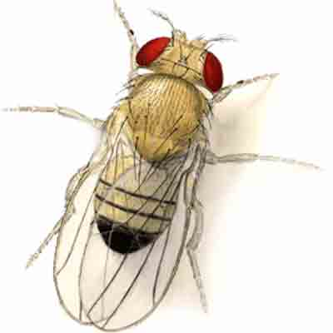
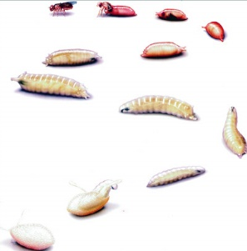
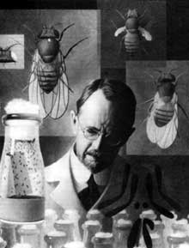
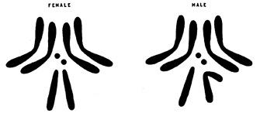
Drosophila melanogaster and Thomas Hunt Morgan
1907
Notes:
Thomas Hunt Morgan and his students began studying the genetics of the fruit fly, Drosophila melanogaster, in 1907
Several characteristics make fruit flies a convenient organism for genetic studies
They produce many offspring
A generation can be bred every two weeks
They have only four pairs of chromosomes

Slide 4
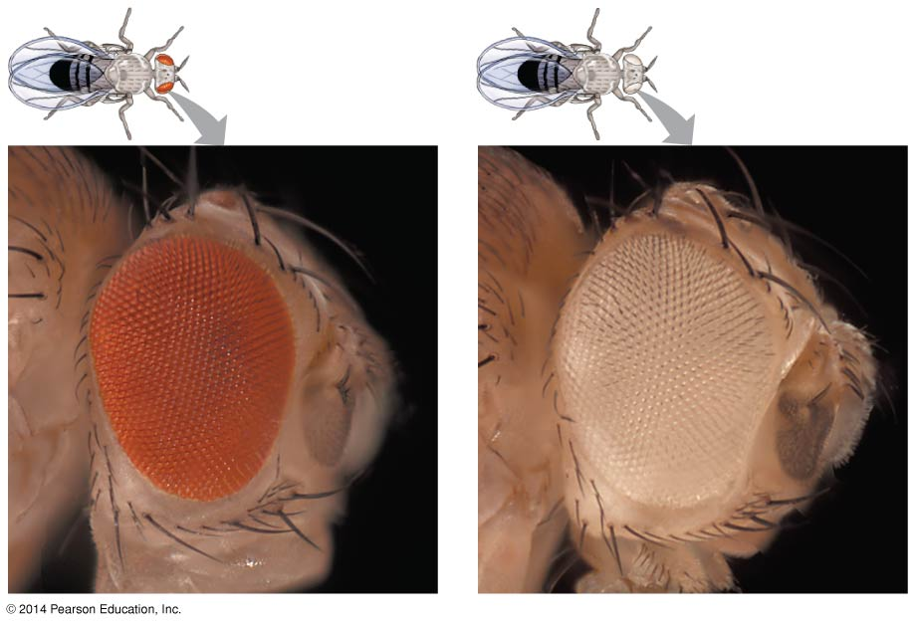
wild-type: normal, common phenotype
Mutant
Notes:
4
Morgan noted wild-type, or normal, phenotypes that were common in the fly populations.
Traits alternative to the wild type are called mutant phenotypes.
The first mutant phenotype they discovered was a fly with white eyes instead of the wild type, red.

Slide 5
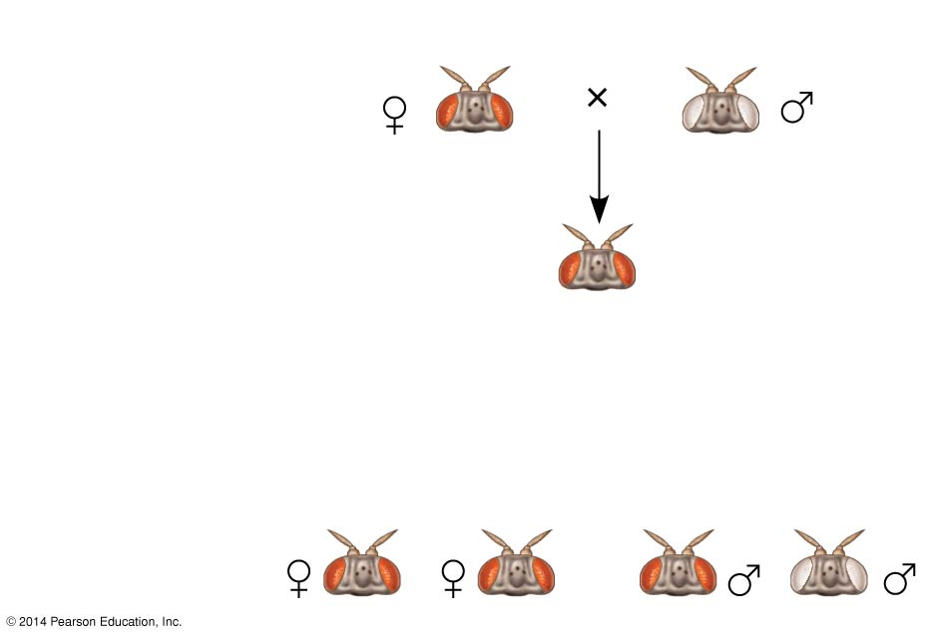
Figure 12.4a
Experiment
P
Generation
All offspring
had red eyes.
F₁
Generation
Results
F₂
Generation
Notes:
5

Slide 6
Figure 12.4
Figure 12.4a
X^{w+}X^{w+}
X^{w}Y
Hypothesis
P
Generation
All offspring
had red eyes.
F₁
Generation
 | X^{w} | Y
X^{w+} | X^{w+} X^{w} | X^{w+} Y
X^{w+} | X^{w+} X^{w} | X^{w+} Y
F₁ Genotypes
Notes:
6
Figure 12.4 Inquiry: In a cross between a wild-type female fruit fly and a mutant white-eyed male, what color eyes will the F₁ and F₂ offspring have?

Slide 7
 | X^{w+} | Y
X^{w+} | X^{w+} X^{w+} | X^{w+} Y
X^{w} | X^{w+}X^{w} | X^{w} Y
F₂ Genotypes
F₂
Notes:
7
In one experiment, Morgan mated male flies with white eyes (mutant) with female flies with red eyes (wild type).
The F₁ generation all had red eyes
The F₂ generation showed the classical 3:1 red:white ratio, but only males had white eyes
Morgan concluded that the eye color was related to the sex of the fly.
Morgan determined that the white-eyed mutant allele must be located on the X chromosome.
Morgan’s finding supported the chromosome theory of inheritance.

Slide 8
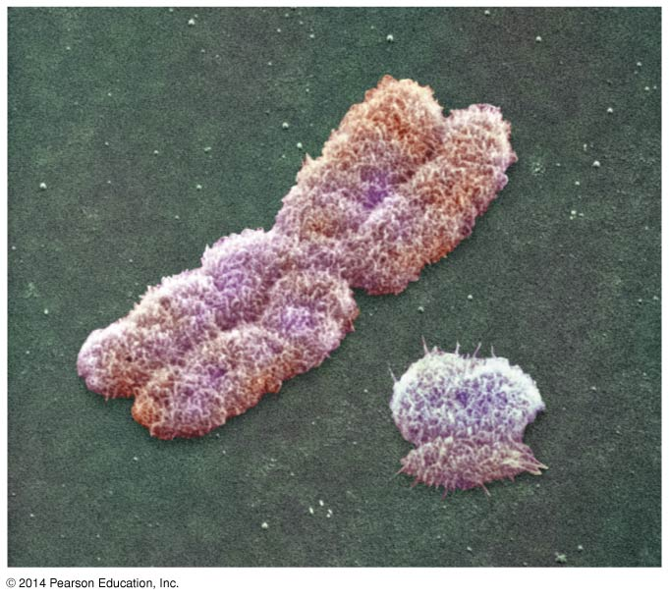
Human sex chromosomes
SRY gene on the Y chromosome is required for the developments of testes
X
Y
Notes:
8
In humans and other mammals, there are two varieties of sex chromosomes: a larger X chromosome and a smaller Y chromosome.
Only the ends of the Y chromosome have regions that are homologous with corresponding regions of the X chromosome.
The SRY gene on the Y chromosome is required for the developments of testes.
X chromosomes have genes for many characters unrelated to sex, whereas the Y chromosome mainly encodes genes related to sex determination.

Slide 9
A gene that is located on either sex chromosome is called a sex-linked gene. Genes on the X chromosome are called X-linked genes
Notes:
. X-linked genes follow specific patterns of inheritance.
For a recessive X-linked trait to be expressed
A female needs two copies of the allele (homozygous)
A male needs only one copy of the allele (hemizygous)
X-linked recessive disorders are much more common in males than in females

Slide 10
Notes:
A gene that is located on either sex chromosome is called a sex-linked gene. Genes on the Y chromosome are called Y-linked genes; there are few of these. Genes on the X chromosome are called X-linked genes. X-linked genes follow specific patterns of inheritance.
For a recessive X-linked trait to be expressed
A female needs two copies of the allele (homozygous)
A male needs only one copy of the allele (hemizygous)
X-linked recessive disorders are much more common in males than in females

Slide 11
