Slide 1
0
Chapter 12
Mendelian inheritance has its physical basis in the behavior of chromosomes

Slide 2
You Must Know
How the chromosome theory of inheritance connects the physical movement of chromosomes in meiosis to Mendel’s laws of inheritance.

Slide 3
Overview: Locating Genes Along Chromosomes
Mendel’s “hereditary factors” were genes
Today we know that genes are located on chromosomes
The location of a particular gene can be seen by tagging isolated chromosomes with a fluorescent dye that highlights the gene
Notes:
3

Slide 4
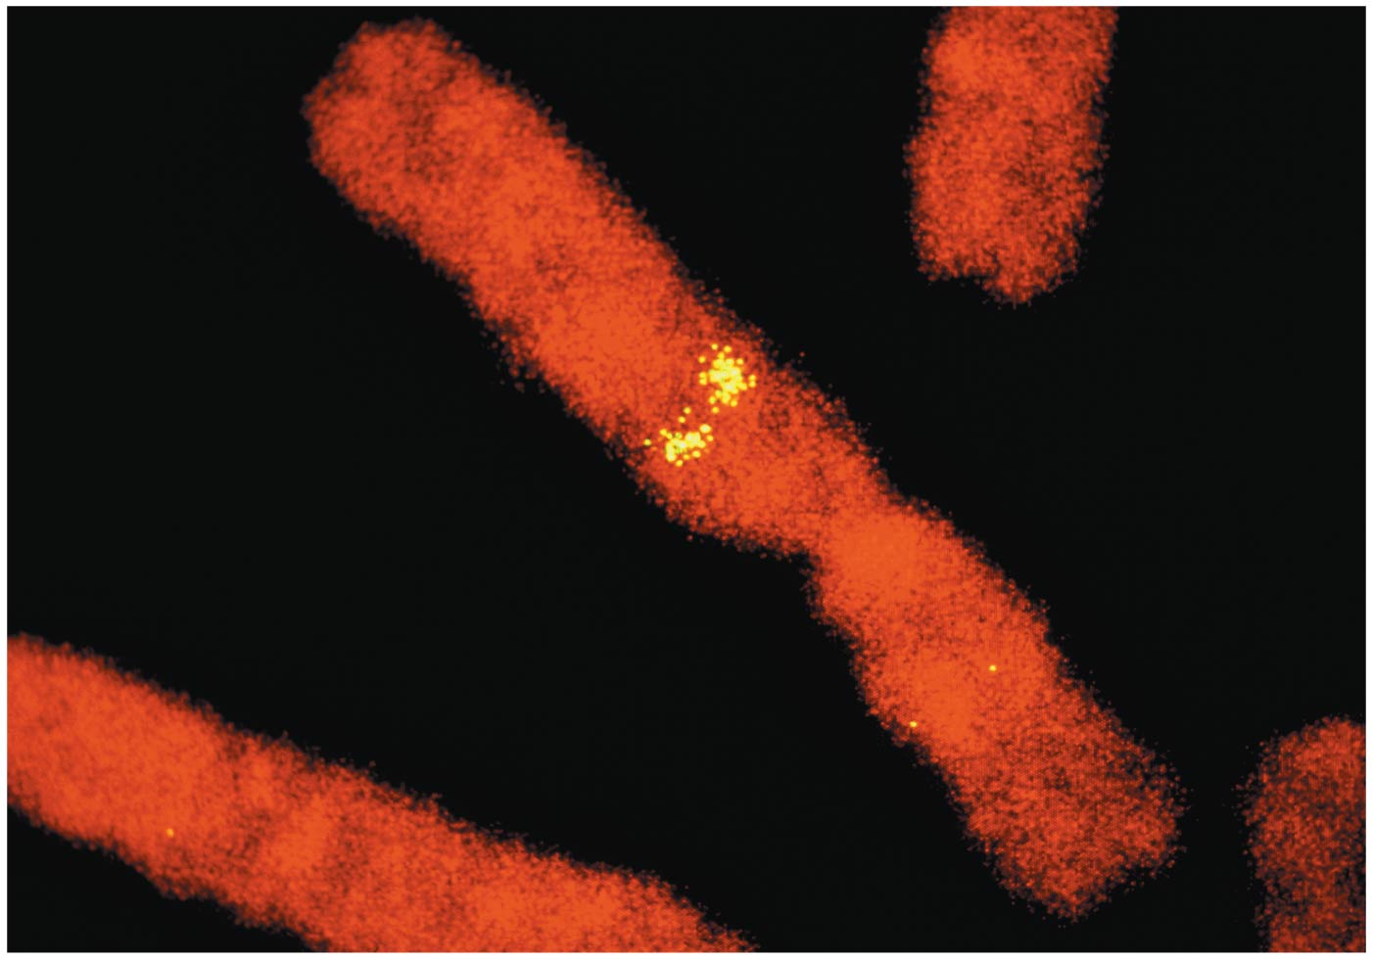
Figure 12.1
Notes:
4
Figure 12.1 Where are Mendel's hereditary factors located in the cell?

Slide 5
Concept 12.1: Mendelian inheritance has its physical basis in the behavior of chromosomes
Mitosis and meiosis were first described in the late 1800s
The chromosome theory of inheritance states
Mendelian genes have specific loci (positions) on chromosomes
Chromosomes undergo segregation and independent assortment
The behavior of chromosomes during meiosis can account for Mendel’s laws of segregation and independent assortment
Notes:
5

Slide 6
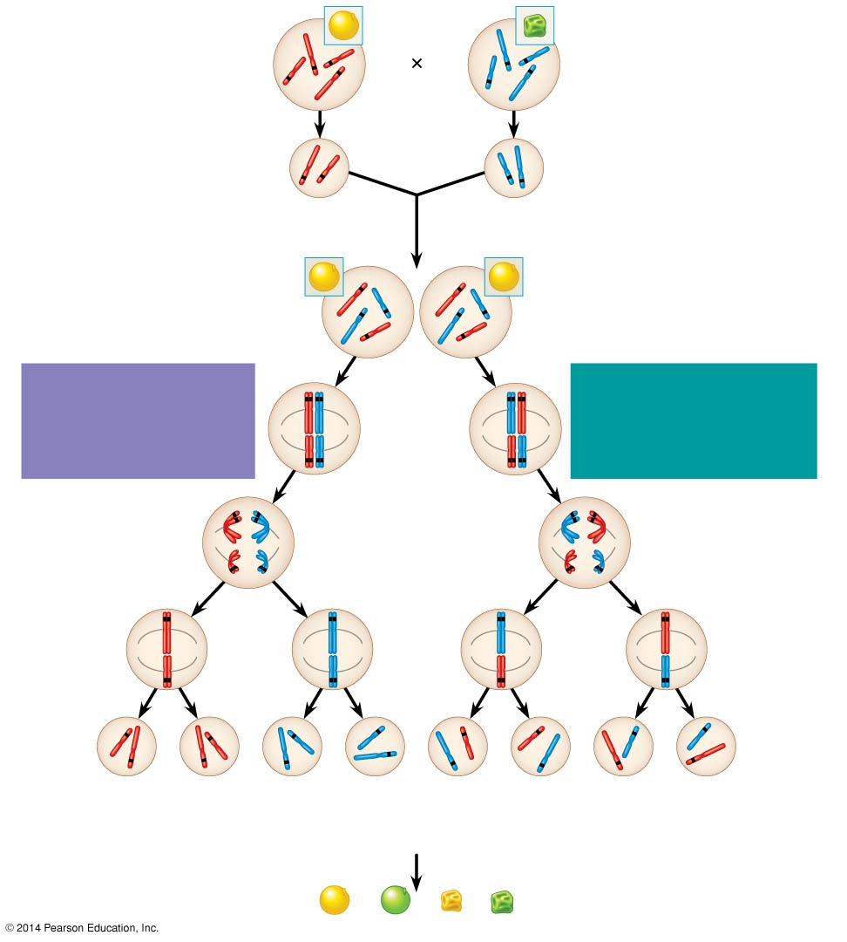
Figure 12.2
P Generation
Yellow-round
seeds (YYRR)
Green-wrinkled
seeds (yyrr)
Y
r
y
Y
R
R
y
r
Meiosis
Fertilization
y
r
Gametes
R
Y
All F₁ plants produce
yellow-round seeds (YyRr).
F₁ Generation
R
R
r
y
r
y
Y
Y
LAW OF SEGREGATION
The two alleles for each
gene separate.
Meiosis
LAW OF INDEPENDENT
ASSORTMENT Alleles of
genes on nonhomologous
chromosomes assort
independently.
R
r
Metaphase
I
r
R
Y
y
Y
y
1
1
R
r
r
R
Anaphase I
Y
y
Y
y
R
r
Metaphase
II
r
R
2
2
Y
y
Y
y
Y
Y
y
y
Y
Y
y
y
R
R
r
r
r
r
R
R
1
/
YR
1
/
yr
YR
1
/
Yr
1
/
yR
F₂ Generation
4
4
4
4
3
An F₁ × F₁ cross-fertilization
3
Fertilization
recombines the R and
r alleles at random.
Fertilization results in the
9:3:3:1 phenotypic ratio
in the F₂ generation.
9
: 3
: 3
: 1
Notes:
6
Figure 12.2 The chromosomal basis of Mendel’s laws

