Slide 1
0
Chapter 12
Alterations of Chromosomes

Slide 2
You Must Know
The unique pattern of inheritance in sex-linked genes.
Alteration of chromosome number or structurally.

Slide 3
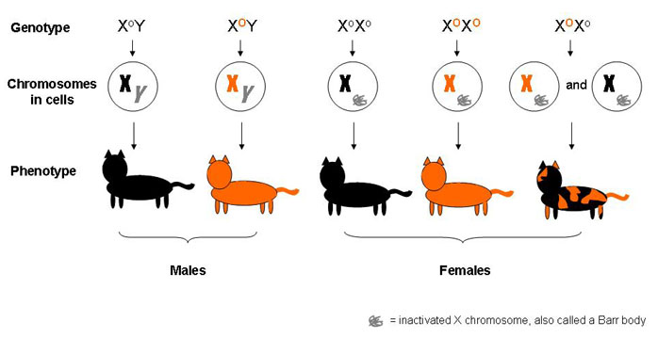
Notes:
In mammalian females, one of the two X chromosomes in each cell is randomly inactivated during embryonic development.
The inactive X condenses into a Barr body.
If a female is heterozygous for a particular gene located on the X chromosome, she will be a mosaic for that character.

Slide 4
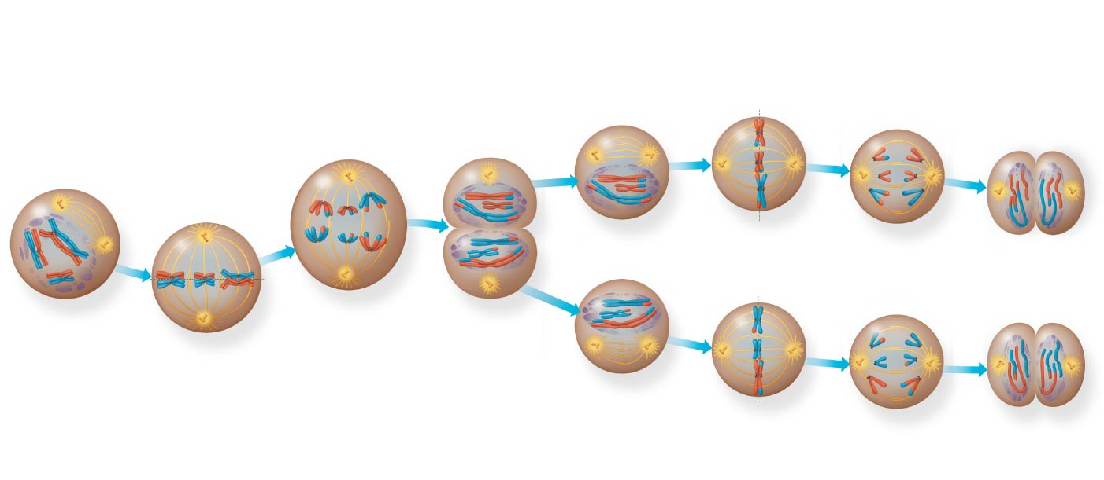
Nondisjunction is the failure of homologous chromosome or sister chromatids to separate properly during cell division.
MEIOSIS I: Separates homologous chromosomes
Prophase I
Metaphase I
Anaphase I
Telophase I and
Cytokinesis
Prophase II
Metaphase II
Anaphase II
Telophase II and
Cytokinesis
Sister chromatids
separate
Homologous
chromosomes
separate
Failure
Failure
Notes:
4
Figure 10.8 Exploring meiosis in an animal cell

Slide 5
Meiosis I
Meiosis II
Nondisjunction
Non-
disjunction
n + 1
n + 1
n − 1
n − 1
n + 1
n − 1
n
n
Number of chromosomes
Number of chromosomes
(a)
Nondisjunction of homo-
logous chromosomes in
meiosis I
(b)
Nondisjunction of sister
chromatids in meiosis II
Notes:
5

Slide 6
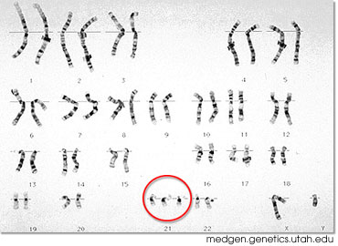
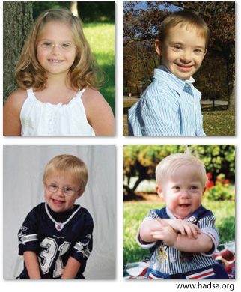
Down Syndrome
Notes:
People with Down syndrome tend to have distinct facial features. They have some level of intellectual disability, which is usually mild to moderate. Children with Down syndrome usually develop more slowly than their peers. They can take longer to learn to walk, talk, and care for themselves.
People with Down syndrome are at an increased risk of having certain medical issues. These including respiratory infections, problems with the gastrointestinal (digestive) tract, leukemia (a blood cancer), eye problems, hearing loss, and hypothyroidism. Many babies are born with heart conditions, and heart problems can also appear later in life. Because of these issues, people with Down syndrome have a life expectancy that is shorter than average—about 60 years. (You don’t need to remember the specifics of this.)

Slide 7
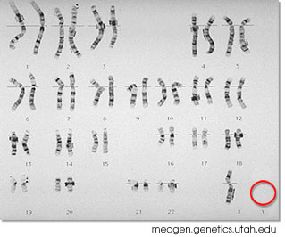
Turners Syndrome
Notes:
Turner syndrome affects growth and sexual development. Without intervention, girls with this disorder are much shorter than average. And because their ovaries (which produce eggs, as well as the sex hormones estrogen and progesterone) do not fully develop and mature, most do not begin puberty on their own. (You don’t need to remember the specifics of this.)

Slide 8
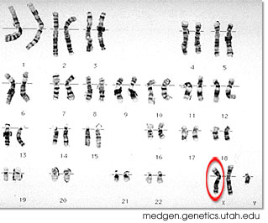
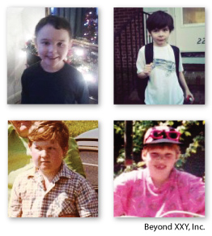
Kleinfelter Syndrome
Notes:
The XXY chromosome arrangement affects primarily sexual development. Typically, testes don't fully develop, and the levels of the hormone testosterone (important for male sexual development) are lower than average. As adults, nearly all XXY males are unable to make sperm and so cannot have biological children. Many men discover their condition only after they seek medical help for infertility.
The features of XXY (Klinefelter syndrome) can be very subtle and are highly varied. Children and adults may be taller than average, with proportionally longer arms and legs, and they may have less-muscular bodies, more belly fat, wider hips, narrower shoulders, or minor to moderate learning disabilities. Changes that appear at puberty can include low growth of facial and body hair, development of breast tissue, and small testes.
XXY individuals are also more likely to develop certain medical conditions, including osteoporosis (weak bones), varicose veins, type 2 diabetes, and heart valve defects. As adults, they are just as likely as XX females to develop breast cancer and certain autoimmune disorders.
(You don’t need to remember this.)

Slide 9
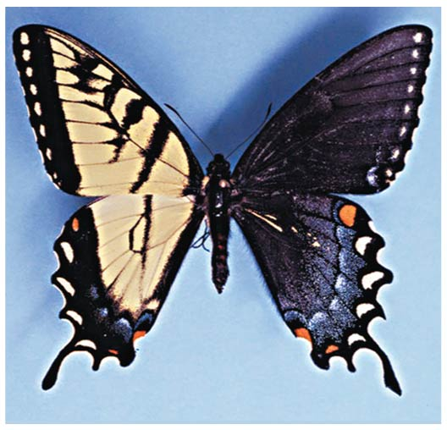
Female Butterfly:
XY (This is normal)
X (This is not lethal)
Male Butterflies:
XX (This is normal)
XXX (This is not lethal)
The 1st division of the fertilized egg divides the embryo into the future right and left halves of the butterfly.
Propose a hypothesis to explain how you could end up with a butterfly that is ½ male and ½ female. (Hint: Think about mitosis)
Male
Female
Notes:
9
You won’t need to remember the specifics of butterfly sex-determination for the test.

Slide 10
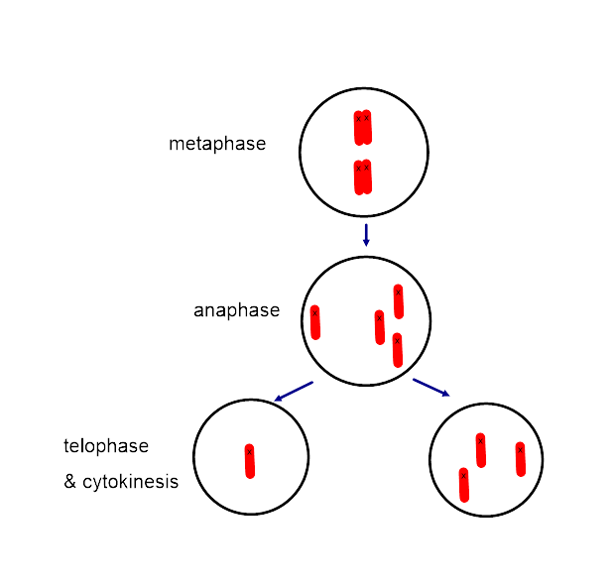
mitosis

Slide 11
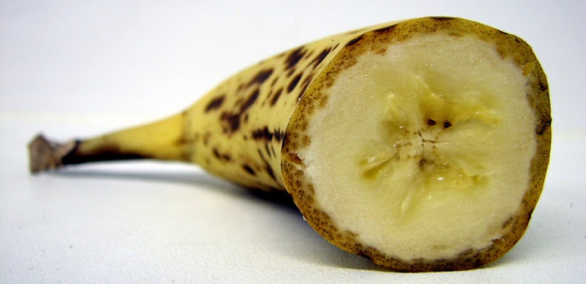
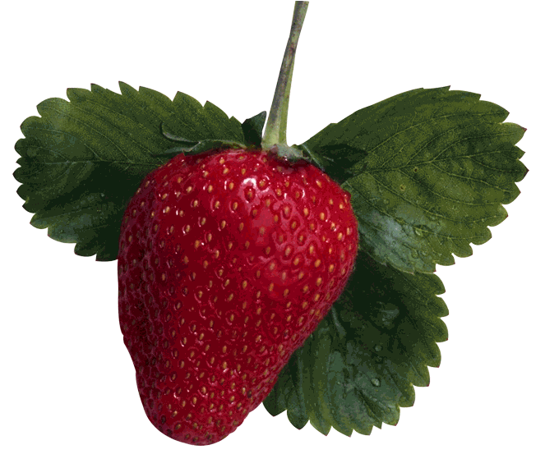
Polyploidy is a condition in which an organism has more than two complete sets of chromosomes
Triploidy (3n) is three sets of chromosomes
Tetraploidy (4n) is four sets of chromosomes
Polyploidy is common in plants, but not animals
Octiploid (8n)!
Notes:
One way a triploid cell may arise is by the fertilization of an abnormal diploid egg produced by nondisjunction of all of this chromosomes. Tetraploidy could result from the failure of a 2n zygote to divide after replicating its chromosomes Subsequent normal mitotic divisions would then produce a 4n embryo.

Slide 12
Alterations in chromosome structure
Translocation
Notes:
Breakage of a chromosome can lead to four types of changes in chromosome structure
Deletion removes a chromosomal segment.
Duplication repeats a segment.
Inversion reverses orientation of a segment within a chromosome.
Translocation moves a segment from one chromosome to another.
Large-scale chromosomal alterations in humans and other mammals often lead to spontaneous abortions (miscarriages) or cause a variety of developmental disorders.
Plants tolerate such genetic changes better than animals do.
A diploid embryo that is homozygous for a large deletion is likely missing a number of essential genes; such a condition is generally lethal.
Duplications and translocations also tend to be harmful.
In inversions, the balance of genes is normal but phenotype may be influenced if the expression of genes is altered.

Slide 13
Chromosomal Mutations
b) Deletion

Slide 14
Chromosomal Mutations
c) Duplication

Slide 15
Chromosomal Mutations
b) Inversion

Slide 16
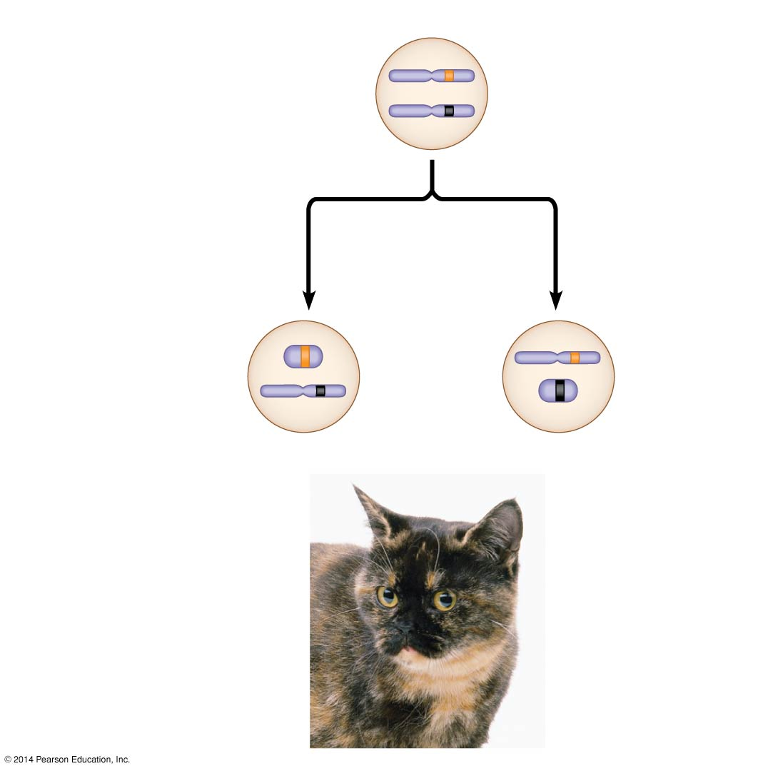
Figure 12.8
X chromosomes
Allele for
orange fur
Early embryo:
Allele for
black fur
Cell division and
X chromosome
inactivation
Two cell
populations
in adult cat:
Active X
Active X
Inactive
X
Black fur
Orange fur
Notes:
16
Figure 12.8 X inactivation and the tortoiseshell cat

