Slide 1
0
Chapter 11
Mendel and the Idea of the Gene

Slide 2
You Must Know
Terms associated with genetics problems: P, F1, F2, dominant, recessive, homozygous, heterozygous, character, trait, true breeding, hybridization, test cross, phenotype, and genotype.

Slide 3
Overview: Drawing from the Deck of Genes
What genetic principles account for the passing of traits from parents to offspring?
The “blending” hypothesis is the idea that genetic material from the two parents blends together (the way blue and yellow paint blend to make green)
Notes:
3

Slide 4
The “particulate” hypothesis is the idea that parents pass on discrete heritable units (genes)
Mendel documented a particulate mechanism through his experiments with garden peas
Notes:
4

Slide 5
Concept 11.1: Mendel used the scientific approach to identify two laws of inheritance
Mendel discovered the basic principles of heredity by breeding garden peas in carefully planned experiments.
Notes:
5

Slide 6
Mendel’s Experimental, Quantitative Approach
Mendel probably chose to work with peas because
There are many varieties with distinct heritable features, or characters (such as flower color); character variants (such as purple or white flowers) are called traits
He could control mating between plants
Notes:
6

Slide 7
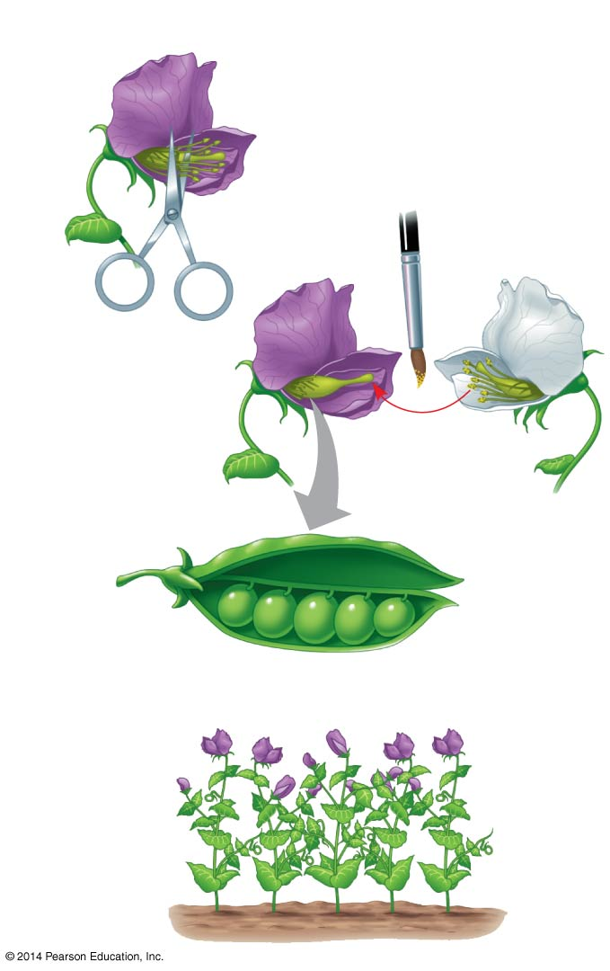
Figure 11.2
Technique
1
2
Parental
generation
(P)
3
Stamens
Carpel
4
Results
5
First filial
generation
offspring
(F₁)
Notes:
7
Figure 11.2 Research method: crossing pea plants

Slide 8
Mendel chose to track only characters that occurred in two distinct alternative forms.
He also used varieties that were true-breeding (plants that produce offspring of the same variety when they self-pollinate).
Notes:
8

Slide 9
In a typical experiment, Mendel mated two contrasting, true-breeding varieties, a process called hybridization
The true-breeding parents are the P generation
The hybrid offspring of the P generation are called the F₁ generation
When F₁ individuals self-pollinate or cross- pollinate with other F₁ hybrids, the F₂ generation is produced
Notes:
9

Slide 10
The Law of Segregation
When Mendel crossed contrasting, true-breeding white- and purple-flowered pea plants, all of the F₁ hybrids were purple
When Mendel crossed the F₁ hybrids, many of the F₂ plants had purple flowers, but some had white
Mendel discovered a ratio of about three to one, purple to white flowers, in the F₂ generation
Notes:
10

Slide 11
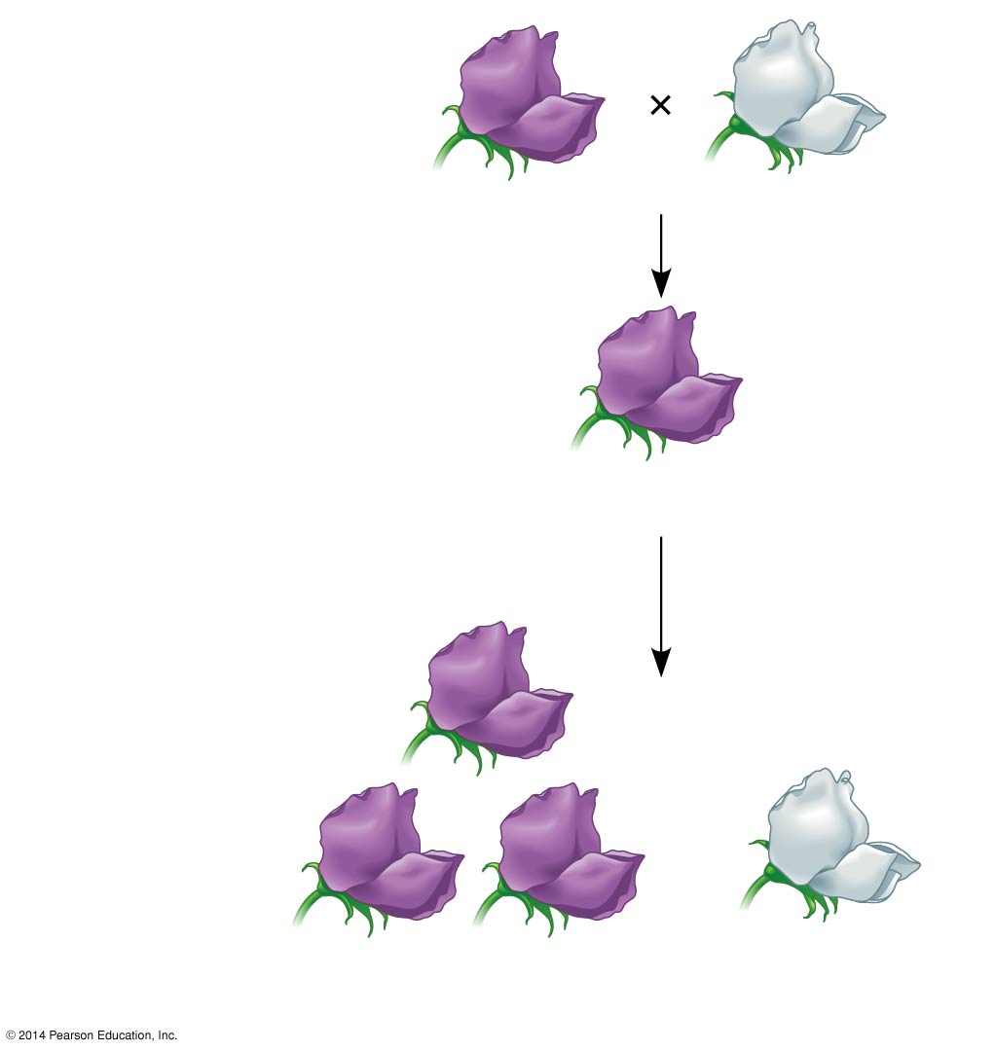
Figure 11.3-3
Experiment
P Generation
(true-breeding
parents)
Purple flowers
White flowers
F₁ Generation
(hybrids)
All plants had purple flowers
Self- or cross-pollination
F₂ Generation
705 purple-flowered
plants
224 white-flowered
plants
Notes:
11
Figure 11.3-3 Inquiry: When F₁ hybrid pea plants self- or cross-pollinate, which traits appear in the F₂ generation? (step 3)

Slide 12
Mendel reasoned that in the F₁ plants, the heritable factor for white flowers was hidden or masked in the presence of the purple-flower factor
He called the purple flower color a dominant trait and the white flower color a recessive trait
The factor for white flowers was not diluted or destroyed because it reappeared in the F₂ generation
Notes:
12

Slide 13
Mendel observed the same pattern of inheritance in six other pea plant characters, each represented by two traits
What Mendel called a “heritable factor” is what we now call a gene
Notes:
13

Slide 14
The Testcross
How can we tell the genotype of an individual with the dominant phenotype?
Such an individual could be either homozygous dominant or heterozygous
The answer is to carry out a testcross: breeding the mystery individual with a homozygous recessive individual
If any offspring display the recessive phenotype, the mystery parent must be heterozygous
Notes:
14

Slide 15
Mendel’s Model
Mendel developed a model to explain the 3:1 inheritance pattern he observed in F₂ offspring
Four related concepts make up this model
Notes:
15

Slide 16
First, alternative versions of genes account for variations in inherited characters
For example, the gene for flower color in pea plants exists in two versions, one for purple flowers and the other for white flowers
These alternative versions of a gene are now called alleles
Each gene resides at a specific locus on a specific chromosome
Notes:
16

Slide 17
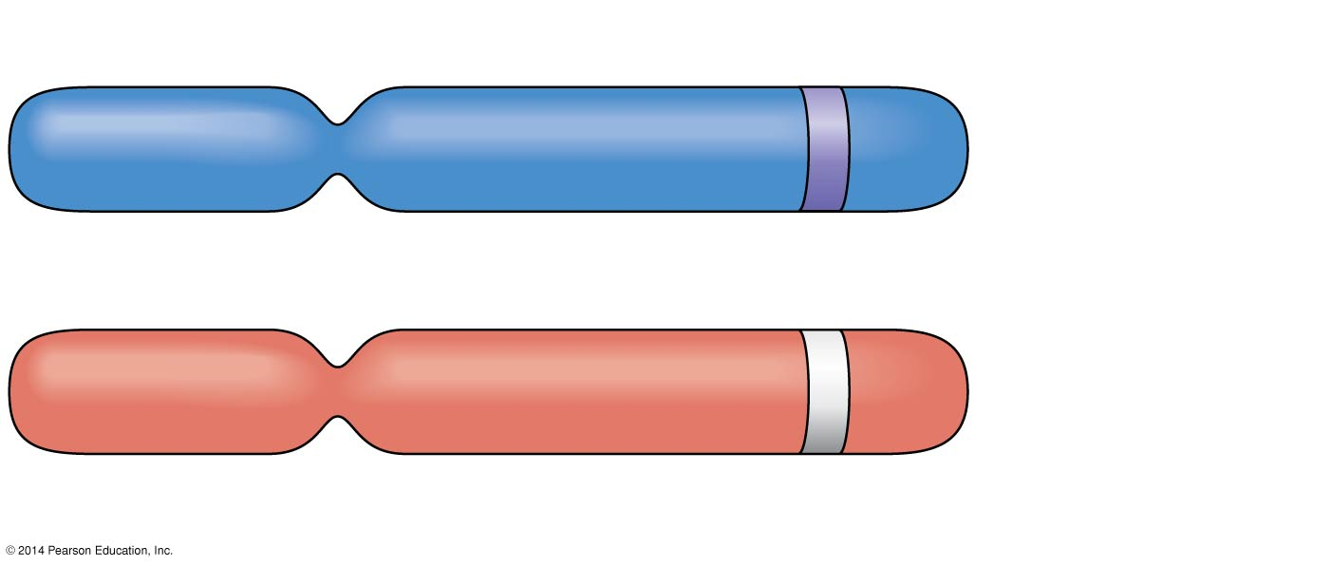
Figure 11.4
Allele for purple flowers
Pair of
homologous
chromosomes
Locus for flower-color gene
Allele for white flowers
Notes:
17
Figure 11.4 Alleles, alternative versions of a gene

Slide 18
Second, for each character, an organism inherits two alleles, one from each parent
Mendel made this deduction without knowing about the existence of chromosomes
Two alleles at a particular locus may be identical, as in the true-breeding plants of Mendel’s P generation
Alternatively, the two alleles at a locus may differ, as in the F₁ hybrids
Notes:
18

Slide 19
Third, if the two alleles at a locus differ, then one (the dominant allele) determines the organism’s appearance, and the other (the recessive allele) has no noticeable effect on appearance
In the flower-color example, the F₁ plants had purple flowers because the allele for that trait is dominant
Notes:
19

Slide 20
Fourth (now known as the law of segregation), the two alleles for a heritable character separate (segregate) during gamete formation and end up in different gametes
Thus, an egg or a sperm gets only one of the two alleles that are present in the organism
This segregation of alleles corresponds to the distribution of homologous chromosomes to different gametes in meiosis
Notes:
20

Slide 21
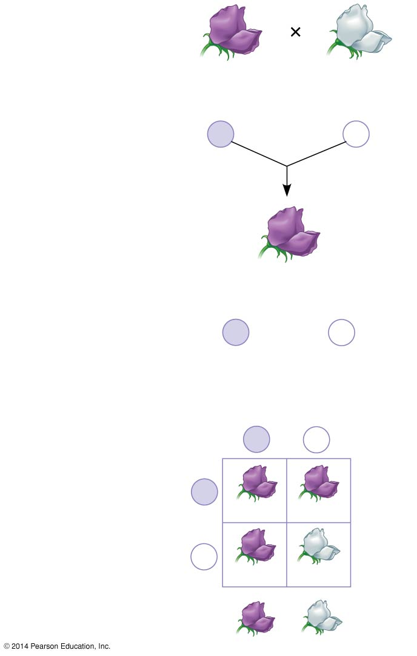
Figure 11.5-3
P Generation
Appearance:
Genetic makeup:
Purple flowers
PP
White flowers
pp
Gametes:
P
p
F₁ Generation
Appearance:
Genetic makeup:
Purple flowers
Pp
Gametes:
½
P
½
p
Sperm from
F₁ (Pp) plant
F₂ Generation
P
p
P
Eggs from
F₁ (Pp) plant
PP
Pp
p
Pp
pp
3
: 1
Notes:
21
Figure 11.5-3 Mendel’s law of segregation (step 3)

Slide 22
Mendel’s segregation model accounts for the 3:1 ratio he observed in the F₂ generation of his numerous crosses
The possible combinations of sperm and egg can be shown using a Punnett square, a diagram for predicting the results of a genetic cross between individuals of known genetic makeup
A capital letter represents a dominant allele, and a lowercase letter represents a recessive allele
For example, P is the purple-flower allele and p is the white-flower allele
Notes:
22

Slide 23
Useful Genetic Vocabulary
An organism with two identical alleles for a character is said to be homozygous for the gene controlling that character
An organism that has two different alleles for a gene is said to be heterozygous for the gene controlling that character
Unlike homozygotes, heterozygotes are not true-breeding
Notes:
23

Slide 24
Because of the effects of dominant and recessive alleles, an organism’s traits do not always reveal its genetic composition
Therefore, we distinguish between an organism’s phenotype, or physical appearance, and its genotype, or genetic makeup
In the example of flower color in pea plants, PP and Pp plants have the same phenotype (purple) but different genotypes
Notes:
24

Slide 25
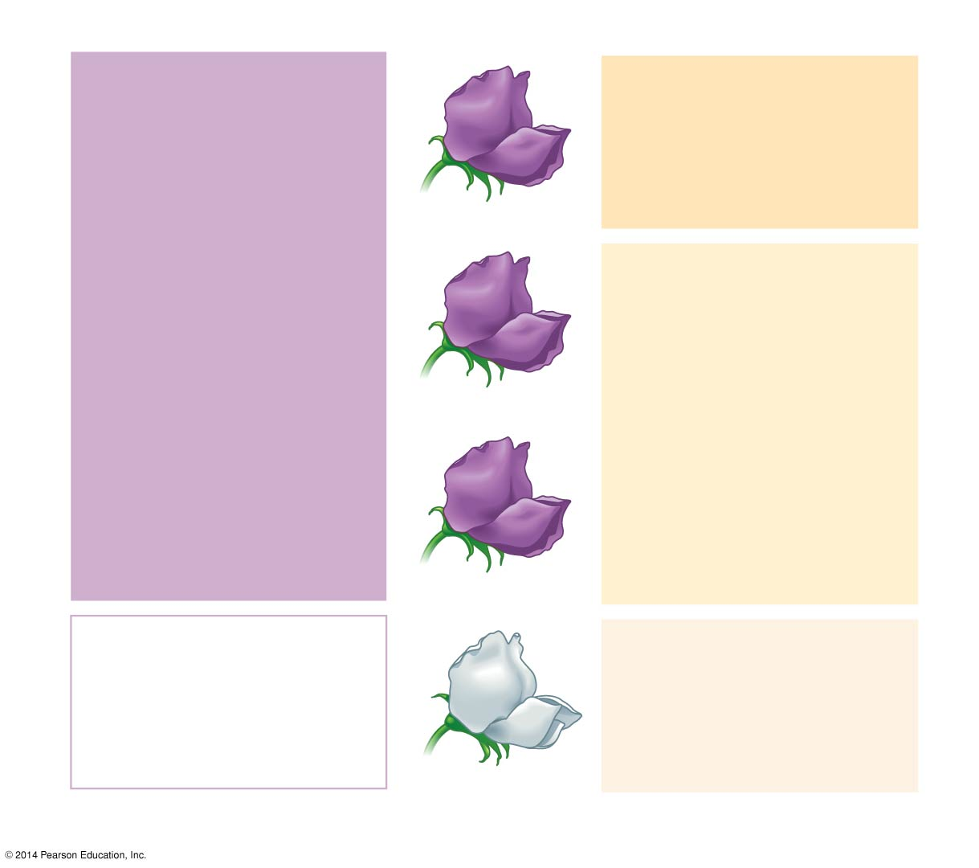
Figure 11.6
Phenotype
Genotype
Purple
PP
(homozygous)
1
3
Purple
Pp
(heterozygous)
2
Purple
Pp
(heterozygous)
1
White
pp
(homozygous)
1
Ratio 3:1
Ratio 1:2:1
Notes:
25
Figure 11.6 Phenotype versus genotype

