Slide 1
0
Chapter 11
Independent Assortment, Segregation and an Introduction to Probability

Slide 2
You Must Know
The law of independent assortment and the law of segregation. (This is review from last chapter.)
The addition and multiplication rules. (You will get more practice using these later.)

Slide 3
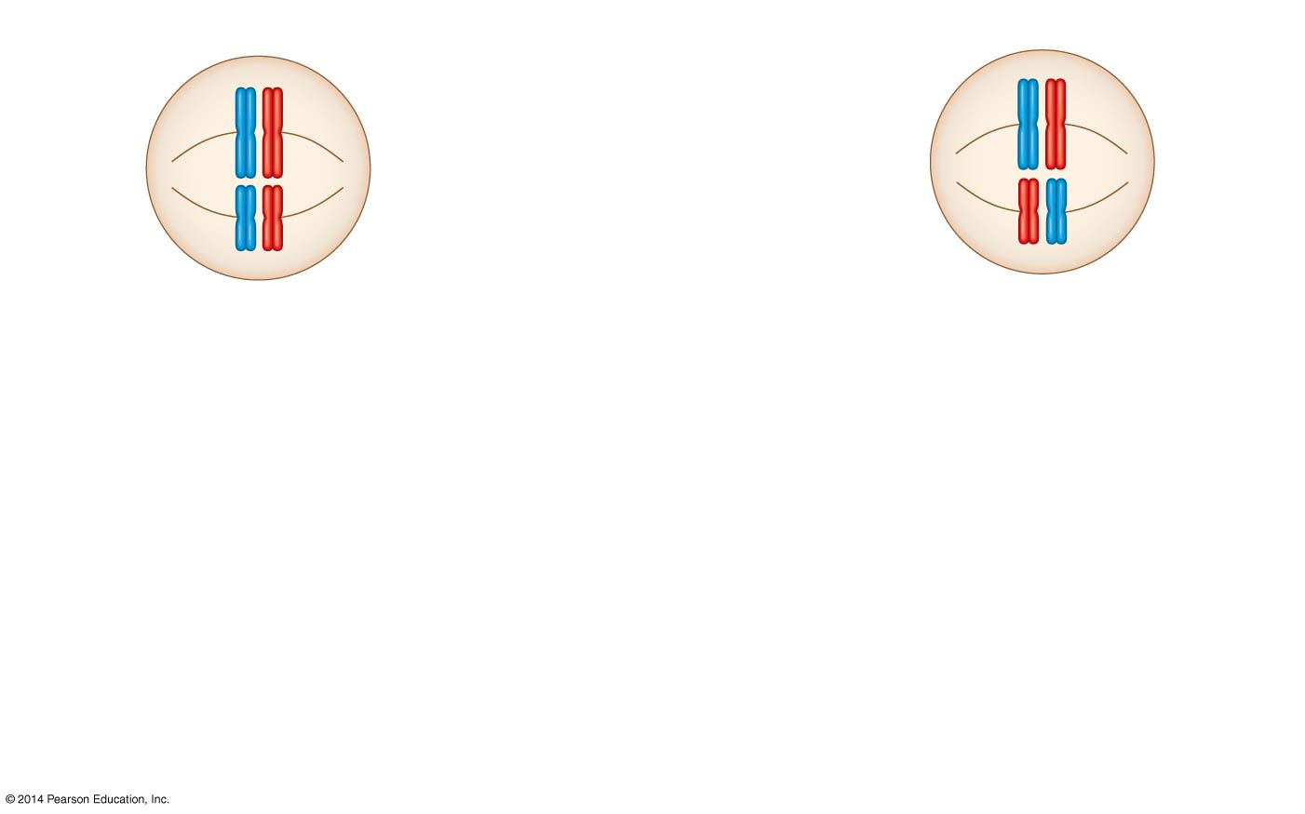
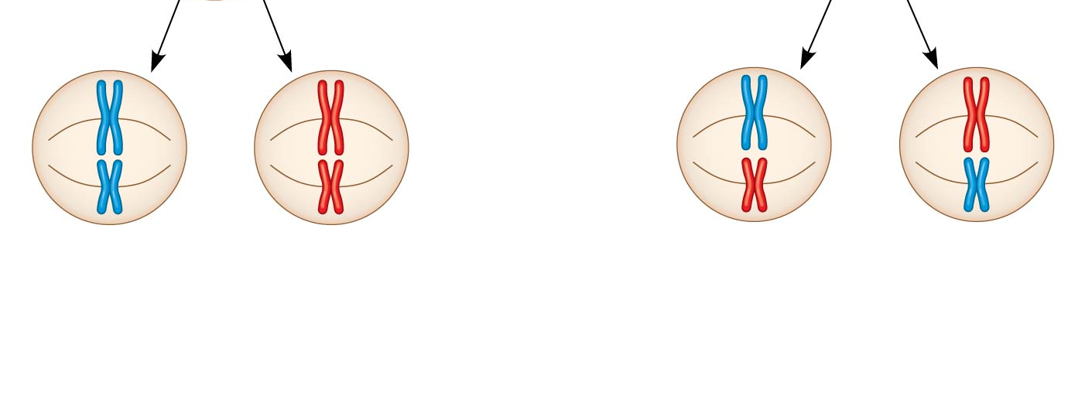
Independent Assortment of Chromosomes
Possibility 1
Possibility 2
Two equally probable
arrangements of
chromosomes at
metaphase I
Metaphase II
Daughter
cells
Combination 1
Combination 2
Combination 3
Combination 4
Number of possible gamete combinations = 2^{n}
n =
2² = 4
2
Notes:
3
Homologous pairs of chromosomes orient randomly at metaphase I of meiosis.
In independent assortment, each pair of chromosomes sorts maternal and paternal homologs into daughter cells independently of the other pairs.
The number of combinations possible when chromosomes assort independently into gametes is 2^{n}, where n is the haploid number.
For humans (n = 23), there are more than 8 million (2²³) possible combinations of chromosomes.

Slide 4
Experiment showing independent assortment.
YYRR
YYRR
yyrr
P Generation
yyrr
P Generation
dihybrid
Gametes
Gametes
yr
YR
yr
YR
F₁ Generation
Identify all the possible gametes
YyRr
Hypothesis of
dependent assortment
Hypothesis of
independent assortment
Predictions
Hypothesis of
independent assortment
Sperm
or
Sperm
Predicted
offspring in
F₂ generation
or
¼
¼
¼
¼
¼
¼
¼
¼
yr
YR
yr
YR
Yr
Yr
yR
Sperm
yR
½
YR
½
yr
¼
¼
YR
YR
YYRR
YYRR
YYRr
YYRr
YyRR
YyRR
YyRr
YyRr
½
YR
YYRR
YyRr
¼
¼
Yr
Eggs
Yr
YYRr
YYRr
YYrr
YYrr
YyRr
YyRr
Yyrr
Eggs
Yyrr
½
yr
Eggs
YyRr
yyrr
¼
¼
yR
yR
YyRR
YyRR
YyRr
YyRr
yyRR
yyRR
yyRr
yyRr
¾
¼
¼
¼
yr
Phenotypic ratio 3:1
yr
YyRr
YyRr
Yyrr
Yyrr
yyRr
yyRr
yyrr
yyrr
³ ₁₆
⁹ ₁₆
³ ₁₆
⁹ ₁₆
³ ₁₆
³ ₁₆
¹ ₁₆
¹ ₁₆
Phenotypic ratio 9:3:3:1
Results
Phenotypic ratio 9:3:3:1
Phenotypic ratio approximately 9:3:3:1
315
108
101
32
Phenotypic ratio approximately 9:3:3:1
Notes:
4
Figure 11.8 Inquiry: Do the alleles for one character segregate into gametes dependently or independently of the alleles for a different character?
Mendel identified the law of independent assortment of inheritance by following two characters at the same time.
Crossing two true-breeding parents differing in two characters produces dihybrids in the F₁ generation, heterozygous for both characters.
A dihybrid cross, a cross between F₁ dihybrids, can determine whether two characters are transmitted to offspring as a package or independently.
The results of Mendel’s dihybrid experiments are the basis for the law of independent assortment.
It states that each pair of alleles segregates independently of each other pair of alleles during gamete formation.
This law applies to genes on different, nonhomologous chromosomes or those far apart on the same chromosome.
Genes located near each other on the same chromosome tend to be inherited together.

Slide 5
Law of segregation: The two alleles for each character separate from each other during gamete formation.
Diploid
Diploid
Meiosis I
haploid
Meiosis II
Haploid
Gametes
Notes:
5
Mendel derived the law of segregation by following a single character.
The F₁ offspring produced in this cross were monohybrids, individuals that are heterozygous for one character.
A cross between such heterozygotes is called a monohybrid cross.

Slide 6
×
Rr
×
The multiplication rule states that the probability that two or more independent events will occur together is the product of their individual probabilities.
Ex. (1/2)(1/2)=1/4
What is the probability you will get a RR offspring?
Rr
Rr
Rr
Rr
×
Rr
Segregation of
alleles into eggs
Segregation of
alleles into eggs
Segregation of
alleles into sperm
Segregation of
alleles into sperm
Segregation of
alleles into eggs
Segregation of
alleles into sperm
Sperm
Sperm
½
R
½
r
½
R
½
r
R
R
R
R
½
R
R
r
½
R
R
r
¼
¼
Eggs
¼
¼
Eggs
r
r
r
r
½
r
R
r
½
r
R
r
¼
¼
¼
¼
Notes:
6
Figure 11.9 Segregation of alleles and fertilization as chance events.
Mendel’s laws of segregation and independent assortment reflect the rules of probability.
When tossing a coin, the outcome of one toss has no impact on the outcome of the next toss.
The multiplication rule states that the probability that two or more independent events will occur together is the product of their individual probabilities.
This can be applied to an F₁ monohybrid cross.
Segregation in a heterozygous plant is like flipping a coin: Each gamete has a 1/2 chance of carrying the dominant allele and a 1/2 chance of carrying the recessive allele.

Slide 7
The addition rule states that the probability that any one of two or more mutually exclusive events will occur is calculated by adding together their individual probabilities.
Ex. ¼ + ¼ = ½
What is the probability you will get either a RR or a rr offspring?
Rr
×
Rr
Segregation of
alleles into eggs
Segregation of
alleles into sperm
Sperm
½
R
½
r
R
R
½
R
R
r
¼
¼
Eggs
r
r
½
r
R
r
¼
¼
Notes:
7
The addition rule states that the probability that any one of two or more mutually exclusive events will occur is calculated by adding together their individual probabilities.
It can be used to figure out the probability that an F₂ plant from a monohybrid cross will be heterozygous rather than homozygous.

