Slide 1
Please get out the worksheet from Friday

Slide 4
0
Chapter 11
Complex Inheritance Patterns

Slide 5
You Must Know
Complex inheritance patterns

Slide 6
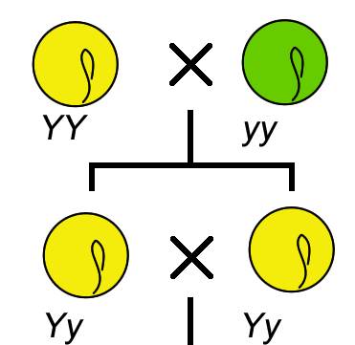
Complete Dominance:
  Homozygous and heterozygous phenotypes are indistinguishable.
These look the same

Slide 7
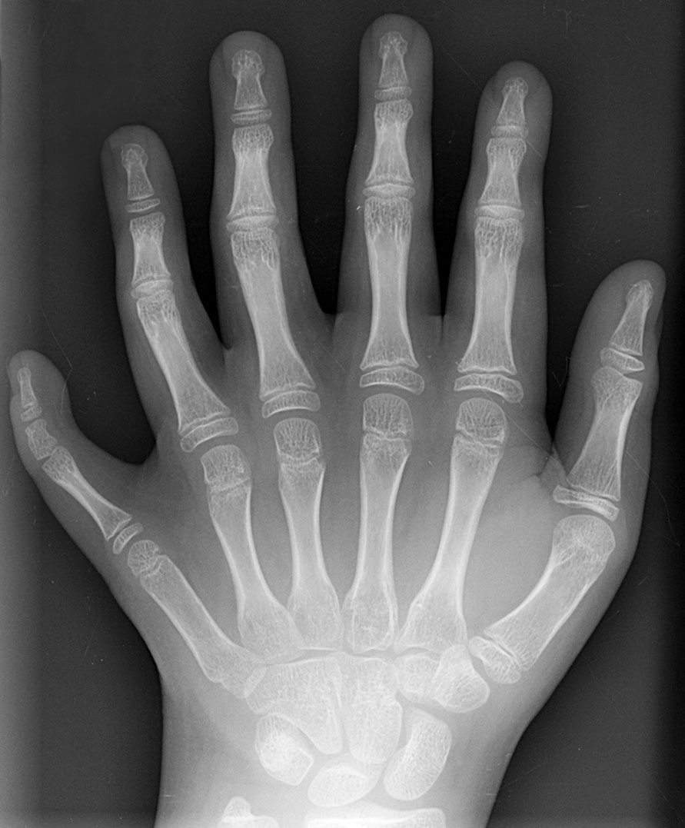
Dominant alleles are not necessarily more common in populations than recessive alleles.
Six finger trait is dominant to the five finger trait
Notes:
7

Slide 8
Extending Mendelian Genetics for a Single Gene
Inheritance of characters by a single gene may deviate from simple Mendelian patterns in the following situations.
  When alleles are not completely dominant or recessive.
  When a gene has more than two alleles.
  When a single gene influences multiple phenotypes.
  When a single phenotype is influenced by multiple genes.
Notes:
8
Not all heritable characters are determined as simply as the traits Mendel studied. However, the basic principles of segregation and independent assortment apply even to more complex patterns of inheritance.

Slide 9
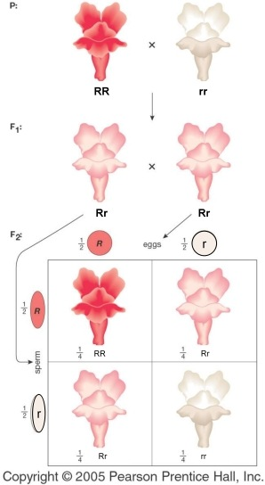
Incomplete dominance:
  the phenotype of F₁ hybrids is somewhere between the phenotypes of the two parental varieties.
Notes:
9

Slide 10

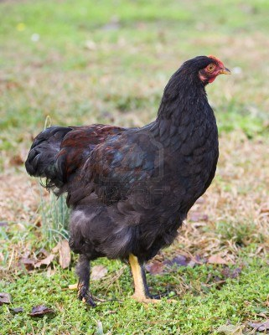
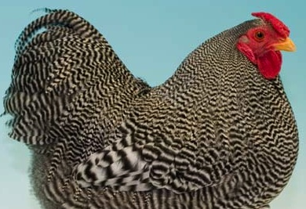
Codominance:
two dominant alleles affect the phenotype in separate, distinguishable ways
x
Homozygous
White
Homozygous
Black
Heterozygous
Black & White
Notes:
10

Slide 11

(a) The three alleles for the ABO blood groups and their
carbohydrates
Allele
I^{A}
I^{B}
i
Codominant
none
Carbohydrate
A
B
Recessive
(b) Blood group genotypes and phenotypes
Genotype
I^{A}I^{A} or I^{A}i
I^{B}I^{B} or I^{B}i
I^{A}I^{B}
ii
Red blood cell
appearance
Phenotype
(blood group)
A
B
AB
O
Notes:
11
Figure 11.11 Multiple alleles for the ABO blood groups
Most genes exist in populations in more than two allelic forms.
For example, the four phenotypes of the ABO blood group in humans are determined by three alleles of the gene: I^{A}, I^{B}, and i.
The enzyme (I) adds specific carbohydrates to the surface of blood cells.
The enzyme encoded by I^{A} adds the A carbohydrate, and the enzyme encoded by I^{B} adds the B carbohydrate; the enzyme encoded by the i allele adds neither.
The O allele is recessive
A, B are codominant to each other (if you have both alleles, you are type “AB”)

Slide 12

Pleiotropy: The property of a gene that causes it to have multiple phenotypic effects.
Tay-Sachs
Notes:
12
For example, pleiotropic alleles are responsible for the multiple symptoms of certain hereditary diseases, such as cystic fibrosis, sickle-cell disease, and Tay-Sachs .

Slide 13
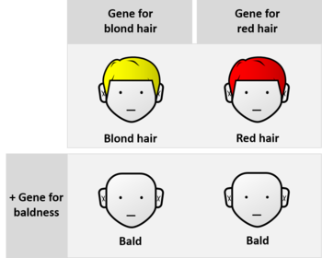
Epistasis: a gene at one locus alters the phenotypic expression of a gene at a second locus.
This is a simplification to illustrate the concept.
Notes:
13
Figure 11.12 An example of epistasis
In Labrador retrievers and many other mammals, coat color depends on two genes.
One gene determines the pigment color (with alleles B for black and b for brown).
The other gene (with alleles C for color and c for no color) determines whether the pigment will be deposited in the hair.

Slide 14
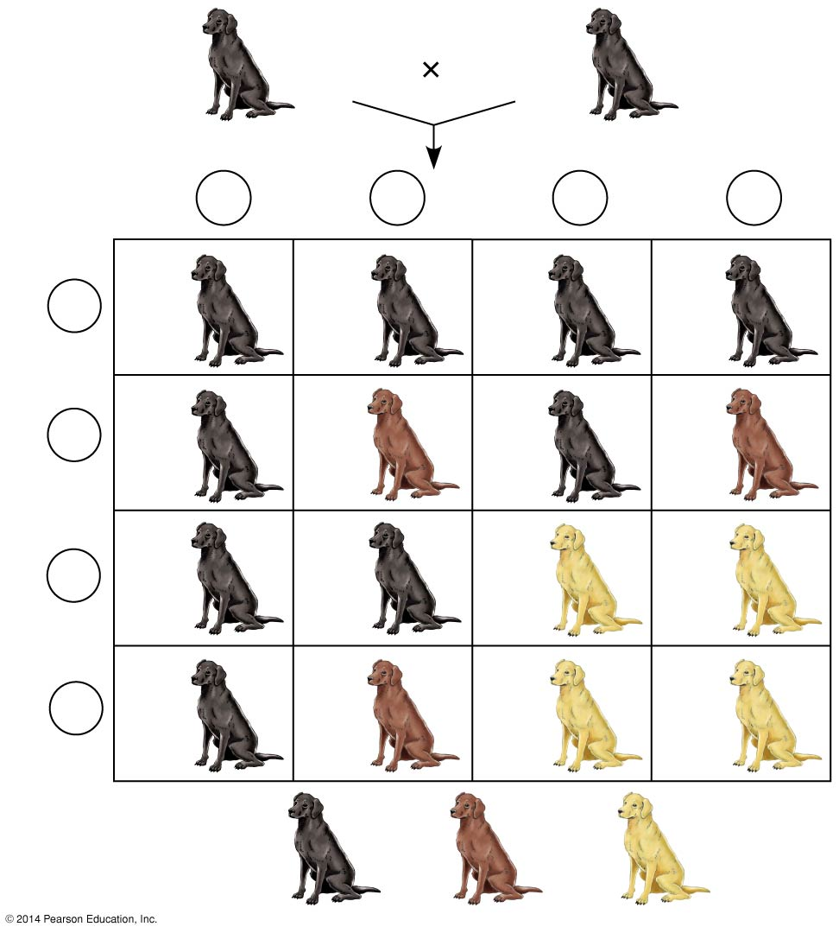
B =
b=
E=
e=
black
brown
color
No color
BbEe
BbEe
BbEe
BbEe
BbEe
BbEe
Sperm
Sperm
¼
BE
¼
bE
¼
Be
¼
be
¼
BE
¼
bE
¼
Be
¼
be
Eggs
Eggs
¼
¼
BE
BE
BBEE
BbEE
BBEe
BbEe
BBEE
BbEE
BBEe
BbEe
¼
bE
¼
bE
BbEE
bbEE
BbEe
bbEe
BbEE
bbEE
BbEe
bbEe
¼
¼
Be
Be
BBEe
BbEe
BBee
Bbee
BBEe
BbEe
BBee
Bbee
¼
be
¼
be
BbEe
bbEe
Bbee
bbee
BbEe
bbEe
Bbee
bbee
9
: 3
: 4
9
: 3
: 4
Notes:
14
Figure 11.12 An example of epistasis
In Labrador retrievers and many other mammals, coat color depends on two genes.
One gene determines the pigment color (with alleles B for black and b for brown).
The other gene (with alleles E for color and e for no color) determines whether the pigment will be deposited in the hair.

Slide 15
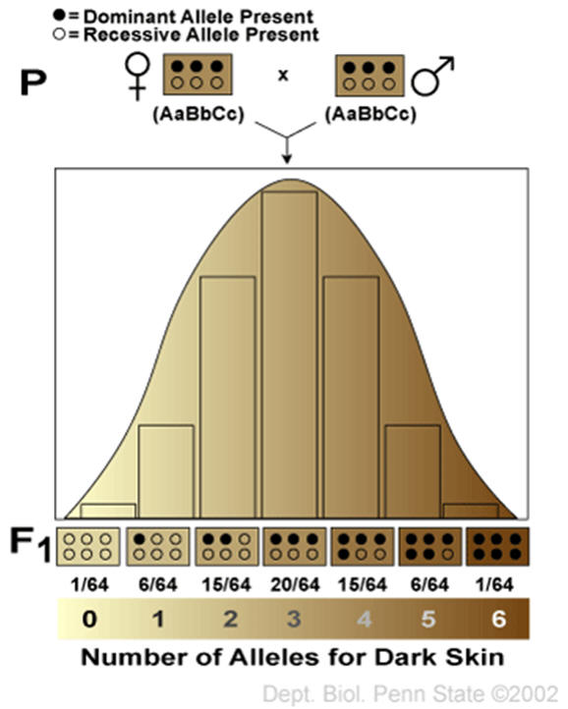
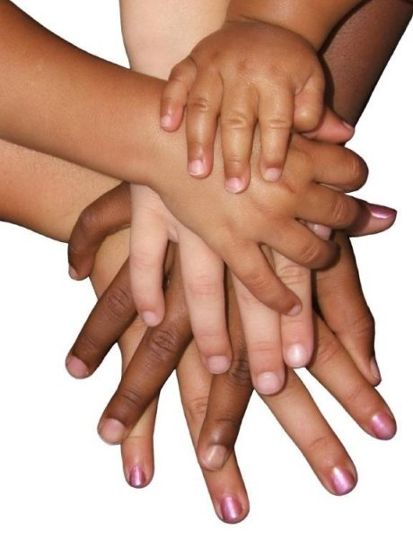
Polygenic Inheritance
an additive effect of two or more genes on a single phenotype.
Notes:
15
Quantitative characters are those that vary in the population along a continuum. Quantitative variation usually indicates polygenic inheritance, an additive effect of two or more genes on a single phenotype. Skin color in humans is an example of polygenic inheritance.

Slide 16
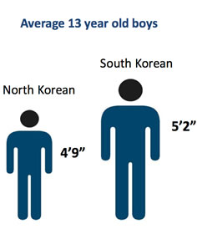
Nature and Nurture: The Environmental Impact on Phenotype
Notes:
16
Another departure from Mendelian genetics arises when the phenotype for a character depends on environment as well as genotype. The norm of reaction is the phenotypic range of a genotype influenced by the environment. The phenotypic range is generally broadest for polygenic characters. Such characters are called multifactorial because genetic and environmental factors collectively influence phenotype.

Slide 17
Integrating a Mendelian View of Heredity and Variation
An organism’s phenotype includes its physical appearance, internal anatomy, physiology, and behavior.
An organism’s phenotype reflects its overall genotype and unique environmental history.
Notes:
17

