Slide 2
0
Chapter 10
Meiosis

Slide 3
You Must Know
The importance of homologues chromosomes to meiosis.
How the chromosome number is reduced from diploid to haploid in meiosis.
Three events that occur in meiosis but not mitosis.

Slide 4
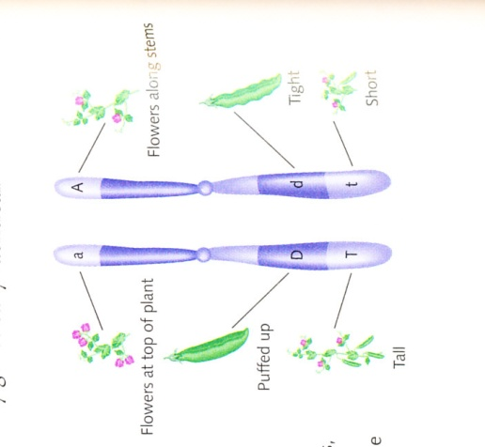
Homologs may have different versions of genes, each called an allele.
From the female →
← From the male
Homologous Chromosomes

Slide 5
Meiosis Overview
Interphase
Pair of homologous
chromosomes in
diploid parent cell
Meiosis starts with a ______ cell.
2n = ____
Meiosis ends with four ________ cells.
1n = _____
diploid
Duplicated pair
of homologous
chromosomes
Chromosomes
duplicate
2
Sister
chromatids
Meiosis I
haploid
Homologous
chromosomes
separate
1
Haploid cells with
duplicated chromosomes
Haploid cells with
duplicated chromosomes
Meiosis II
Sister chromatids
separate
Haploid cells with unduplicated chromosomes
Notes:
5
Like mitosis, meiosis is preceded by the replication of chromosomes. Meiosis takes place in two sets of cell divisions, called meiosis I and meiosis II. The two cell divisions result in four daughter cells, rather than the two daughter cells in mitosis. Each daughter cell has only half as many chromosomes as the parent cell and is genetically distinct from the others and from the parent cell.
Meiosis halves the total number of chromosomes very specifically.
It reduces the number of sets from two to one, with each daughter cell receiving one set of chromosomes.
In the second meiotic division, sister chromatids of each chromosome separate.
Four new haploid cells are produced as a result.

Slide 6
Meiosis Overview
Meiosis starts with a ______ cell.
2n = ____
Meiosis ends with four ________ cells.
1n = ____
diploid
4
haploid
2
Notes:
6

Slide 7
Crossing over prophase I of meiosis
homologous chromosomes pair up gene by gene
homologous portions of two nonsister chromatids trade places
recombinant chromosomes
Notes:
Prophase I typically occupies more than 90% of the time required for meiosis.
Crossing over begins very early in prophase I, as homologous chromosomes pair up gene by gene. Crossing over produces recombinant chromosomes, which combine DNA inherited from each parent. Crossing over contributes to genetic variation by combining DNA, producing chromosomes with new combinations of maternal and paternal alleles.

Slide 8
The results of crossing over during meiosis
Prophase I
of meiosis
Nonsister chromatids
held together
during synapsis
In synapsis, homologous chromosomes loosely pair up, aligned gene by gene.
Pair of
homologs
Synapsis and
crossing over
Chiasma
Anaphase I
Breakdown of
proteins holding sister
chromatid arms together
Anaphase II
Daughter
cells
Recombinant chromosomes
Notes:
8
Each homologous pair has one or more X-shaped regions called chiasmata.
Chiasmata exist at points where crossing over has occurred.

Slide 9
Figure 10.8
MEIOSIS I: Separates homologous chromosomes
MEIOSIS II: Separates sister chromatids
Prophase I
Metaphase I
Anaphase I
Telophase I and
Cytokinesis
Prophase II
Metaphase II
Anaphase II
Telophase II and
Cytokinesis
Sister
chromatids
Centromere
(with kinetochore)
Sister chromatids
remain attached
Chiasmata
Sister chromatids
separate
Homologous
chromosomes
separate
Microtubule
attached to
kinetochore
Homologous
chromosomes
Haploid
daughter
cells forming
What are the three events that are unique to meiosis?
Notes:
9
Figure 10.8 Exploring meiosis in an animal cell

Slide 10
Three events are unique to meiosis, and all three occur in meiosis l
Synapsis and crossing over in prophase I: Homologous chromosomes physically connect and exchange genetic information
Homologous pairs at the metaphase plate: Homologous pairs of chromosomes are positioned there in metaphase I
Separation of homologs during anaphase I
Notes:
10
Review Slide

Slide 11
A Comparison of Mitosis and Meiosis
Mitosis conserves the number of chromosome sets, producing cells that are genetically identical to the parent cell.
Meiosis reduces the number of chromosome sets from two (diploid) to one (haploid), producing cells that differ genetically from each other and from the parent cell.
Meiosis includes two divisions after replication, each with specific stages.
Notes:
11
Review Slide

Slide 12
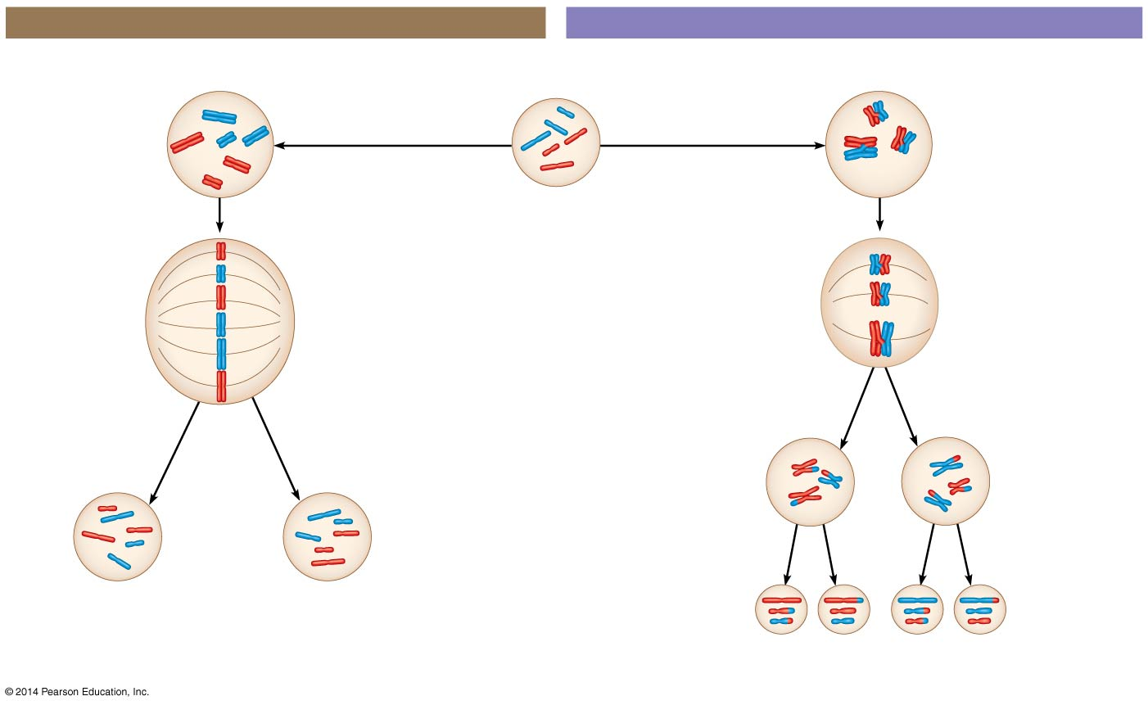
Figure 10.9a
MITOSIS
MEIOSIS
Parent cell
Chiasma
MEIOSIS I
Prophase
Prophase I
Chromosome
duplication
Chromosome
duplication
Homologous
chromosome
pair
Duplicated
chromosome
2n = 6
Metaphase
Individual
chromosomes
line up.
Pairs of
chromosomes
line up.
Metaphase I
Anaphase
Sister chromatids
separate.
Homologs
separate.
Anaphase I
Telophase
Telophase I
Sister
chromatids
separate.
Daughter
cells of
meiosis I
2n
2n
MEIOSIS II
Daughter cells
of mitosis
n
n
n
n
Daughter cells of meiosis II
Notes:
12
Review Slide

