Slide 1
0
Chapter 10
Genetic Variability

Slide 2
You Must Know
The sources of genetic variability.

Slide 3
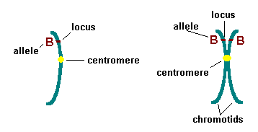
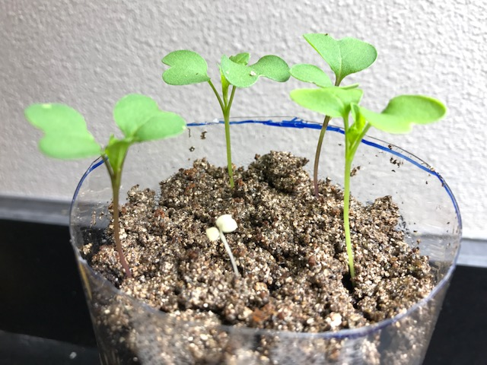
Mutations (changes in an organism’s DNA) create different versions of genes called alleles.
Mutations are the original source of genetic diversity.

Slide 4
Origins of Genetic Variation Among Offspring
The behavior of chromosomes during meiosis and fertilization is responsible for most of the variation that arises in each generation.
Three mechanisms contribute to genetic variation
Independent assortment of chromosomes
Crossing over
Random fertilization
Notes:
4
Review: In crossing over, homologous portions of two nonsister chromatids trade places.
Crossing over contributes to genetic variation by combining DNA, producing chromosomes with new combinations of maternal and paternal alleles.

Slide 5
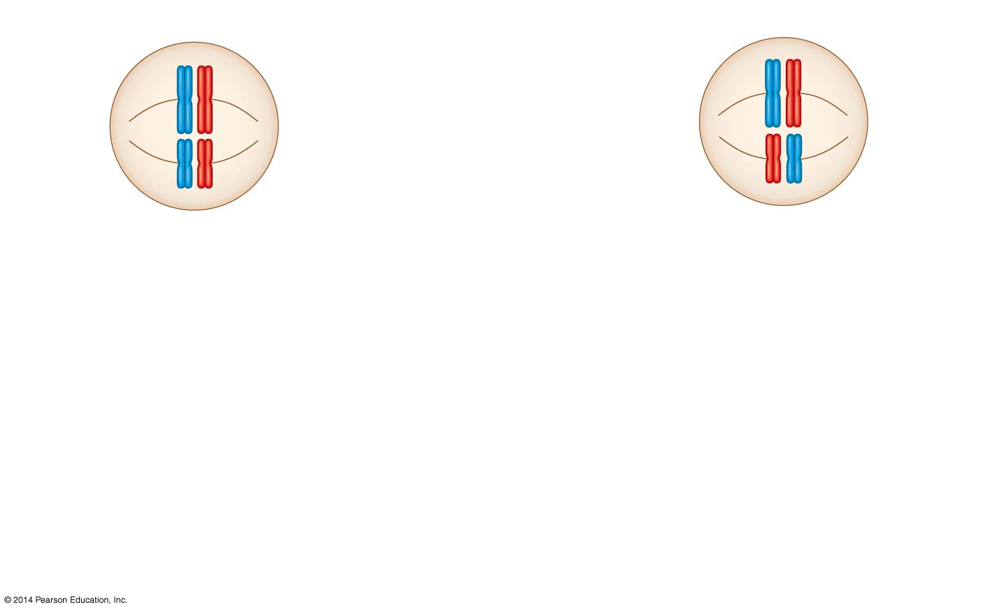
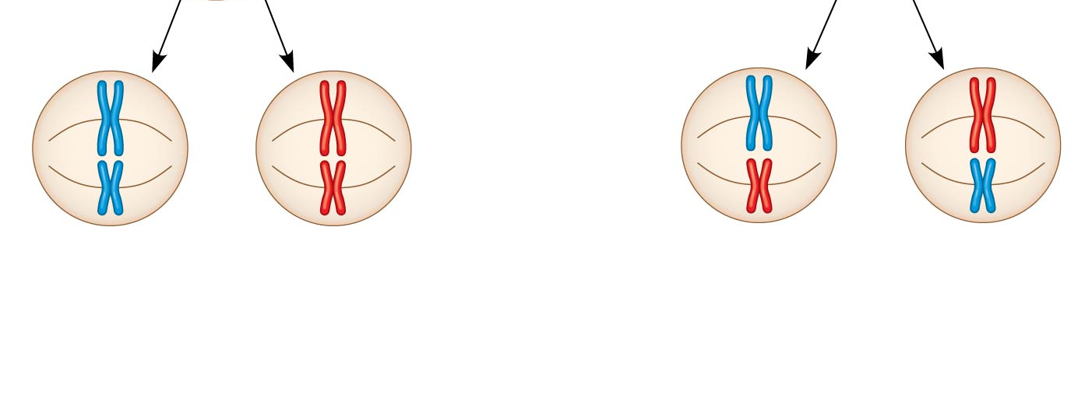
Independent Assortment of Chromosomes
Possibility 1
Possibility 2
Two equally probable
arrangements of
chromosomes at
metaphase I
Metaphase II
Daughter
cells
Combination 1
Combination 2
Combination 3
Combination 4
The number of combinations possible when chromosomes assort independently into gametes is 2^{n}, where n is the haploid number.
Notes:
5
Homologous pairs of chromosomes orient randomly at metaphase I of meiosis.
In independent assortment, each pair of chromosomes sorts maternal and paternal homologs into daughter cells independently of the other pairs.
For humans (n = 23), there are more than 8 million (2²³) possible combinations of chromosomes.

Slide 6
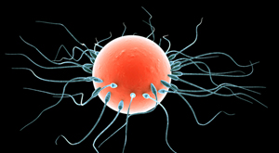
Random Fertilization
Random fertilization adds to genetic variation because any sperm can fuse with any ovum (unfertilized egg)
70 trillion diploid combinations - not counting crossing over!
Notes:
6
The fusion of two gametes (each with 8.4 million possible chromosome combinations from independent assortment) produces a zygote with any of about 70 trillion diploid combinations.
Crossing over adds even more variation.
Each zygote has a unique genetic identity.

Slide 7
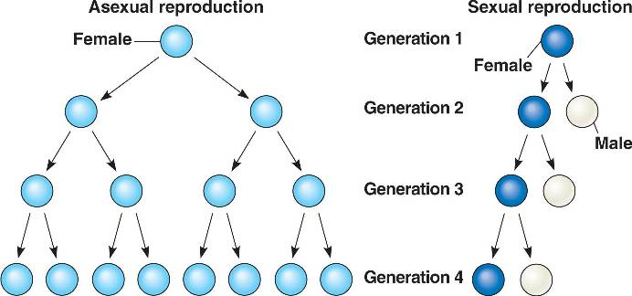
Asexual vs. Sexual Reproduction
Notes:
The Evolutionary Significance of Genetic Variation Within Populations
Natural selection results in the accumulation of genetic variations favored by the environment.
Sexual reproduction contributes to the genetic variation in a population, which originates from mutations.
Asexual reproduction is less expensive than sexual reproduction.
Nonetheless, sexual reproduction is nearly universal among animals.
Overall, genetic variation is evolutionarily advantageous because as the environment changes, the population may survive if, in each generation, at least some of its members can cope effectively with the new conditions.

Slide 8
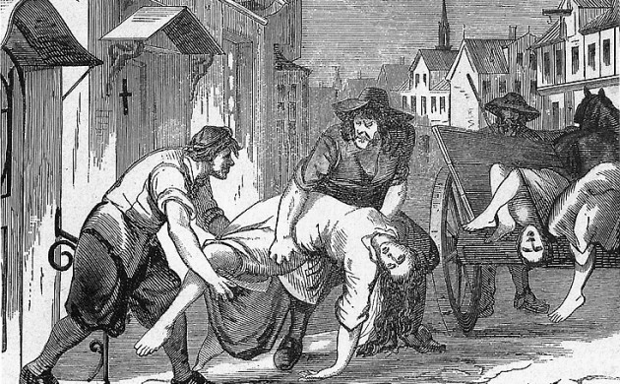
Overall, genetic variation is evolutionarily advantageous because as the environment changes, the population may survive if, in each generation, at least some of its members can cope effectively with the new conditions.

