Slide 1
The Chapter 9 and 10 Test will be Tuesday, December 10
The Chapter 10 Homework is due Monday December 9 at 11:59 pm

Slide 2
0
Chapter 10
Asexual and Sexual Reproduction

Slide 3
You Must Know
The difference between asexual and sexual reproduction.
The role of meiosis and fertilization in sexually reproducing organisms.
The importance of homologous chromosomes to meiosis.

Slide 4
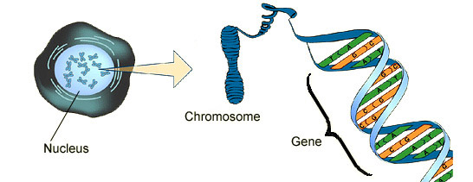
Genes are the units of heredity and are made up of segments of DNA.

Slide 5
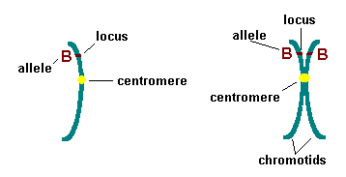
Each gene has a specific position, or locus, on a particular chromosome.
Unreplicated Chromosome 21 Replicated Chromosome 21

Slide 6
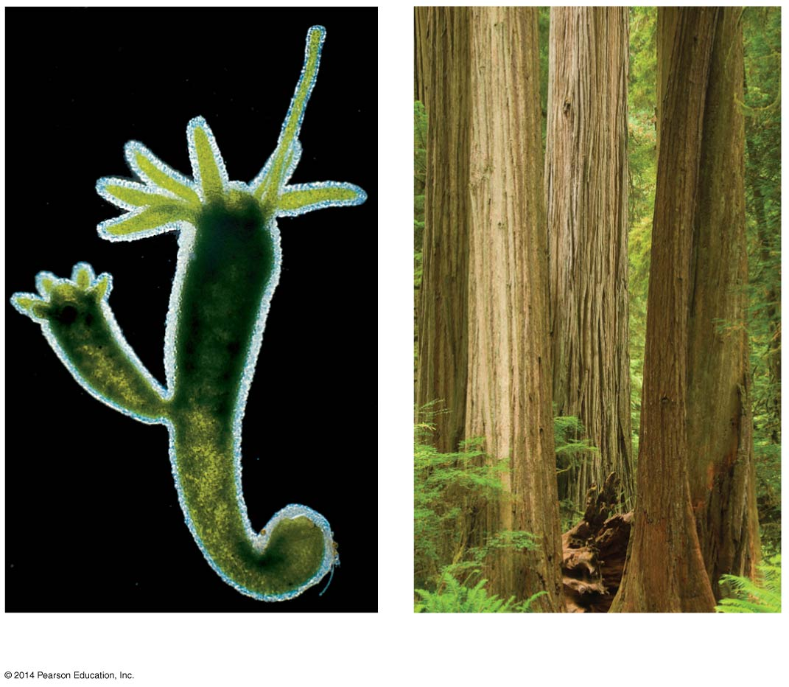
Asexual reproduction results in clones.
0.5 mm
Parent
Bud
(a) Hydra
(b) Redwoods
Notes:
6
Figure 10.2 In asexual reproduction, a single individual passes genes to its offspring without the fusion of gametes.
A clone is a group of genetically identical individuals from the same parent.

Slide 7
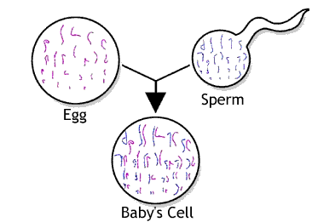
In sexual reproduction, two parents give rise to offspring that have unique combinations of genes inherited from the two parents
Notes:
7
Genes are passed to the next generation via reproductive cells called gametes (sperm and eggs).

Slide 8
Figure 10.3b
Pair of homologous
duplicated chromosomes
Sister
chromatids
Karyotype
Chromosomes in a homologous pair are the same length and shape and carry genes controlling the same inherited characters.
Notes:
8
Human somatic cells have 23 pairs of chromosomes.
A karyotype is an ordered display of the pairs of chromosomes from a cell.
The two chromosomes in each pair are called homologous chromosomes, or homologs.
Chromosomes in a homologous pair are the same length and shape and carry genes controlling the same inherited characters.
Each pair of homologous chromosomes includes one chromosome from each parent.
The 46 chromosomes in a human somatic cell are two sets of 23: one from the mother and one from the father.

Slide 9
The sex chromosomes, which determine the sex of the individual, are called X and Y.
In an unfertilized egg (ovum), the sex chromosome is X.
In a sperm cell, the sex chromosome may be either X or Y.
X
Y
X
X
XY
XX
Boy
Girl
Notes:
9
Human females have a homologous pair of X chromosomes (XX). Human males have one X and one Y chromosome. The remaining 22 pairs of chromosomes are called autosome

Slide 10
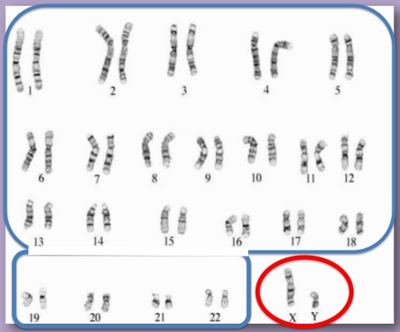
Humans
2n=46
Autosomes
Sex Chromosomes
Notes:
A diploid cell (2n) has two sets of chromosomes.
For humans, the diploid number is 46 (2n = 46).
A gamete (sperm or egg) contains a single set of chromosomes and is haploid (n).
For humans, the haploid number is 23 (n = 23).
Each set of 23 consists of 22 autosomes and a single sex chromosome.

Slide 11
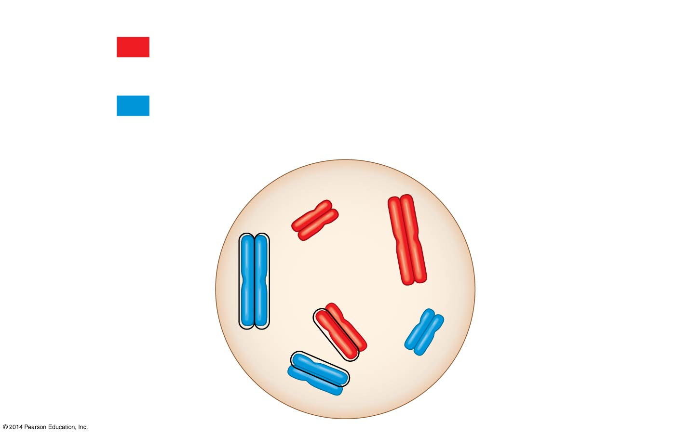
Figure 10.4
Key
Maternal set of
chromosomes (n = 3)
2n = 6
Paternal set of
chromosomes (n = 3)
Sister chromatids
of one duplicated
chromosome
Two nonsister
chromatids in
a homologous pair
Pair of homologous
chromosomes
(one from each set)
Notes:
11
In a cell in which DNA synthesis has occurred, each chromosome is replicated.
Each replicated chromosome consists of two identical sister chromatids.

Slide 12
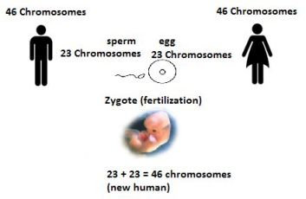
Haploid n=23
Diploid 2n=46
The zygote produces somatic cells by mitosis as it develops into an adult
Notes:
12
Fertilization is the union of gametes (the sperm and the egg)
The fertilized egg is called a zygote and has one set of chromosomes from each parent
The zygote produces somatic cells by mitosis and develops into an adult.
Gametes are the only haploid cells in animals.
They are produced by meiosis and undergo no further cell division before fertilization.
Gametes fuse to form a diploid zygote that divides by mitosis to develop into a multicellular organism.

Slide 13
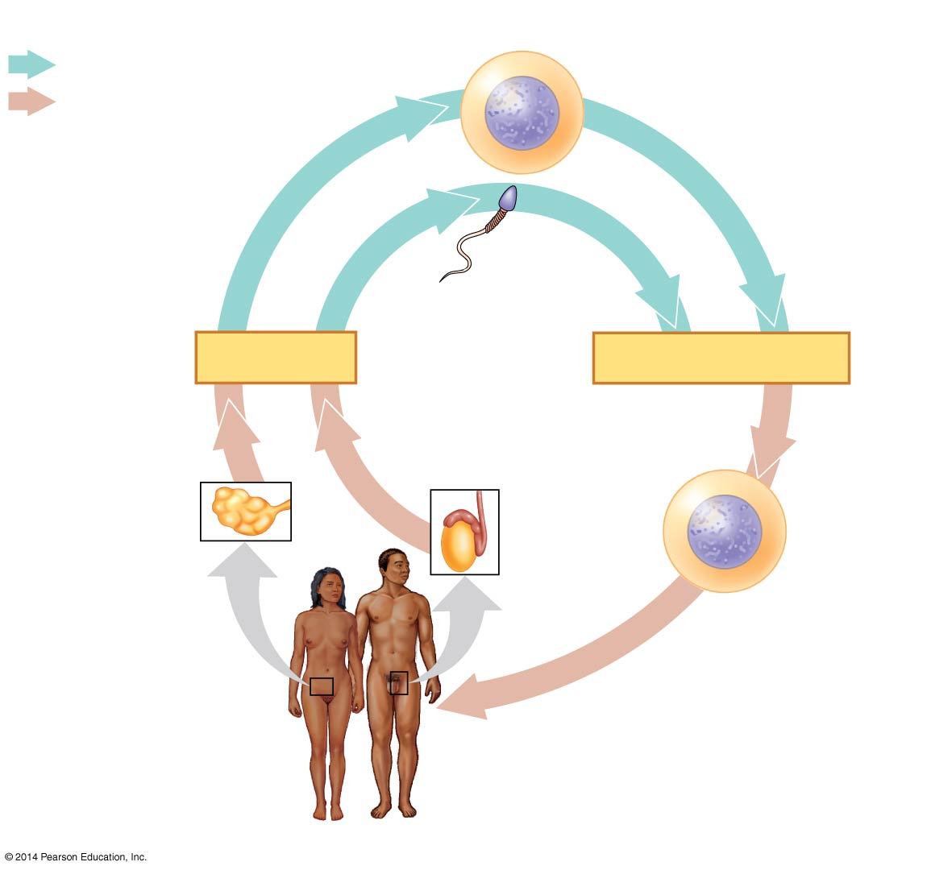
Key
Key
Haploid gametes (n = 23)
Haploid gametes (n = 23)
Haploid (n)
Haploid (n)
Egg (n)
Egg (n)
Diploid (2n)
Diploid (2n)
Sperm (n)
Sperm (n)
MEIOSIS
MEIOSIS
FERTILIZATION
Ovary
Ovary
Testis
Testis
Diploid
zygote
(2n = 46)
Mitosis and
development
Multicellular diploid
adults (2n = 46)
Multicellular diploid
adults (2n = 46)
Notes:
13
At sexual maturity, the ovaries and testes produce haploid gametes.
Gametes are the only types of human cells produced by meiosis rather than mitosis.
Meiosis results in one set of chromosomes in each gamete.
Fertilization and meiosis alternate in sexual life cycles to maintain chromosome number.
The alternation of meiosis and fertilization is common to all organisms that reproduce sexually.

Slide 14
Depending on the type of life cycle, either haploid or diploid cells can divide by mitosis.
However, only diploid cells can undergo meiosis.
The halving and doubling of chromosomes contribute to genetic variation in offspring.
Notes:
14

