Slide 1
Do English ivy leaves grown in the shade have a larger surface area than English ivy leaves grown in the sun?

Slide 2
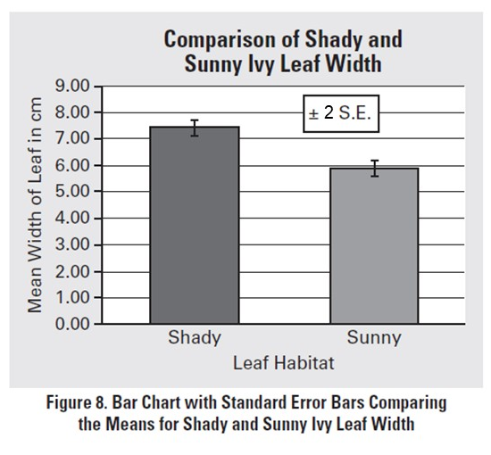
The data show that the surface area of leaves grown in the shade are significantly larger than leaves grown in the sun. The mean width of shade grown leaves was 7.5 cm while the mean width of sun grown leaves was only 6 cm. It is evident from the graph that the error bars, representing ±2SE from the mean, for the shady leaf bar do not overlap with the error bars for the sunny leaf bar. Therefore, researchers can be 95% confident that mean surface area of shade grown leaves is in fact larger that the surface area of the sun grown leaves. This makes sense because leaves grown in the shade get less sun and therefore would need to be larger to get enough energy to produce the carbohydrates the plant needs.
.
Warning: There are things needed for the results section of the Floating Disk Lab that are not included here.

Slide 3
The data do not show that the surface area of leaves grown in the shade are significantly larger than leaves grown in the sun. The mean width of shade grown leaves was 7.5 cm while the mean width of sun grown leaves was only 6 cm. However, the error bars, representing ±2SE from the mean, for the shady leaf bar overlap with the error bars for the sunny leaf bar. Therefore, researchers can not be confident that mean surface area of shade grown leaves is in fact larger that the surface area of the sun grown leaves. This is surprising because leaves grown in the shade get less sun and therefore would need to be larger to get enough energy to produce the carbohydrates the plant needs. There might be other factors not considered in this study that are influencing the surface area of the leaves.
.
Warning: There are things needed for the results section of the Floating Disk Lab that are not included here.

Slide 4
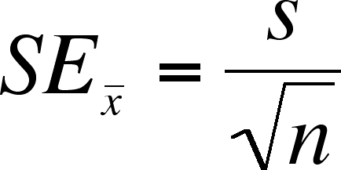
Standard Error
A sample mean of ±1 SE describes the range of values about which an investigator can have approximately 67% confidence that the range includes the true population mean. A sample with a ±2 SE defines a range of values with approximately a 95% certainty.

