Slide 1
0
Chapter 9
Mitosis

Slide 2
You Must Know
The features of mitosis that result in the production of genetically identical daughter cells.
Video- Real
Video - Animation

Slide 3
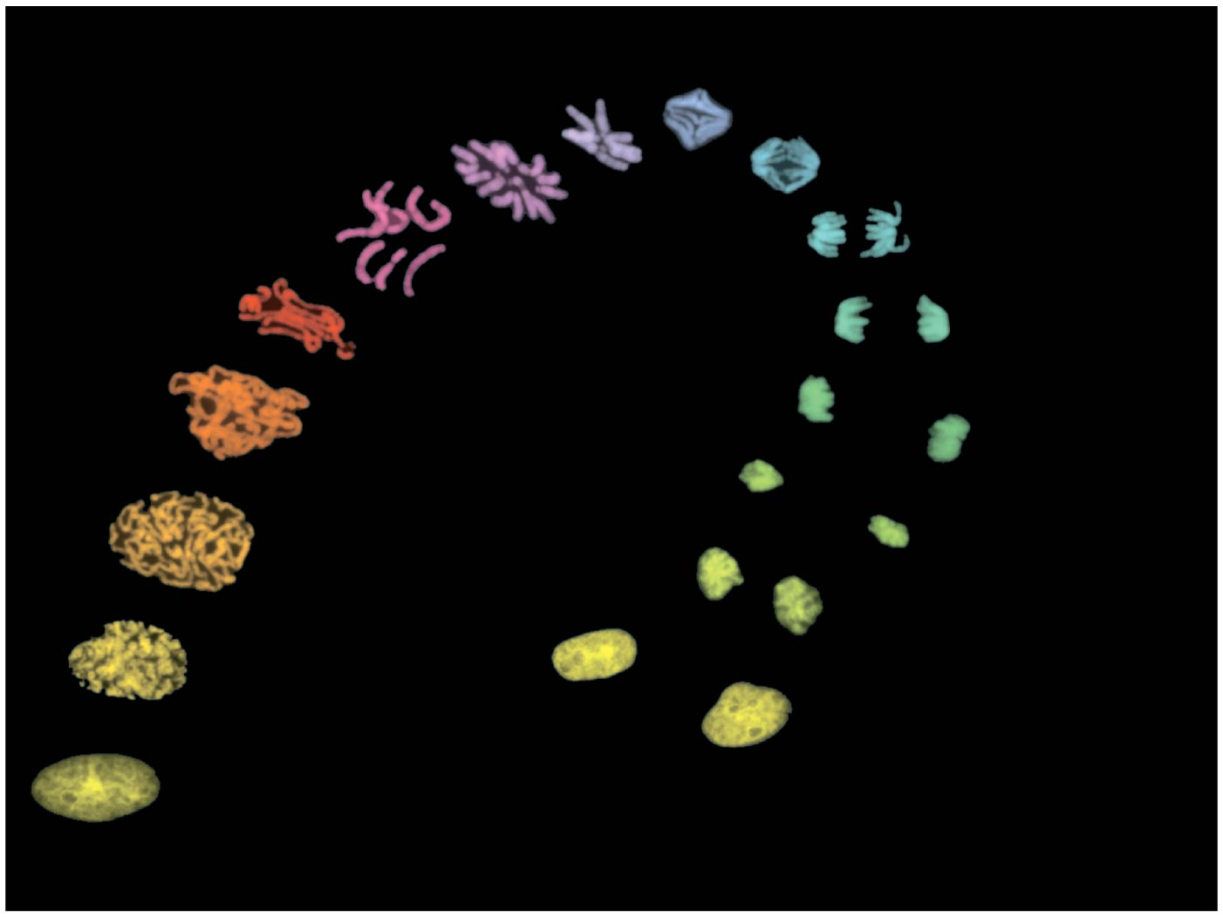
Figure 9.1 – Chromosomes during cell division
Notes:
3

Slide 4
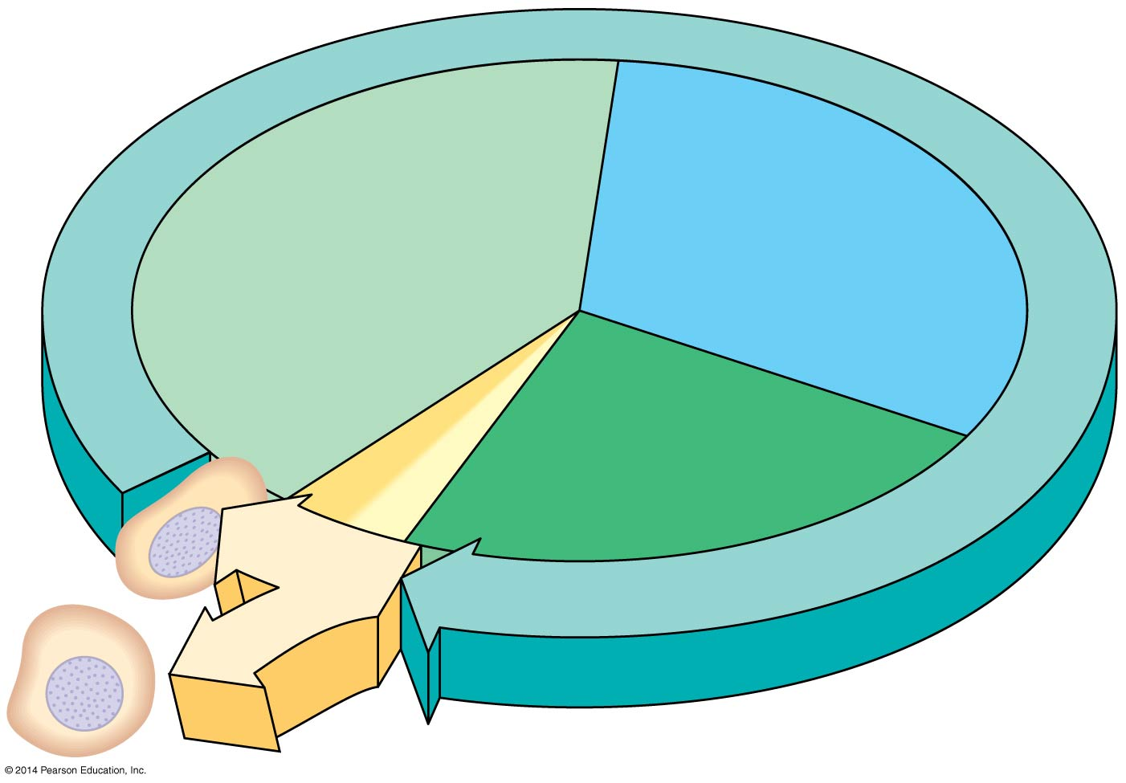
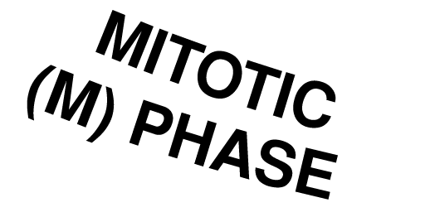
The Cell Cycle
S
(DNA synthesis)
G₁
Cytokinesis
G₂
Mitosis
Notes:
4
Most eukaryotic cell division consists of mitosis, the division of the genetic material in the nucleus and Cytokinesis, the division of the cytoplasm.
The cell cycle consists of
Mitotic (M) phase, including mitosis and cytokinesis
Interphase, including cell growth and copying of chromosomes in preparation for cell division

Slide 5
Mitosis is divided into five phases
Prophase
Prometaphase
Metaphase
Anaphase
Telophase
Cytokinesis overlaps the latter stages of mitosis
© 2014 Pearson Education, Inc.
Notes:
5

Slide 6
Figure 9.7c
G₂ of Interphase
Prophase
Prophase
Centrosomes
(with centriole
pairs)
Chromosomes
(duplicated)
Early mitotic
spindle
Centromere
Plasma
membrane
Nucleolus
Nuclear
envelope
Two sister chromatids of
one chromosome
Notes:
6
The mitotic spindle is a structure made of microtubules and associated proteins.
It controls chromosome movement during mitosis.
In animal cells, assembly of spindle microtubules begins in the centrosome, the microtubule organizing center.
The centrosome replicates during interphase, forming two centrosomes that migrate to opposite ends of the cell during prophase and prometaphase.
An aster (radial array of short microtubules) extends from each centrosome.
The spindle includes the centrosomes, the spindle microtubules, and the asters.

Slide 7
Figure 9.7d
Prometaphase
Metaphase
Metaphase
Fragments
of nuclear
envelope
Nonkinetochore
microtubules
Metaphase
plate
Kinetochore
Kinetochore
microtubule
Spindle
Notes:
7
During prometaphase, some spindle microtubules attach to the kinetochores of chromosomes and begin to move the chromosomes .
Kinetochores are protein complexes that assemble on sections of DNA at centromeres.
At metaphase, the centromeres of all the chromosomes are at the metaphase plate, an imaginary structure at the midway point between the spindle’s two poles.

Slide 8
Figure 9.7e
Anaphase
Telophase and
Cytokinesis
Telophase and
Cytokinesis
Cleavage
furrow
Nuclear
envelope
forming
Daughter
chromosomes
Notes:
8
In anaphase, sister chromatids separate and move along the kinetochore microtubules toward opposite ends of the cell.
The microtubules shorten by depolymerizing at their kinetochore ends.
Chromosomes are also “reeled in” by motor proteins at spindle poles, and microtubules depolymerize after they pass by the motor proteins.
Nonkinetochore microtubules from opposite poles overlap and push against each other, elongating the cell.
At the end of anaphase, duplicate groups of chromosomes have arrived at opposite ends of the elongated parent cell.
Cytokinesis begins during anaphase or telophase and the spindle eventually disassembles.

Slide 9
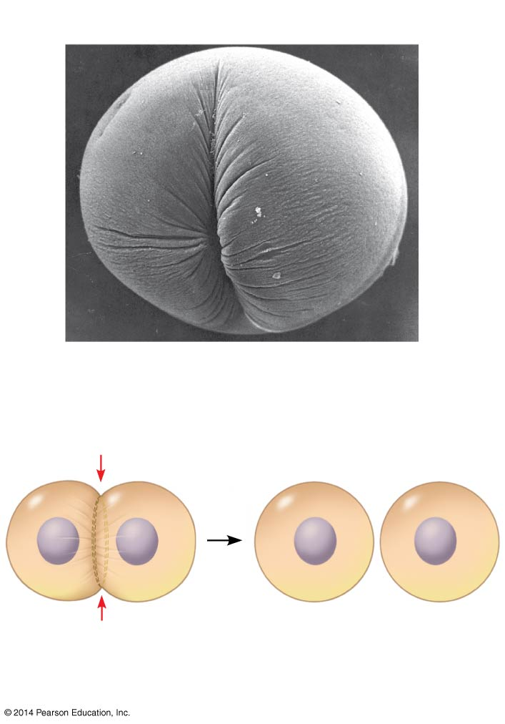
Cytokinesis in an animal cell
100 μm
Cleavage furrow
Contractile ring of
microfilaments
Daughter cells
Notes:
9

Slide 10
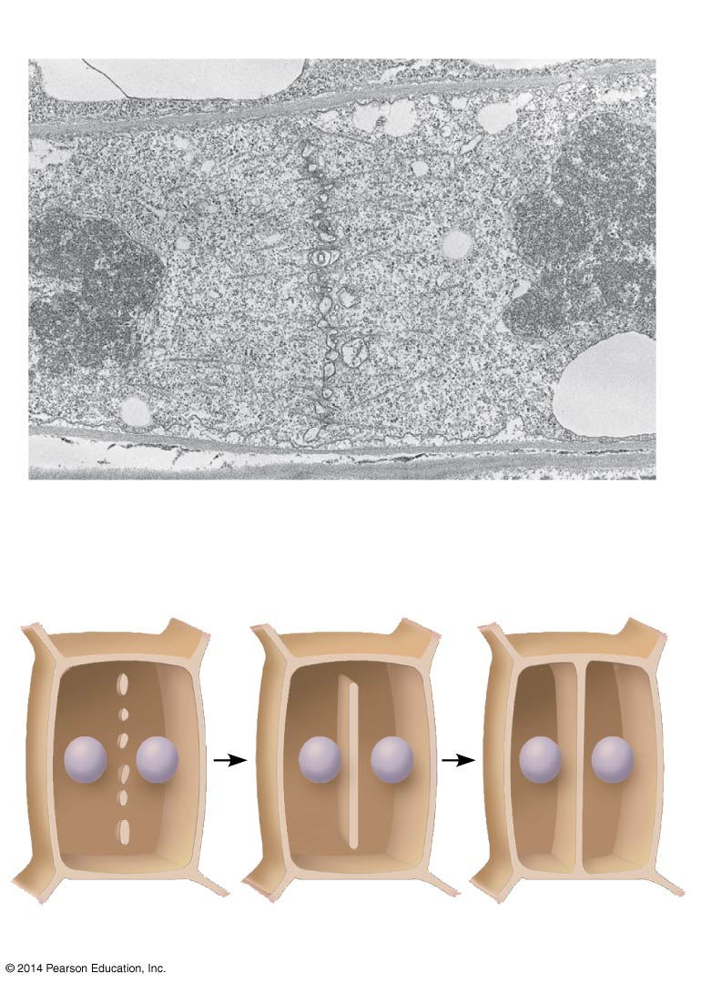
Cytokinesis in a plant cell
Vesicles
forming
cell plate
Wall of parent
cell
1 μm
Cell plate
New cell wall
Daughter cells
Notes:
10
In plant cells, a cell plate forms during cytokinesis.

Slide 11
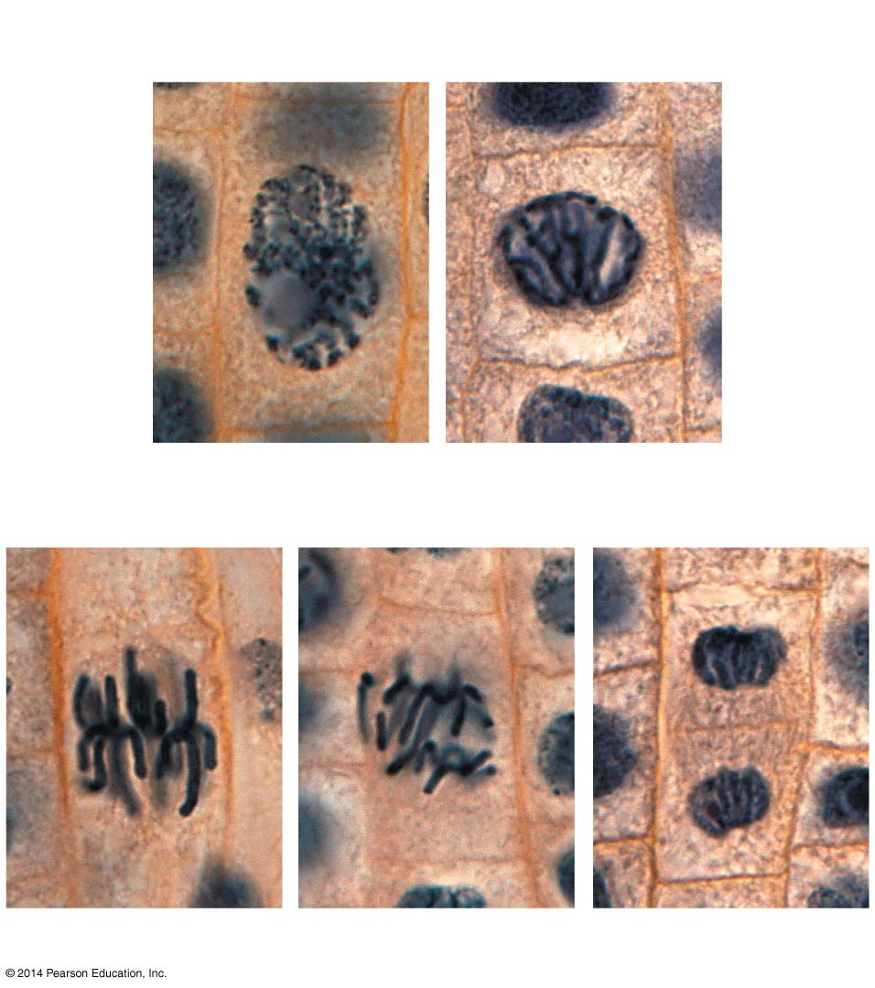
Figure 9.11
Nucleus
Chromosomes
condensing
Nucleolus
Chromosomes
10 μm
1
Prophase
2
Prometaphase
Cell plate
3
Metaphase
4
Anaphase
5
Telophase
Notes:
11
Figure 9.11 Mitosis in a plant cell

Slide 12
Please set up your lab poster on the counter in the back of the classroom

