Slide 1
0
Chapter 9
Cell Cycle

Slide 2
You Must Know
The structure of a duplicated chromosome.
The events that occur in the cell cycle (G₁, S, and G₂)

Slide 3
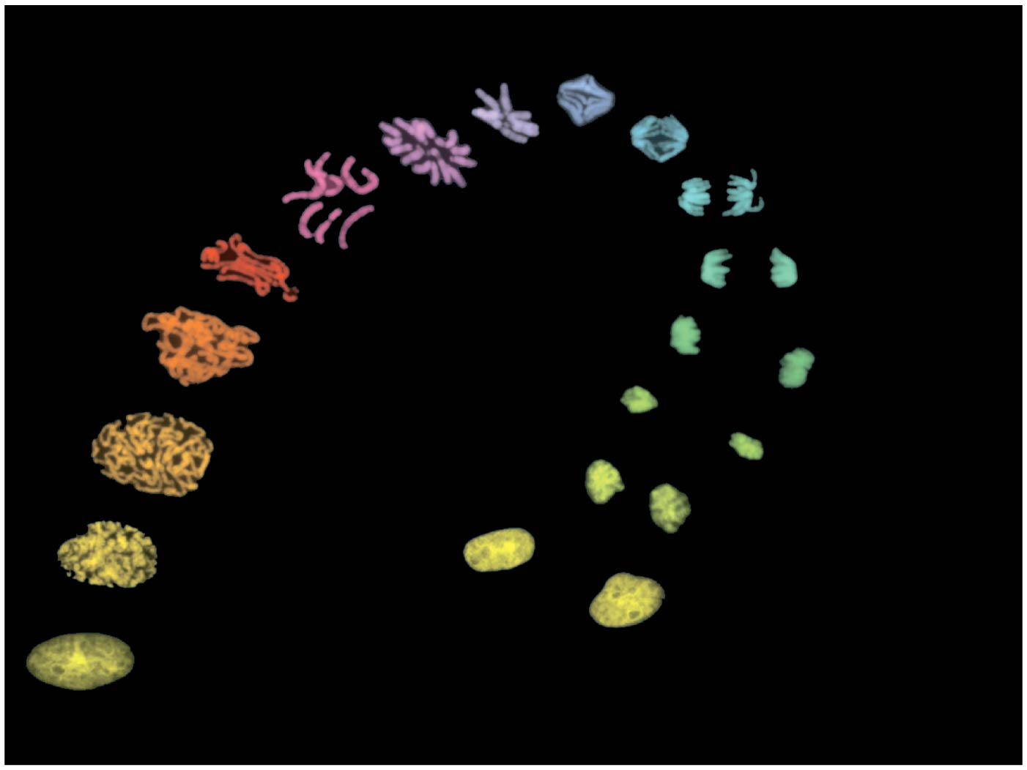
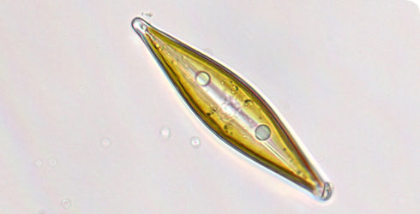
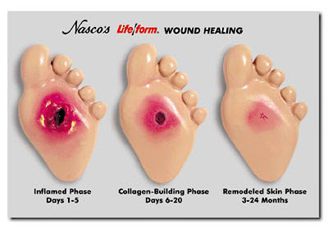
Figure 9.1 – Chromosomes during cell division
Notes:
3
The continuity of life is based on the reproduction of cells, or cell division.
Most cell division results in the distribution of identical genetic material—DNA—to two daughter cells.
DNA is passed from one generation of cells to the next with remarkable fidelity.
In unicellular organisms, division of one cell reproduces the entire organism.
Cell division enables multicellular eukaryotes to develop from a single cell and, once fully grown, to renew, repair, or replace cells as needed.
Cell division is an integral part of the cell cycle, the life of a cell from formation to its own division.

Slide 4
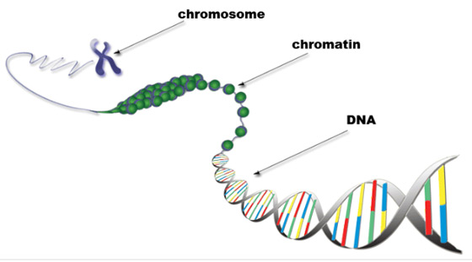
Eukaryotic chromosomes consist of chromatin, a complex of DNA and protein.

Slide 5
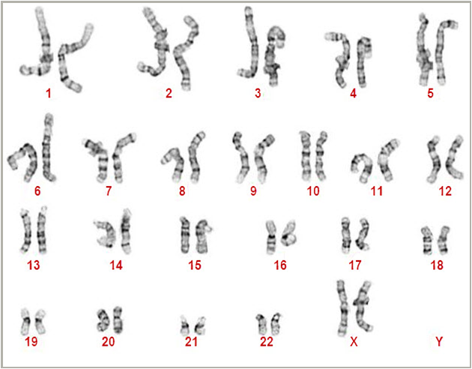
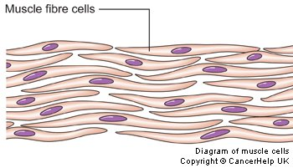
Every eukaryotic species has a characteristic number of chromosomes in each cell nucleus.

Slide 6
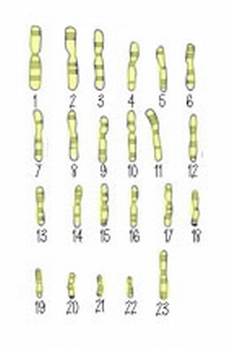
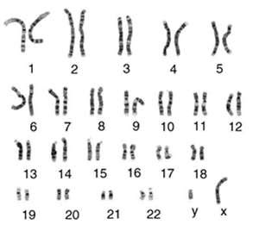
Somatic cells (nonreproductive cells) have two sets of chromosomes. They are diploid.
Gametes (reproductive cells: sperm and eggs) have one set of chromosomes. They are haploid.
1n
2n

Slide 7
What has to happen to the DNA before a cell can divide?
The DNA needs to replicate.

Slide 8
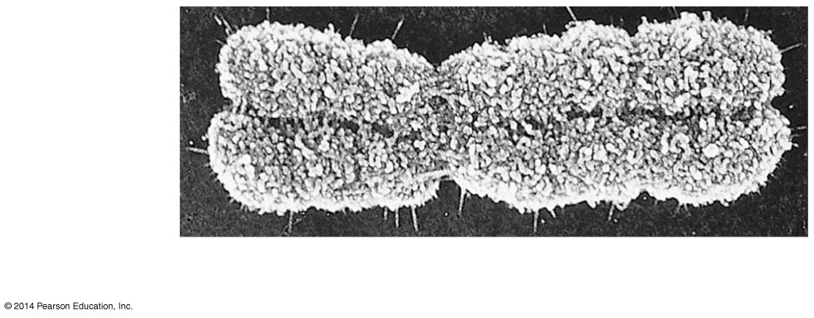
One Replicated Chromosome
Sister
chromatids
Centromere
0.5 μm
Sister chromatids are identical copies of each other.
Notes:
8
In preparation for cell division, DNA is replicated and the chromosomes condense.
Each duplicated chromosome has two sister chromatids, joined identical copies of the original chromosome.
The centromere is where the two chromatids are most closely attached.

Slide 9
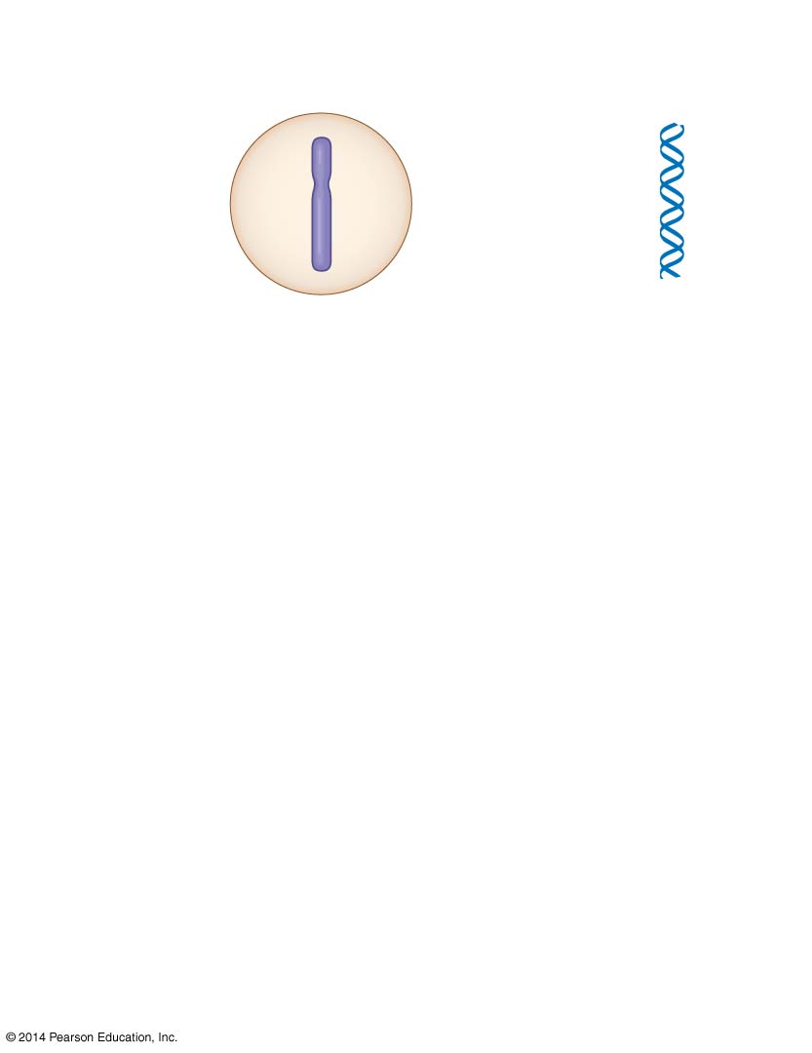
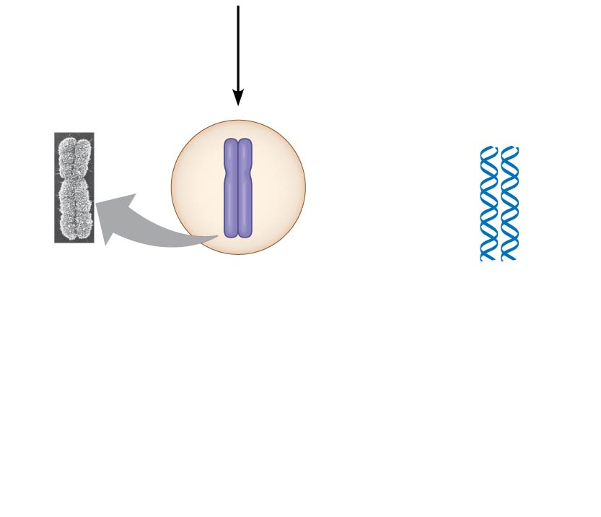
Chromosomal
DNA molecules
Chromosomes
1
Centromere
One chromosome and one DNA molecule.
Chromosome
arm
Chromosome
arm
Chromosome duplication
2
One chromosome and two DNA molecules.
Sister
chromatids
Separation of sister
chromatids
3
Two chromosomes and two DNA molecules.
Notes:
9
During cell division, the two sister chromatids of each duplicated chromosome separate and move into two nuclei.
Once separate, the chromatids are called chromosomes.

Slide 10
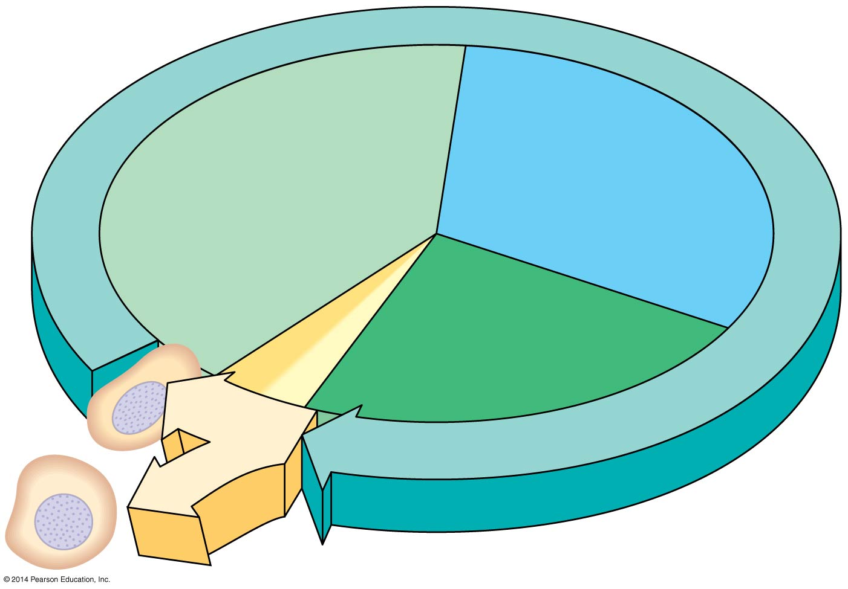
The Cell Cycle
S
(DNA synthesis)
G₁
Cytokinesis
G₂
Mitosis
Notes:
10
Most eukaryotic cell division consists of mitosis, the division of the genetic material in the nucleus and Cytokinesis, the division of the cytoplasm.
The cell cycle consists of
Mitotic (M) phase, including mitosis and cytokinesis
Interphase, including cell growth and copying of chromosomes in preparation for cell division
Interphase (about 90% of the cell cycle) can be divided into subphases
G₁ phase (“first gap”)
S phase (“synthesis”)
G₂ phase (“second gap”)
The cell grows during all three phases, but chromosomes are duplicated only during the S phase

