Slide 1
0
Chapter 9
Cell Cycle Regulation and Cancer

Slide 2
You Must Know
Ways that the cell cycle is regulated.
Ways in which the normal cell cycle is disrupted to cause cancer.

Slide 3
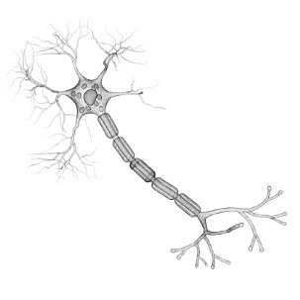
Concept 9.3: The eukaryotic cell cycle is regulated by a molecular control system
The frequency of cell division varies with the type of cell.
These differences result from regulation at the molecular level.
Cancer cells manage to escape the usual controls on the cell cycle.
Notes:
3

Slide 4
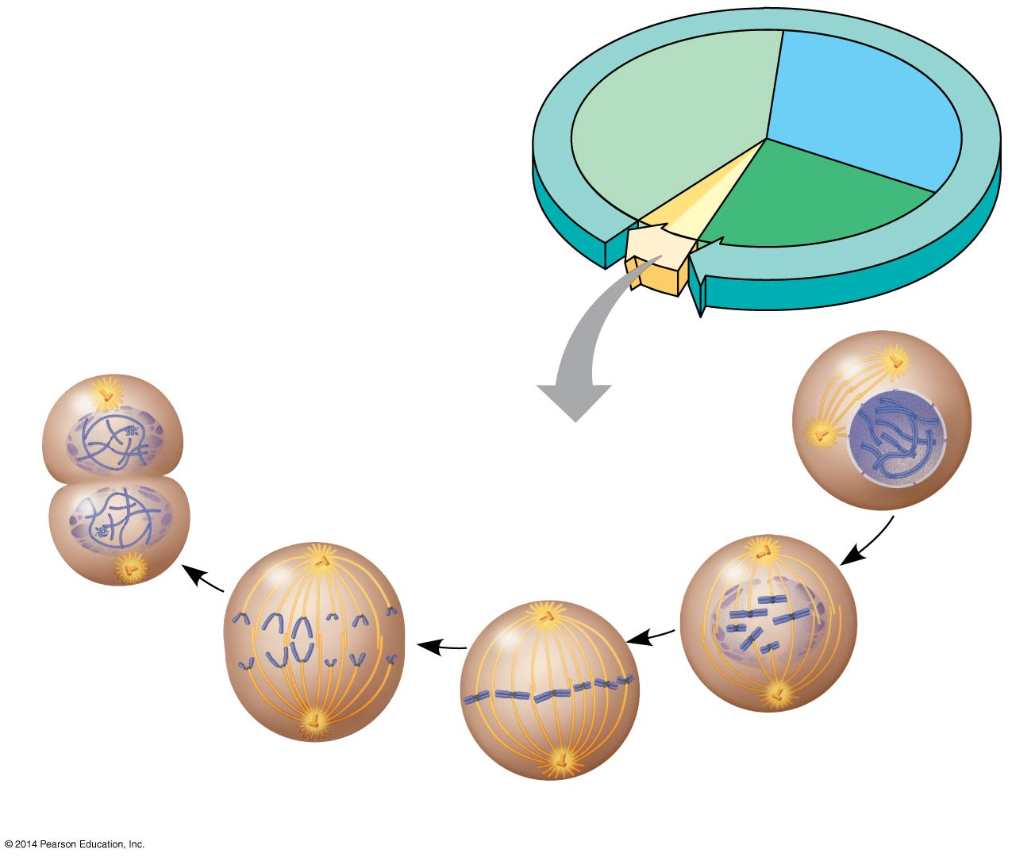
Figure 9.UN02
G₁
S
Cytokinesis
Mitosis
G₂
MITOTIC (M) PHASE
Prophase
Telophase and
Cytokinesis
Prometaphase
Anaphase
Metaphase
Notes:
4
Figure 9.UN02 Summary of key concepts: mitotic phase and interphase

Slide 5
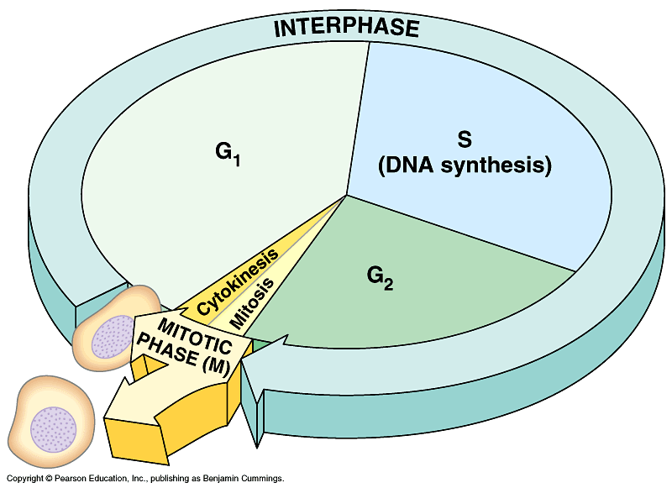
Experiment 1
Experiment 2
S
G₁
M
G₁
S
S
M
M
G₁ nucleus
immediately entered
S phase and DNA
was synthesized.
G₁ nucleus began
mitosis without
chromosome
duplication.
Conclusion Molecules present in the cytoplasm
control the progression to S and M phases.
Notes:
5
The cell cycle is driven by specific signaling molecules present in the cytoplasm.
Some evidence for this hypothesis comes from experiments with cultured mammalian cells.
Cells at different phases of the cell cycle were fused to form a single cell with two nuclei at different stages.
Cytoplasmic signals from one of the cells could cause the nucleus from the second cell to enter the “wrong” stage of the cell cycle.

Slide 6
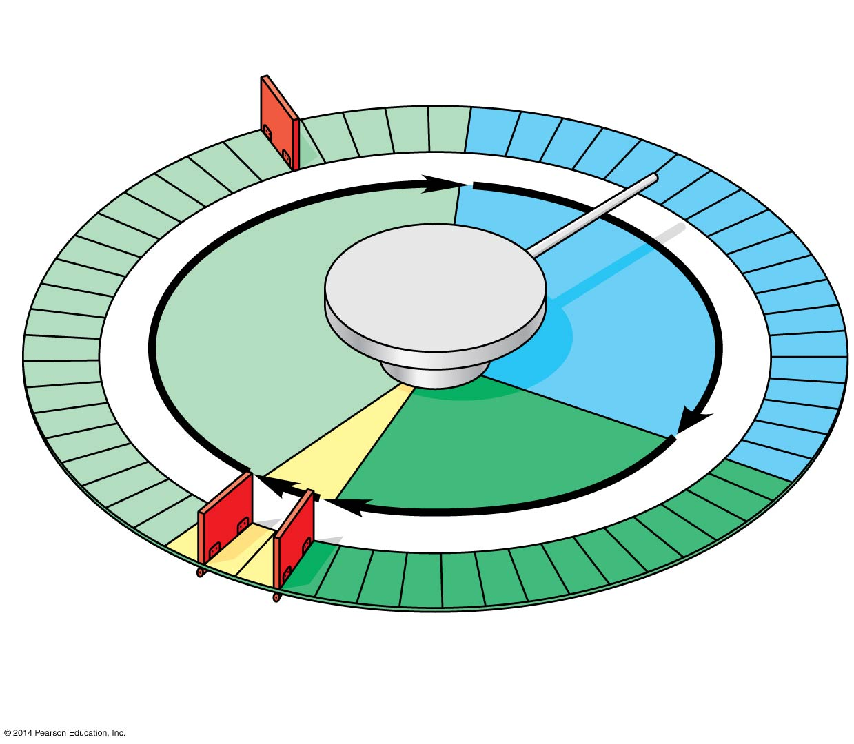
The cell cycle has specific checkpoints where the cycle stops until a go-ahead signal is received
G₁ checkpoint
Control
system
S
G₁
M
G₂
M checkpoint
G₂ checkpoint
Notes:
6
The sequential events of the cell cycle are directed by a distinct cell cycle control system, which is regulated by both internal and external controls.

Slide 7
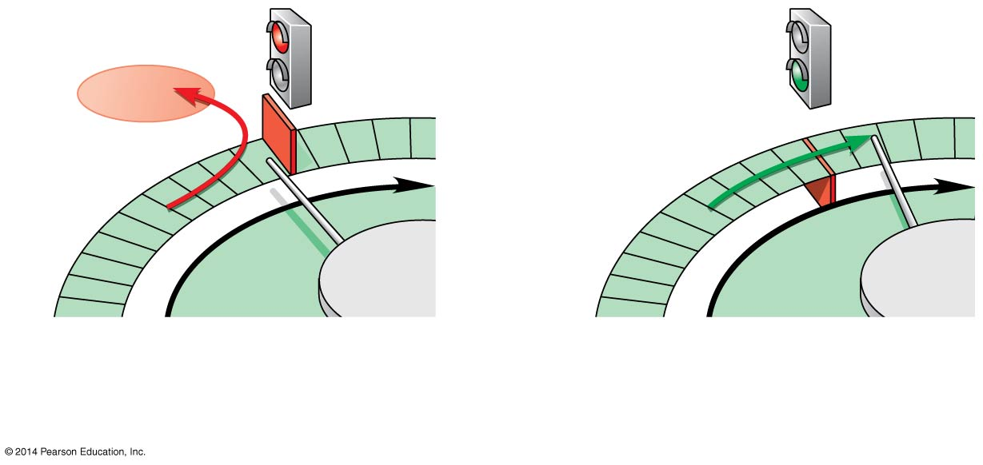
Non dividing cells are in the G₀ phase.
G₁ checkpoint
G₀
G₁
G₁
G₁
Without go-ahead signal,
cell enters G₀.
With go-ahead signal,
cell continues cell cycle.
With go-ahead signal,
cell continues cell cycle.
(a) G₁ checkpoint
If a cell receives a go-ahead signal at the G₁ checkpoint, it will usually complete the S, G₂, and M phases and divide.
Notes:
7
For many cells, the G₁ checkpoint seems to be the most important .
If a cell receives a go-ahead signal at the G₁ checkpoint, it will usually complete the S, G₂, and M phases and divide.
If the cell does not receive the go-ahead signal, it will exit the cycle, switching into a nondividing state called the G₀ phase.

Slide 8
Figure 9.16b
G₁
G₁
M
G₂
M
G₂
M checkpoint
Anaphase
Prometaphase
Metaphase
Without full chromosome
attachment, stop signal is
received.
With full chromosome
attachment, go-ahead signal
is received.
Separase – an enzyme that allows sister chromatids to separate.
Notes:
8
An example of an internal signal occurs at the M phase checkpoint.
In this case, anaphase does not begin if any kinetochores remain unattached to spindle microtubules.
Attachment of all of the kinetochores activates a regulatory complex, which then activates the enzyme separase.
Separase allows sister chromatids to separate, triggering the onset of anaphase.

Slide 9
Figure 9.17-4
Scalpels
Platelet-derived growth factor (PDGF) stimulates the division of human fibroblast cells in culture.
1
A sample of
human connective
tissue is cut
up into small
pieces.
Petri
dish
2
Enzymes digest
the extracellular
matrix, resulting
in a suspension of
free fibroblasts.
3
Cells are transferred
to culture vessels.
4
PDGF is added to
half the vessels.
Without PDGF
With PDGF
Cultured fibroblasts
(SEM)
10 μm
Notes:
9
Some external signals are growth factors, proteins released by certain cells that stimulate other cells to divide.
For example, platelet-derived growth factor (PDGF) stimulates the division of human fibroblast cells in culture.

Slide 10
Figure 9.18
Anchorage dependence: cells
require a surface for division
Density-dependent inhibition:
cells form a single layer
Density-dependent inhibition:
cells divide to fill a gap and
then stop
20 μm
20 μm
(a) Normal mammalian cells
(b) Cancer cells
Notes:
10
Another example of external signals is density-dependent inhibition, in which crowded cells stop dividing.
Most animal cells also exhibit anchorage dependence, in which they must be attached to a substratum in order to divide.
Cancer cells exhibit neither density-dependent inhibition nor anchorage dependence.

Slide 11
Loss of Cell Cycle Controls in Cancer Cells
Cancer cells do not respond to signals that normally regulate the cell cycle.
Cancer cells may not need growth factors to grow and divide.
They may make their own growth factor
They may convey a growth factor’s signal without the presence of the growth factor
They may have an abnormal cell cycle control system
© 2014 Pearson Education, Inc.
Notes:
11

Slide 12
Figure 9.19
A normal cell is converted to a cancerous cell by a process called transformation.
5 μm
Breast cancer cell
(colorized SEM)
Metastatic
tumor
Lymph
vessel
Tumor
Blood
vessel
Glandular
tissue
Cancer
cell
1
A tumor grows
from a single
cancer cell.
2
Cancer cells
invade
neighboring
tissue.
3
Cancer cells spread
through lymph and
blood vessels to
other parts of the
body.
4
A small percentage
of cancer cells may
metastasize to
another part of the
body.
Notes:
12
Cancer cells that are not eliminated by the immune system form tumors, masses of abnormal cells within otherwise normal tissue.
If abnormal cells remain only at the original site, the lump is called a benign tumor.
Malignant tumors invade surrounding tissues and can metastasize, exporting cancer cells to other parts of the body, where they may form additional tumors.

